Slide 1
Expression analysis: NextGen sequencing vs. microarrays
Center for Computational Science
Bioinformatics Journal Club
Tuesday, April 7th, 2009

Slide 2
Deep sequencing-based expression analysis shows major advances in robustness, resolution and inter-lab portability over five microarray platforms
Published in Nucleic Acids Research - Oct 15, 2008
PMID: 18927111
Laboratory of Johan T. den Dunnen
The Center for Human and Clinical Genetics, Leiden University Medical Center
Leiden, The Netherlands

Slide 3
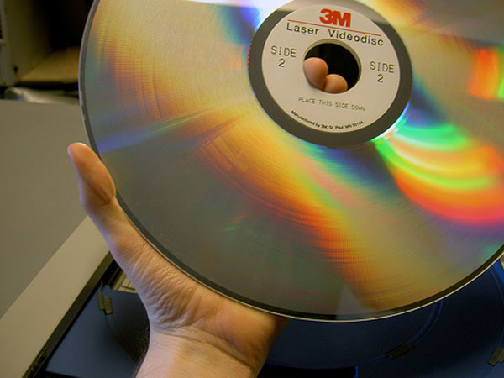
Next Generation Sequencing: turning microarrays into the Laserdiscs of genomics research
acc. to Wikipedia: The Laserdisc (LD) is an obsolete home video disc format, and was the first commercial optical disc storage medium.

Slide 4
Paper overview
Examined expression profiles from:
Mice
Hippocampus
Wild-type vs. transgenic for δC-doublecortin-like kinase
This is a splice variant of the Dclk 1 gene
The splice variant makes the kinase constitutively active
Compared Solexa/Illumina deep sequencing to five microarray platforms

Slide 5
Paper overview
With the digital gene expression assay, obtained: approximately 2.4 million sequence tags per sample
Highly reproducible results (across labs)
Differential expression of 3,179 transcripts (Bayesian model).
False-discovery rate: 8.5%
Affymetrix chips (out of the five microarrays) came closest to DGE results

Slide 6
Paper overview
Because of DGE, relevant processes such as:
Calmodulin-dependent protein kinase activity
Vesicle transport along microtubules
Were found.
They were not found in microarray tests.
DGE also found:
Anti-sense transcription in 51% of all genes
Alternative polyadenylation in 47%

Slide 7
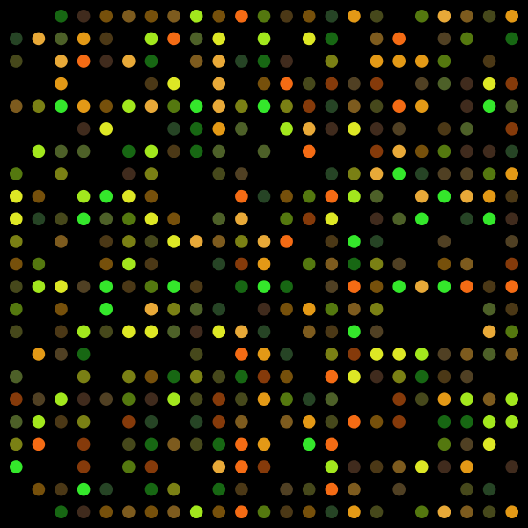
Genomics Methods
Serial Analysis of Gene Expression (SAGE)
Deep Sequencing
Microarrays

Slide 8
Microarray Disadvantages
Suffer from background and cross-hybridization problems
Measure only relative abundance of transcripts
Only pre-defined sequences are detected (!)

Slide 9
Genomics Methods
Serial Analysis of Gene Expression (SAGE)
Deep Sequencing
Microarrays

Slide 10
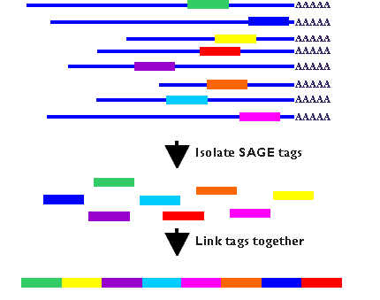
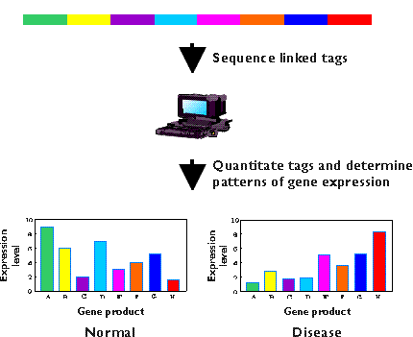
Serial Analysis of Gene Expression

Slide 11
Serial Analysis of Gene Expression
Tag based, measures absolute abundance
Not limited by array content
Laborious: requires cloning and sequencing steps
Can only sequence pooled samples
(intrinsic hazard)

Slide 12
Genomics Methods
Serial Analysis of Gene Expression (SAGE)
Deep Sequencing
Microarrays

Slide 13
Deep Sequencing
Offers simultaneous sequencing of millions of DNA molecules
Good for tag-based transcriptome sequencing
Sequence individual samples

Slide 14
Gene Sequencing
Whole genome sequencing (DNA) ???????
Are these the same thing?
Sequencing of Gene Expression Transcripts (RNA)

Slide 15
What did they use?
Solexa/Illumina 1G Genome Analyzer
Digital Gene Expression tag profiling (DGE) is an improved version of Massively Parallel Signature Sequencing (MPSS) technology
DGE yields millions of short reads (36 bp)
Which makes it very suitable for tag-based transcriptome sequencing

Slide 16
What did they find?
DGE detects differences between the two groups of mice in:
- Antisense transcripts
- 3’-untranslated regions (UTRs)

Slide 17
Methods
DGE:
- Two restriction enzymes generate tags, cutting at the most 3’ CATG and 17bp downstream of the first enzyme site (like LONG-SAGE)
Tags are sequenced immediately (not cloned)
Microarray:
- Same RNA samples were analyzed before on five different genome-wide platforms

Slide 18
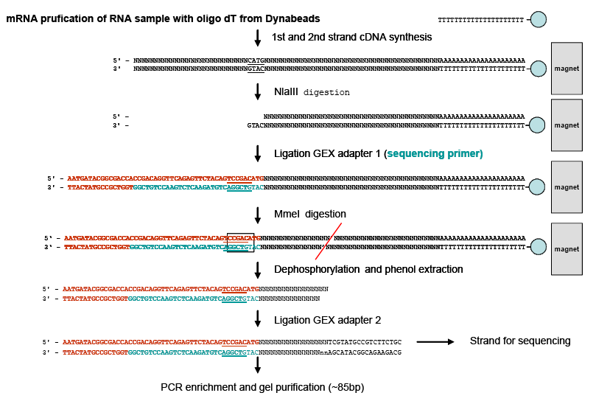
Methods
Male mice (N = 4) removed hippocampi from Wild-type and transgenic.
RNA extraction, tissue homogenization, purification, and quality check.
Sequence tag preparation:

Slide 19
Methods (cont.)
Biological pathway analysis
The global test (from Bioconductor) was used to test which Gene Ontology defined pathways were significantly deregulated in DCLK compared to wild-type mice.
Alignment to Ensembl transcripts
Took canonical sequences and compared to microarray probes
Microarray platforms used:
Agilent
Illumina
home-spotted long oligonucleotide arrays
Affymetrix
Applied Biosystems

Slide 20
Methods (cont.)
Sequencing using Solexa/Illumina Whole Genome Sequencer
Raw data (tag sequences and counts) submitted to GEO as GSE10782
18 cycles of base incorporation
Illumina DGE tag annotation
A preprocessed database of all possible CATG + 17-nt tag sequences was created, using mouse genome (UCSC’s mm8 version) and mouse transcriptome (Unigene’s Mm159)
The genome was used as a backbone for tag clustering

Slide 21
Methods (cont.)
Total set of all annotation tags is separated into the following groups:
Canonical transcriptomic tags (52,281 tags most expected in a DGE profiling experiment)
Noncanonical transcriptomic tags (mouse genomic tags map to a known exon ~1.6 million tags)
Ribosomal RNA (46 tags)
Mitochondrial RNA (108 tags)
Tags that map to the genome more than 100 times (2900 tags)
Tags that map to the genome but not to known exons (~17 million)

Slide 22
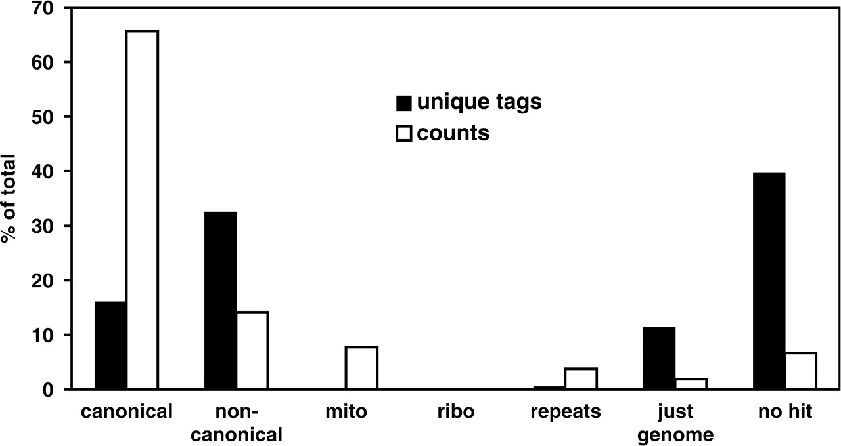
Results

Slide 23
Conclusion
Extremely wide dynamic range
Sensitive to low- and high-abundance transcripts
Most abundant transcript: Ckb gene
Brain isoform of creatine kinase
0.55% of all tags
Least abundant
2 transcripts per million
which is about 1 copy in every 3 cells

Slide 24
Conclusion
Extremely wide dynamic range
- Sensitive to low- and high-abundance transcripts
Hippocampus in both wt and transgene model
had 28,341 commonly expressed different canonical tags
Had 45,500 commonly expressed different noncanonical tags

Slide 25
Antisense transcription

