Slide 1
Introduction to Next Generation Sequencing
Stefan Bekiranov
University of Virginia

Slide 2
Strategies For Interrogating the Transcriptome
Known genes
Predicted genes
Surrogate strategy
Exon verification strategy
Transcript discovery strategy

Slide 3
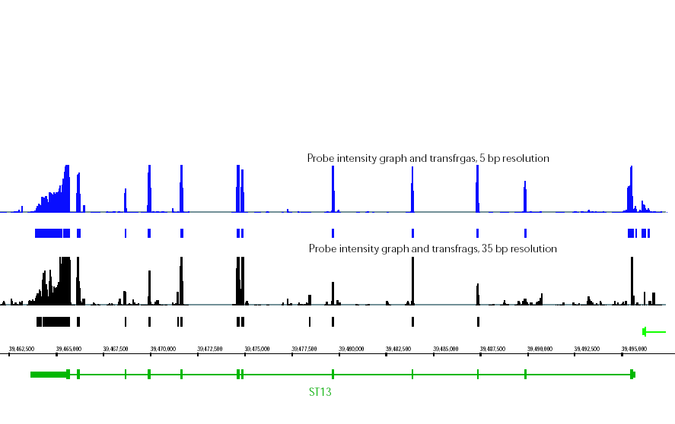
Transcriptome
Suppression of tumorigenicity 13 gene

Slide 4
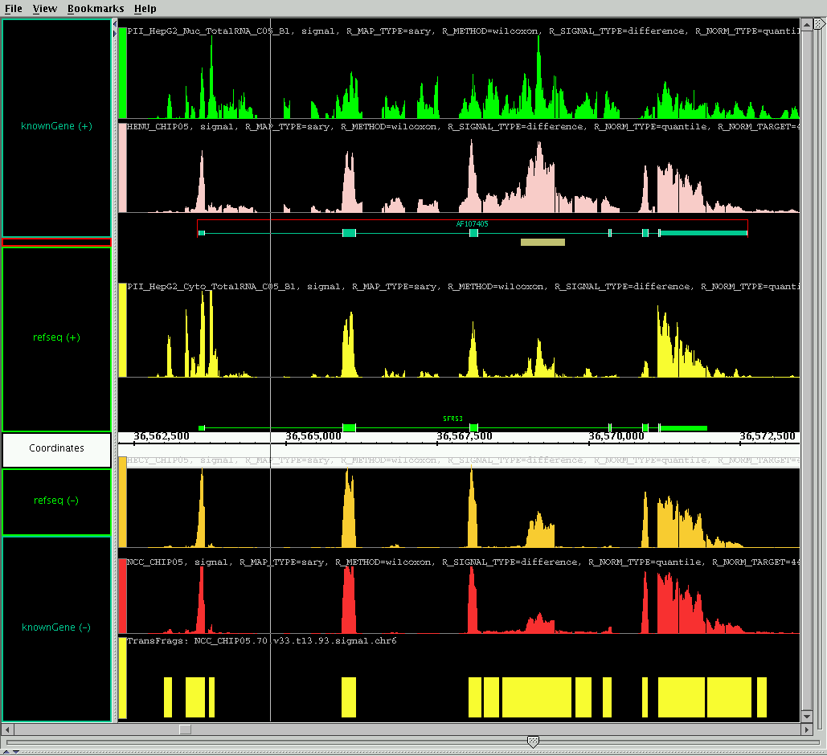
SFRS3: Pre-mRNA splicing factor on Chr. 6;
Subcellular Location: Nuclear
Notes:
Powerful discovery tool!
Relatively unbiased look at the transcriptome.
Conserved element over alternative spliced exon…not in annotation! Why…lower abundance. Possibly introduced non-sense codon and decay. Note: trans frag cutoffs are low. Retained intron. How much more transcription do we observe than is present in annotations?

Slide 5
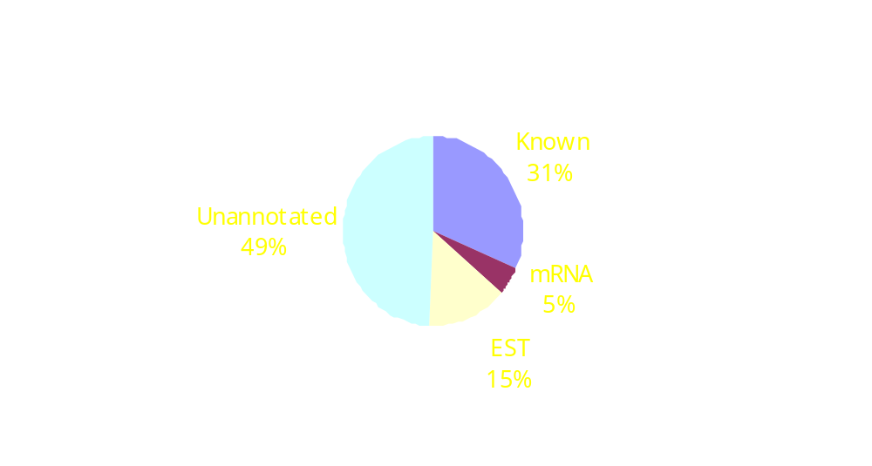
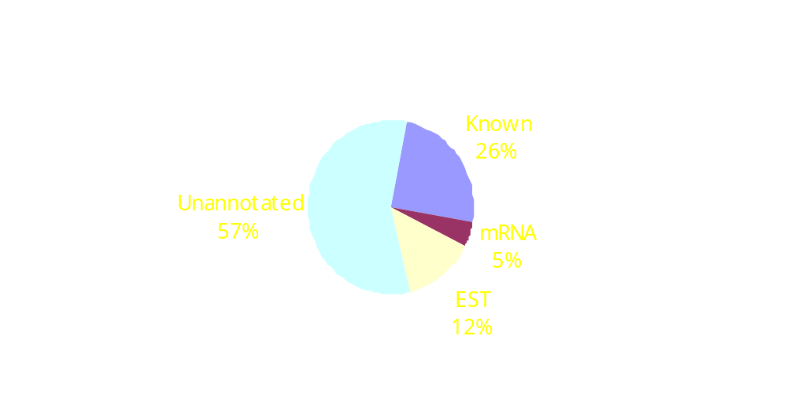
Distribution of Transcription Based on Annotations:
Union (1 of 8) of All Cell Lines
Design 1:
Chr. 21, 22
11 cell lines
Design 2:
Chr. 6, 7, 13, 14, 19, 20, 21, 22, X, Y
8 cell lines
~ 50% of the observed transcribed regions is unannoated.

Slide 6
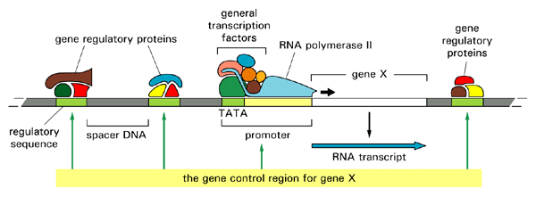
Genetic Regulatory Region

Slide 7
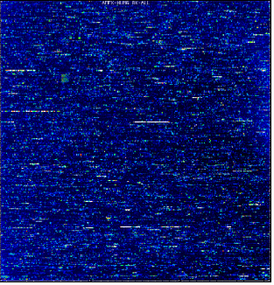
ChIP-Chip Experimental Design
Two cell lines
  HCT116 (colon cancer)
    anti-p53 (FL) and p53 (D01)
  Jurkat (acute T-cell leukemia)
    anti-Sp1
    anti-cMyc
Controls
  Input (skip IP step)
  anti-GST (IP with non-specific antibody)
DNA
DNA
+ formaldehyde
Cell lysis
Sonicate
Target protein
Add antibody
Add protein A
beads
Wash/Elute
DNA-Protein
complexes
A
A
A
Reverse
X-links
Isolate DNA
Amplify +
Label/hybridize
to arrays
A

Slide 8
Analysis of ChIP Data
Enriched Sample
PM
MM
Control Sample
PM
MM
1000bp
Apply Wilcoxn Rank Sum Test
Treat: log2(max(PM-MM,1))_ES
Control: log2(max(PM-MM,1))_CS

Slide 9
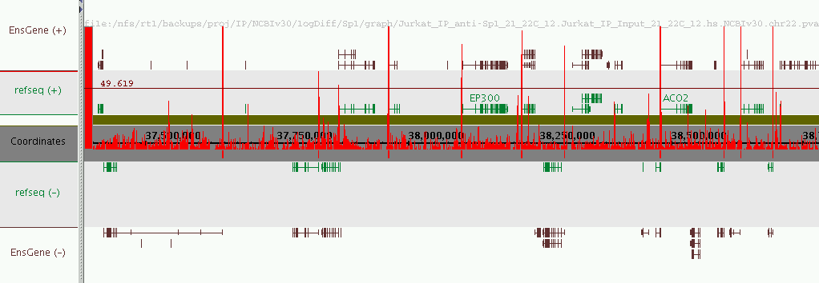
Sp1 on Chr. 22: -10log(pvalue)

Slide 10
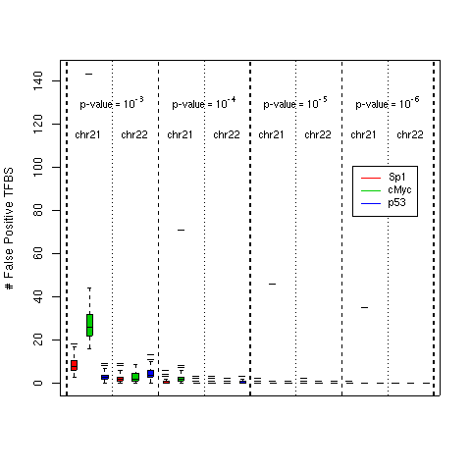
FP Estimate

Slide 11
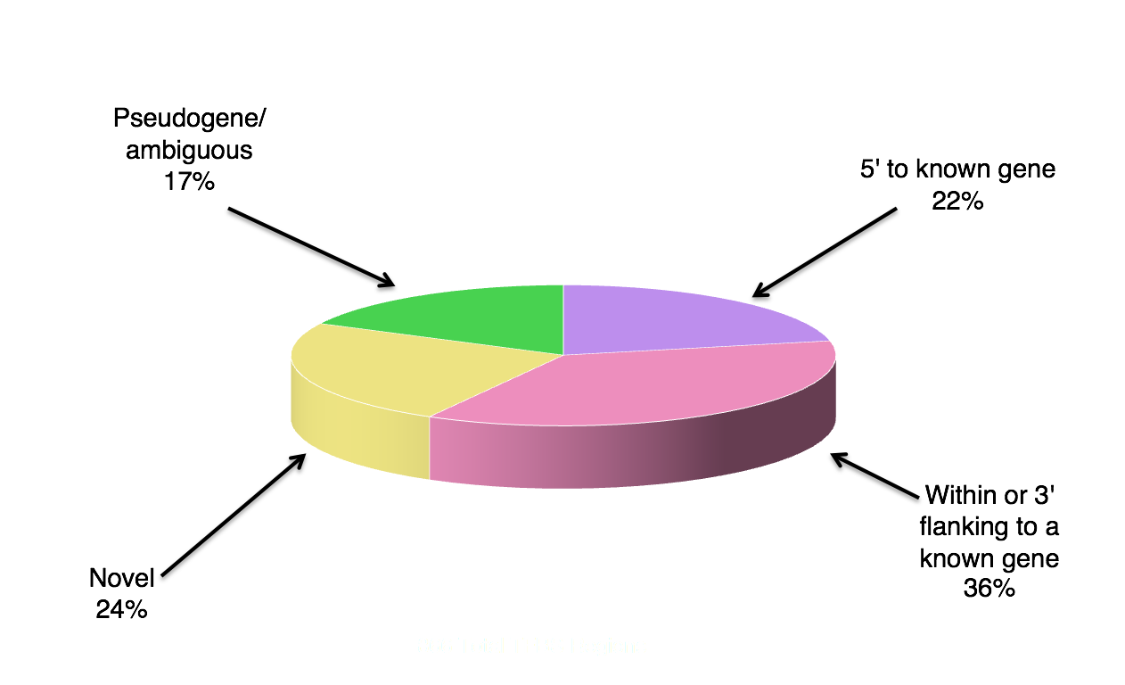
Distribution of All TFBS Regions

Slide 12
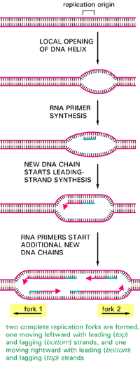
Origins of Replication

Slide 13
Analysis Approach
Synchronize Hela Cells
BrdU label (2hr intervals) during S-phase
Replication Rate ~ 1kb/min
Use wide smoothing window ~ many kb
Modest but detectable enrichment to 0-8hr HL control ~ 4 fold
Look for low amplitude but statistically significant enrichment

Slide 14
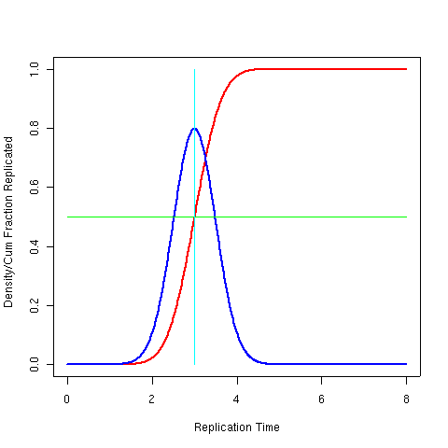
Calculating TR50

Slide 15
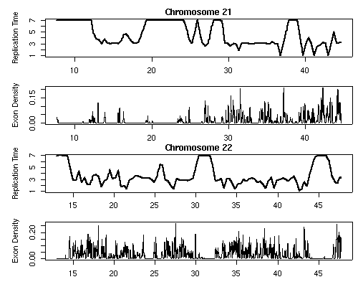
TR50 vs Exon Density

Slide 16
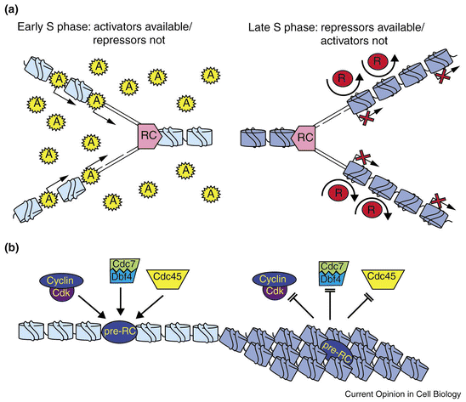
Models of Replication Timing

Slide 17
Additional Microarray Platforms
Gene Expression Arrays
SNP/CNV Arrays
  Whole Genome Association Studies
Exon Arrays
Promoter Arrays
Yeast TAG Arrays
Re-sequencing Arrays
Micro-RNA Arrays

Slide 18
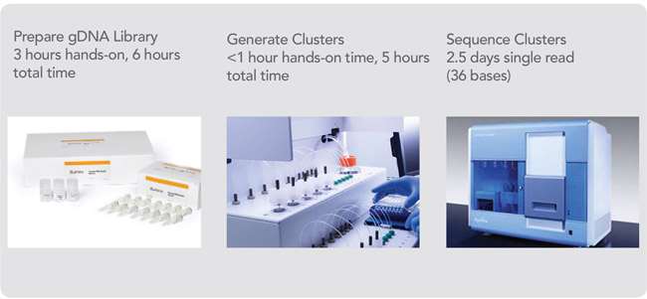
Disruptive Technology: High Throughput Sequencing

Slide 19
Advances in High Throughput Technologies
Moores Law: Advances in technology are driving the ability to address questions on a genomic scale
Optimized Array Design Achievable
  Requires Control Spike-In Data for Changes in Assay and Oligo Synthesis Approaches
  Time consuming and costly
High Throughput Sequencing (Unbiased Functional Genomics)
  No noise floor: sequence sample more ($$)
  No saturation ceiling
  No probe effects: variable affinity, cross-hyb
  Map reads to unique repeat-mask regions of genome
  Slight biases introduced during sample prep
  Quantitative/digital output
  ChIP-Seq much cheaper than ChIP-chip (Gb genomes)
  Ability to detect SNPs (functional genomics assays)
  Competition Driving Rapid Advances: Illumina, ABI, Roche 454, Helicos, Pacific Biosciences, many more!

Slide 20
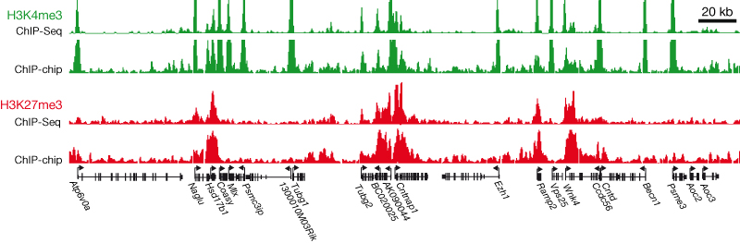
Comparison of ChIP-Chip to Chip-Seq
Mikkelsen T. S. et al Nature (2007)

Slide 21
Comparing Sequencers
 | Roche (454) | Illumina | SOLiD
Chemistry | Pyrosequencing | Polymerase-based | Ligation-based
Amplification | Emulsion PCR | Bridge Amp | Emulsion PCR
Paired ends/sep | Yes/3kb | Yes/200 bp | Yes/3 kb
Mb/run | 100 Mb | 1300 Mb | 3000 Mb
Time/run | 7 h | 4 days | 5 days
Read length | 250 bp | 32-40 bp | 35 bp
Cost per run (total) | $8439 | $8950 | $17447
Cost per Mb | $84.39 | $5.97 | $5.81

Slide 22
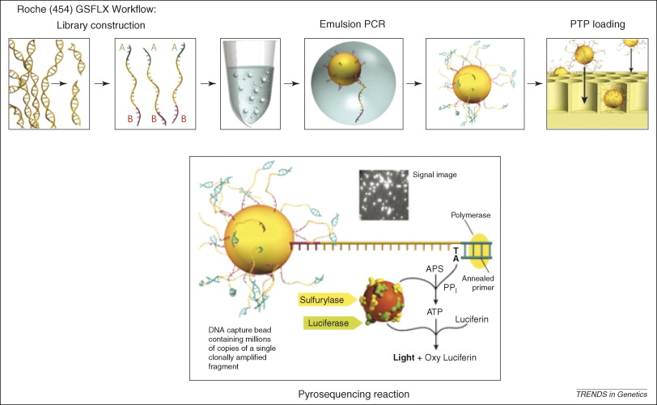
Roche (454) Workflow

Slide 23
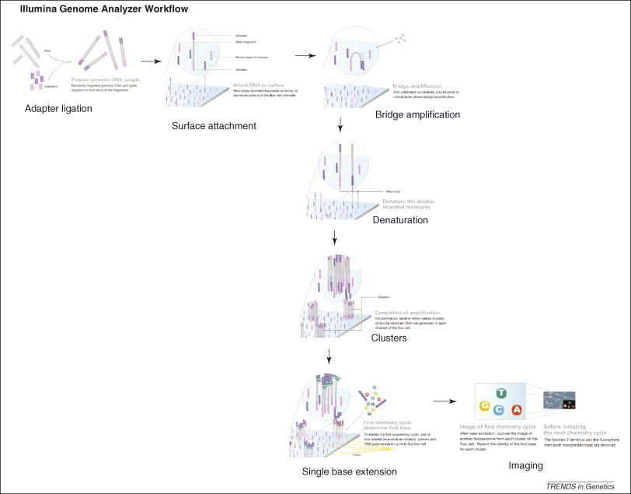
Illumina (Solexa) Workflow

Slide 24
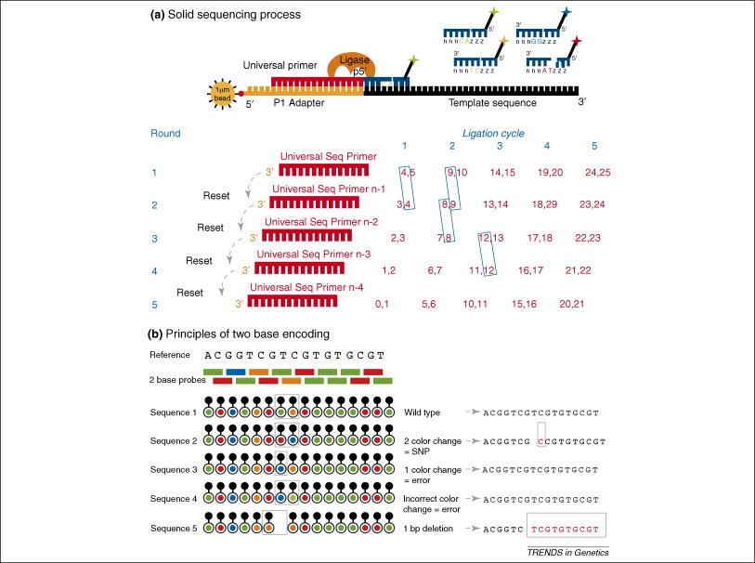
ABI SOLiD Workflow

Slide 25
Applications
Genomes
Re-sequencing Human Exons (Microarray capture/amplification)
small (including mi-RNA) and long RNA profiling (including splicing)
ChIP-Seq:
  Transcription Factors
  Histone Modifications
  Effector Proteins
DNA Methylation
Polysomal RNA
Origins of Replication/Replicating DNA
Whole Genome Association (rare, high impact SNPs)
Copy Number/Structural Variation in DNA
ChIA-PET: Transcription Factor Looping Interactions
???

Slide 26
Functional Genomics Data Analysis
Map reads to the genome
  Available Tools
    MAQ
    RMAP
    MOSAIK
    BLAST
    ELAND (Illumina)
  Determine the target genome sequence (i.e., repeat classes)
  Mapping options
    Number of allowed mis-matches (as function of position)
    Number of mapped loci (e.g., 1 = unique read sequence)
Generate Consensus Sequence and identify SNPs
Generate Read Enrichment Profile (e.g., Wald Lab tool)
Develop Null Model and Calculate Significantly Enriched Sites
High level analysis: compare to annotations, other data sets, etc

Slide 27
ChIP-Seq Analysis of Histone Modifications in hESC
BG01v cell lines
ChIP (~ 10 ng of DNA)
  H3K4me3
  H3K9/14Ac
  Pan-H3 (control)
Sequence using Illumina GA (Y. Gao at VCU) (Cost: $500-$1k/lane)
  Sequencer contains 8 lanes
  1 sample per lane
  12M 36bp reads/lane (3.5 Gb full run)
  8M reads mapped to non-repeat regions of genome (2.5 Gb full run)
Map reads to the non-repeat regions of genome using Mapping and Assembly Quality Tool (MAQ)
Generate read enrichment profiles
Generate ChIP enriched sites using Wold Lab Tool
  Minimum number of reads: 13
  Applied 3, 4 and 5 fold sample over control cutoff

Slide 28
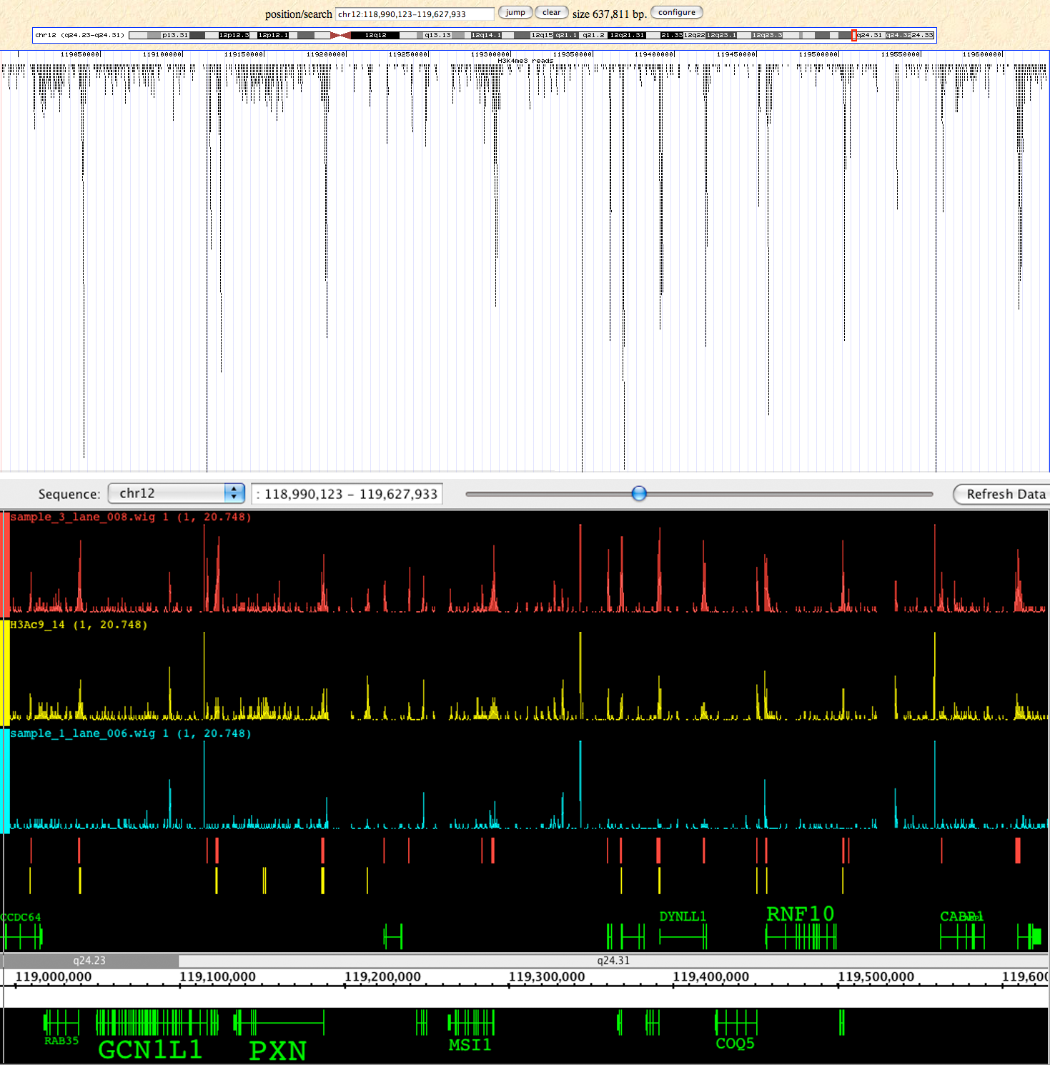
Mapped ChIP-Seq Data

Slide 29
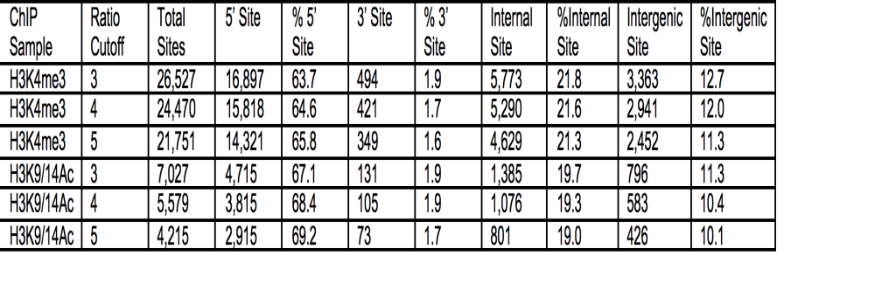
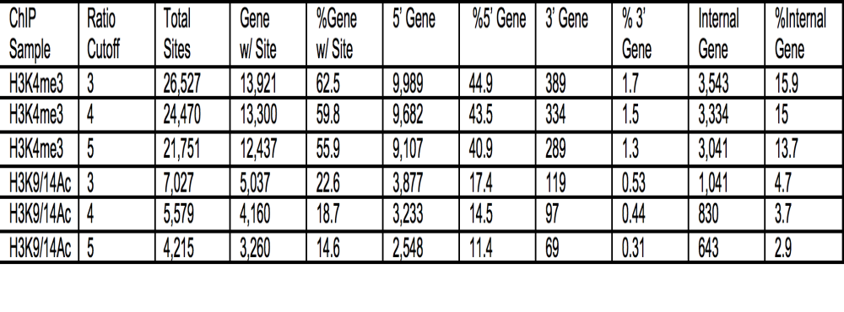
Location of Sites Relative to ENSEMBLE genes
94% of H3K9/14Ac sites overlap H3K4me3.

Slide 30
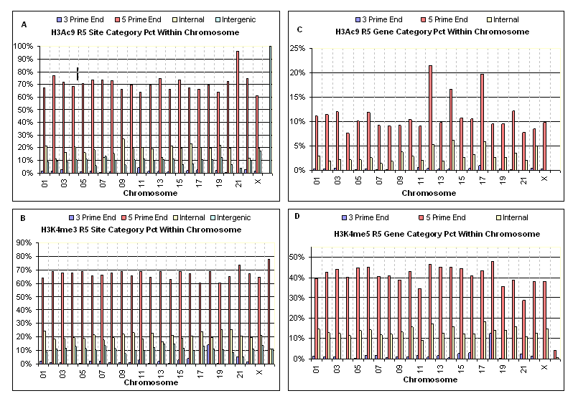
Location of Sites for each Chromosome

Slide 31
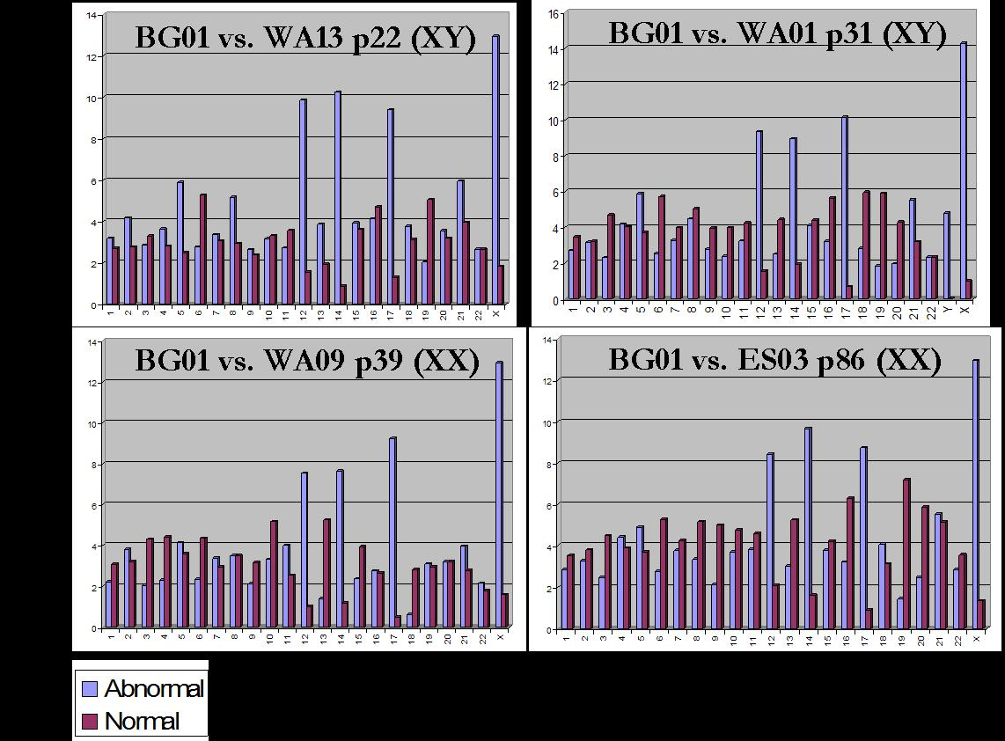
Elevated Gene Expression in BG01v cells: chr12, chr 14, chr 17 and chr X.

Slide 32
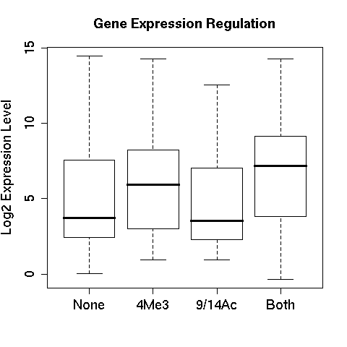
H3K4Me3 and H3K9/14 Mark Active Genes

Slide 33
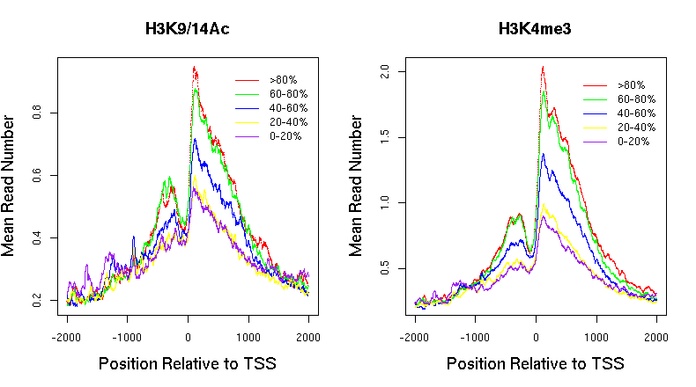
Distribution of Marks Relative to TSSs

