Slide 1
Model View Controller (MVC)
Rick Mercer with a wide variety of others

Slide 2
Smalltalk-80™
In the MVC paradigm the user input, the modeling of the external world, and the visual feedback to the user are explicitly separated and handled by three types of objects, each specialized for its task.
  The view manages the graphical and/or textual output to the portion of the bitmapped display that is allocated to its application.
  The controller interprets the mouse and keyboard inputs from the user, commanding the model and/or the view to change as appropriate.
  The model manages the behavior and data of the application domain, responds to requests for information about its state (usually from the view), and responds to instructions to change state (usually from the controller).

Slide 3
Smalltalk-80™ continued
The formal separation of these three tasks is an important notion that is particularly suited to Smalltalk-80 where the basic behavior can be embodied in abstract objects: View, Controller, Model and Object.

Slide 4
Sun says
Model-View-Controller ("MVC") is the recommended architectural design pattern for interactive applications
MVC organizes an interactive application into three separate modules:
  one for the application model with its data representation and business logic,
  the second for views that provide data presentation and user input, and
  the third for a controller to dispatch requests and control flow.

Slide 5
Sun continued
Most Web-tier application frameworks use some variation of the MVC design pattern
The MVC (architectual) design pattern provides a host of design benefits

Slide 6
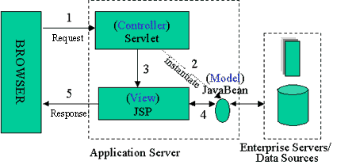
Java Server Pages
Model 2 Architecture to serve dynamic content
  Model: Enterprise Beans with data in the DBMS
  Controller: Servlets, create beans, decide which JSP to return, do the bulk of the processing
  View: The JSP generates the presentation layer

Slide 7
OO-tips Says
The MVC paradigm is a way of breaking an application, or even just a piece of an application's interface, into three parts: the model, the view, and the controller.
MVC was originally developed to map the traditional input, processing, output roles into the GUI realm:
  Input --> Processing --> Output
  Controller --> Model --> View

Slide 8
Wikipedia says
Model-View-Controller (MVC) is a software architecture that separates an application's data model, user interface, and control logic into three distinct components so that modifications to one component can be made with minimal impact to the others.
MVC is often thought of as a software design pattern. However, MVC encompasses more of the architecture of an application than is typical for a design pattern. Hence the term architectural pattern may be useful (Buschmann, et al 1996), or perhaps an aggregate design pattern.

Slide 9
MVC Benefits
Clarity of design
  easier to implement and maintain
Modularity
  changes to one don't affect the others
  can develop in parallel once you have the interfaces
Multiple views
  games, spreadsheets, powerpoint, Eclipse, UML reverse engineering, ….

Slide 10
Example
Simple MVC given in section this week
Spreadsheet (with 3 charts and 1 column of numbers
  Actual data 26 As, 26 Bs, 7Cs, 2Ds
Use observer

Slide 11
Summary (MVC)
The intent of MVC is to keep neatly separate objects into one of tree categories
  Model
    The data, the business logic, rules, strategies, and so on
  View
    Displays the model and usually has components that allows user to edit change the model
  Controller
    Allows data to flow between the view and the model
    The controller mediates between the view and model

Slide 12
Model
The Model's responsibilities
  Provide access to the state of the system
  Provide access to the system's functionality
  Can notify the view(s) that its state has changed

Slide 13
View
The view's responsibilities
  Display the state of the model to the user
At some point, the model (a.k.a. the observable) must registers the views (a.k.a. observers) so the model can notify the observers that its state has changed

Slide 14
Controller
The controller's responsibilities
  Accept user input
    Button clicks, key presses, mouse movements, slider bar changes
  Send messages to the model, which may in turn notify it observers
  Send appropriate messages to the view
In Java, listeners are controllers

Slide 15
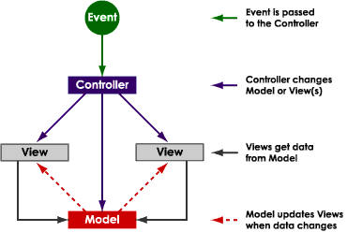
from http://www.enode.com/x/markup/tutorial/mvc.html)

Slide 16
MVC Misunderstood
MVC is understood by different people in different ways
It is often misunderstood, but most software developers will say it is important; powerful
Lets start it right: MVC is a few patterns put together

Slide 17
Questions
Do controllers have a user interface?
Does a view allow user input?
Can a view send messages to the model?
Can a view send messages to the controller?
Can you have more than one view?
Can you more than one model?
Can you more than one controller?
Is a controller just one file? A View?, A Model?
Should the view UI be separate from the controller interface?
Should the view and the controller be in separate windows?

