Slide 1
Agua
A workflow tool and genome viewer:
      Data generation pipeline
      Flexible analysis tools
      Easy-to-use interface
      Enable sharing of data
      View large feature data sets in real time
      Interactive querying & annotation
Notes:
These requirements were emerging alongside the large growth in genome sequence data from traditional Sanger sequencing.
The need is urgent now because of the quantum leap in data volume due to short read Next Generation sequencing technologies.
The integration of data generation and downstream analysis is an important component of Bioptic and necessitates an emphasis on ease of extensibility and flexibility.

Slide 2
Project Outline
Modular design:
  Functions: Project, Workflow, Report, View, etc.
  One Function = One Plugin
  Version control for multiple plugins
  Dojo javascript framework tools
    Plugin loading
    AJAX, utilities and Testing
Notes:
Bioptic has been designed for open-source development by multiple teams or individuals.
Its modular design facilitates code reuse and allows for independent development of different functionalities.
As part of the large-scale software engineering approach, the Bioptic project incorporates software testing tools and project management systems to ensure cooperation between developers and strengthen version control.

Slide 3
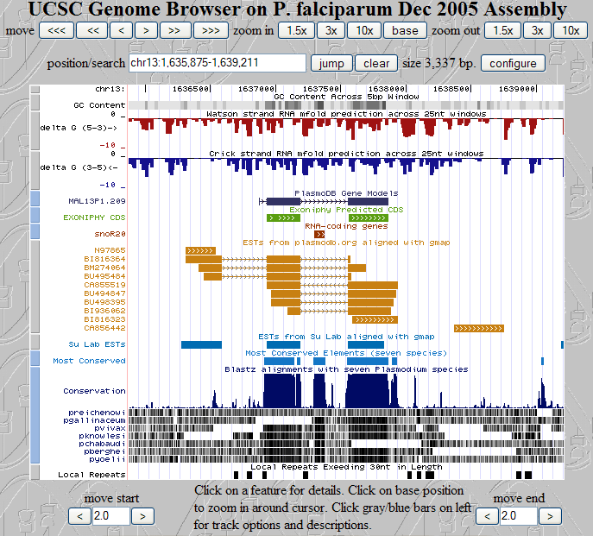
UCSC Genome Browser
Notes:
The UCSC Genome Browser is a web-based genome browser which incorporates an increasing number of genome-related external data sources.
Users can select feature tracks from a large assortment of sources and modify their display format.
Aside from feature track selection, it does not provide a lexical search of the displayed data.

Slide 4
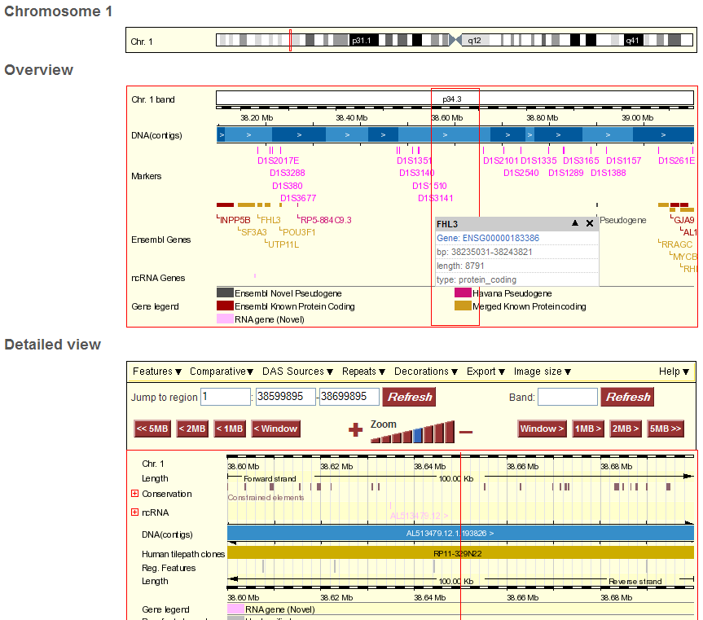
Notes:
Like UCSC, Ensembl’s Genome Browser has evolved to provide and more data sources as feature tracks. It also now displays base-level detail, similar to a sequence editor such as Consed.
The achilles heel of both systems remains the image-file based display system.

Slide 5
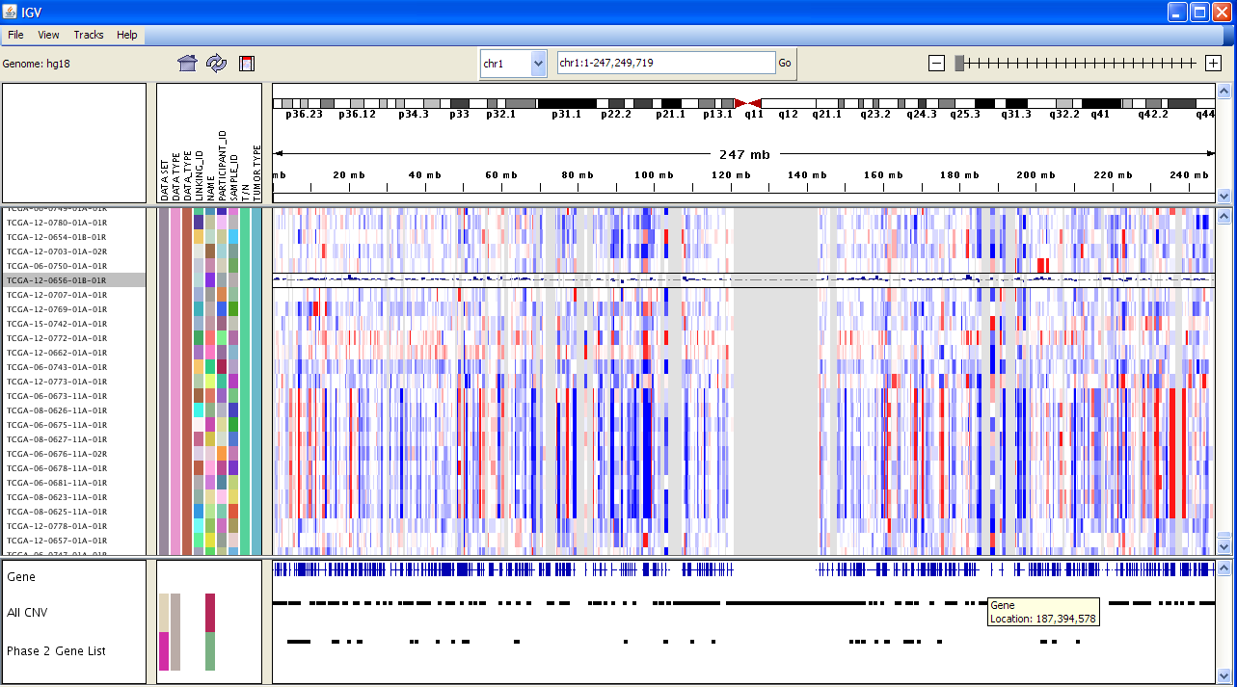
IGV (Integrative Genome Viewer)
Notes:
IGV has a basic filtering option which allows the user to limit the displayed feature lines using keywords in the feature ID and type.
Produced by the Broad Institute:
http://www.broad.mit.edu/igv/index.html
Tutorial is here:
http://www.broad.mit.edu/igv/doc/quickstart.html

Slide 6
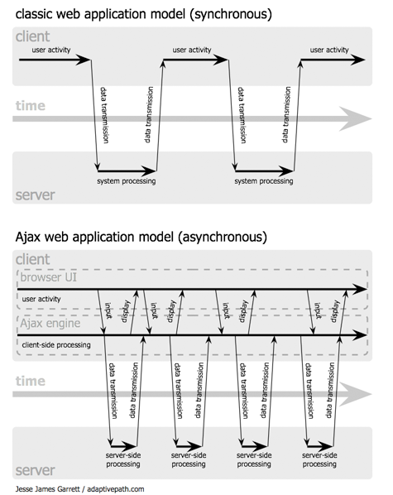
AJAX web applications
Notes:
AJAX enables the ‘thick client’ approach to building web applications
AJAX = Asynchronous Javascript and XML
The key capability is independently manipulating different parts of the web page in response to the user.
By not reloading the whole page each time the user clicks a button, the Javascript entity can maintain state whilst providing application functionality.

Slide 7
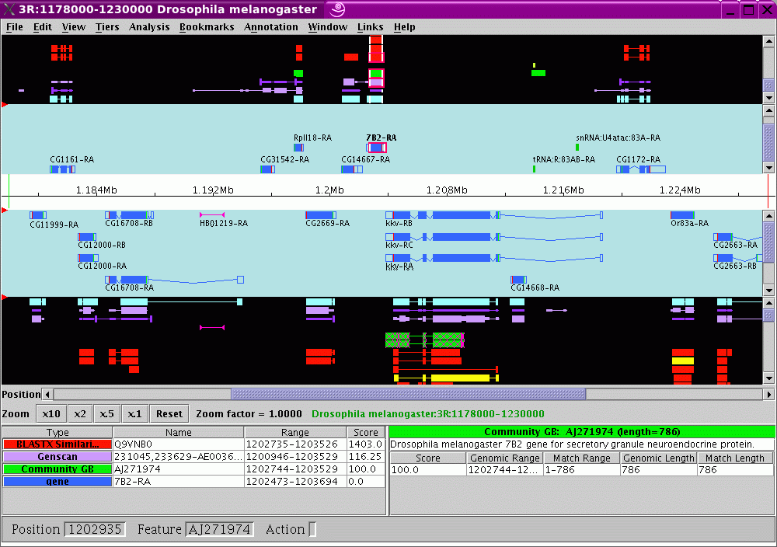
Apollo
Notes:
Apollo is an open-source java application which was initially designed as a genome annotation tool for the Drosophila genome (Flybase).
Access to the code and updated databases is now available using Java Webstart but annotations are stored in a local database.

Slide 8
JBrowse
Advantages
  On-demand loading = fast
  Nested container lists for quick searching
  Features are displayed using DHTML
  Allows access to the DOM (Document Object Model) using Javascript
  Open-source and based on well-supported Javascript framework (Dojo)

Slide 9
Workflow plugin
Drag-n-drop Workflow wizard
  Wide range of applications, including nextgen datat processing and analysis, utilities for sequence file format conversions, etc.
  Automatic and custom settings for each application
  Inputs of downstream applications automatically reflect new settings in upstream applications
  Run workflow and view progress
  View output files and error files
  Save workflows and reuse with different inputs

Slide 10

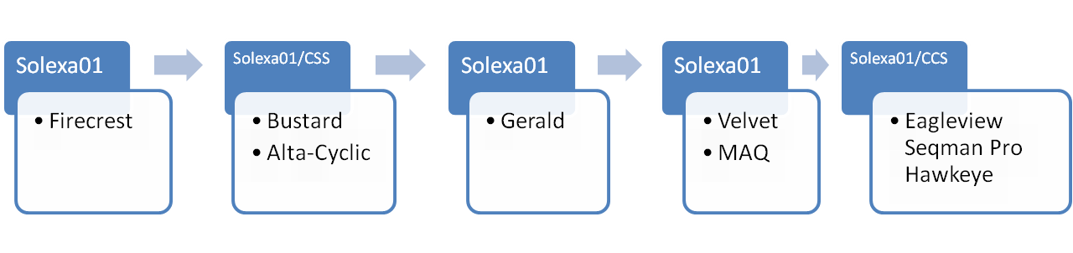
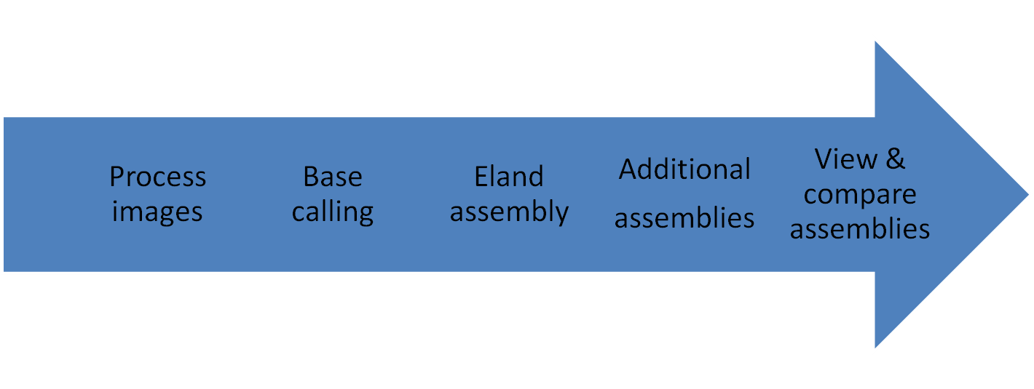
Workflow Plugin (cont.)
Multiple pipelines and tools

Slide 11
View plugin
Genome-level data exploration
  Results in Report plugin are linked to views
  Predicted SNPs, etc. are viewed alongside annotated genomic features
  Annotations can be added by the user and saved to the database
  External features can be uploaded by the user
  Additional features to be developed

Slide 12
Admin plugin
User account and data management
  User can manage Groups, Group members and Group permissions
  Administrator can manage Users, Groups, Projects and Sources

Slide 13
Backend
Data interchange with JSON (Javascript Object Notation)
Perl CGI on Apache 2.0 web server
Relational database: sqlite3
Runs on single machine or cluster

