Slide 1
Project Summary
Design a viewer for the growing volume of genome sequence data:
View large feature data sets
Fast image rendering
Interactive querying & annotation
Easy-to-use interface
Enable sharing of data
Upstream: Data generation pipeline
Downstream: Analysis plugins
Notes:
These requirements were emerging alongside the large growth in genome sequence data from traditional Sanger sequencing.
The need is urgent now because of the quantum leap in data volume due to short read Next Generation sequencing technologies.
The integration of data generation and downstream analysis is an important component of Bioptic and necessitates an emphasis on ease of extensibility and flexibility.

Slide 2
Motivation
Current sequence viewers are limited by their technologies:
UCSC, Ensembl, Gbrowse
Thin client server → browser paradigm
Each new view means a new image (slow)
Limited interaction
IGV, Apollo
Java application
Increased interaction
Limited data sharing (data is local)

Slide 3
Project Outline
Modular design:
Functions: Pipeline + Report + View
Function = Plugin
Dojo javascript framework tools
Plugin loading
AJAX, utilities and Testing
Project management:
CVS: trac/subversion
Check-out, modify, merge
Issue tracking
Notes:
Bioptic has been designed for open-source development by multiple teams or individuals.
Its modular design facilitates code reuse and allows for independent development of different functionalities.
As part of the large-scale software engineering approach, the Bioptic project incorporates software testing tools and project management systems to ensure cooperation between developers and strengthen version control.

Slide 4
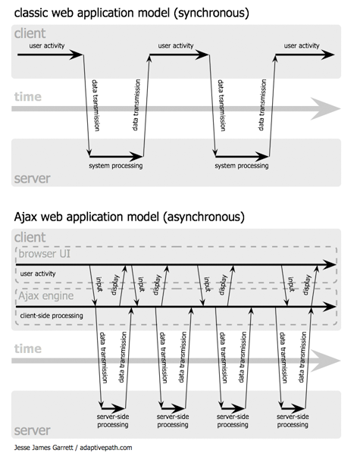
AJAX web applications
Notes:
AJAX enables the ‘thick client’ approach to building web applications
AJAX = Asynchronous Javascript and XML
The key capability is independently manipulating different parts of the web page in response to the user.
By not reloading the whole page each time the user clicks a button, the Javascript entity can maintain state whilst providing application functionality.

Slide 5
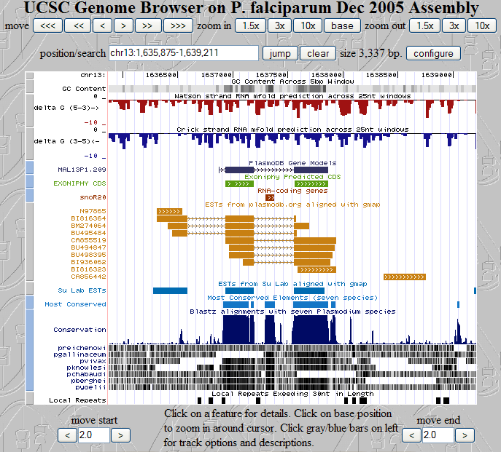
UCSC Genome Browser
Notes:
The UCSC Genome Browser is a web-based genome browser which incorporates an increasing number of genome-related external data sources.
Users can select feature tracks from a large assortment of sources and modify their display format.
Aside from feature track selection, it does not provide a lexical search of the displayed data.

Slide 6
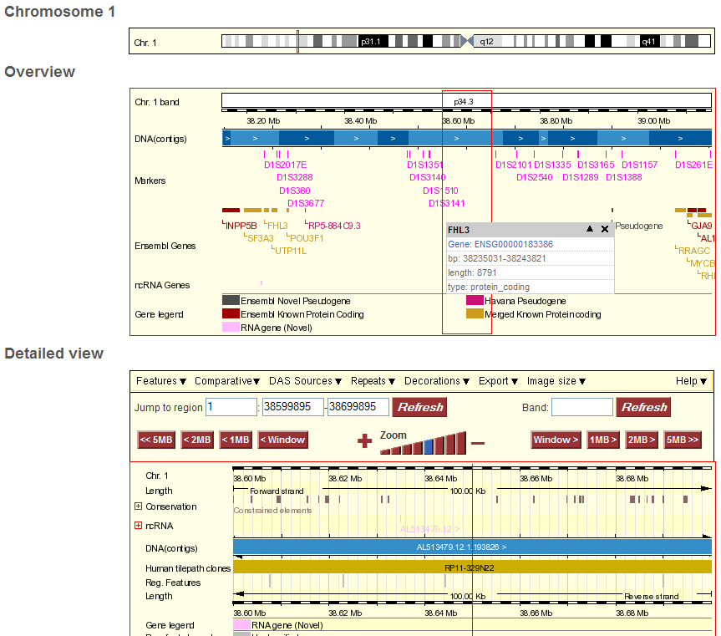
Ensembl Genome Browser
Notes:
Like UCSC, Ensembl’s Genome Browser has evolved to provide and more data sources as feature tracks. It also now displays base-level detail, similar to a sequence editor such as Consed.
The achilles heel of both systems remains the image-file based display system.

Slide 7
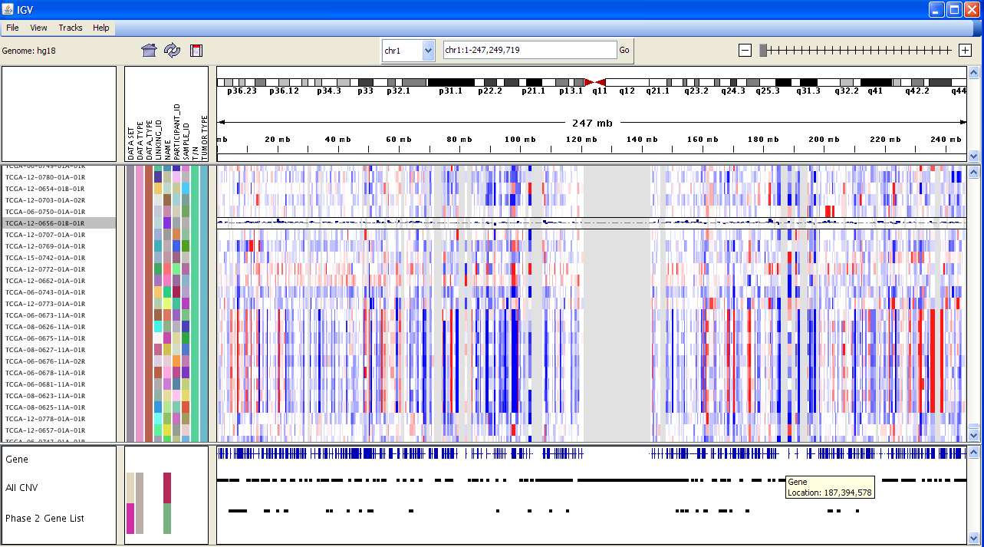
IGV (Integrative Genome Viewer)
Notes:
IGV has a basic filtering option which allows the user to limit the displayed feature lines using keywords in the feature ID and type.
Produced by the Broad Institute:
http://www.broad.mit.edu/igv/index.html
Tutorial is here:
http://www.broad.mit.edu/igv/doc/quickstart.html

Slide 8
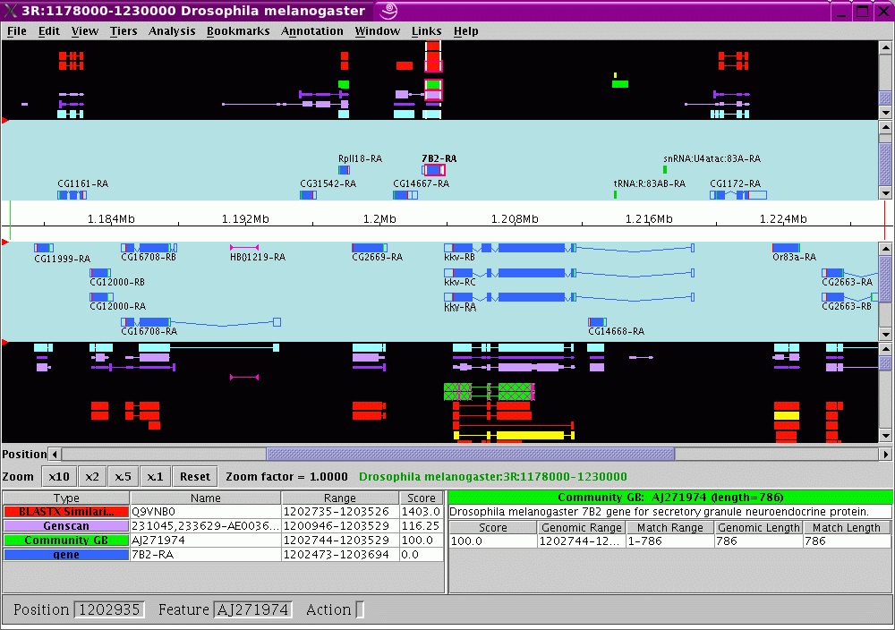
Apollo
Notes:
Apollo is an open-source java application which was initially designed as a genome annotation tool for the Drosophila genome (Flybase).
Access to the code and updated databases is now available using Java Webstart but annotations are stored in a local database.

Slide 9
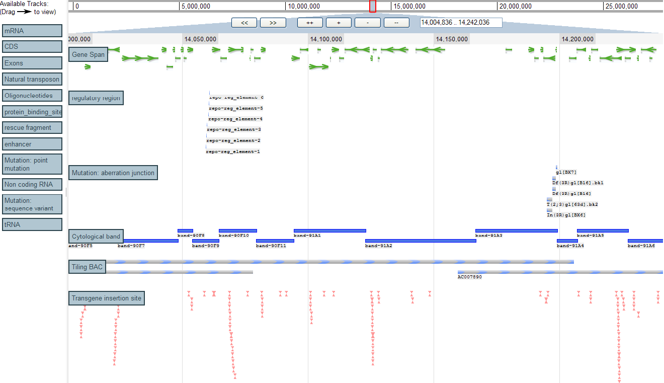
Ajax GBrowse
Notes:
Ajax GBrowse is a paradigm shift relative to the existing web genome browsers.
One of its main advantages is its ease of use – it allows extremely fast genome viewing and drag-and-drop feature selection.
It uses the ‘thick client’ approach, pushing much of the work the server previously did onto the web browser.
JSON (JavaScript Object Notation) data files representing chunks of the genome and feature data are loaded on demand (like Google Maps), which dramatically reduces the bandwidth requirements and speeds up the image viewing, providing a real-time genome browsing experience.

Slide 10
Ajax Gbrowse (cont.)
Advantages
On-demand loading = fast
Nested container lists for quick searching
Features are displayed using DHTML
Allows access to the DOM (Document Object Model) using Javascript
Open-source and based on well-supported Javascript framework (Dojo)

Slide 11
Project Outline
Modular design:
Functions: Pipeline + Report + View
Function = Plugin
Dojo javascript framework tools
Plugin loading
AJAX, utilities and Testing
Project management:
CVS: trac/subversion
Check-out, modify, merge
Issue tracking
Notes:
Bioptic has been designed for open-source development by multiple teams or individuals.
Its modular design facilitates code reuse and allows for independent development of different functionalities.
As part of the large-scale software engineering approach, the Bioptic project incorporates software testing tools and project management systems to ensure cooperation between developers and strengthen version control.

Slide 12
Bioptic plugins
Pipeline
Run NGS pipeline from base calling to downstream analysis (SNP prediction, etc.)
Report
Select features from the analysis output (e.g., SNPs) using user-defined criteria
Output to Excel, .txt file or web page
View
Features are mapped to human genome
Annotation of features

Slide 13
Workflow Plugin
GA Pipeline
MIHG Pipeline
Solexa01
Solexa01/CSS
Solexa01
Bustard
Solexa01
Alta-Cyclic
Solexa01/CCS
Velvet
MAQ
Gerald
Firecrest
Eagleview Seqman Pro Hawkeye
Process images
Base calling
Eland assembly
Additional
assemblies
View & compare assemblies

Slide 14
Workflow plugin (cont.)
Drag-n-drop Workflow wizard
User decides series of application to use
User can alter parameters for each application
Utility applications are available for sequence file format conversions, etc.
User can run workflow and view progress, output files and error files
Workflows can be saved and reused with different input data sets

Slide 15
Workflow plugin (cont.)
Screenshot of workflow tab

Slide 16
Report plugin
SNP prediction verification
User employs criteria to select from possible SNPs predicted in the workflow stage:
% frequency of SNP
matching with dbSNP
proximity to exons, introns, UTR
Output to Excel, .txt and .html
Selected SNPs are linked to the View: clicking on them will open a View Tab

Slide 17
Report plugin (cont.)
Screenshot of Report tab

Slide 18
View plugin
Genome-level data exploration
SNPs or other genomic features predicted in the Report step are added to existing annotated features
Annotations can be added by the user and saved to the database
External features can be uploaded by the user
Additional features to be developed

Slide 19
View plugin (cont.)
Screenshot of View tab

Slide 20
Roadmap
Development milestones:
Workflow, SNP Report, View coupling
Human mitochondrial SNPs
Advanced SNP verification
Human genome SNPs
Genome viewer-based data mining
Optimized querying
External databases
First Release (version 1.0)

Slide 21
Thank you
syoung@med.miami.edu

