Slide 1
Bioptic
NGS Visualization and Analysis Web Tool
Stuart Young, Ph.D.

Slide 2
Project Summary
Design a viewer for the growing volume of genome sequence data:
      View large feature data sets
      Fast image rendering
      Interactive querying & annotation
      Easy-to-use interface
      Enable sharing of data
      Upstream: Data generation pipeline
      Downstream: Analysis plugins
Notes:
These requirements were emerging alongside the large growth in genome sequence data from traditional Sanger sequencing.
The need is urgent now because of the quantum leap in data volume due to short read Next Generation sequencing technologies.
The integration of data generation and downstream analysis is an important component of Bioptic and necessitates an emphasis on ease of extensibility and flexibility.

Slide 3
Motivation
Current sequence viewers are limited by their technologies:
UCSC, Ensembl, Gbrowse
  Thin client server → browser paradigm
  Each new view means a new image (slow)
  Limited interaction
IGV, Apollo
  Java application
  Increased interaction
  Limited data sharing (data is local)

Slide 4
Project Outline
Modular design:
  Functions: Pipeline + Report + View
  Function = Plugin
  Dojo javascript framework tools
    Plugin loading
    AJAX, utilities and Testing
Project management:
  CVS: trac/subversion
  Check-out, modify, merge
  Issue tracking
Notes:
Bioptic has been designed for open-source development by multiple teams or individuals.
Its modular design facilitates code reuse and allows for independent development of different functionalities.
As part of the large-scale software engineering approach, the Bioptic project incorporates software testing tools and project management systems to ensure cooperation between developers and strengthen version control.

Slide 5
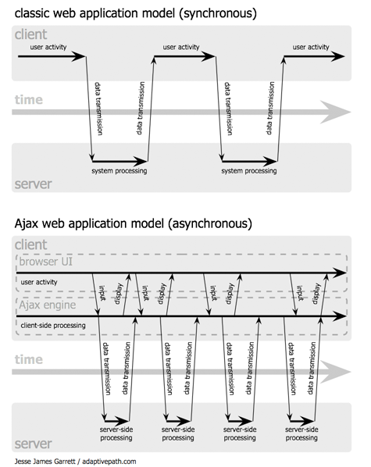
AJAX web applications
Notes:
AJAX enables the ‘thick client’ approach to building web applications
AJAX = Asynchronous Javascript and XML
The key capability is independently manipulating different parts of the web page in response to the user.
By not reloading the whole page each time the user clicks a button, the Javascript entity can maintain state whilst providing application functionality.

Slide 6
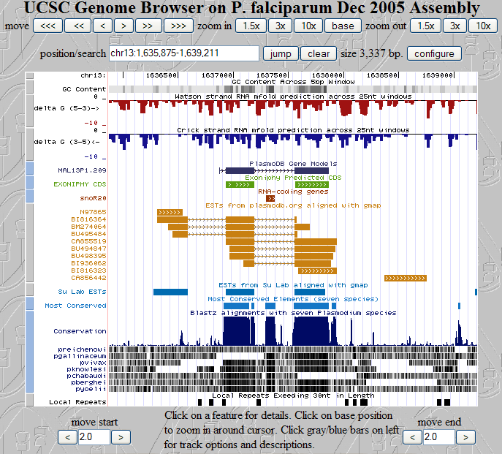
UCSC Genome Browser
Notes:
The UCSC Genome Browser is a web-based genome browser which incorporates an increasing number of genome-related external data sources.
Users can select feature tracks from a large assortment of sources and modify their display format.
Aside from feature track selection, it does not provide a lexical search of the displayed data.

Slide 7
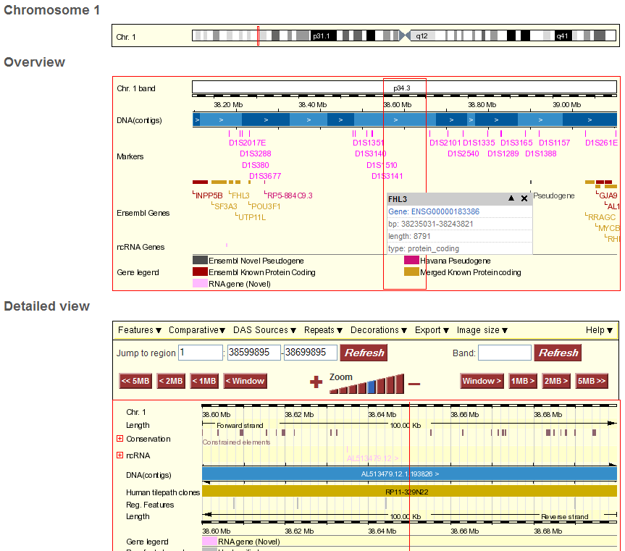
Ensembl Genome Browser
Notes:
Like UCSC, Ensembl’s Genome Browser has evolved to provide and more data sources as feature tracks. It also now displays base-level detail, similar to a sequence editor such as Consed.
The achilles heel of both systems remains the image-file based display system.

Slide 8
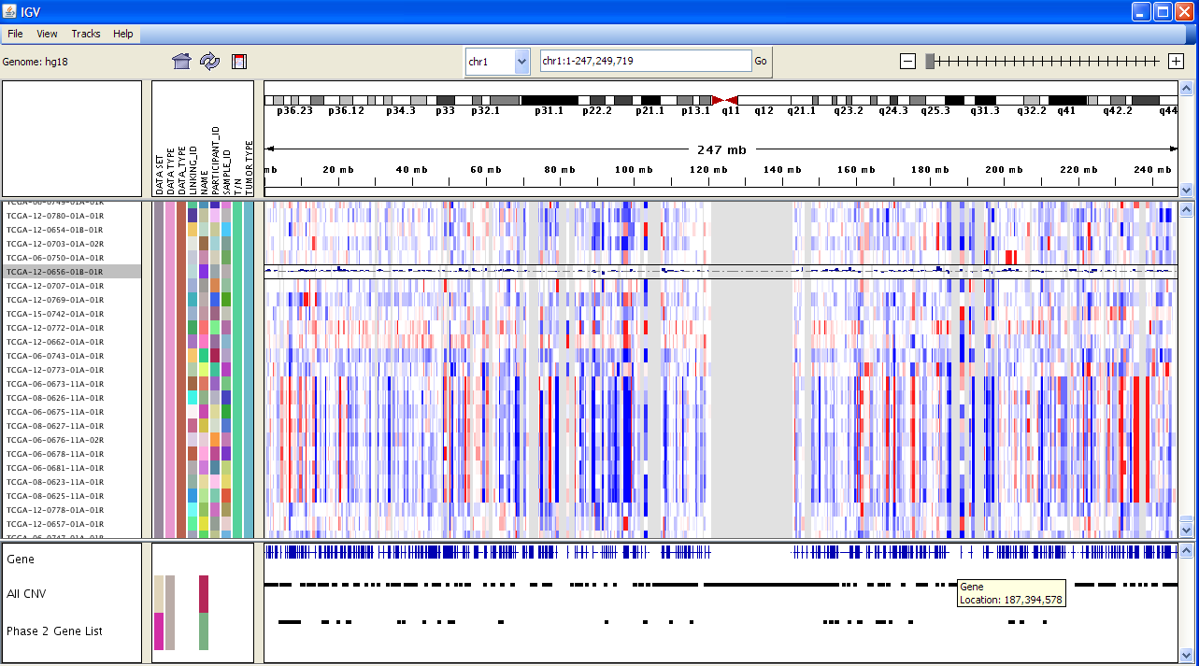
IGV (Integrative Genome Viewer)
Notes:
IGV has a basic filtering option which allows the user to limit the displayed feature lines using keywords in the feature ID and type.
Produced by the Broad Institute:
http://www.broad.mit.edu/igv/index.html
Tutorial is here:
http://www.broad.mit.edu/igv/doc/quickstart.html

Slide 9
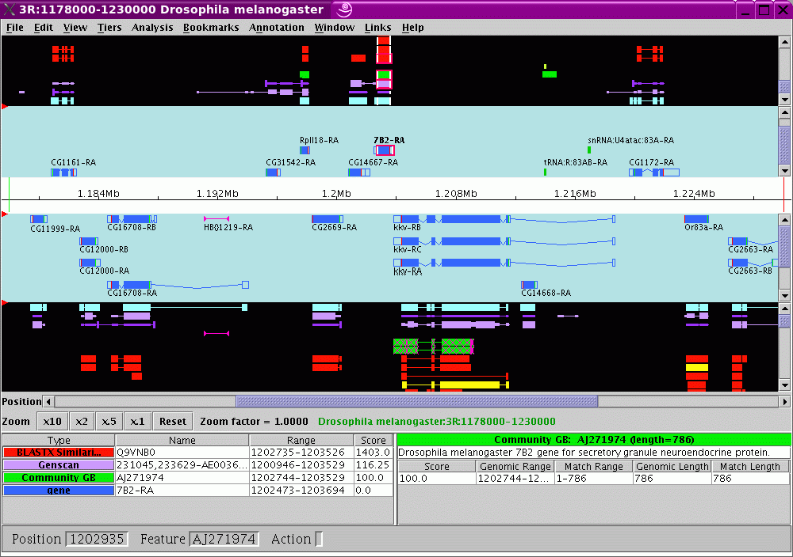
Apollo
Notes:
Apollo is an open-source java application which was initially designed as a genome annotation tool for the Drosophila genome (Flybase).
Access to the code and updated databases is now available using Java Webstart but annotations are stored in a local database.

Slide 10
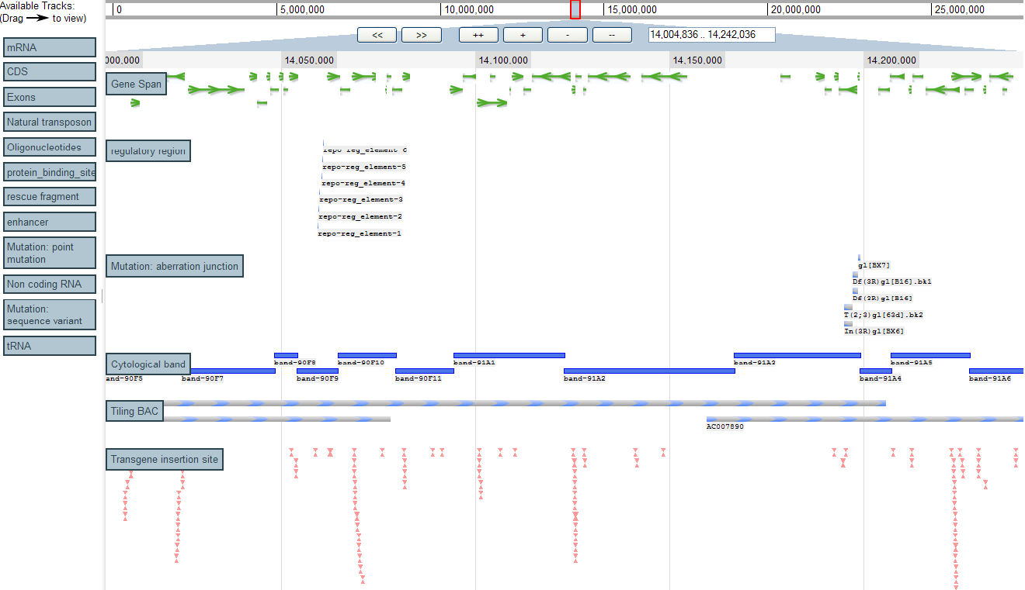
Ajax GBrowse
Notes:
Ajax GBrowse is a paradigm shift relative to the existing web genome browsers.
One of its main advantages is its ease of use – it allows extremely fast genome viewing and drag-and-drop feature selection.
It uses the ‘thick client’ approach, pushing much of the work the server previously did onto the web browser.
JSON (JavaScript Object Notation) data files representing chunks of the genome and feature data are loaded on demand (like Google Maps), which dramatically reduces the bandwidth requirements and speeds up the image viewing, providing a real-time genome browsing experience.

Slide 11
Ajax Gbrowse (cont.)
Advantages
  On-demand loading = fast
  Nested container lists for quick searching
  Features are displayed using DHTML
  Allows access to the DOM (Document Object Model) using Javascript
  Open-source and based on well-supported Javascript framework (Dojo)

Slide 12
Project Outline
Modular design:
  Functions: Pipeline + Report + View
  Function = Plugin
  Dojo javascript framework tools
    Plugin loading
    AJAX, utilities and Testing
Project management:
  CVS: trac/subversion
  Check-out, modify, merge
  Issue tracking
Notes:
Bioptic has been designed for open-source development by multiple teams or individuals.
Its modular design facilitates code reuse and allows for independent development of different functionalities.
As part of the large-scale software engineering approach, the Bioptic project incorporates software testing tools and project management systems to ensure cooperation between developers and strengthen version control.

Slide 13
Bioptic plugins
Pipeline
  Run NGS pipeline from base calling to downstream analysis (SNP prediction, etc.)
Report
  Select features from the analysis output (e.g., SNPs) using user-defined criteria
  Output to Excel, .txt file or web page
View
  Features are mapped to human genome
  Annotation of features

Slide 14

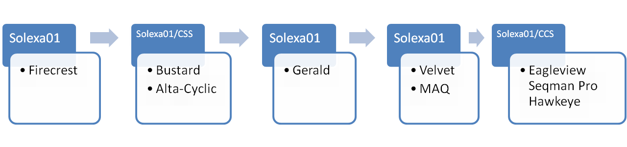
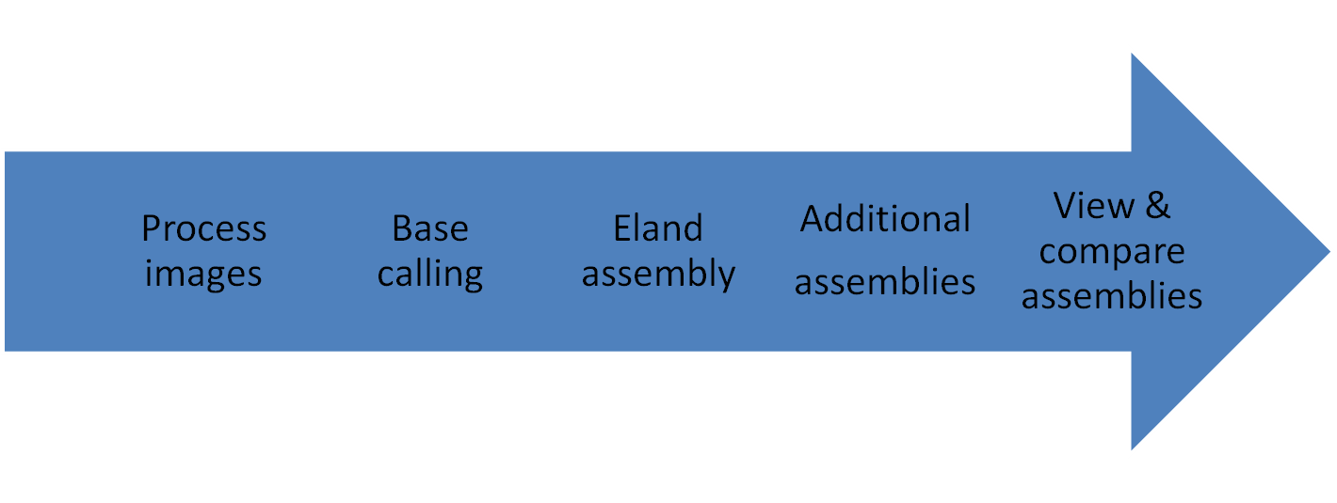
Workflow Plugin

Slide 15
Workflow plugin (cont.)
Drag-n-drop Workflow wizard
  User decides series of application to use
  User can alter parameters for each application
  Utility applications are available for sequence file format conversions, etc.
  User can run workflow and view progress, output files and error files
  Workflows can be saved and reused with different input data sets

Slide 16
Workflow plugin (cont.)
Screenshot of workflow tab

Slide 17
Report plugin
SNP prediction verification
  User employs criteria to select from possible SNPs predicted in the workflow stage:
    % frequency of SNP
    matching with dbSNP
    proximity to exons, introns, UTR
  Output to Excel, .txt and .html
  Selected SNPs are linked to the View: clicking on them will open a View Tab

Slide 18
Report plugin (cont.)
Screenshot of Report tab

Slide 19
View plugin
Genome-level data exploration
  SNPs or other genomic features predicted in the Report step are added to existing annotated features
  Annotations can be added by the user and saved to the database
  External features can be uploaded by the user
  Additional features to be developed

Slide 20
View plugin (cont.)
Screenshot of View tab

Slide 21
Roadmap
Development milestones:
Workflow, SNP Report, View coupling
  Human mitochondrial SNPs
Advanced SNP verification
  Human genome SNPs
Genome viewer-based data mining
  Optimized querying
  External databases
First Release (version 1.0)

Slide 22
Thank you
syoung@med.miami.edu

