Slide 1
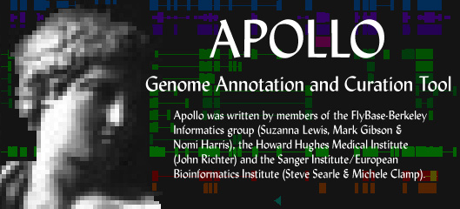
The Apollo genome annotation browser & editor
Sima Misra
FlyBase/Berkeley Drosophila Genome Project
University of CA, Berkeley
Notes:
I am excited to tell you about an software tool that we have been working on for 5 years, the Apollo graphical genome annotation browser & editor. Apollo has lots of capabilities; I’m going to touch on just a few of the functionalities in this talk, but feel free to ask me for a demo of other functionalities after my talk

Slide 2
What is Apollo?
Annotating a genome
  Automated analysis pipeline: good
  Analysis pipeline + biologist: better
Allows curators to view analysis results and create and refine annotations
Developed by groups at FlyBase-BDGP and the Sanger Institute
Open Source Java application
In production use for 4 years at FlyBase to annotate D. melanogaster genome
Notes:
Idea behind apollo editing is that although automated pipelines are good, having a biologist manually create annotations by synthesizing results can be better
FlyBase modified from release 2 to release 3 85% of transcripts and 45% of encoded proteins

Slide 3
Why use Apollo?
Integrate large amounts of data in a visually efficient manner
Browser and editor
Customizable
Open Source, extensible
Multi-platform (Java)
Part of GMOD tool kit
Good user manual
Easy to install

Slide 4
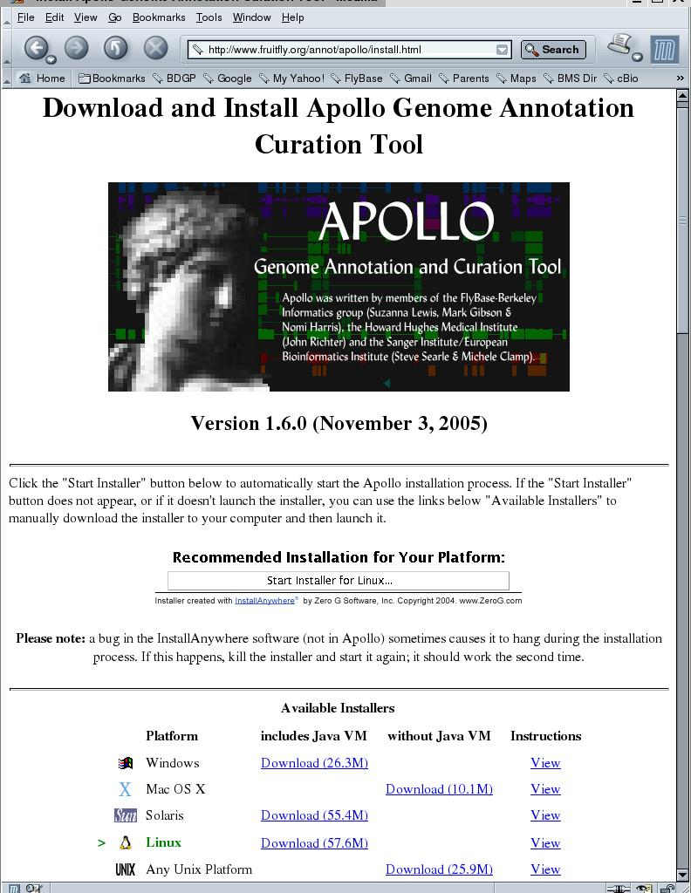
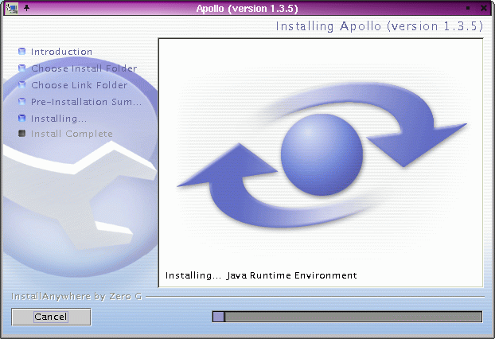
Installing Apollo
http://www.fruitfly.org/annot/apollo/
Notes:
Apollo works on Windows, Mac OS X, Solaris, Linux, or any Unix platform; installation is quick and easy
Only requirement is memory and a 3-button mouse makes it easier to use

Slide 5
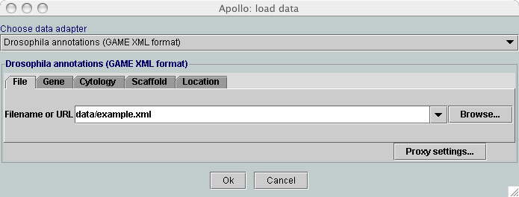
Loading data
Many file formats (Chado & GAME XML, GenBank, GFF, etc.)
Transparent access to Chado, FlyBase, and Ensembl databases
Accessing fly annotations
  Chromosome, start, end
  Gene symbol
  Map position
Navigation bar
Notes:
One of the advantages of apollo is that it reads data in many different ways: 2 kinds of XML, GenBank or EMBl, GFF, etc.
Can use Java database connectivity or HTTP to transparently query a database; Chado database is the official database of GMOD, and Apollo is official annotation editing tool; you can roundtrip data via JDBC or Chado XML flatfiles between Chado and Apollo
For Drosophila melanogaster, can query in many ways transparently over the internet with chromosome location, gene name, map position, etc.
A navigation bar at the top can allow you to quickly navigate along the chromosome or expand the region you are looking at

Slide 6
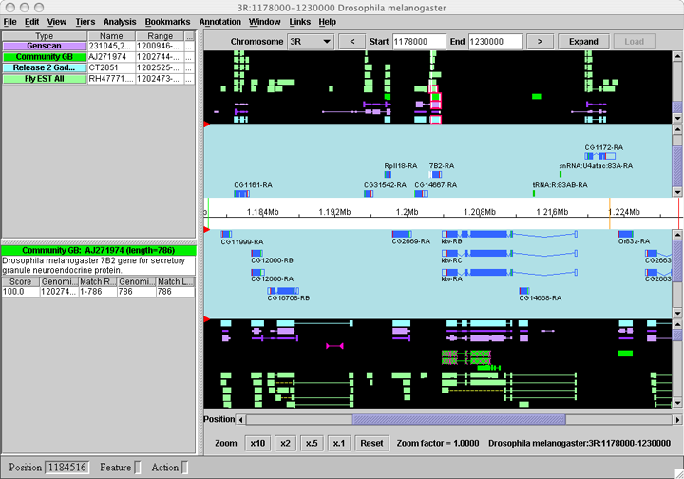
Main display
Annotations
Results
Zoom
Notes:
- +/- strands
evidence (raw computational results) in black, sorted into color by type of result
Annotations in blue zone with alternative transcripts, indicating starts and stops of translation, UTRs for protein-coding genes
- select any feature(s) to see more info
- scrollbars
- zoom buttons

Slide 7
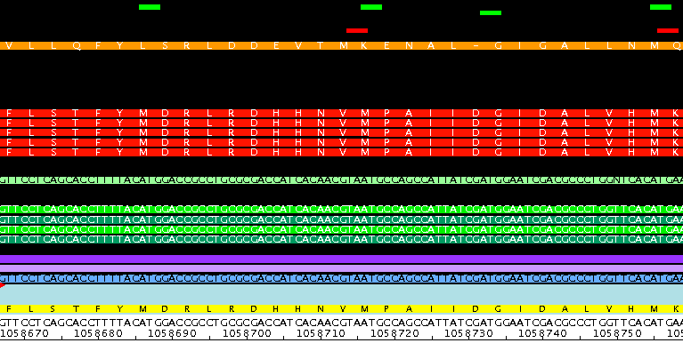
Zoom in to see more detail
Start & stop codons
Sequence
Notes:
As you zoom, start and stop codons appear at the top of the screen, and if you zoom in enough, sequences of result features and the genomic reference appear
In red are blast hits to proteins, and in green and blue are sim4 NA alignments, can see differences between features and genomic sequence

Slide 8
Many ways to customize
What to show?
  Show/hide forward/reverse strands
  Show/hide results, annotations, axis
  Reverse complement
How to show it?
  Change evidence panel orientation (vertical/horizontal)
  Change colors
  Control display of each result type: name, color, shape, position, logical grouping (tier), etc.

Slide 9
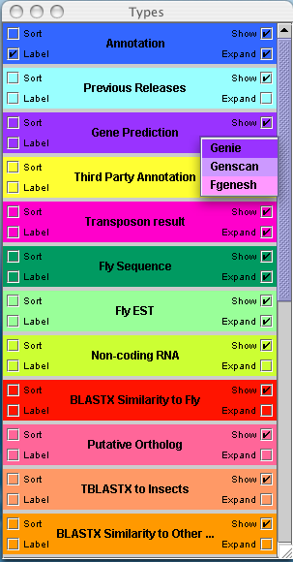
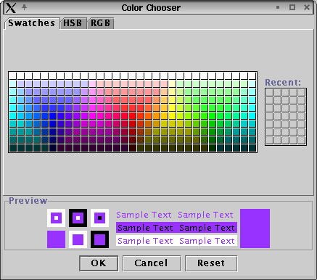
Types panel
Show? Expand? Label? Sort?
Change color or score threshold
Notes:
Features are color-coded by type of result, e.g. gene predictions in purples, ESTs in light green, blastx similarity in reds and oranges in this example
Can decide whether to show, label, or how to sort
Can change color or threshold, only displaying hits with high enough score

Slide 10
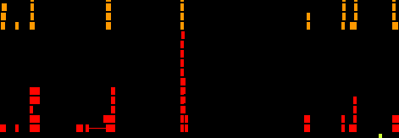
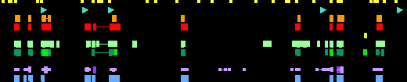
Tiers collapse/expand
Notes:
To save real estate on display, can decide whether to collapse all results in one level or expand as in this example

Slide 11
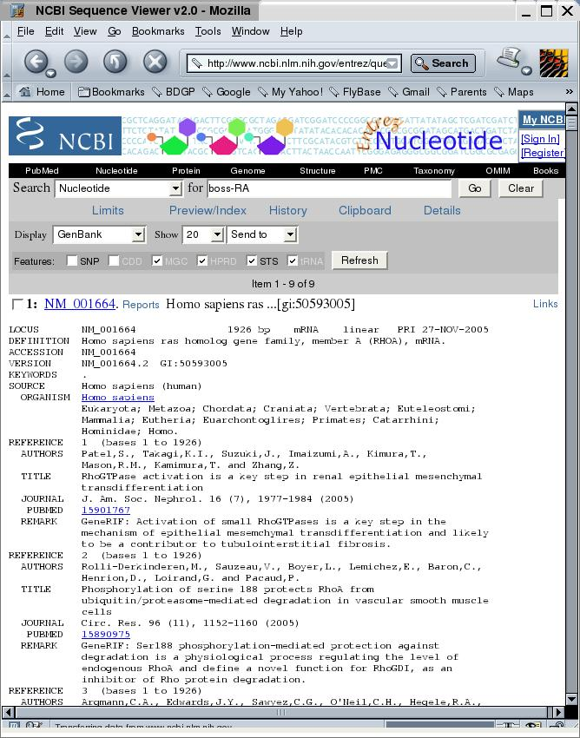
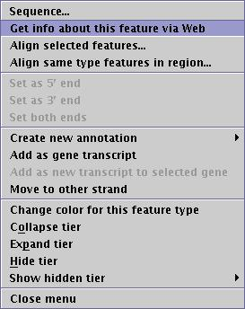
Features link to web pages
Notes:
Clicking on a feature brings up a popup menu, and you can specify URLs and select to open web browser to find out more about that feature, for example, GenBank report
Customizable to your own database

Slide 12
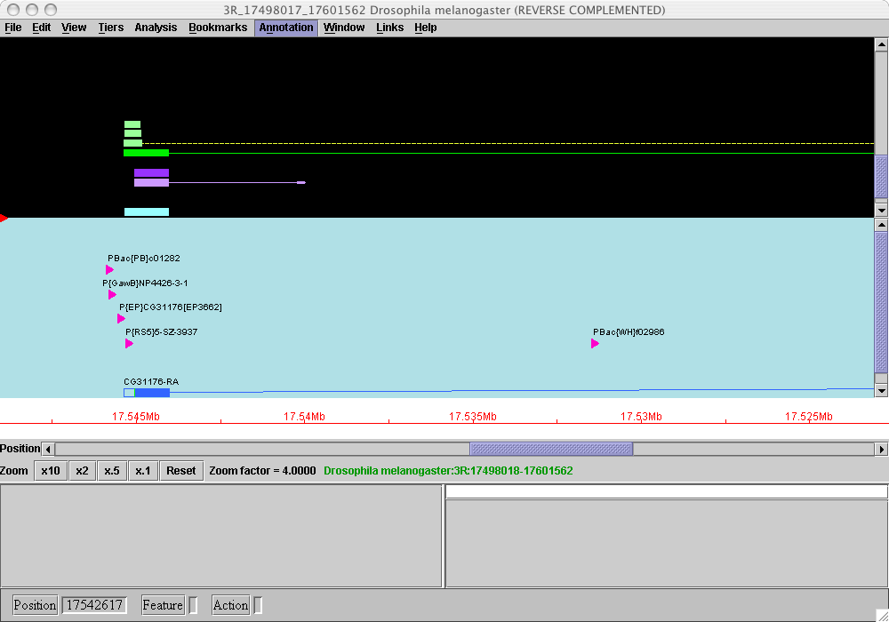
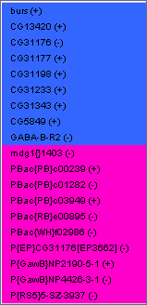
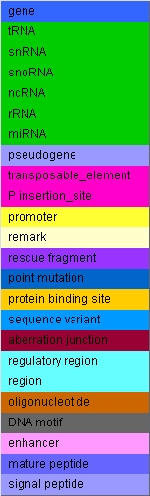
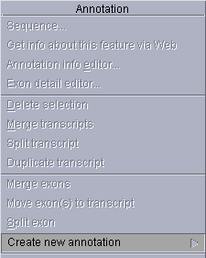
Variety of annotation types
Notes:
Different types of annotations can be displayed with custom colors and shapes. An annotation dropdown menu has these color-coded.
Curator can create annotations of any type de novo (also customizable)

Slide 13
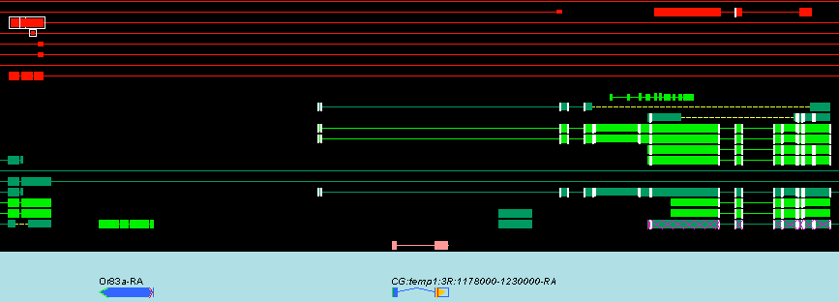
Visual cues
Edge matching
Sequencing gaps
Unconventional splice sites
Problematic data
New data
Missing start/stop codons
Notes:
Also gaps in sequence data (not shown)

Slide 14
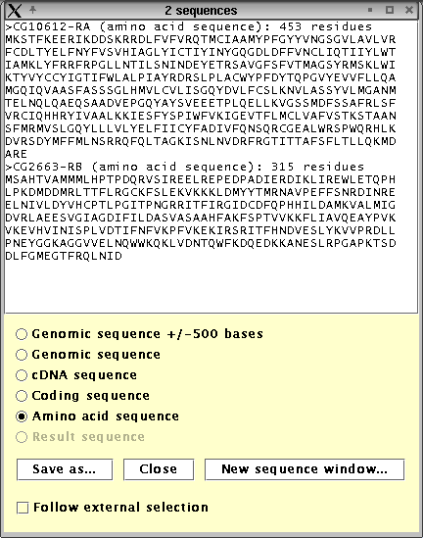
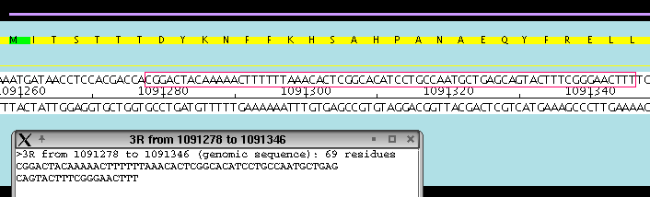
Sequence
Select features or region of sequence
Sequence window
  cDNA, translation, genomic
  Save as FASTA
  Copy & paste to another application

Slide 15
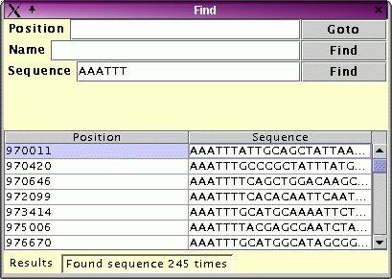
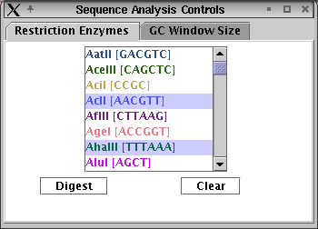

More about sequence
Search for patterns
Restriction sites
GC content graph

Slide 16
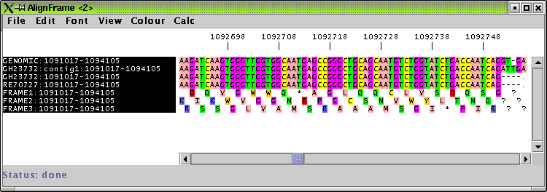
Jalview alignment viewer
View multiple alignments of selected features
Shows selected sequences plus genomic sequence with 3-frame translation
Can view DNA and/or amino acid alignments

Slide 17
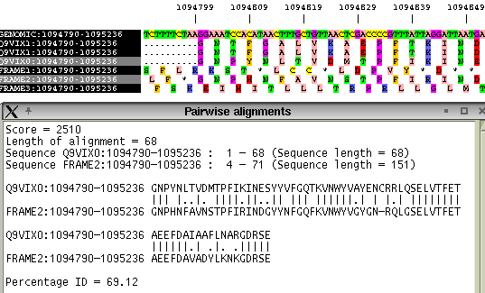
Alignment viewer, cont.
View pairwise alignments between any sequences (including genomic translations)
Notes:
Point out very briefly the genomic, three-frame translation, matches vs. mismatches.

Slide 18
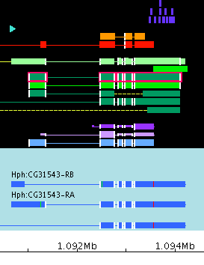
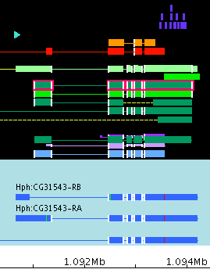
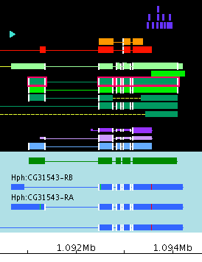
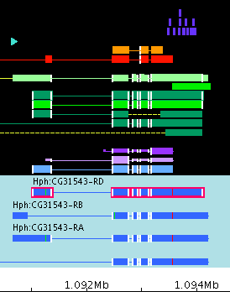
Creating and editing annotations
Drag-and-drop creation and modification of gene models
Set 5’/3’ edges based on evidence
Edge-matching increases confidence
Notes:
Box at the bottom of the panel indicates the action you are performing
Can drag and drop start codons as well
Update with create new annotation action bar

Slide 19
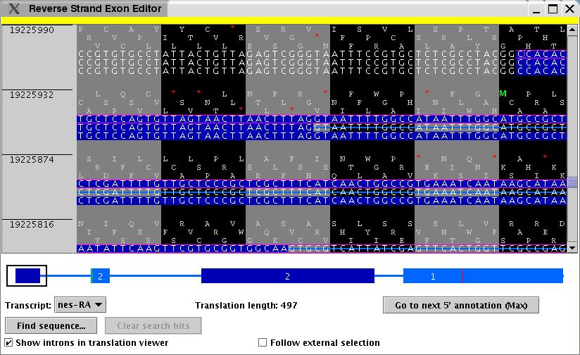
Exon detail editor
See 3-frame translation
Adjust edges
Set translation start, etc.
Notes:
See glyph at bottom of EDE with exon-intron structure of transcript and any open reading frames; can use this to navigate by clicking on it
Can drag and drop edges to modify, or select a new start codon

Slide 20
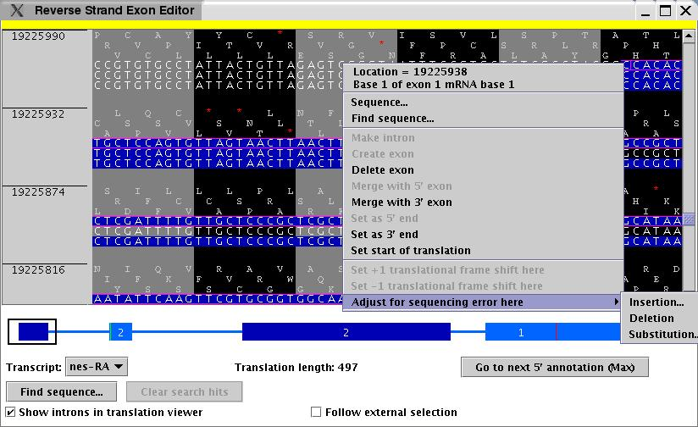
Exon detail editor
See 3-frame translation
Adjust edges
Set translation start, etc.
Notes:
Curator can set for translational frameshifts or genomic sequencing errors using the popup menu in this editor as well

Slide 21
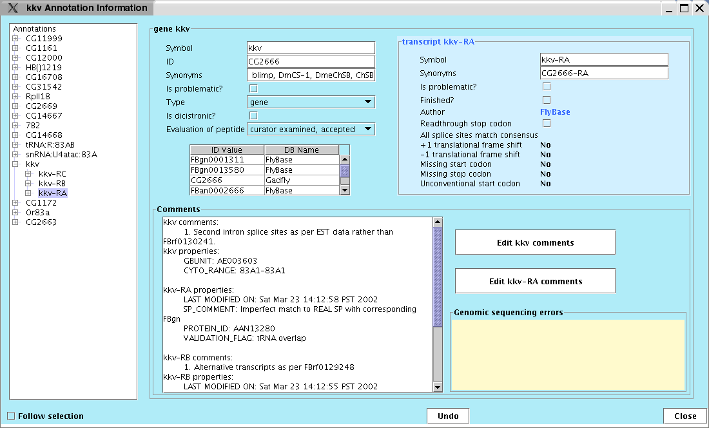
Annotation info editor
Change annotation type (transposon, tRNA, etc.)
Add comments (CV or free text)
Special categories (problematic, dicistronic)
Translation exceptions
Full Undo

Slide 22
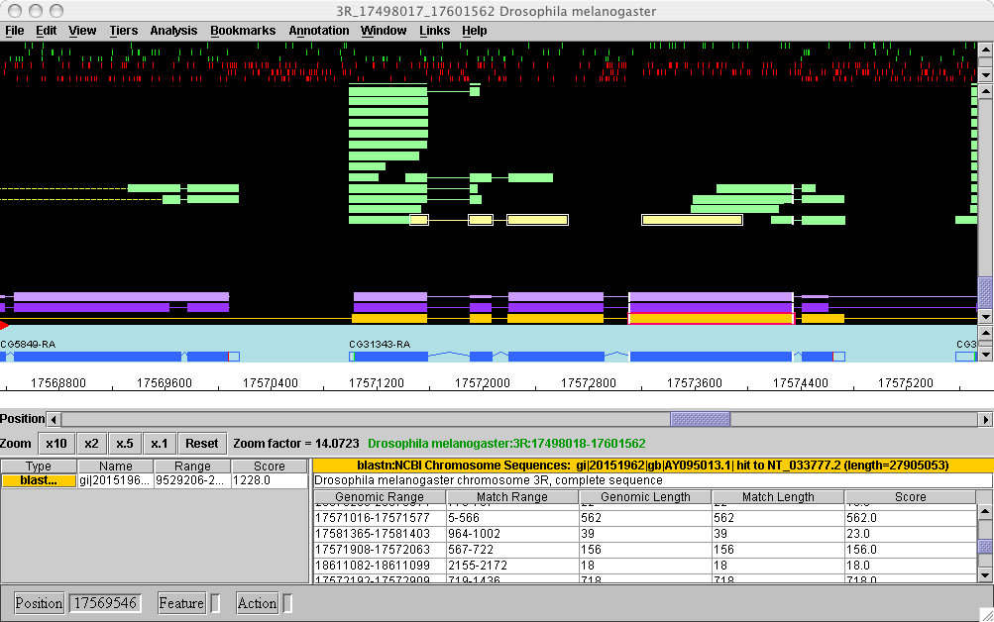
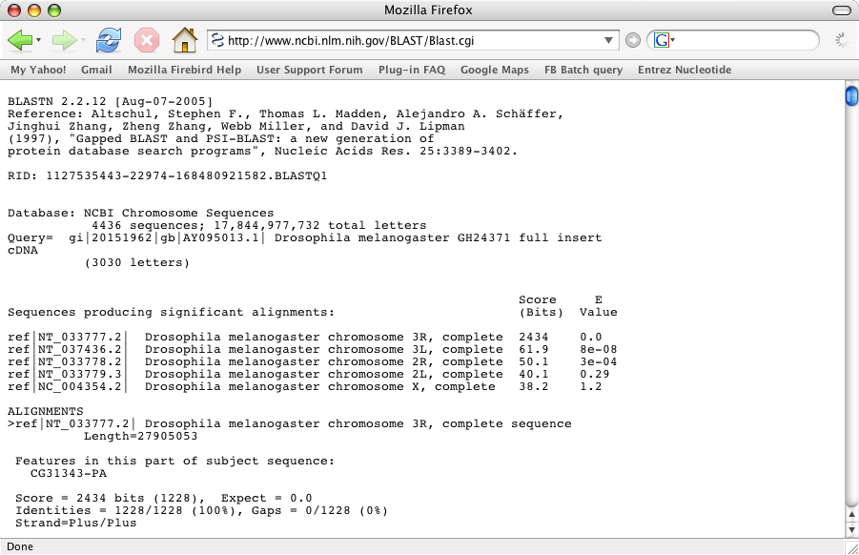
Layering BLAST results
Notes:
New cDNA GH24731 was deposited in GenBank but not yet aligned to gene. I simply took the FASTA sequence of this cDNA, blastn at the NCBI web server, saved the results as a text file, and layered them into Apollo. The bright yellow tier shows the new blast HSPs.

Slide 23
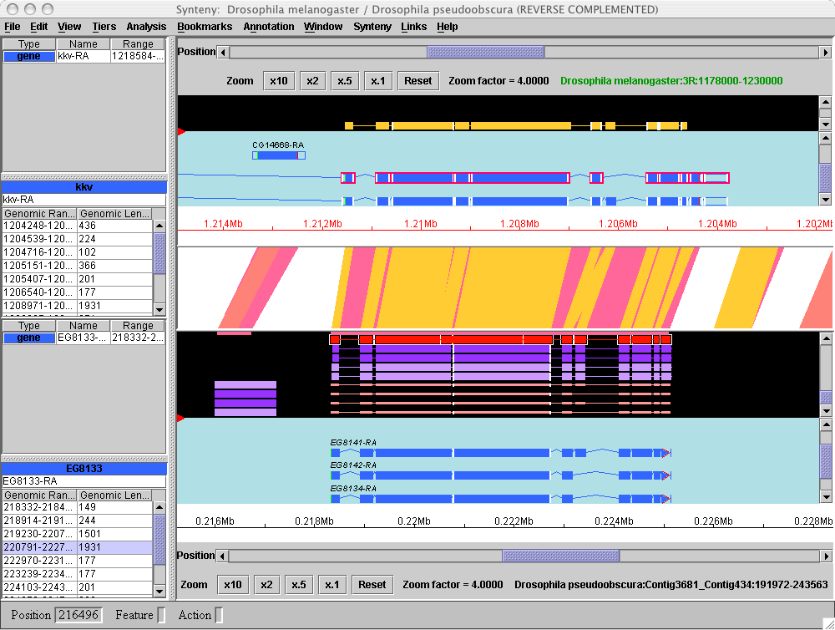
Synteny viewer
View comparisons between two genomes
Beta: annotation editing and multiple genomes
Notes:
Synteny viewer shows two Apollo panels, one for each species, plus a graphic showing regions of homology between the two genomes.

Slide 24
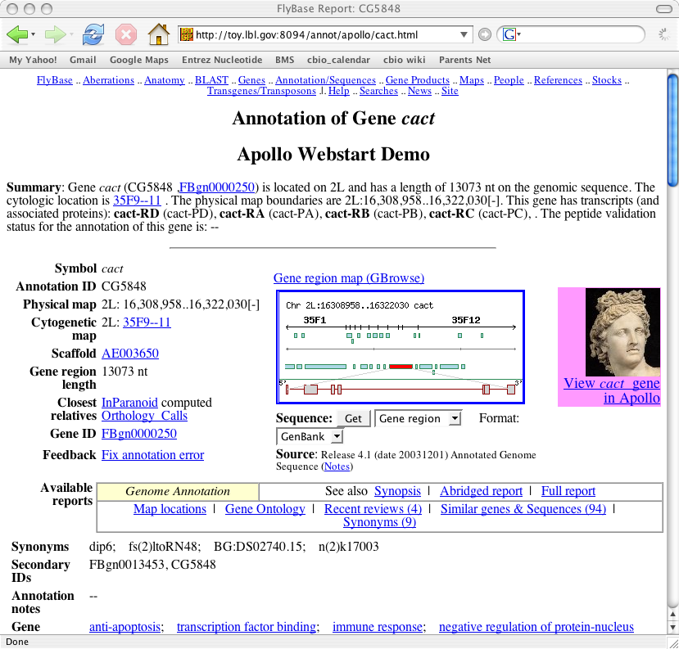
Webstart
Automatically downloads Apollo if necessary
Automatically checks for updates of code or configuration files
Displays region of interest automatically
Notes:
- Webstart is an increasingly popular way to distribute applications
- no need to run installer--apollo automatically downloads to your computer the first time you click on a webstart link
- automatic updating--if there's been a new release since last time you ran it, it automatically updates your copy (but if there hasn't been a new release, it doesn't--it uses the one already on your computer so it launches quickly)
- config files bundled in--no need to download separately when there's a change
- can set up links to allow users to easily launch apollo on any region of interest from a web page

Slide 25
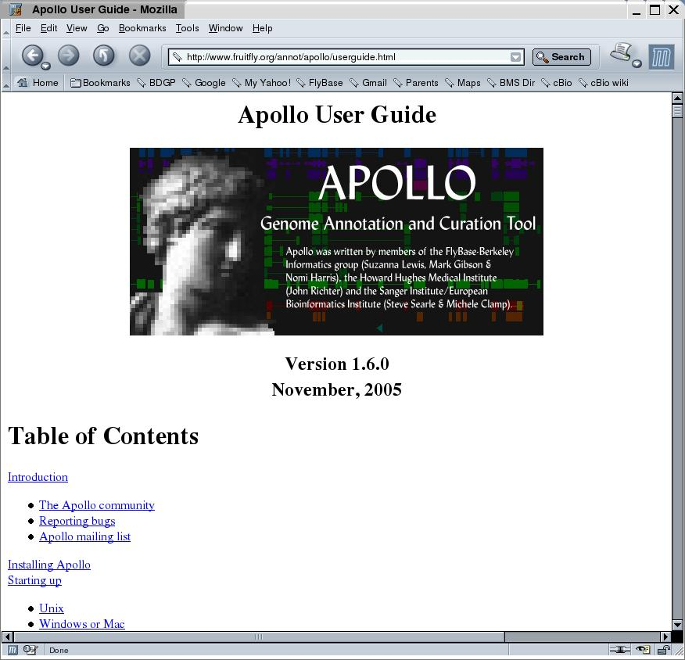
Extensive documentation
Lewis et al. (2002) Genome Biology 3(12):research0082
Misra & Harris (2005) Current Protocols in Bioinformatics
Unit9.5
Online user manual

Slide 26
Many groups are using Apollo
>5000 downloads
Many groups are modifying it
  New result types
  New annotation types
  New data adapters

Slide 27
Customizing Apollo
Ensembl (Steve Searle)
JGI (David Goodstein)
  Curate human annotations
TIGR (Jonathan Crabtree)
  Apollo <-> Chado (human & microbial genomes)
TAIR (Chris Wilks)
  View and edit Arabidopsis genes
  Apollo <-> MySQL database (Arabidopsis genome)
Baylor Human Genome Sequencing Center
  15 curators annotated human chromosomes 3 & 12
  Used for other finished genomes and gene family annotation
  Data adapter talks to MySQL database
Notes:
There are at least 14 other groups using Apollo

Slide 28
Customizing Apollo
INRA - URGI Bioinformatique (Cyril Pommier)
  Interactive manipulation & validation of scaffolds
dictyBase (Sohel Merchant, Eric Just)
  Curate Dictyostelium genes and genomic sequence errors
Institute for Systems Biology (Alistair Rust)
  Transcription factor binding site alignment viewer
Pegasys, UBiC (Graham McVicker)
  Annotation of 12 vertebrate regions homologous to human chromosome 21q22.11
  Annotation of pathogenic Cryptococcus gattii
ParameciumDB (Linda Sperling)
  Community annotation of newly sequenced genome

Slide 29
Customizing Apollo
CSHL Dolan DNA Learning Center (Guanming Wu, Scott Cain)
  Annotation of genes for Gramene by high school/college students
International Rice Research Institute (IRRI)
  Annotation within Java GCP platform
HGMP-RC Fugu Genomics group
  Interactive manipulation & validation of scaffolds
GNF
  JDBC adapter layer over BioSQL
Bristol-Myers Squibb
  Front end to yeast sequence database

Slide 30
Conclusions
Robust, well supported
Extensive documentation
User-customizable
Modular and extensible
Part of GMOD toolkit

Slide 31
The Apollo Team
FlyBase BDGP:
  Suzanna Lewis
  Nomi Harris
  Mark Gibson
  Sima Misra
Other contributors:
  Sanger Institute--Steve Searle, Michele Clamp, Vivek Iyer
  HHMI--John Day-Richter
  TIGR--Jonathan Crabtree
  CSHL--Guanming Wu, Scott Cain
  INRA - URGI Bioinformatique--Cyril Pommier

Slide 32
Downloading Apollo
Installer available at http://www.fruitfly.org/annot/apollo/install.html
Source code available at SourceForge: http://sourceforge.net/projects/gmod/

