Slide 1
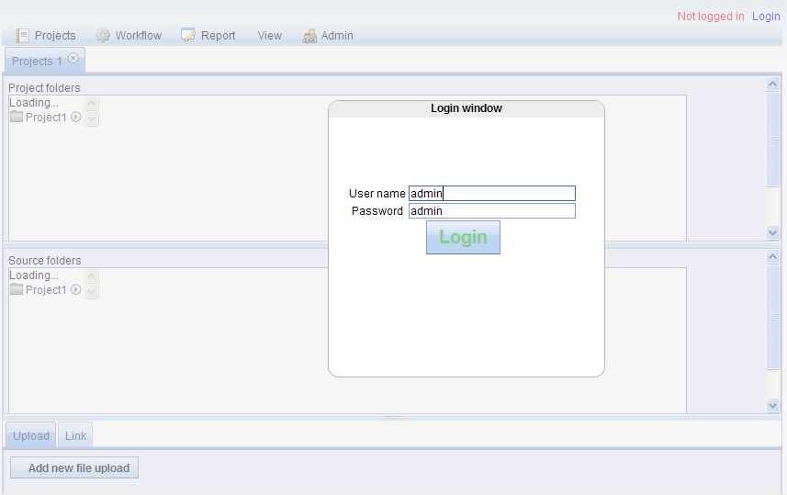
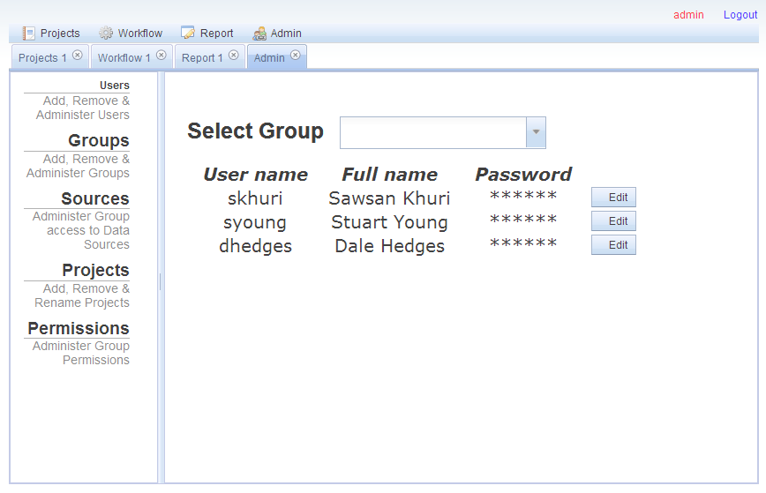
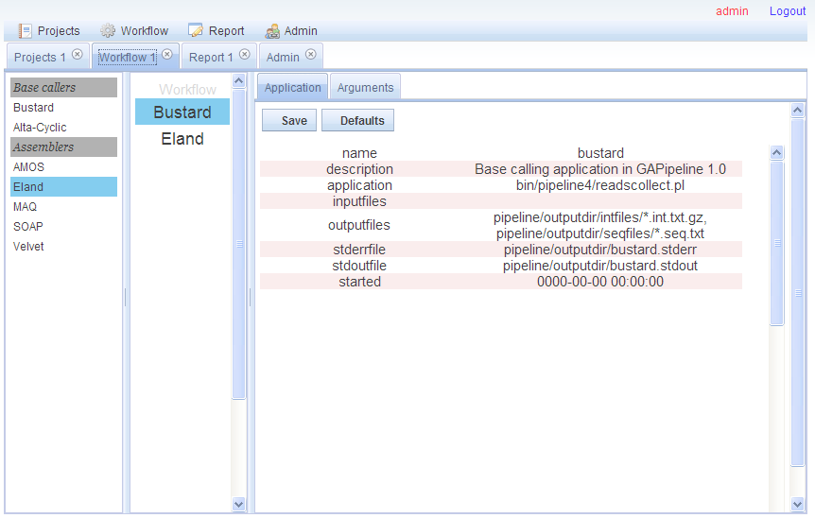
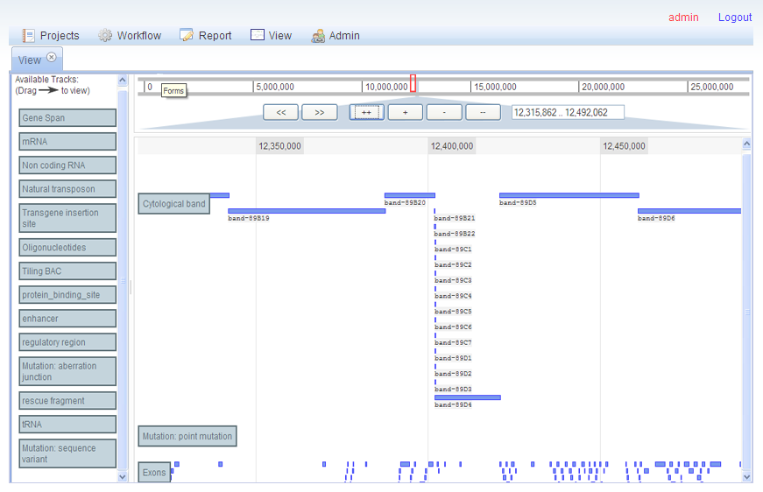
Bioptic: NGS Visualization and Analysis Web Tool

Slide 2
Bioptic: A workflow tool and sequence viewer for Next Generation data
View large feature data sets
Fast image rendering
Interactive querying & annotation
Easy-to-use interface
Enable sharing of data
Upstream: Data generation pipeline
Downstream: Analysis plugins
Notes:
These requirements were emerging alongside the large growth in genome sequence data from traditional Sanger sequencing.
The need is urgent now because of the quantum leap in data volume due to short read Next Generation sequencing technologies.
The integration of data generation and downstream analysis is an important component of Bioptic and necessitates an emphasis on ease of extensibility and flexibility.

