Slide 1
Aqwa
Automated Query and Workflow Agent
A Web Tool for Bioinformatics Data Analysis and Visualization
Stuart Young, Ph.D.
Post Doctoral Research Associate
Center for Computational Science syoung@med.miami.edu

Slide 2
Motivation
Sequence data volumes are increasing exponentially
Bioinformatics bottleneck – need easy tools for big jobs
Current viewers are limited by their technologies:
  UCSC, Ensembl, Gbrowse
    Thin client server → browser paradigm
    Each new view means a new image (slow)
    Limited interaction
  IGV, Apollo
    Java application
    Increased interaction
    Limited data sharing (data is local)

Slide 3
Project Summary
Design a workflow tool and viewer for next generation sequence analysis:
      Data generation pipeline
      Flexible analysis tools
      Easy-to-use interface
      Enable sharing of data
      View large feature data sets in real time
      Interactive querying & annotation
Notes:
These requirements were emerging alongside the large growth in genome sequence data from traditional Sanger sequencing.
The need is urgent now because of the quantum leap in data volume due to short read Next Generation sequencing technologies.
The integration of data generation and downstream analysis is an important component of Bioptic and necessitates an emphasis on ease of extensibility and flexibility.

Slide 4
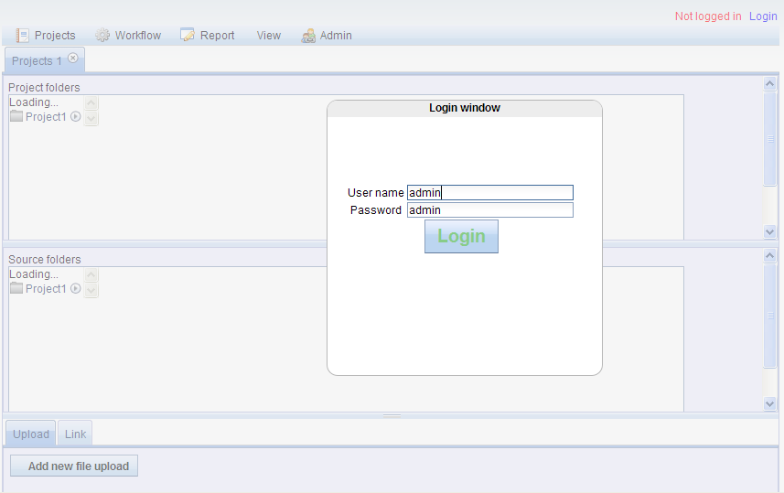
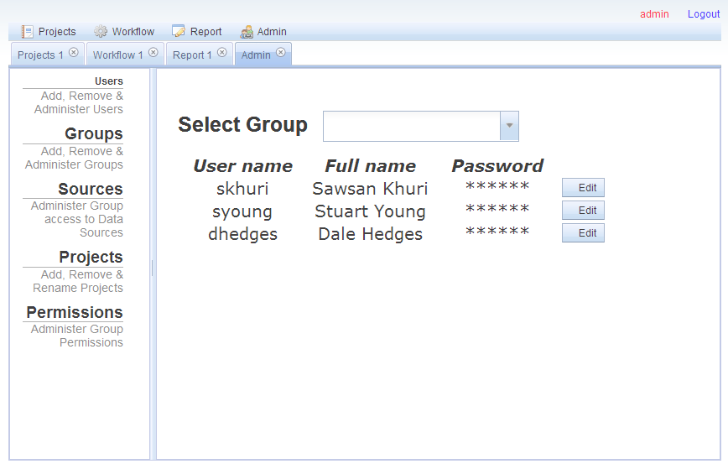
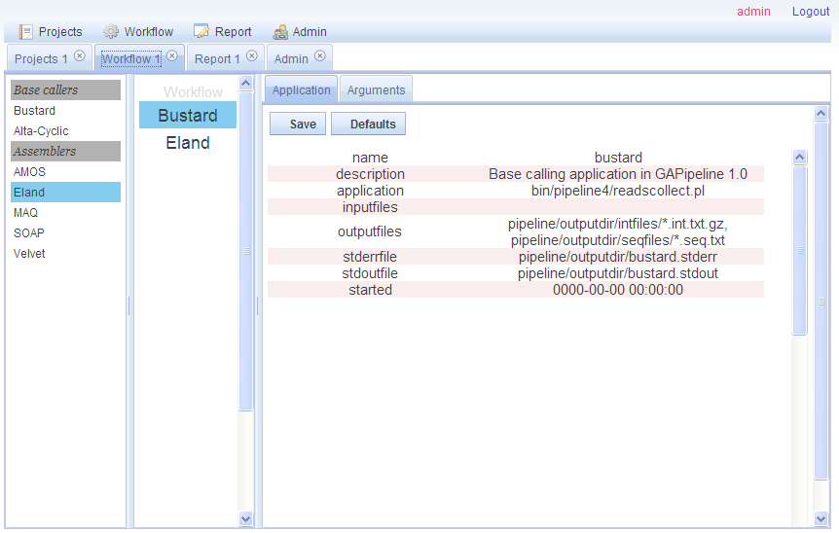
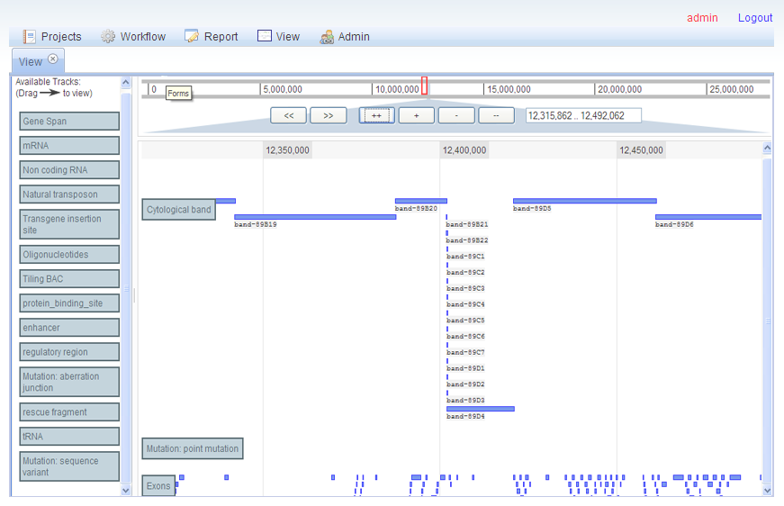
Aqwa
Automated Query and Workflow Agent

Slide 5
Project Outline
Modular design:
  Functions: Project, Workflow, Report, View, etc.
  One Function = One Plugin
  Version control for multiple plugins
  Dojo javascript framework tools
    Plugin loading
    AJAX, utilities and Testing
Project management:
  Subversion CVS (check-out, modify, merge)
  Issue tracking (trac)
Notes:
Bioptic has been designed for open-source development by multiple teams or individuals.
Its modular design facilitates code reuse and allows for independent development of different functionalities.
As part of the large-scale software engineering approach, the Bioptic project incorporates software testing tools and project management systems to ensure cooperation between developers and strengthen version control.

Slide 6
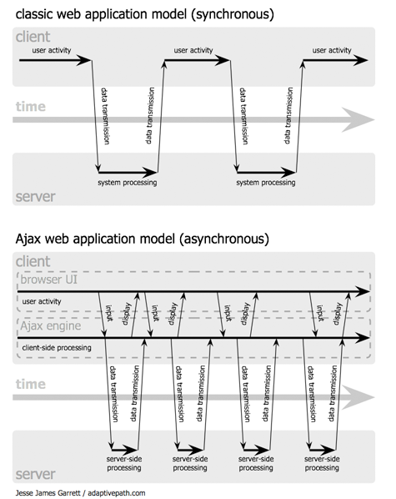
AJAX web applications
Notes:
AJAX enables the ‘thick client’ approach to building web applications
AJAX = Asynchronous Javascript and XML
The key capability is independently manipulating different parts of the web page in response to the user.
By not reloading the whole page each time the user clicks a button, the Javascript entity can maintain state whilst providing application functionality.

Slide 7
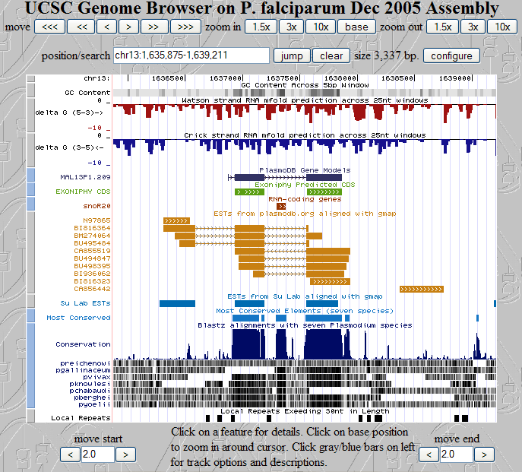
UCSC Genome Browser
Notes:
The UCSC Genome Browser is a web-based genome browser which incorporates an increasing number of genome-related external data sources.
Users can select feature tracks from a large assortment of sources and modify their display format.
Aside from feature track selection, it does not provide a lexical search of the displayed data.

Slide 8
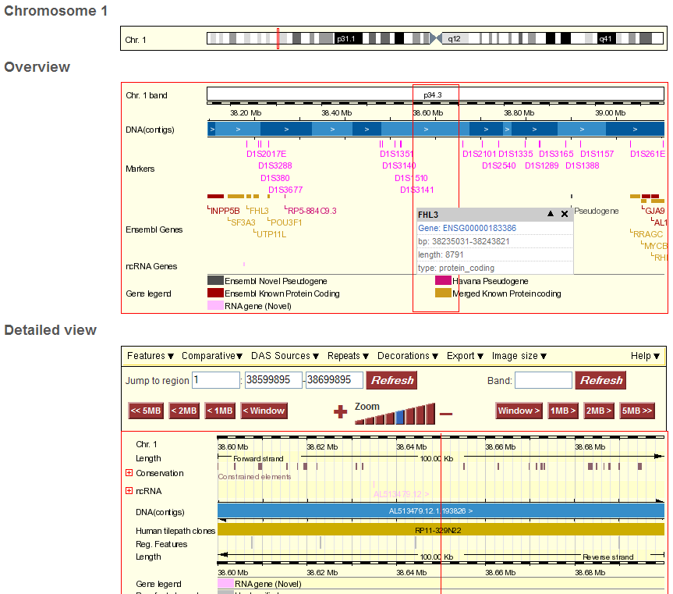
Ensembl Genome Browser
Notes:
Like UCSC, Ensembl’s Genome Browser has evolved to provide and more data sources as feature tracks. It also now displays base-level detail, similar to a sequence editor such as Consed.
The achilles heel of both systems remains the image-file based display system.

Slide 9
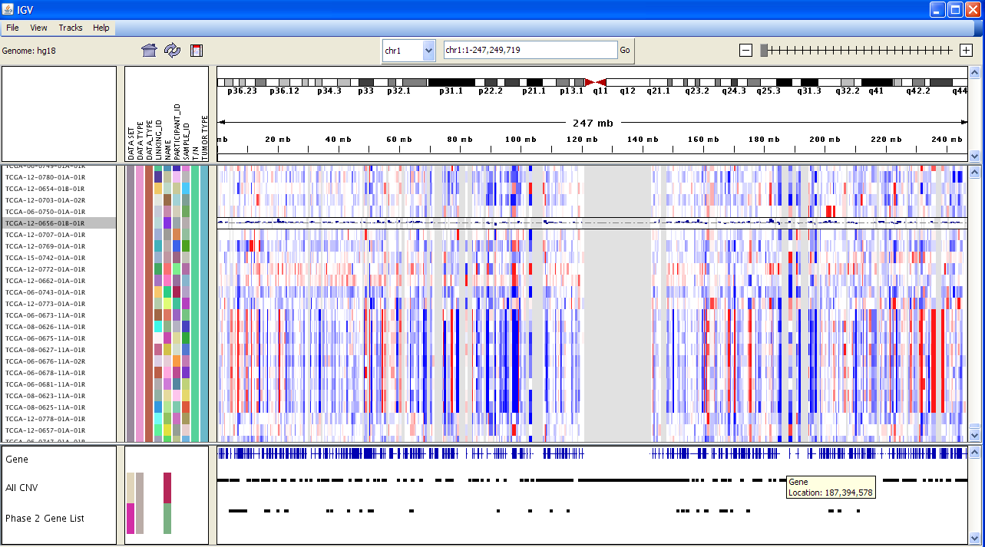
IGV (Integrative Genome Viewer)
Notes:
IGV has a basic filtering option which allows the user to limit the displayed feature lines using keywords in the feature ID and type.
Produced by the Broad Institute:
http://www.broad.mit.edu/igv/index.html
Tutorial is here:
http://www.broad.mit.edu/igv/doc/quickstart.html

Slide 10
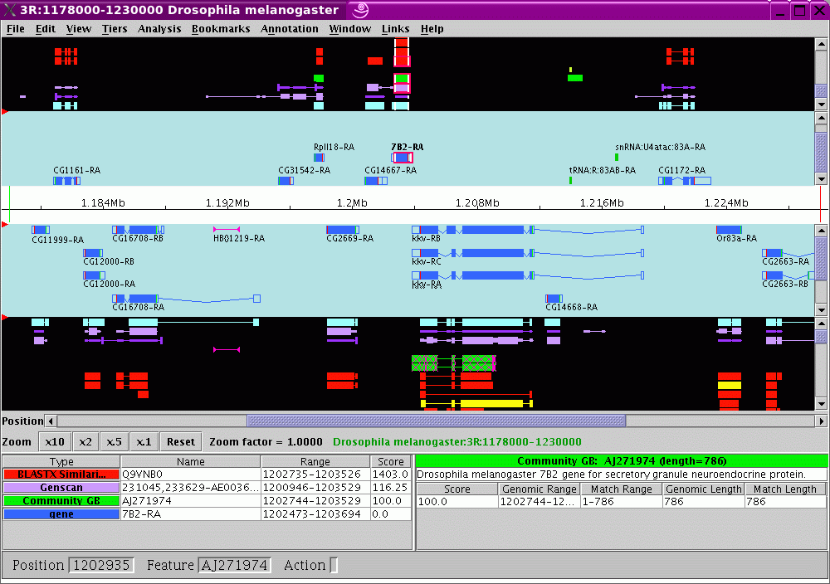
Apollo
Notes:
Apollo is an open-source java application which was initially designed as a genome annotation tool for the Drosophila genome (Flybase).
Access to the code and updated databases is now available using Java Webstart but annotations are stored in a local database.

Slide 11
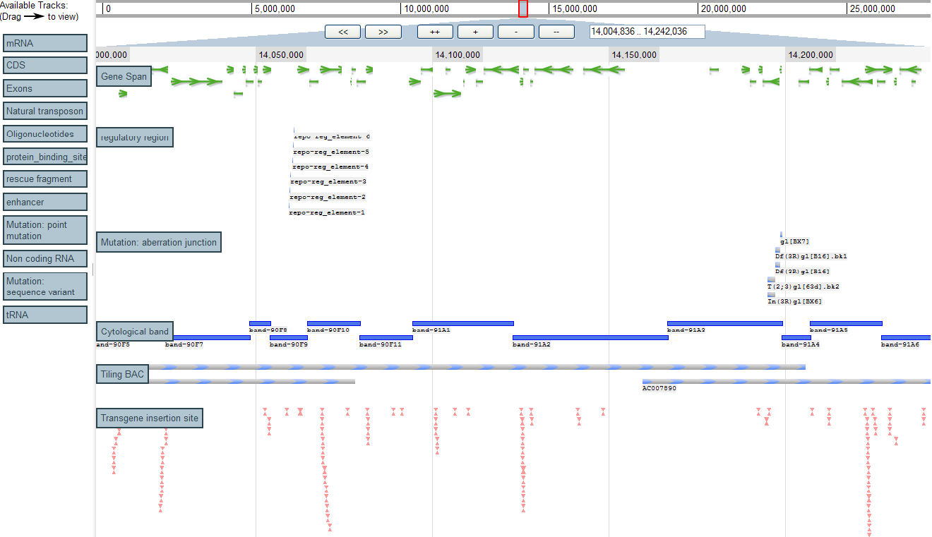
Ajax GBrowse
Notes:
Ajax GBrowse is a paradigm shift relative to the existing web genome browsers.
One of its main advantages is its ease of use – it allows extremely fast genome viewing and drag-and-drop feature selection.
It uses the ‘thick client’ approach, pushing much of the work the server previously did onto the web browser.
JSON (JavaScript Object Notation) data files representing chunks of the genome and feature data are loaded on demand (like Google Maps), which dramatically reduces the bandwidth requirements and speeds up the image viewing, providing a real-time genome browsing experience.

Slide 12
Ajax Gbrowse (cont.)
Advantages
  On-demand loading = fast
  Nested container lists for quick searching
  Features are displayed using DHTML
  Allows access to the DOM (Document Object Model) using Javascript
  Open-source and based on well-supported Javascript framework (Dojo)

Slide 13
Project Outline
Modular design:
  Functions: Project, Workflow, Report, View, etc.
  One Function = One Plugin
  Version control for multiple plugins
  Dojo javascript framework tools
    Plugin loading
    AJAX, utilities and Testing
Project management:
  Subversion CVS (check-out, modify, merge)
  Issue tracking (trac)
Notes:
Bioptic has been designed for open-source development by multiple teams or individuals.
Its modular design facilitates code reuse and allows for independent development of different functionalities.
As part of the large-scale software engineering approach, the Bioptic project incorporates software testing tools and project management systems to ensure cooperation between developers and strengthen version control.

Slide 14
Plugins
Project
  View, copy and remove files in Workflows inside user’s project directories
Workflow
  Run NGS pipeline from base calling to downstream analysis (SNP prediction, etc.)
Report
  Select features from the analysis output (e.g., SNPs) using user-defined criteria
  Output to Excel, .txt file or web page

Slide 15
Plugins (cont.)
View
  Features are mapped to human genome
  Annotation of features
Admin
  User can create Projects and Workflows, and add/remove users from Groups with user-defined permissions on each Project, add/remove Sources (Projects with read-only permission)
  Administrator can add/remove users and manage Groups, Projects and Sources

Slide 16
Project plugin
Drag-n-drop Project and File management
User can administer (add/remove/rename) Projects, Workflows and files
Projects contain Workflows contain files
Users can upload files from local hard disk
Users can upload linked files

Slide 17
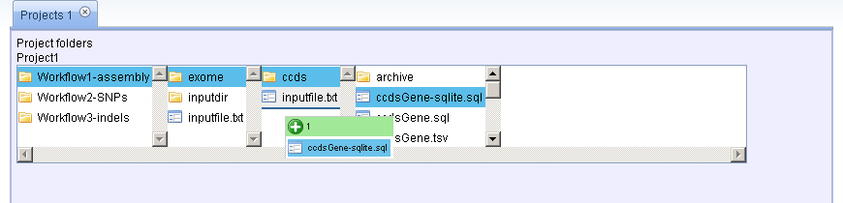
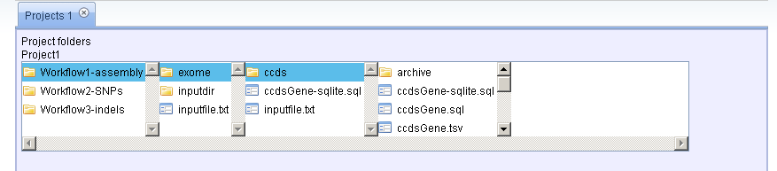
Project plugin (cont.)

Slide 18
Workflow plugin
Drag-n-drop Workflow wizard
  Wide range of applications, including nextgen datat processing and analysis, utilities for sequence file format conversions, etc.
  Automatic and custom settings for each application
  Inputs of downstream applications automatically reflect new settings in upstream applications
  Run workflow and view progress
  View output files and error files
  Save workflows and reuse with different inputs

Slide 19

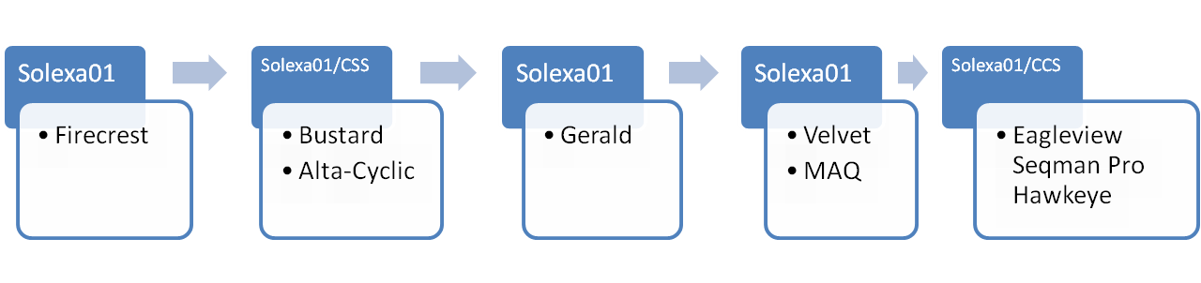
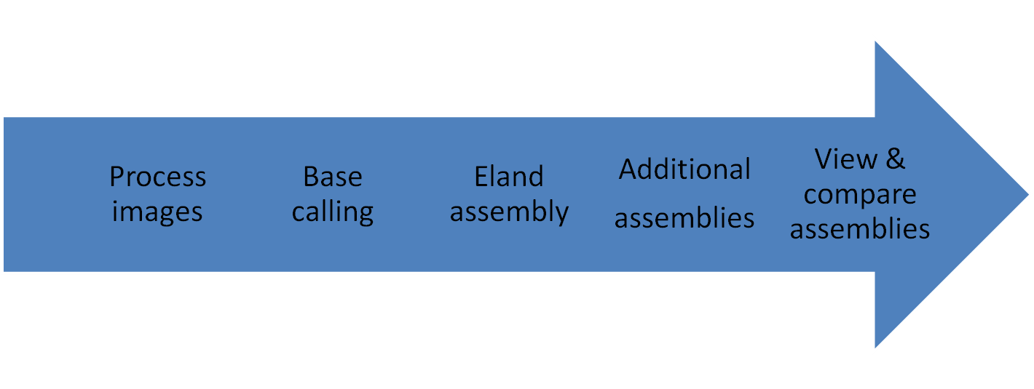
Workflow Plugin (cont.)
Multiple pipelines and tools

Slide 20
Workflow plugin (cont.)

Slide 21
Report plugin
SNP prediction verification
  User employs criteria to select from possible SNPs predicted in the workflow stage:
    % frequency of SNP
    matching with dbSNP
    proximity to exons, introns, UTR
  Output to Excel, .txt and .html
  Selected SNPs are linked to the View: clicking on them will open a View Tab

Slide 22
Report plugin (cont.)

Slide 23
View plugin
Genome-level data exploration
  Results in Report plugin are linked to views
  Predicted SNPs, etc. are viewed alongside annotated genomic features
  Annotations can be added by the user and saved to the database
  External features can be uploaded by the user
  Additional features to be developed

Slide 24
View plugin (cont.)

Slide 25
Admin plugin
User account and data management
  User can manage Groups, Group members and Group permissions
  Administrator can manage Users, Groups, Projects and Sources

Slide 26
Admin plugin (cont.)

Slide 27
Backend
Data interchange with JSON (Javascript Object Notation)
Perl CGI on Apache 2.0 web server
Relational database: sqlite3
Runs on single machine or cluster

Slide 28
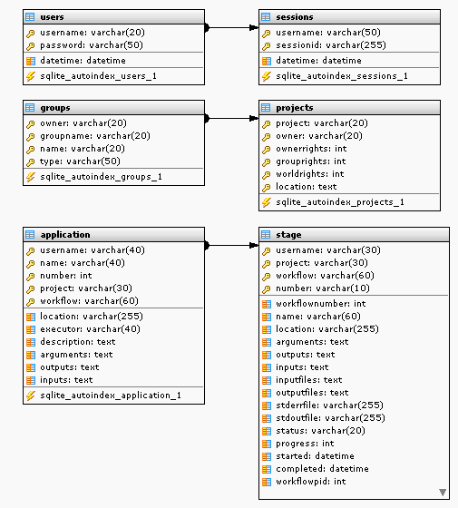
Relational database
Authentication
Administration
Workflows

Slide 29
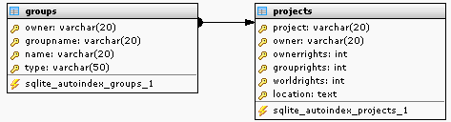
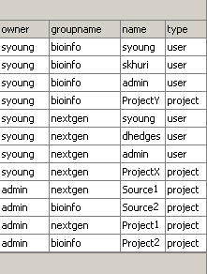
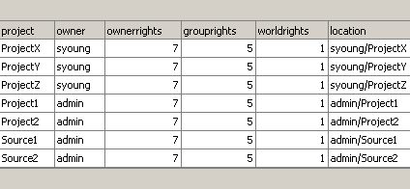
Administration tables

Slide 30
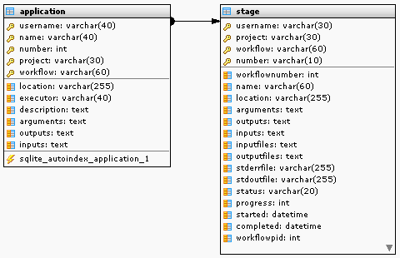
Workflow tables

Slide 31
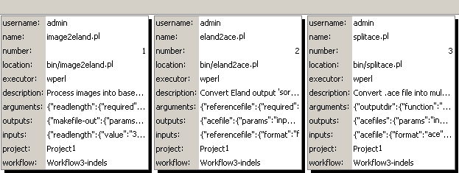
Workflow tables (cont.)
‘application’ table

Slide 32
Development roadmap
Version | Summary | Date
Alpha 0.3 | Project web file manager and User project admin. Workflow→ Report → View SNP reports: (mtDNA, exome) | Mar 30th, 2009
Beta 0.4 | View improvements: Advanced querying, data mining External sources (NCBI, UCSC) Advanced SNP verification Custom genomes (mouse, HIV) | Apr 30th, 2009
Gamma 0.5 | Advanced tools: Back-button sessions Grid distributed workflows | May 30th, 2009

Slide 33
Aqwa
Automated Query and Workflow Agent
Thank you
Stuart Young, Ph.D.
Post Doctoral Research Associate
Center for Computational Science syoung@med.miami.edu

Slide 34
UML

