Slide 1
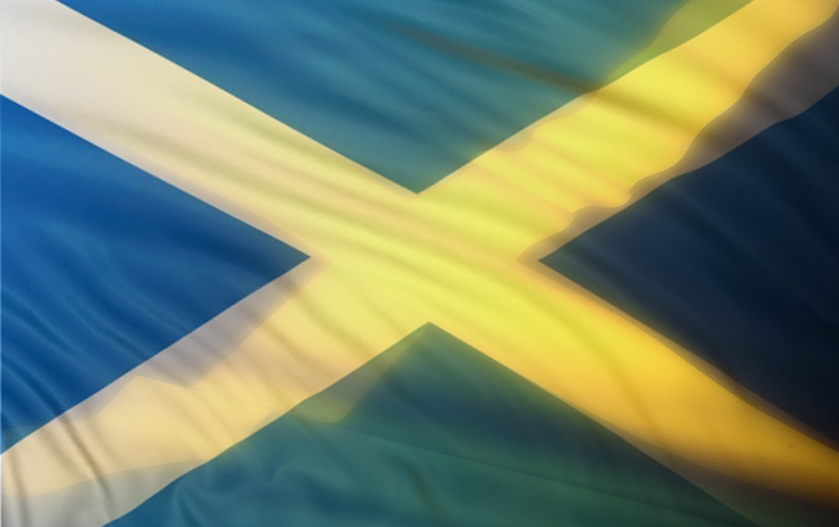
Jamaica
&
Scotland

Slide 8


Slide 9
