Slide 1
Plogger App
Task flow & UX
V0.1

Slide 2
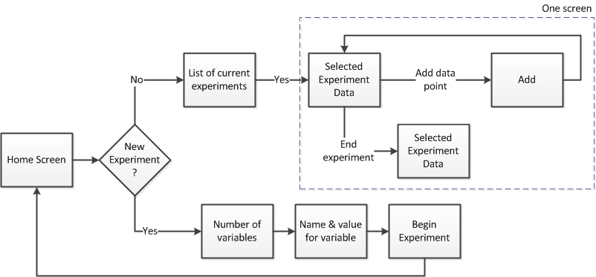
Task Flow

Slide 3
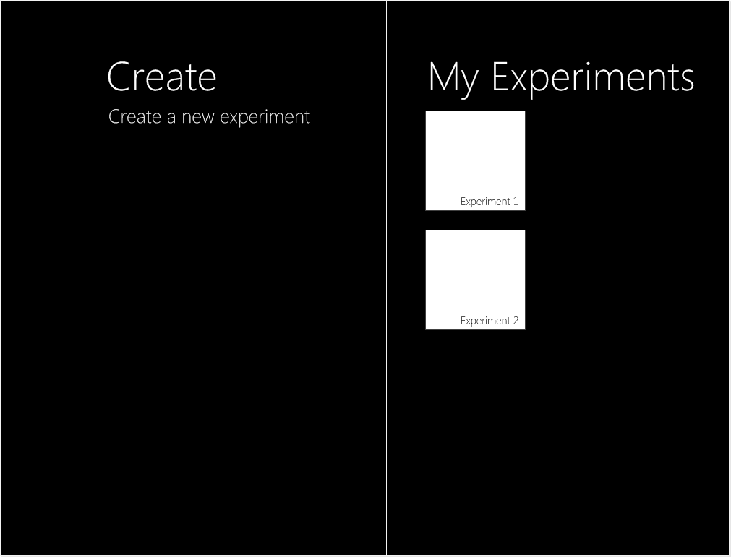
UI Level 1
UI layout using Windows 8 specifications

Slide 4
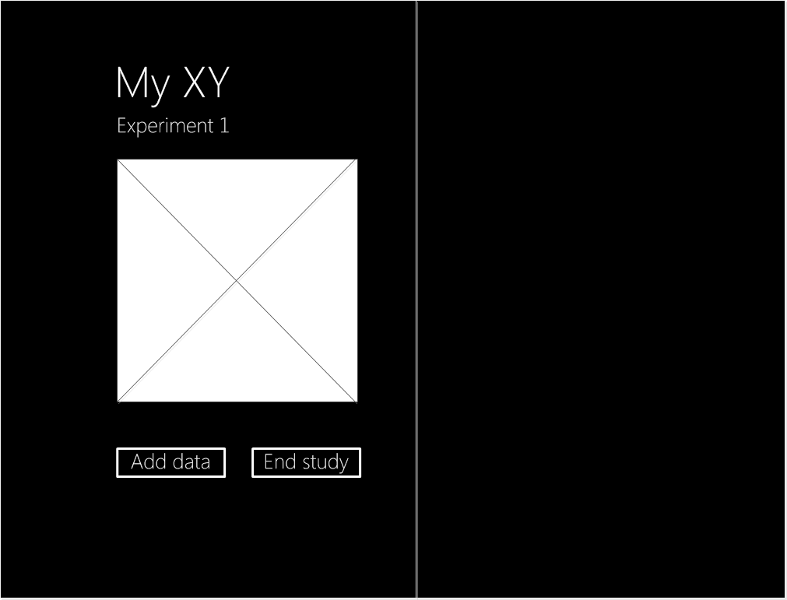
UI Level 2 – Experiment Information
UI layout using Windows 8 specifications

Slide 5
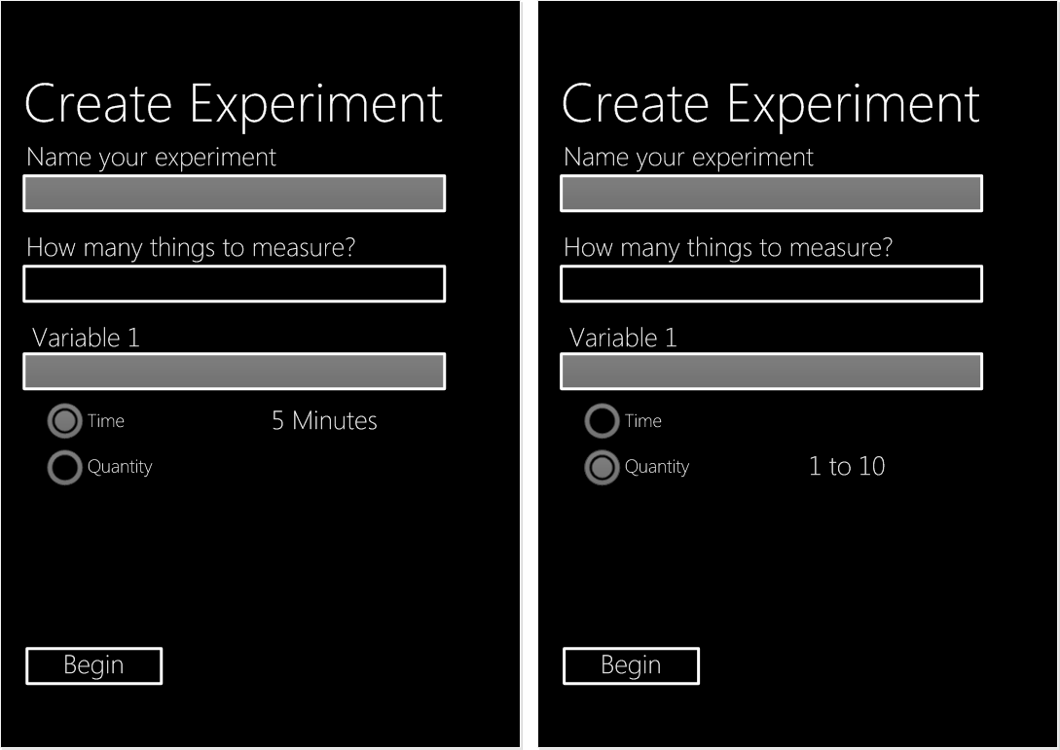
UI Level 2 – Create Experiment
UI layout using Windows 8 specifications

Slide 6
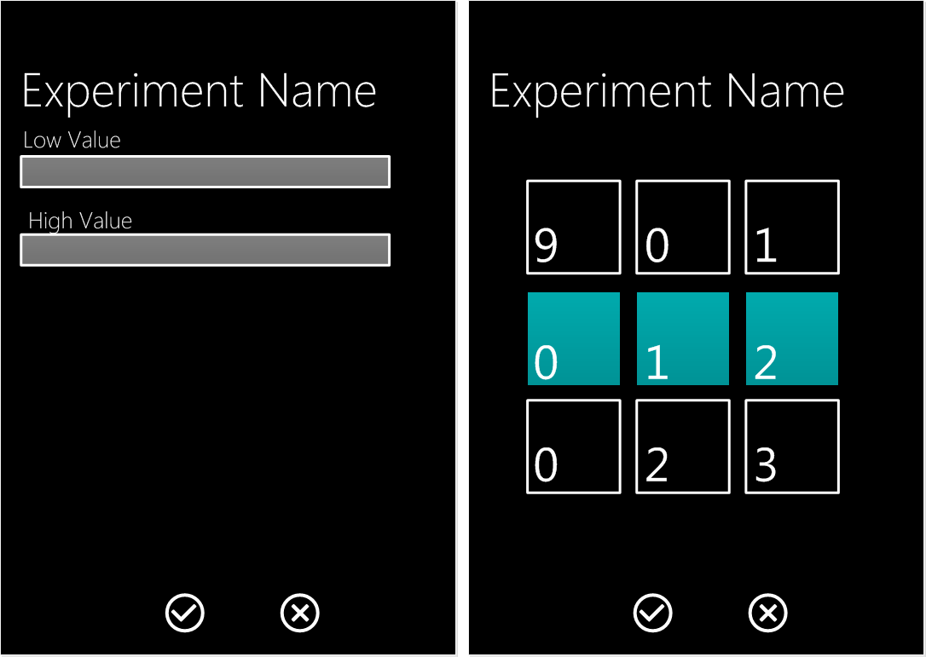
UI Level 2 –Experiment Details
UI layout using Windows 8 specifications

