Slide 1
Plogger App
Task flow & UX
V0.2

Slide 2
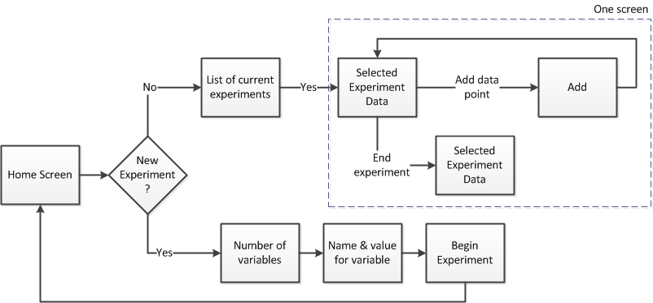
Task Flow

Slide 3
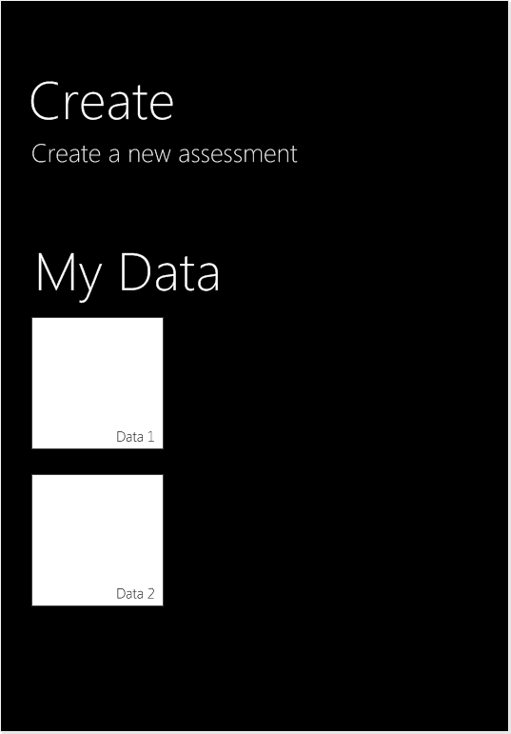
Start Screen
1
If number of My Experiments thumbnails exceeds length of page, the screen will scroll.
2
2
Interactive element. Selecting text will take user to Slide 5.
3
Interactive element. Selecting thumbnail will take user to Slide 4.
3
1
UI layout using Windows 8 specifications

Slide 4
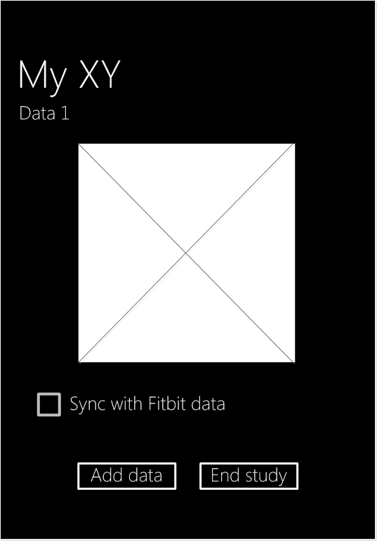
Data Information
1
Dynamic content. Visualized data chart. Layout TBD.
2
Checkbox will pull in data from FitBit. Checkbox is unchecked by default.
3
Interactive element. Selecting button will take user to Slide 9. If user checks FitBit checkbox, they must press Add Data button to refresh chart and depict combined data sets.
1
4
Interactive element. Selecting button will stop collecting data for this study. Text will change to ‘Restart’. Selecting ‘Restart’ will continue collecting data.
3
4
UI layout using Windows 8 specifications

Slide 5
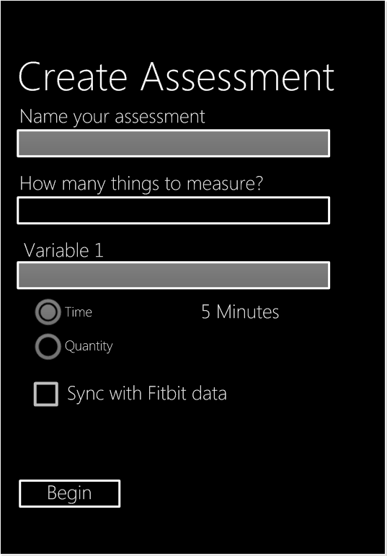
Create Assessment
1
Text field. Touching will open keyboard and accept text input.
2
Interactive element. Selecting box will open Numeric Selection Menu, Slide 6.
3
Text field. Touching will open keyboard and accept text input.
1
4
Interactive element. Mutually exclusive radio buttons will be unselected by default. Selecting Time will open Time Selection Menu, Slide 7. Selecting Quantity will open Amount Selection Menu, Slide 8. In both cases, selected time/quantity will appear to right of respective radio button. User cannot begin study unless a variable type and parameters selected.
2
3
4
5
5
Interactive element. Checkbox will get FitBit data and populate for this assessment. Checkbox is unchecked by default
6
6
Interactive element. Button will be grayed out until all fields completed. Pressing button will start data gathering. User will be returned to UI Level 1, Slide 3.

Slide 6
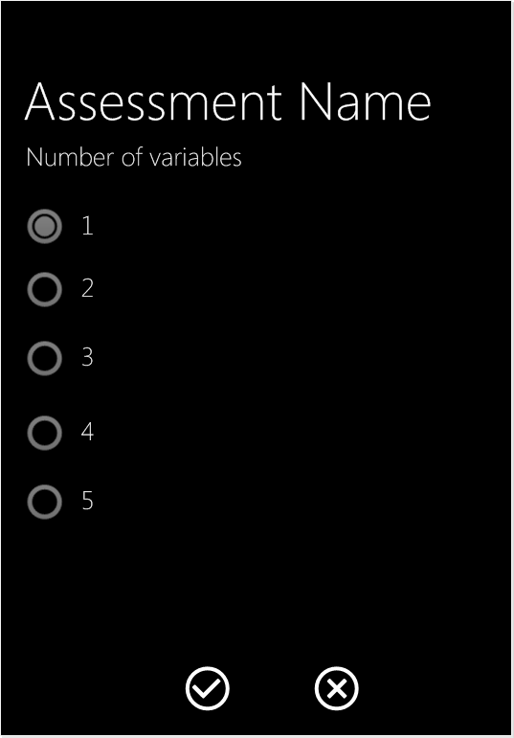
Number of Variables
1
Dynamic content. Windows Phone radio button menu from one to five. One is selected by default. Actual number of variables is TBD.
2
Interactive element. Selecting button will save selection and return user to Create Experiment screen, Slide 5.
1
3
Interactive element. Selecting button will not save selection and return user to Create Experiment screen, Slide 5.
2
3
UI layout using Windows 8 specifications

Slide 7
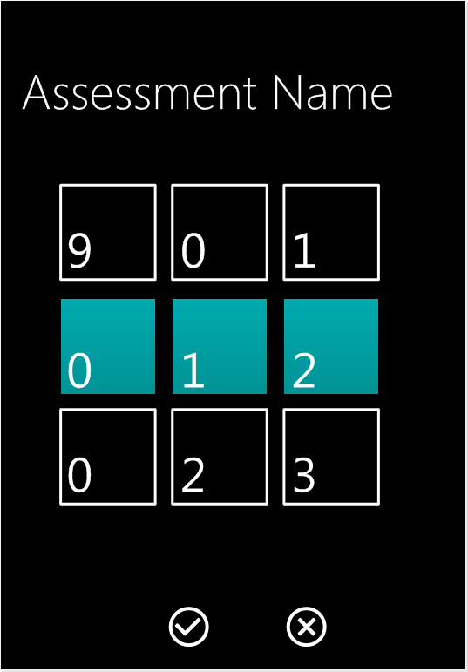
Time Variable
1
Dynamic content. Windows Phone scroller to select hour, minute, and second.
2
Interactive element. Selecting button will save selection and return user to Create Experiment screen, Slide 5.
1
3
Interactive element. Selecting button will not save selection and return user to Create Experiment screen, Slide 5.
TBD – how do we want to represent time? In clock format? Hours, minutes, seconds? How granular do we need to be?
2
3
UI layout using Windows 8 specifications

Slide 8
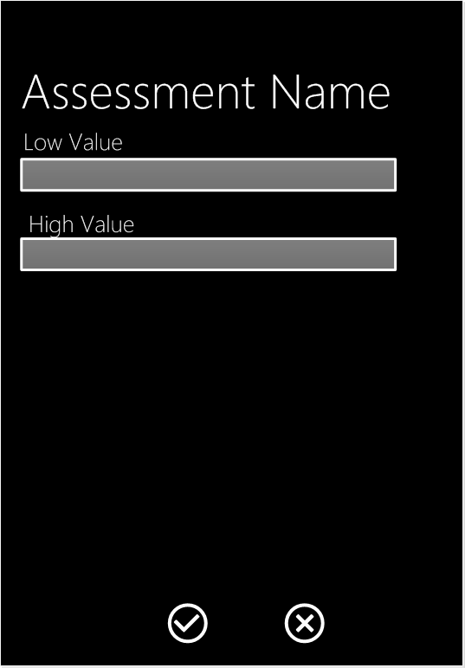
Quantity Variable
1
Text box. Touching keyboard will open keyboard. Numeric integers accepted. <TBD is there a low value that must be defined?
1
2
Text box. Touching keyboard will open keyboard. Numeric integers accepted. <TBD is there a high value that must be defined?
2
3
Interactive element. Selecting button will save selection and return user to Create Experiment screen, Slide 5.
4
Interactive element. Selecting button will not save selection and return user to Create Experiment screen, Slide 5.
3
4
UI layout using Windows 8 specifications

Slide 9
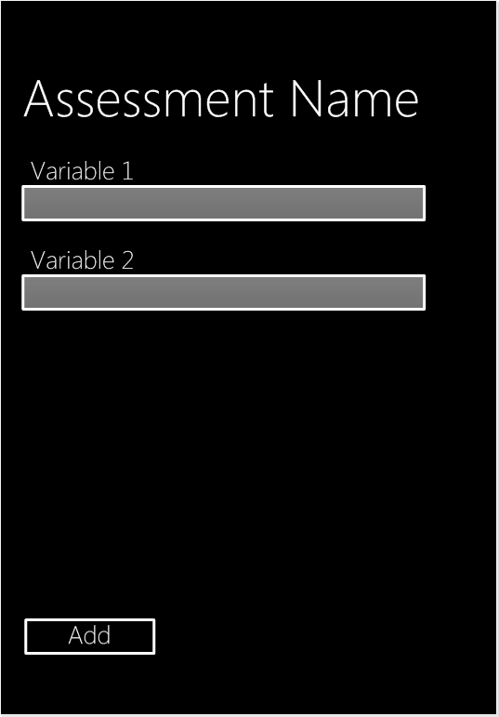
Quantity Variable
1
Both the Variable name and the Input method will be what was selected by the user in the Create Assessment screen, Slide 5. If the control is a Time variable, selecting the control will open the Time Variable screen, Slide 7. If the control is a Quantity variable, selecting the control will open the Quantity variable screen, Slide 8.
1
2
Interactive element. Pressing button will save the data. User will be returned to the Data Information screen, Slide 4.
2
UI layout using Windows 8 specifications

