Slide 1
Challenge #1: Small Screen, Fat Fingers
PPT: Siyuan Peng, Siyou Pei, Yifei Tang

Slide 2
Our goal: light, novel, fast

Slide 3
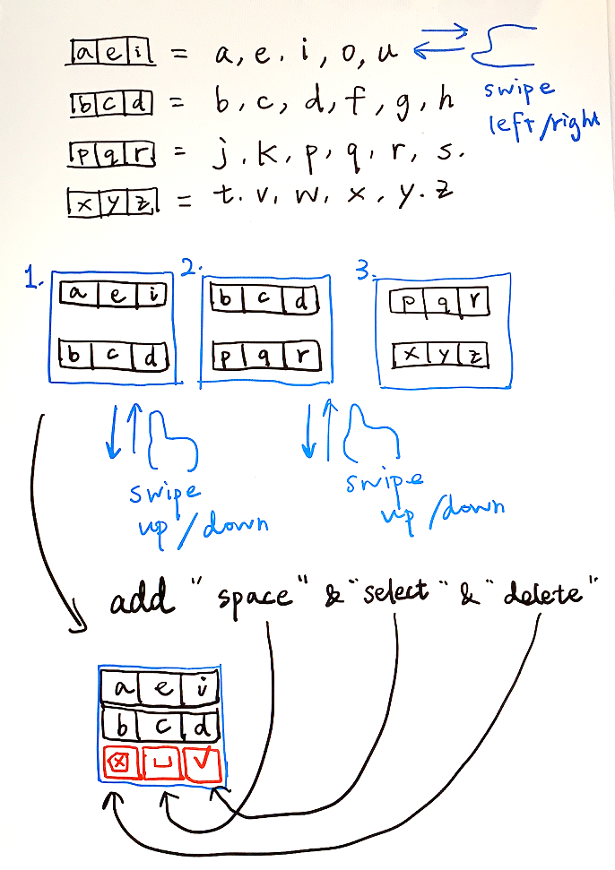
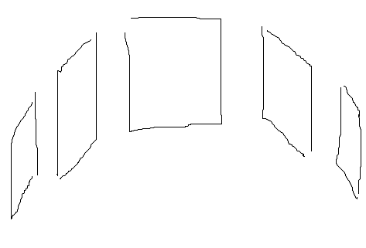
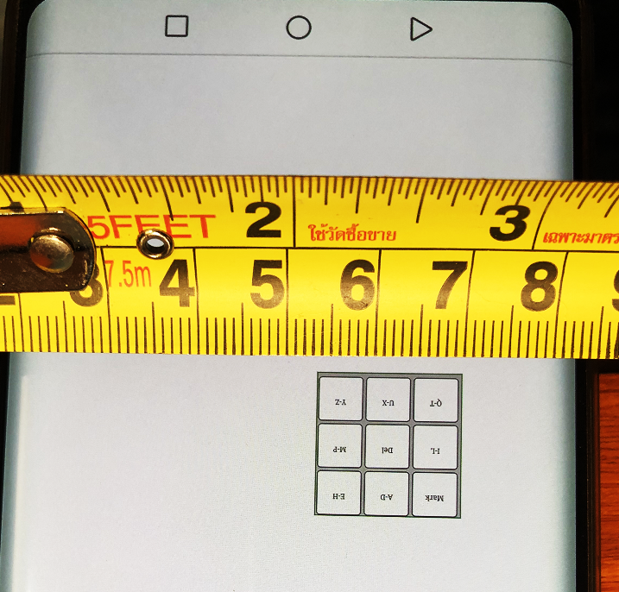
Our goal: light, novel, fast
Low-fi prototype
High-fi prototype
Notes:
Chest X-ray (CXR) images

Slide 4

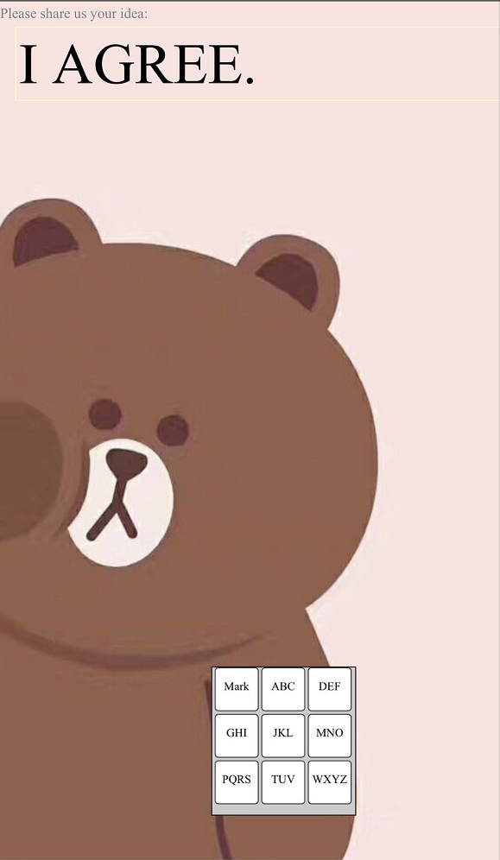
Our goal: light, novel, fast
Low-fi prototype
High-fi prototype
Notes:
Chest X-ray (CXR) images

Slide 5
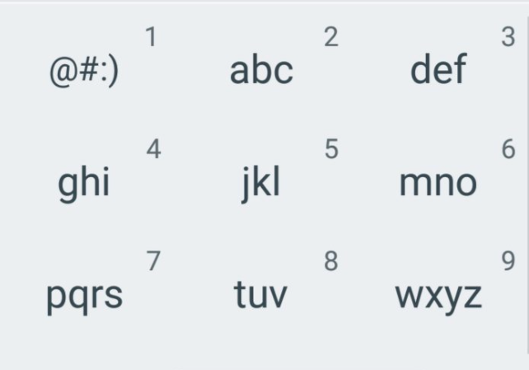
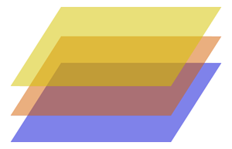
Design Ideas #1
Multiple layers
Save input area
Easy to tap
Low learning curve
Img from: https://i.imgur.com/0sCnL2Ph.jpg
Feel free to try it out here
http://sypei.com/ppt3.html
Img from: https://wizardfu.com/assets/book/cocos2d-x/SpriteDraggerX-Layers.png

Slide 6
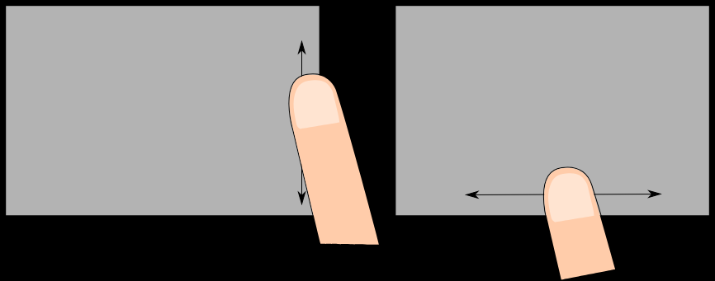
Design Ideas #2
Scrolling interface
Save input area
Smooth and natural interaction
Feel free to try it out here
http://sypei.com/test.html
Img from: https://wayland.freedesktop.org/libinput/doc/1.2.1/edge-scrolling.svg
Notes:
A paired-survey design (physicians and radiologists answer the same question set)
“what kinds of information do radiologists use to explain their examination results to you? ” v.s. “what kinds of information do you use to explain your examination results to the referring physicians?”

Slide 7
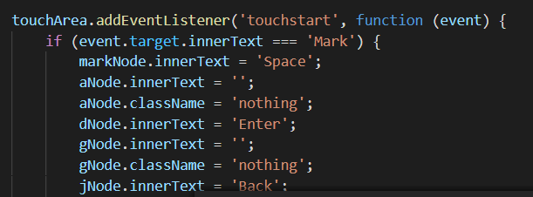
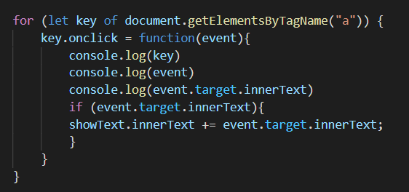
Implementation
HTML & JavaScript (utilize touch event on mobile devices)
Website Server

Slide 8
X1 Speed Video
Design Ideas #1

Slide 9
X1 Speed Video
Design Ideas #2

Slide 10
User Study
Notes:
Percentages of physicians’ ratings for grouped features.
1. drawing on specific CXR examples as evidence (offering images with different probabilities
“defines different likelihoods so I know which is statistically more likely”)
2. “I can know where AI looked at to figure out the result
3. Physicians found that both features in this category were not
directly related to helping physicians understand AI; rather,
physicians considered them as filters to help physicians target
their understanding or reduce time cost of interacting with the
system.

Slide 11
Q&A 5min
What do you think of the designs?
Which one do you prefer? Why?
What are the pros/cons of our work?
What do you think we can further improve our system?
Thank you!
Notes:
Fds
dsf

