Slide 1

YC Spring 2025 Application
Syvora Team
Feb 2025

Slide 2
AI Agents slated for exponential growth
AI Agents Market expected to grow from US $3.66B in 2023 to around US $139.12B in 2033 at a CAGR of 43.88%
Ready-to-deploy agents had dominant market-share in 2023 with 69.19% of the market
These agents expected to increase global GDP by 26% by 2030
Source: Market.us, Dec 2024

Slide 3
Environmental Concerns with AI Proliferation*
E-waste
Only 22 per cent of e-waste is recycled and disposed of in an environmentally sound manner & with exponential growth of AI Data Centers, this is currently a big concern*
Water
It is estimated that the global demand for water resulting from AI may reach 4.2–6.6 billion cubic metres in 2027 (This would exceed half of the annual water use in the United Kingdom in 2023)*
Energy Consumption
Large language models (LLMs), driving a significant increase in energy use
Single LLM query requires 2.9 watt-hours of electricity (Inferencing), compared with 0.3 watt-hours for a regular internet search*
Training a single LLM generates approximately 300,000 kg of carbon dioxide emissions, “which is five times the lifetime emissions of an average car or equivalent to 125 round-trip flights between New York and Beijing*
* UN Issue Note, 09/24, Artificial Intelligence (AI) end-to-end: “The Environmental Impact of the Full AI Lifecycle Needs to be Comprehensively Assessed”

Slide 4
Few Trends…
Accelerated Adoption of S(L)LM’s
Faced paced research & results around Knowledge Distilling & Reinforcement Learning (reference a couple of results from DeepSeek paper)
Mature recipes for domain specific distilling from larger general purpose models (eg Llama 3.2 405B) to smaller models (eg Llama 3.2 2B)
Voice LLMs driving low-latency real-time voice agents
Continuously enhancing AI acceleration capability in lower end SoC’s (Qualcomm Snapdragon, Mediatek Dimensity, AMD Versal, NVIDIA Jetson Nano, and many edge-AI semiconductor start-ups etc)

Slide 5
Important Predictions & Challenges
The HMI (Human-Machine-Interaction) is on the verge of being disrupted, driven by Voice based AI Agents
Every hardware device, appliance, machines hungry to become intelligent (ex. the legendary ”sentient” car Herbie from Walt Disney’s “The Love Bug” becoming a reality)
Accelerated movement of LLM inferencing to the edge
Key challenges to making these embedded devices intelligent & transforming their interaction with humans:
Optimized S(L)LLM’s for resource constrained hardware
Knowledge Distilling from general purpose SOTA large LLMs to these S(L)LLM’s
How to enable domain specific business experts to drive all of the above

Slide 6


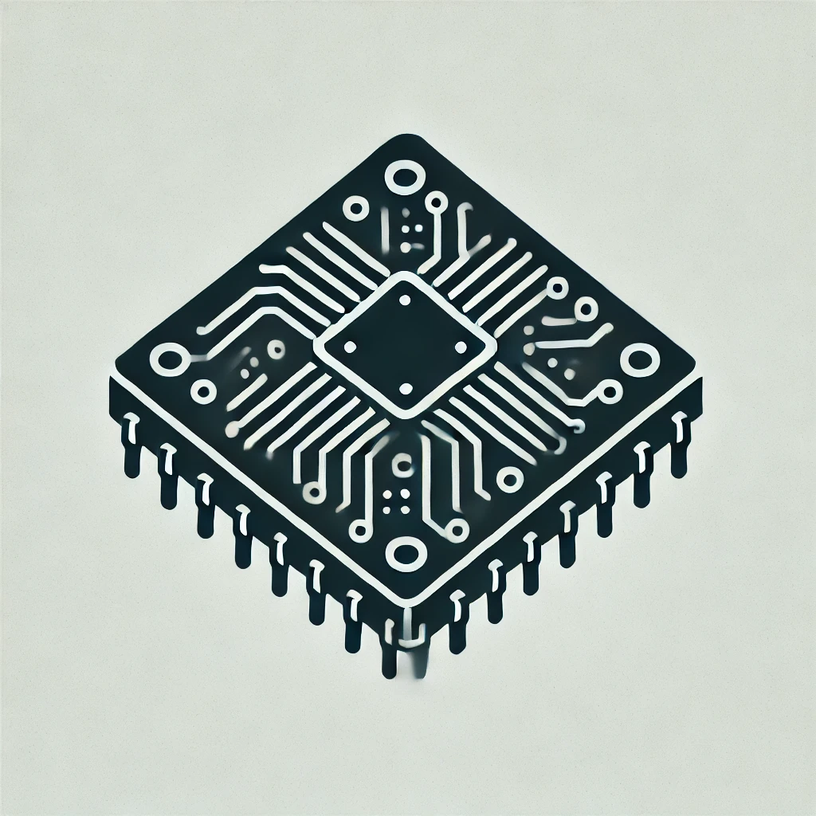
SYVORA: Solution Components
AI-Capable Hardware
Hardware Optimization
LLM Adaptation
Distillation
Domain Adaptation
sLLM Adaptation Platform
Low Code/No Code Agentic Workflow Authoring
A low code platform for authoring agentic workflows for multiple use cases
SDKs for Integration
- SDK Based integration with the product (eg. Electric Vehicle, Smart home device, plant machinery etc)
Small
Medium
Large

Slide 7
Introducing Syvora: Enabling Embedded Intelligence
Syvora enables AI-native devices with on-edge intelligence
We provide:
1. AI-optimized hardware – Cost-effective, scalable hardware for on-device AI inferencing across industries. 2. Comprehensive software stack – Tools for domain adaptation, LLM distillation, and optimization tailored to device constraints.
3. Platform for Authoring Agentic Workflows – A platform to author personalized agentic workflows, through pre trained LLMs 4. SDKs – To integrate with the environment.
With Syvora, businesses can build truly autonomous, intelligent devices—from EVs to home appliances—unlocking real-time AI capabilities without reliance on the cloud

Slide 8

Our Team
Agastya Seth
Aditya Seth
Yash Tomar
Anurag Seth
linkedin.com/in/anuragseth
Completing his post grad at Arizona State University in May 2025
Part of Cogint NLP lab, co-authored papers on LLM Safety & …
Worked as a software engineer for 3 years at Cadence
Graduated from BITS Pilani, Hyderabad in 2024
Working as a software intern at Cadence
Worked upon deployment on cutting edge ML Models.
Senior Advisor
GenAI Thought Leader
30 Years experience in deep tech – semiconductor chip design, EDA, taking multiple cloud & native AI/GenAI/ Deep-Learning applications to production
Managed large x-functional, x-geo product teams
Served as Principal AI/ML Advisor at Amazon AWS and nurtured the AI/ML Startup eco-system in APAC
Senior management roles at Cadence, Motorola, Kawasaki
Entrepreneurship, Venture Capital & Startup Mentoring

Slide 9
Embedded Systems Market
Source: MMR
Source: Precedence Research
Automotive Embedded Market expected to grow at CAGR of 8% to about US $60.5B in 2032 *
*Source: Global Market Insights

Slide 10
Edge AI: Total Market Sizing
Assuming 7% spend on Embedded AI enablement in 2023, growing at 10% CAGR
Corresponding Global Edge/Embedded AI market in 2032 expected to be around US $12B
Source: Global Market Insights

Slide 11
Business Model
Primarily B2B
 | Pricing
Hardware | Target Selling Price: Rs. 15000 (L), Rs. 9000 (Medium), Rs. 3500 (Small)
SDK License | $5 per month per car
Syvora Platform License | $49 per user per month
Monthly subscription per car | $5.0
Hardware Cost | $175.0
Svora platform subscription per month per user (average) | $49.0
 | Y1 | Y2 | Y3 | Y4 | Y5 | Y6 | Y7
# Cars | 0 | 10,000 | 35,000 | 100,000 | 200,000 | 360,000 | 720,000
# Users on Svora Platform | 0 | 50 | 200 | 500 | 1,500 | 5,000 | 15,000
Subscription Revenues |  | $600,000 | $2,100,000 | $6,000,000 | $12,000,000 | $21,600,000 | $43,200,000
Hardware Revenues |  | $1,750,000 | $4,375,000 | $11,375,000 | $17,500,000 | $28,000,000 | $63,000,000
Platform subscription revenues |  | $29,400 | $117,600 | $294,000 | $882,000 | $2,940,000 | $8,820,000
US $million |  | $2.38 | $6.59 | $17.67 | $30.38 | $52.54 | $115.02

Slide 12
GTM Strategy
Phase | Goal | Strategy | Outcome | Timelines
Beta Phase | Establish PMF for Automotive sector | Founder-led initial customer acquisition | - 2-3 POCs completed; at least 1 paying customer | 12m
Scaling automotive sector | Scaled, self-sustaining growth in automotive sector | Internal sales team, and partner led growth in automotive; establish US, Europe & Korea GTM | Target 3-3-2-2-2 revenue growth pattern from automotive | 12m >
Broad-basing solution for all sectors | Establish PMF and service partner led strategy for other sectors | Internal sales team and service partner led deployments |  | > 18m

