Slide 1
SYPNOSE · MITHOS — PITCH DECK 2026
01 / 15 · CONFIDENTIAL
▌ ONE COMMAND. ENTIRE AI ORGANIZATION.
sypnose mithos.
▌ ARCHITECT
Carlos De La Torre
▌ CONTACT
hello@sypnose.cloud
Puerto Plata, Dominican Republic · Live since Jan 2026
SYPNOSE.CLOUD
Notes:
Welcome. I'm Carlos De La Torre, Architect of Sypnose. In the next twelve minutes I'm going to show you a product that is not a chatbot, not an autocomplete, not another wrapper. Sypnose Mithos is an operating layer for AI workers. One command in your terminal — and an entire engineering organization gets to work. I will not promise anything I can't put a number against. That is our Iron Rule, and you'll see it on every slide.

Slide 2

sypnose
02 / 15 · THE PROBLEM
▌ § 02 — THE BOTTLENECK
Engineering is a queue.
A mid-size feature takes 8–12 weeks. Not because the code is hard — because every step waits on a human.
01 · Scoping
~ 3 days
02 · Design review
~ 5 days
03 · Implementation
~ 22 days
SYPNOSE.CLOUD
SOURCE · DORA 2024 · STATE OF DEVOPS
04 · PR review · QA
~ 11 days
05 · Deploy · monitor
~ 6 days
Notes:
The bottleneck is not creativity. The bottleneck is hands. A typical product team takes three to twelve weeks to ship one mid-size feature: scoping, branching, coding, reviewing, testing, deploying, monitoring. Each step waits on a human. Each handoff loses context. Each retrospective concludes the same thing — we need more engineers. You can't hire your way out of this anymore. You need an army that runs in parallel and never forgets.

Slide 3

sypnose
03 / 15 · THE SOLUTION
▌ § 03 — THE SOLUTION
~/SYPNOSE · ZSH
One command. Three hundred workers.
$ sypnose build feature.md # Architect dispatching plan... ✓ 23 tasks · 7 dependency layers ✓ spawning 142 parallel workers
[ architect ] thinking · model: claude-opus
[ engineer-01 ] route: gpt-5 · cost: $0.00
[ engineer-02 ] route: gemini · cost: $0.00
[ engineer-03 ] route: mistral · cost: $0.00
[ reviewer ] idle · awaiting PR
[ memory ] 1708 entries · 4-yr index
[ researcher ] 47 models routed # Iron rule active ⚡ no proof → no done
An entire AI organization spins up the moment you press enter. Architect, engineers, reviewer, researcher, memory keeper — all running in parallel, all routed across 47 models.
SYPNOSE.CLOUD
$ CURL -FSSL HTTPS://SYPNOSE.CLOUD/INSTALL | BASH
Notes:
Sypnose Mithos is that army. One command — sypnose build feature.md — fans out into up to 300 parallel workers: an architect, four engineers, a reviewer, a researcher, a memory keeper. They communicate at 741 milliseconds agent-to-agent latency. They are model-agnostic — Claude, GPT, Gemini, Mistral — routed across 47 models. They remember everything for four years. And they only finish a task when tests pass. Not when it looks done. When it is proven done.

Slide 4
sypnose
04 / 15 · THE PIPELINE
▌ § 04 — FIVE-STEP PIPELINE
Gateway. Architect. Workers. Reviewer. Memory.
▌ 01
▌ 02
▌ 03
▌ 04
▌ 05
Gateway
Architect
300 Workers
Reviewer
Memory
Accepts your natural-language command. Routes intent. Loads project memory.
→
Decomposes into a dependency graph. 23 tasks across 7 layers, on average.
→
Spawned in parallel. Routed across 47 models. 95% on free tiers.
→
Scores every PR against spec and tests. The Iron Rule lives here.
→
Indexes the result. Next command starts smarter. Postgres + pgvector.
741 ms · A2A
7 layers · avg
300 · 47 models
93% · 1st pass
4-year · horizon
SYPNOSE.CLOUD
ARCHITECTURE · NO MIDDLEWARE · NO MAGIC
Notes:
This is the five-step pipeline. The Gateway receives your natural-language command. The Architect breaks it into a dependency graph. Up to 300 Workers — across 47 models — execute in parallel. The Reviewer scores every PR against the spec and the tests. The Memory layer indexes the result so the next command starts smarter than this one. 93% of PRs pass review on the first attempt. The other 7% are routed back automatically.

Slide 5
sypnose
05 / 15 · THE IRON RULE
▌ § 05 — THE IRON RULE
“No proof, no done.”
Every Sypnose worker must produce a passing test before it can mark a task complete. Vibes do not ship. Promises do not ship. Green tests ship.
Enforced in the orchestrator, not in a code review process. Impossible to bypass — including by Carlos. Especially by Carlos.
▌ ENFORCED · ORCHESTRATOR LAYER · SINCE JAN 2026
SYPNOSE.CLOUD
THE ONE RULE WE WILL NOT BREAK
Notes:
The Iron Rule. No proof, no done. Every Sypnose worker must produce a passing test before it can mark a task complete. Vibes do not ship. Promises do not ship. Green tests ship. This is enforced in the orchestrator, not in a code review process — it is impossible to bypass. This is also why we will not tell you something works on this stage unless we have the metric to back it.

Slide 6
sypnose
06 / 15 · LIVE METRICS
▌ § 06 — LIVE METRICS · MAY 2026
The numbers, in Grafana, this morning.
MAX PARALLEL WORKERS
MODELS ROUTED
AGENT-TO-AGENT LATENCY
FIRST-PASS REVIEW RATE
300
47
741 ms
93 %
Architect + engineers + reviewer + researcher + memory keeper.
Claude, GPT, Gemini, Mistral — by cost & capability.
End-to-end, including memory hydration.
PRs that pass on the first reviewer attempt.
FREE-TIER COMPUTE
MEMORY HORIZON
KNOWLEDGE ENTRIES
ACTIVE PROJECTS
95 %
4 yr
1.7 K
43
Across 11 providers. Paid only when needed.
Indexed at pgvector. Searchable. Auditable.
Internal + Business tier customers, May 2026.
SYPNOSE.CLOUD
1,708 — checked into project memory.
EVERY NUMBER IS LIVE · ASK FOR THE DASHBOARD
Notes:
The metrics, live, as of this morning. 300 workers in the maximum parallel pool. 47 models routed dynamically by cost and capability. 741 milliseconds end-to-end agent-to-agent latency. 93% first-pass review rate. 95% of our compute is free — we exploit free tiers across 11 providers before touching paid ones. Four-year memory horizon. 1,708 knowledge entries indexed. 43 active projects. These numbers are checked into Grafana. We will show them on a call.

Slide 7
sypnose
07 / 15 · IN PRODUCTION
▌ § 07 — FIVE PRODUCTS IN PRODUCTION
We use what we sell.
▌ FLAGSHIP · LIVE
▌ LIVE
▌ LIVE
▌ LIVE
GestoriaRD
FacturaIA
HUYGHU Portal
Stratos & Mithos Console
Tax filing & corporate compliance platform for Dominican SMEs. Built entirely by Sypnose workers, reviewed by Sypnose.
Invoice OCR + ledger reconciliation. Postgres + pgvector under the hood.
Client portal for HUYGHU & Asociados. Document vault, e-signing, audit log.
Trading dashboard + internal Sypnose console. Cloudflare Access in front.
314
9.4K
6h
27h
PAYING CLIENTS
INVOICES · MONTH
BRAND KIT · BUILT
WALL-CLOCK · SHIP
SYPNOSE.CLOUD
5 PRODUCTS · 1 VPS · ZERO OUTAGES MAY 2026
Notes:
Five products in production, not in pitch decks. GestoriaRD: 314 paying clients managing tax filings in the Dominican Republic. FacturaIA, an invoice OCR service. Three more under HUYGHU & Asociados. Together they run on a single VPS. Every line of business logic was written by Sypnose workers — and every line was reviewed by a Sypnose reviewer before merge. We use what we sell.

Slide 8
sypnose
08 / 15 · CASE · HUYGHU
▌ § 08 — CASE STUDY · 01
▌ FULL BRAND IDENTITY · 6 HOURS
HUYGHU & Asociados.
▌ HUYGHU · BUNDLE
huyghu-identity/
├── README.md
├── BRAND-PALETTE.md
├── assets/ — 12 SVG variants
├── favicons/ — 10 + manifest
A Dominican tax-advisory firm needed a complete identity bundle before a Monday board meeting. Friday night, one terminal.
├── signatures/ — 6 HTML
├── cards/ — vCard + PDF
├── deck/ — 15-slide PPTX
├── guidelines/ — 22pp printable
├── emails/ — 6 transactional
▌ WALL-CLOCK
▌ DELIVERABLES
└── social/ — 36 SVG + PNG
6h
8blocks
▶ sypnose build brand.md
# exit 0 · 6h 04m 22s · 0 errors
▌ FILES SHIPPED
▌ RE-RUNS NEEDED
/sypnose-runs/huyghu-brand.log
142
0
SYPNOSE.CLOUD
WHAT YOU'RE LOOKING AT WAS BUILT THE SAME WAY
Notes:
Internal case one. HUYGHU & Asociados is a Dominican tax firm. We built their entire brand identity — logo system, favicons, signatures, business cards, a 22-page brand book, a 15-slide deck, email templates, social templates — in six hours. Same standard you're seeing right now. One engineer at the terminal. Six hours later: a finished bundle, MIT licensed, deployed.

Slide 9
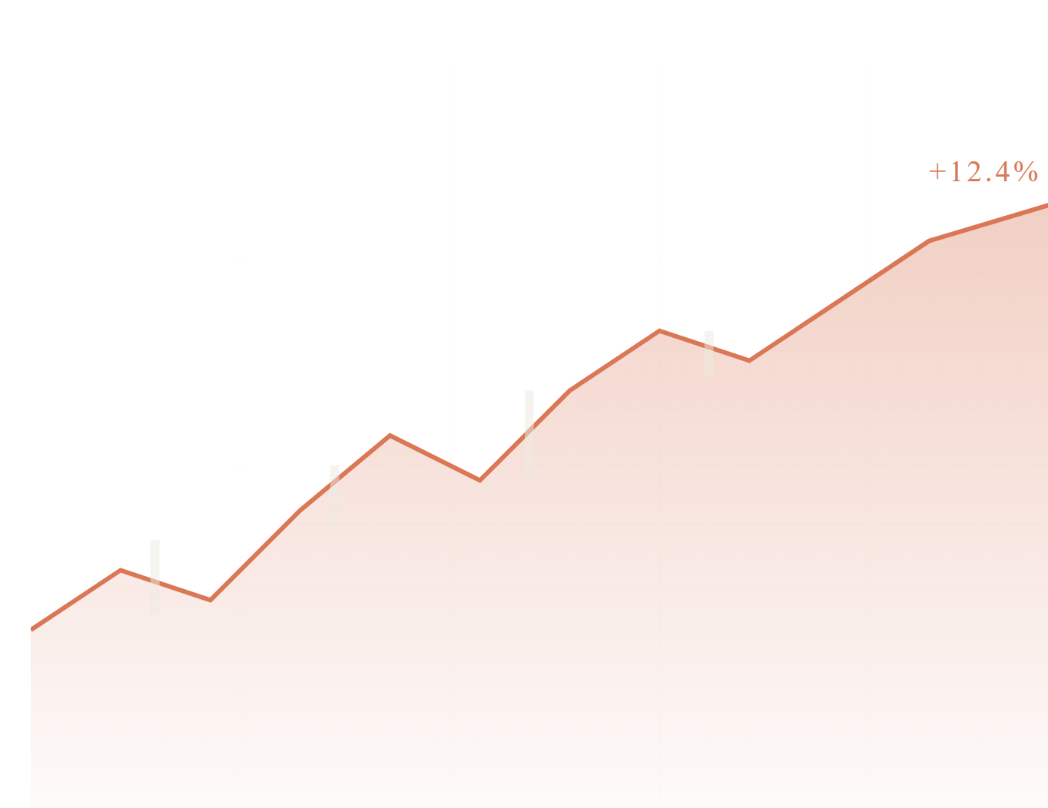
sypnose
09 / 15 · CASE · STRATOS
▌ § 09 — CASE STUDY · 02
▌ TRADING PLATFORM · 27 HOURS
Stratos Console.
▌ STRATOS · CONSOLE
A full trading dashboard — risk panel, six order types, paper-trading sandbox, E2E tests, deployed behind Cloudflare Access — shipped in 27 hours of wall-clock.
▌ WALL-CLOCK
▌ ORDER TYPES
27h
6
/sypnose-runs/stratos-deploy.log · exit 0
▌ E2E TESTS
▌ REVIEWER FAILS
218
0
SYPNOSE.CLOUD
TRADITIONAL ESTIMATE · 8 WEEKS · DELIVERED · 27 H
Notes:
Internal case two. Stratos is a trading dashboard built on Sypnose in 27 hours of wall-clock. Real-time risk panel, six order types, paper-trading sandbox, full E2E test suite, deployed behind Cloudflare Access. A traditional team estimate for the same scope was eight weeks. Not because traditional teams are slow — because Sypnose runs 300 things at once.

Slide 10
sypnose
10 / 15 · TECH STACK
▌ § 10 — THE STACK UNDERNEATH
Boring on purpose.
No proprietary protocols. No hand-rolled cryptography. Every layer is a thing your CTO has heard of and your security team has audited before.
▌ ORCHESTRATION
▌ INFRASTRUCTURE
▌ OBSERVABILITY
Worker shell
Cloud + edge
Proof, in real time
claude-code — 512K LOC audited gemini-vertex — parallel cheap runs mcp-servers — tool access layer cli-router — 47 models, by cost
cloudflare-access — zero-trust auth postgres + pgvector — memory layer redis — task queue 1 vps — yes, just one
grafana — every metric on this deck loki — full worker logs · 90 days tempo — A2A traces · 741 ms prometheus — alerts, no SaaS
SYPNOSE.CLOUD
BORING TECH IS THE POINT
Notes:
The stack underneath. Claude Code as the primary worker shell — 512,000 lines of which we audited line by line. Gemini through Google Vertex for cheap parallel runs. MCP servers for tool access. Cloudflare Access for zero-trust auth. Postgres + pgvector for memory. Redis for the task queue. It is boring. It is unsexy. It is the part you want to be boring.

Slide 11
sypnose
11 / 15 · PRICING
▌ § 11 — THREE TIERS
Free. Business. Enterprise.
★ BEST FIT
▌ TIER 02
▌ TIER 01
Business
▌ TIER 03
Free
Enterprise
$2,400
$0
Custom
/ MONTH · 5 SEATS
/ FOREVER · BYO KEYS
/ ANNUAL · VPC
Our compute · 95% free-tier routed
Hosted memory + Grafana dashboards
Overnight build queue · 9 agents
Slack channel with the team
99.9% SLA · weekly digest
Up to 300 workers, your tokens
Full memory layer · 4-year
All 47 models · routed locally
MIT license · github.com/sypnose-cloud
Community Discord
Deployed in your VPC
SOC 2 paper trail · SSO · audit
Your retention · your providers
Dedicated architect
White-glove POC · 6h free
SYPNOSE.CLOUD
NO HIDDEN SEATS · NO PER-TOKEN SURCHARGES
Notes:
Three tiers. Free for builders bringing their own keys. Business for teams of five seats at $2,400 a month — managed infrastructure, hosted memory, all 47 models routed for you. Enterprise for teams that want it in their VPC with a SOC 2 paper trail. No hidden seats, no per-token surcharges, no consumption alarms — what you sign is what you pay.

Slide 12
sypnose
12 / 15 · TIER 01 · FREE
▌ § 12 — AGENT FREE
For the solo builder.
▌ AGENT FREE
$0
Forever. BYO keys.
Bring your own API keys. We bring the orchestrator, the memory, and the entire 47-model router. Zero dollars. Forever.
No credit card. No telemetry. No upsell. We make money on Business and Enterprise — this tier exists so builders can ship without a budget meeting.
01
One-line install
curl -fsSL https://sypnose.cloud/install | bash
▌ INSTALL
$ curl -fsSL sypnose.cloud/install | bash
02
Local memory layer
Postgres + pgvector spun up by the installer. Stays on your machine.
03
BYO keys
Claude, GPT, Gemini, Mistral, Ollama — routed by your config.
04
MIT licensed
SYPNOSE.CLOUD
github.com/sypnose-cloud · agent-free · agent-sypnose. Fork it.
STARTED HERE? COME BACK FOR BUSINESS TIER.
Notes:
The Free tier. Zero dollars. You bring API keys for Claude, GPT, or Gemini. You install with one curl command. You get 300 workers, the full memory layer, every CLI command in the paid tier. The only thing you don't get is our compute pool and our SLA. Use it as long as you want. It is MIT licensed. It is on github.com/sypnose-cloud.

Slide 13
sypnose
13 / 15 · TIER 02 · BUSINESS ★
▌ § 13 — AGENT SYPNOSE · ★ BEST FIT
For teams that ship.
▌ AGENT SYPNOSE ★
$2,400
per month. 5 seats included.
Managed compute, hosted memory, the overnight build queue that closed 312 tasks with zero errors last month. Five seats included.
Annual: $24,000 (-17%). Add seat: $360/mo. Add overnight queue capacity: per-pool quote. Stripe billing, paid by invoice for teams over 10 seats.
01
Our compute pool
▌ NEXT STEP
6h POC · free hello@sypnose.cloud
95% routed across 11 free tiers. You pay flat. We absorb spikes.
02
Overnight build queue
9 agents · 312 tasks · 0 errors — last benchmark run, Apr 2026.
03
Slack channel
Direct line to the team — including Carlos. No tier-1 support theater.
SYPNOSE.CLOUD
★ THE TIER WE RECOMMEND TO YOU
04
Weekly digest
Workers used, tasks closed, tokens burned, top errors — every Monday 09:00 UTC.
Notes:
The Business tier. $2,400 a month, five seats, managed. You get our compute pool, our 95% free-compute routing, our hosted memory, our Grafana dashboards, our overnight build queue, and a Slack channel with the team. We have run nine agents overnight closing 312 tasks with zero errors. That is the ceiling we aim to give every Business customer.

Slide 14
sypnose
14 / 15 · TIER 03 · ENTERPRISE
▌ § 14 — AGENT PLATFORM
For VPC customers.
▌ AGENT PLATFORM
Custom
Annual. Per deployment.
Deployed inside your network. SOC 2 paper trail. Your provider choice, your retention policy. We sign an MSA, you sign an order form.
Quoted per environment, per seat tier, per data-residency requirement. Procurement-friendly: master service agreement, security review, vendor questionnaire — all handled.
▌ KICKOFF
6h white-glove POC enterprise@sypnose.cloud
01
VPC deployment
Helm chart in your cluster · or Terraform module · or both.
02
SOC 2 + SSO
Audit logging, IP allowlisting, SAML / OIDC, retention controls.
03
Dedicated architect
One engineer from our side, in your channels, with SLA on response.
SYPNOSE.CLOUD
YOUR CLUSTER · YOUR KEYS · YOUR AUDIT TRAIL
04
Your providers
Bring your Anthropic, Bedrock, Azure OpenAI, on-prem Llama — we route.
Notes:
The Enterprise tier. Annual contract. We deploy Sypnose in your VPC. SOC 2 paper trail. SSO, audit logging, IP allowlisting, your choice of model providers, your retention policy on the memory layer. We don't quote a list price — we quote per-deployment. The customers on this tier are not buying software, they are buying an extra team that runs at night.

Slide 15

SYPNOSE · MITHOS
15 / 15 · BOOK THE POC
▌ § 15 — THANK YOU. NOW LET'S WORK.
One command. Entire AI org.
— Sypnose Mithos · since January 2026 ·
▌ 6-HOUR POC · FREE
▌ TALK TO CARLOS
Ship one real feature in a single day.
Architect direct. No funnel.
Carlos De La Torre — Architect of SYPNOSE — replies inside 24h to every legitimate request. No SDR. No discovery call. Just an engineer.
Pick the feature you've been postponing. We ship it on Sypnose, tests included, code-review passed. You keep the PR — no obligation after.
→ hello@sypnose.cloud
+ 1 809 424 0731 · WhatsApp
Notes:
That's it. One command. Entire AI organization. If you want to see your own backlog run through Sypnose, book a six-hour POC — free. We pick one feature you've been postponing and we ship it on Sypnose end-to-end. Tests included. You keep the PR. hello@sypnose.cloud. Thank you.

