Slide 1
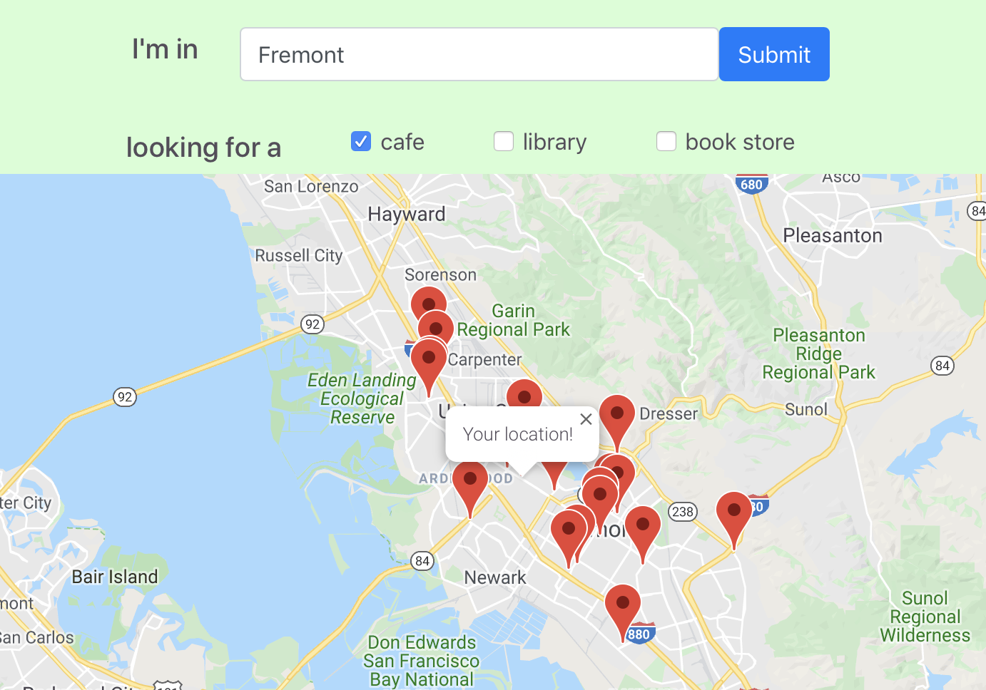
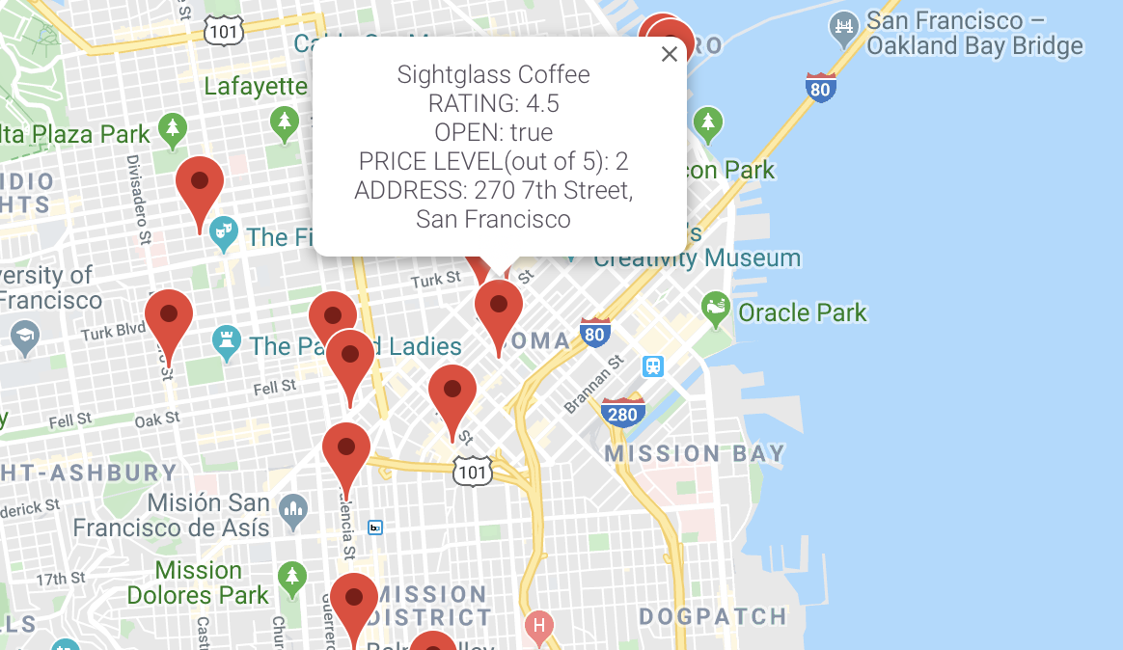







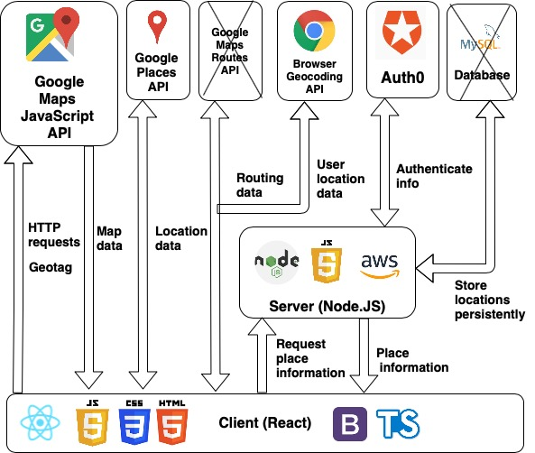


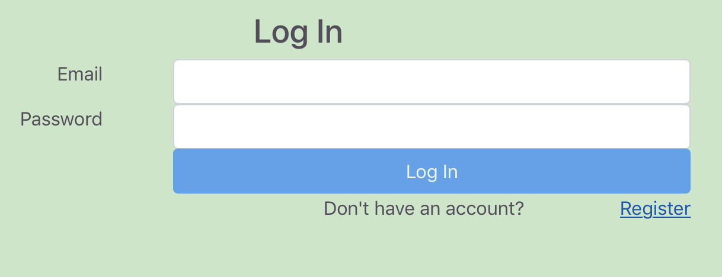
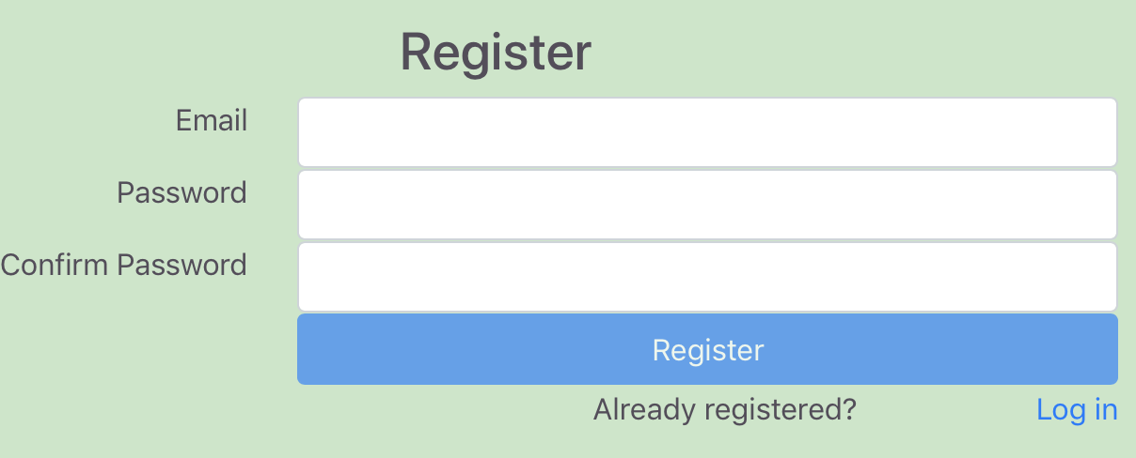
Implementation
Study Seat
Team Study Seat
Utilizing React library, Study Seat is built with the client project nested inside the server project. The intentional separation of client and server code provides better clarity and simplicity to navigate and view.
Study Seat is written in HTML/CSS and TypeScript. The choice to use TypeScript over simply just JavaScript is due to the fact that TypeScript offers static type analysis with features such as modules and classes. It’s great for projects with multiple developers.
Leveraging Google Maps and Places API, Study Seat is able to offer clients a highly interactive and dynamic hands-on experience in their search for study spots.
Instead of implementing a database, auth0 is used for authentication and login verifications.
The project is then hosted on our Amazon Web Service’s Elastic Beanstalk using a Node.Js server instance. Hosting on AWS ensures constant uptime and AWS provides reliability, scalability and security.
Last but not least, to further ensure the client’s safety and privacy, Study Seat’s Domain and Nameserver is transferred from GoDaddy using AWS’s Route53 and then certified using AWS’s Certification Manager. This lets Study Seat run using Hypertext Transfer Protocol Secure or HTTPS.
SEAN HINDS, JOHN YOON, HSIANG LO
https://www.study-seat.com
https://www.github.com/JohnYoon13/StudySeat
Whether it's a café, a library, or even a bookstore, great places nearby to study or to get some work done are only clicks away!
Description
Utilizing Google Maps and Places API, users are able to dynamically interact with a live map that is complete with info windows that display the up-to-date address, rating, price range, and hours. Furthermore, Study Seat’s website is being hosted on Amazon Web Service, providing constant and reliable up-time. Lastly, user information is authenticated and stored through Auth0 and Study Seat is certified and uses https for more reliable connections. This ensures that the client’s personal information is safe and secure.
Study Seat can locate user’s location or utilizing a string input to find/filter places nearby dynamically using Google Maps & Places API.
Tools
User can register and login in on Study Seat utilizing Auth0 for authentication and privacy
Clicking on an info window displays up-to-date information about that location.
Features
Allow the user to dynamically interact with Study Seat using the up-to-date live Google Map on the website to look for a place to study.
User may either enter a location or utilize Study Seat’s built-in function to locate the user and find places near them automatically.
When the location is set, the user may filter the results by categories such as café, library, or bookstore.
User may then click on information markers which are connected to Google’s places database that is constant and up-to-date to display more information about a location such as its name, address, rating, price range, and hours.

