Slide 1

gganimate
Connor Hanan, IST 421

Slide 2
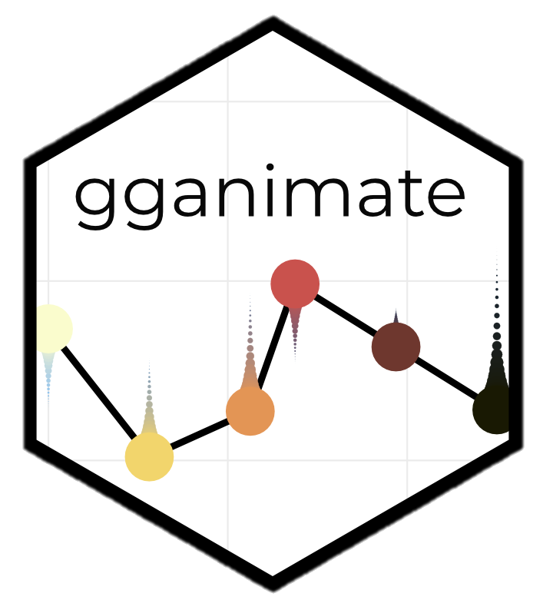
What is gganimate?
An extension of ggplot2
Creates a new class of object known as ‘gganim’
Utilizes the ‘gifski’ and ‘av’ packages for rendering
Saves as gif or mp4, respectively

Slide 3
Syntax
All added on to the end of existing ggplot code as a new layer
transition_*() – code defining what type of transition
components, events, filter, layers, reveal, states, time
enter_*() – code defining how new data should appear
appear, fade, grow, recolor, fly, drift
exit_*() – exactly the same as `enter_*()` but for how data leaves
exactly the same options as well
shadow_*() – determines how the other points should appear
mark, trail, wake
ease_aes() – controls how a value changes from one to another
functions: quadratic, cubic, sine, exponential, elastic, bounce, etc.
modifiers: -in, -out, -in-out

Slide 4
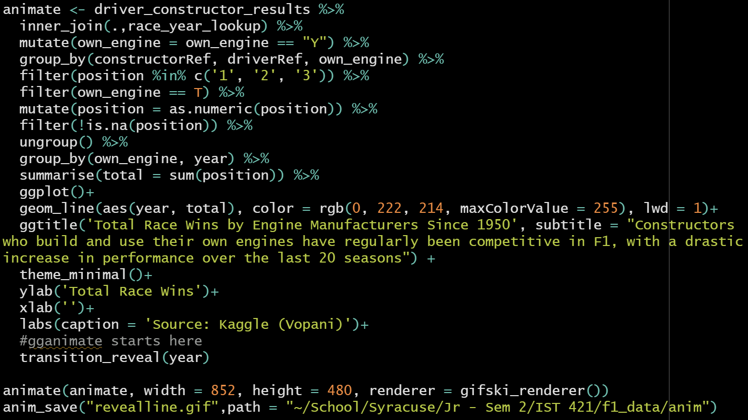
Sample Code
regular dplyr and ggplot
gganimate and save functions

Slide 5
Resulting Visualization

Slide 6
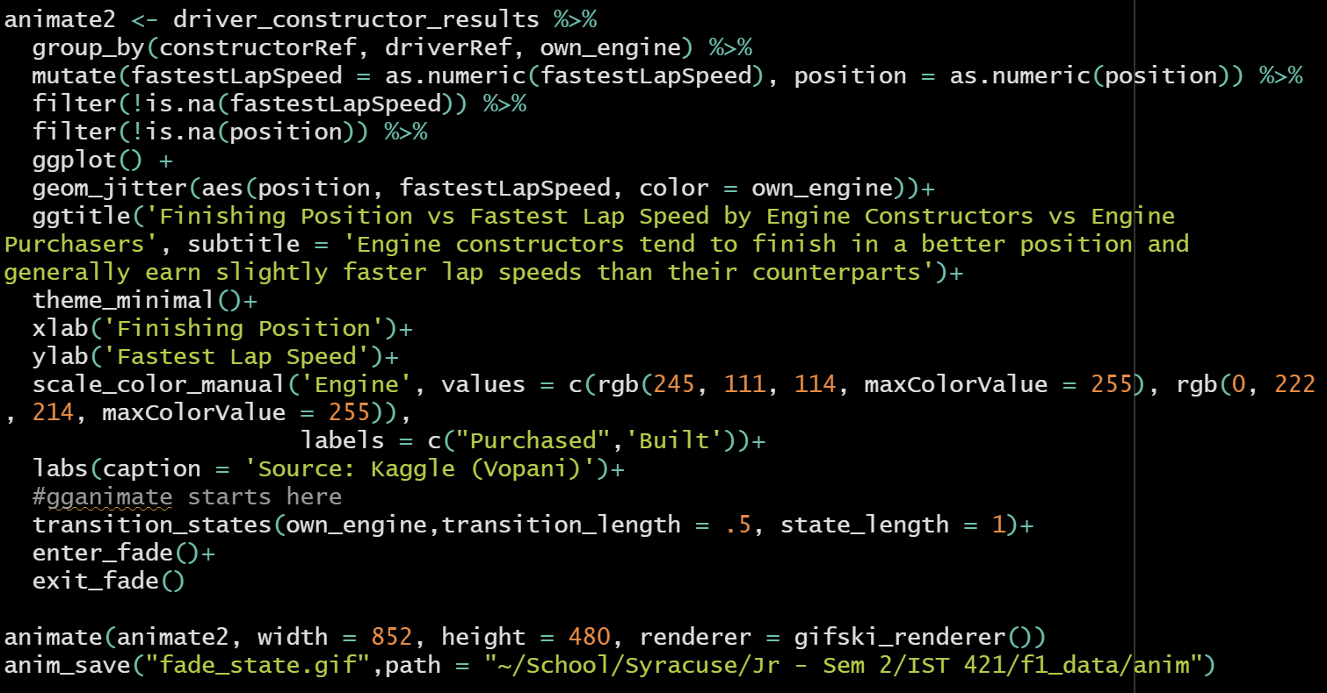
Sample Code II
regular dplyr and ggplot
gganimate and save functions

Slide 7
Resulting Visualization II

Slide 8
Questions?
Connor Hanan, IST 421

