Slide 1

Code Blue: Heart Attack An Analysis on Heart Attack & Heart Disease Data
Author: DeAndre Thomas
Professor: Dr. Debbie Landowski
Course: IST652

Slide 2
Code Blue: Heart Attack An Analysis on Heart Attack & Heart Disease Data
Heart Data
Heart Disease Mortality Data Among US Adults
CSV file per Kaggle
4,560 Data Points
Medical Data
Age
Gender
Chest Pain
Cholesterol
Etc.
CSV file per CDC
1,122,444 Data Points
Demographic Data
Gender
Race/Ethnicity
State
County
Etc.

Slide 3
Questions
What are the top five states effected by heart disease?
What gender is most prone to having heart attacks?
What are the top 3 factors in those that have had heart attacks?
Program Description
Libraries
Analysis Techniques
Pandas
Numpy
Plotly & Plotly.Express
Seaborn
Matplotlib & Matplotlib.Pyplot
XGBoost
Data Cleaning
Correlation
Supervised Learning
Regression

Slide 4
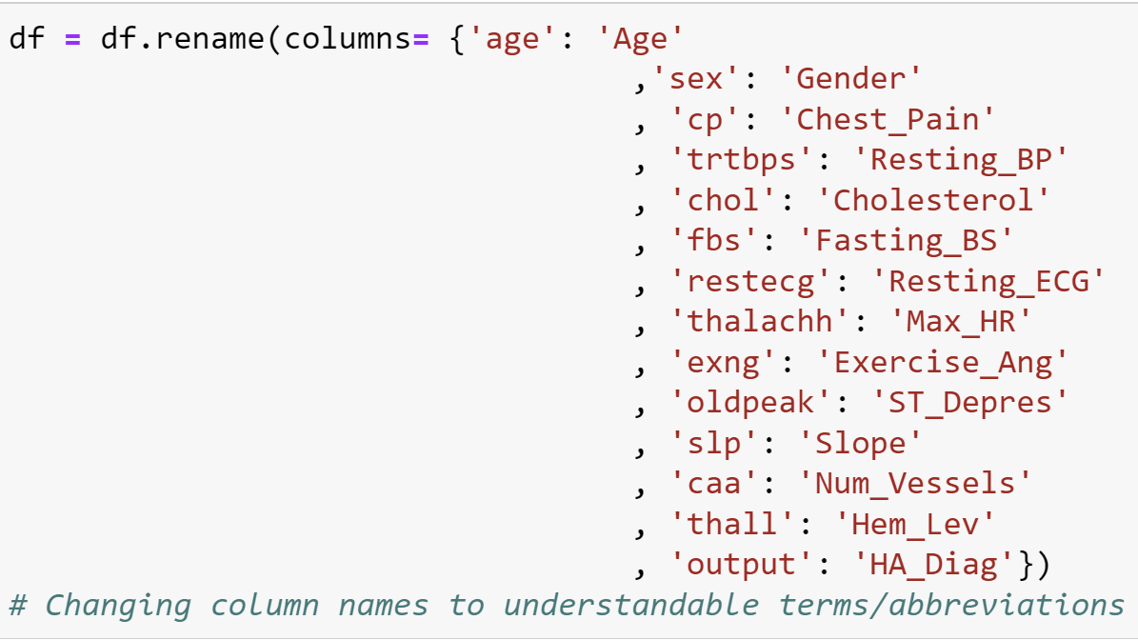
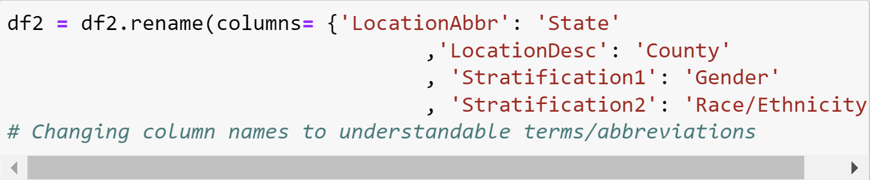
Data Cleaning Renaming Columns
Heart
Heart Disease Mortality Data Among US Adults

Slide 5
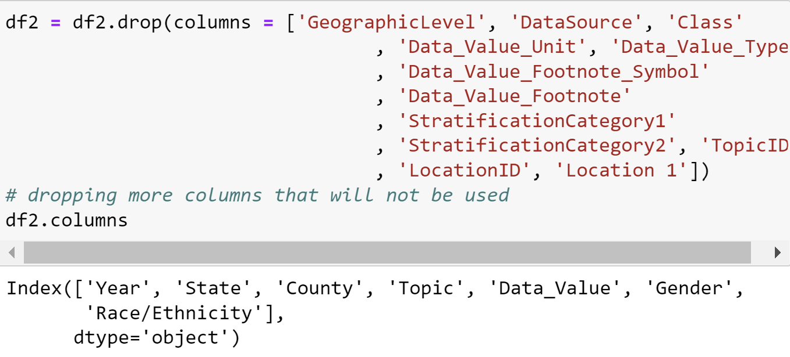
Data Cleaning Dropping Rows & Columns
Heart
Heart Disease Mortality Data Among US Adults
All variables were kept

Slide 6
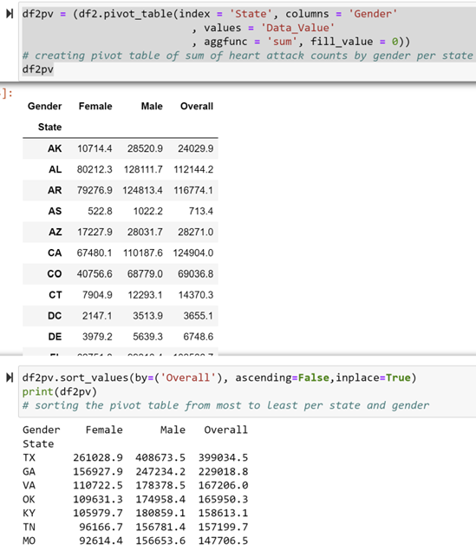
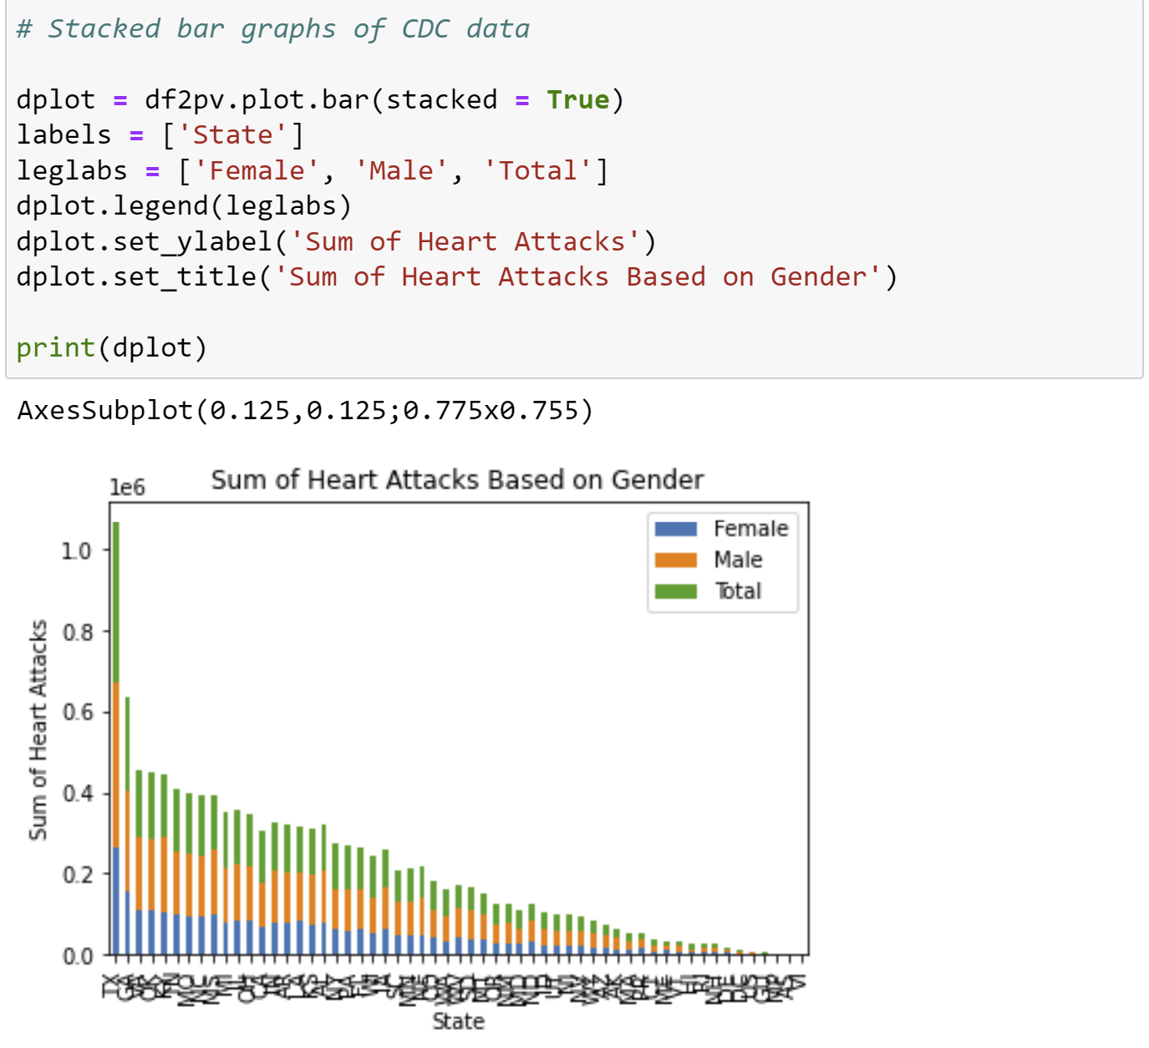
Analysis
Pivot Table
Stacked Bar Chart

Slide 7
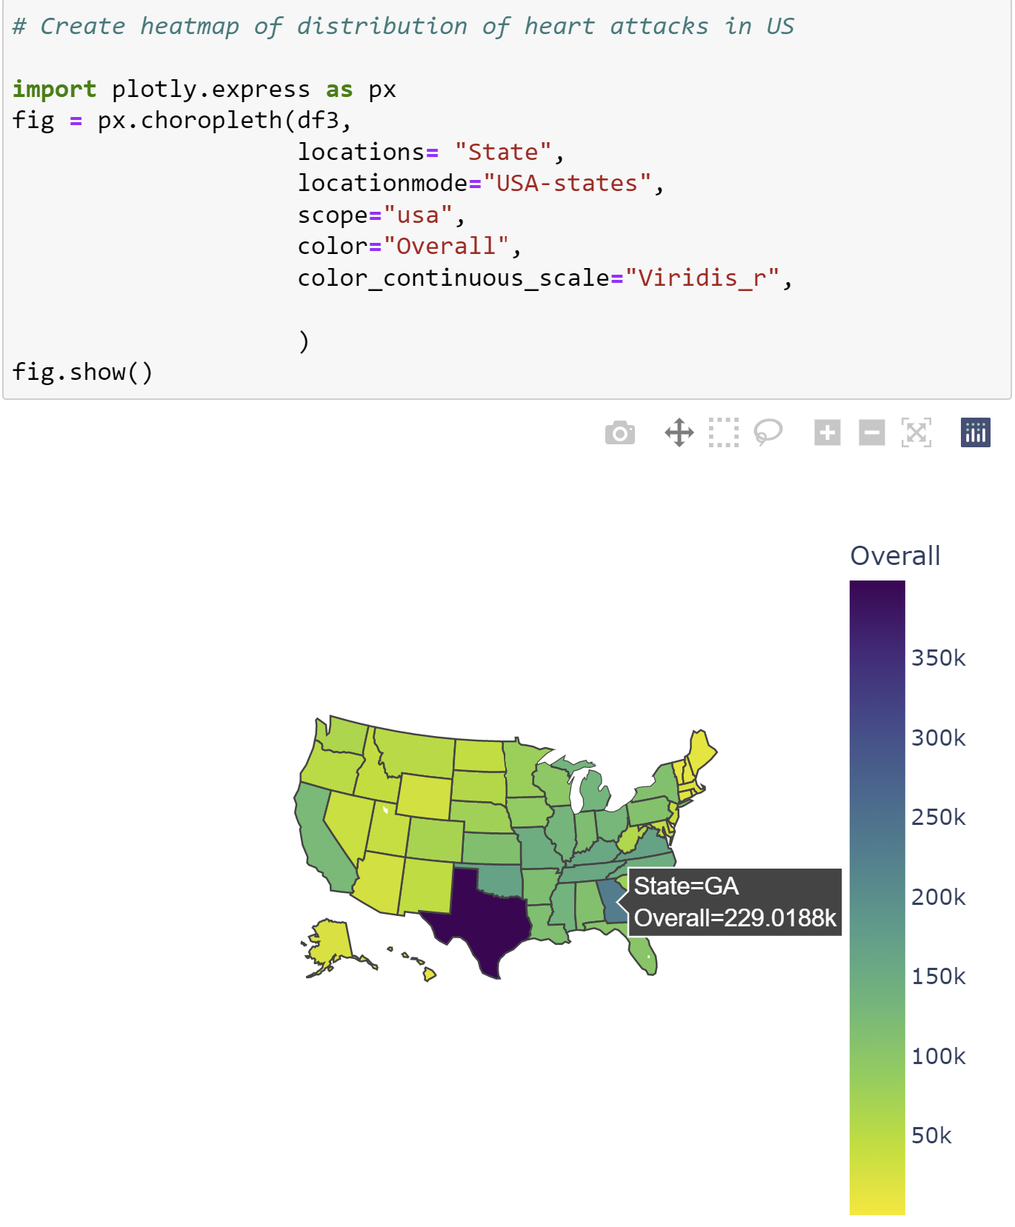
Analysis Heat Map of US

Slide 8
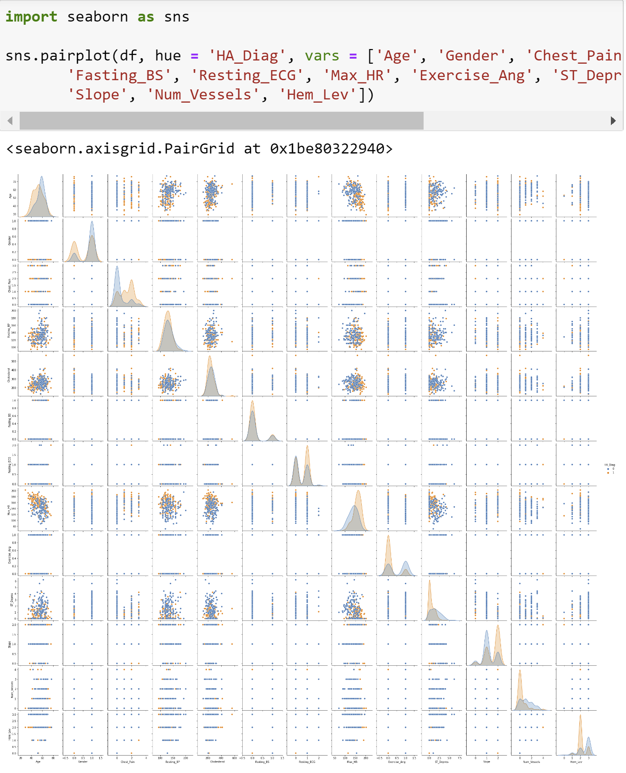
Analysis Searching for Correlation/Multicollinearity

Slide 9
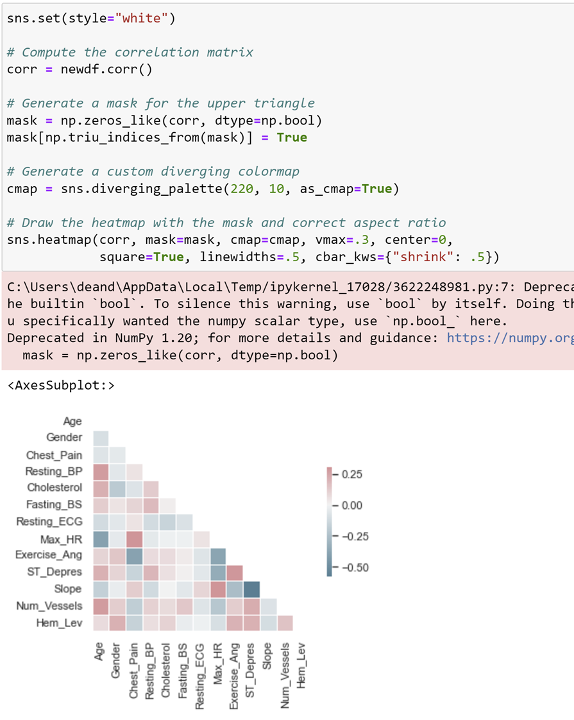
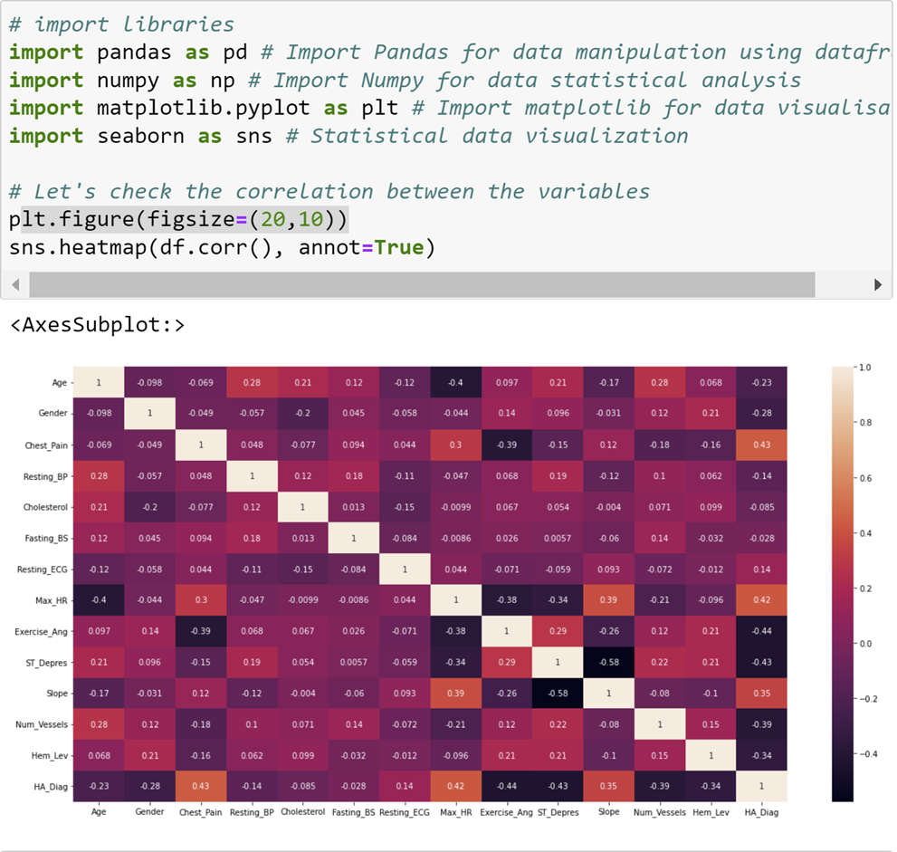
Analysis Searching for Correlation /Multicollinearity

Slide 10
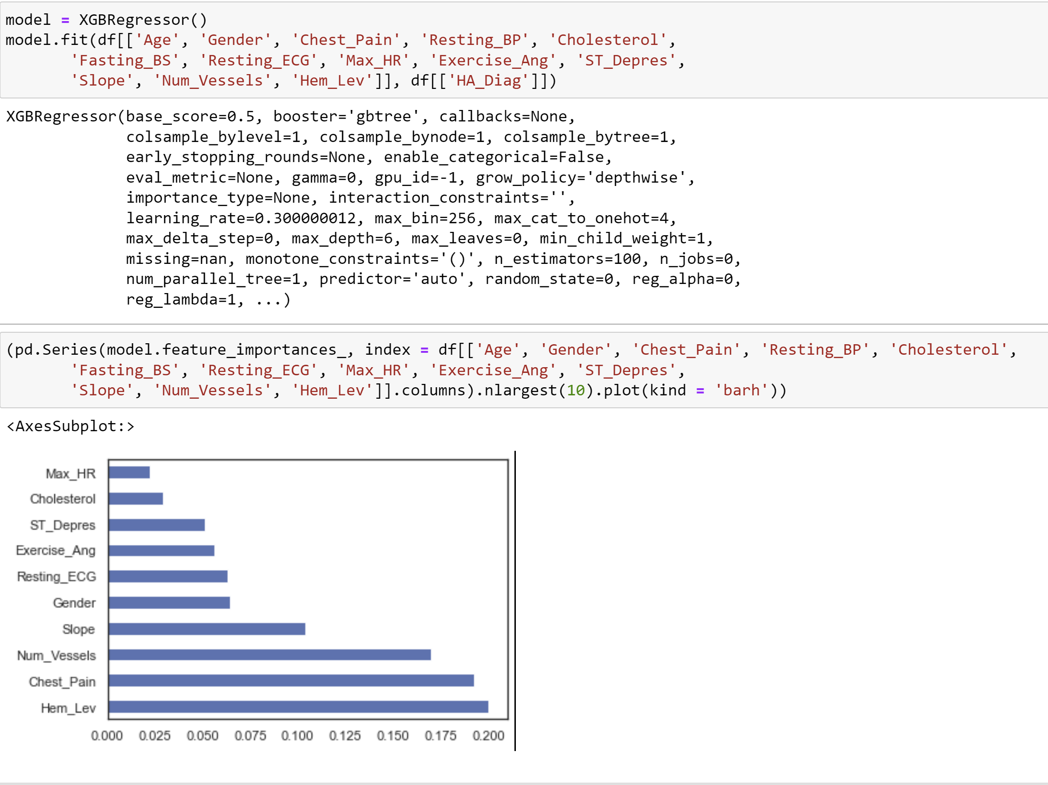
Analysis XGBoost Regressor

Slide 11

Conclusion & Recommendations
Residents of Texas, Georgia, Virginia, Oklahoma, and Kentucky are most effected by heart disease.
Males are most prone to having heart attacks.
Hemoglobin levels, chest pain, and thalassemia are the 3 top factors of someone having a heart attack (per the data provided).
Using up-to-date, global data that includes attributes of lifestyle and other genetic factors

Slide 12
References
Heart Disease Dataset. (2019, June 6). Kaggle. https://www.kaggle.com/datasets/johnsmith88/heart-disease-dataset
Heart Disease Mortality Data Among US Adults (35+) by State/Territory and County | Chronic Disease and Health Promotion Data & Indicators. (2016, September 20). Https://Chronicdata.Cdc.Gov/Heart-Disease-Stroke-Prevention/Heart-Disease-Mortality-Data-Among-US-Adults-35-by/R35g-Znws. https://chronicdata.cdc.gov/Heart-Disease-Stroke-Prevention/Heart-Disease-Mortality-Data-Among-US-Adults-35-by/r35g-znws
WONDER Message. (2020). Https://Wonder.Cdc.Gov/Controller/Datarequest/D76;jsessionid=5135CC1057F85421F7D31B1322B4. https://wonder.cdc.gov/controller/datarequest/D76;jsessionid=5135CC1057F85421F7D31B1322B4
Simplest Way to Create a Choropleth Map by U.S. States in Python. (2022). Https://Towardsdatascience.Com/Simplest-Way-of-Creating-a-Choropleth-Map-by-u-s-States-in-Python-F359ada7735e. https://towardsdatascience.com/simplest-way-of-creating-a-choropleth-map-by-u-s-states-in-python-f359ada7735e

