Slide 1
Hospital Readmission Prediction Based on Medical Notes
Wenjie Yao, Shenghua Xiang, Xinge Zhao
Georgia Institute of Technology, Atlanta, Georgia, US
Narration PPT Edition:
https://drive.google.com/open?id=1KHUL4IAvGPdsEGpa4qs08ejZO-xNsz6_

Slide 2
Motivation and Introduction
20% of all Medicare discharges had a readmission within 30 days
12% preventable
could save $1 billion dollars each year
Our goal: A prediction framework based on medical notes
Challenges:
Readmission identification
Feature extraction
Supervised readmission classification

Slide 3
2. Data Processing and Environment
Table Name | Description
ADMISSIONS.csv | Over 110 thousand hospital admission events.
NOTEEVETS.csv | Over 2 million medical notes for patients
MIMIC-III
Environment Setup
Hardware: a Ubuntu 16.04 machine with 4GB RAM and 2 Cores.
Software: Zeppelin on Apache Spark interpreter with 4 clusters.
Python 2.7 with Scikit-learn,Matplotlib, Numpy, Pandas libraries.
R version 3.3.2.

Slide 4
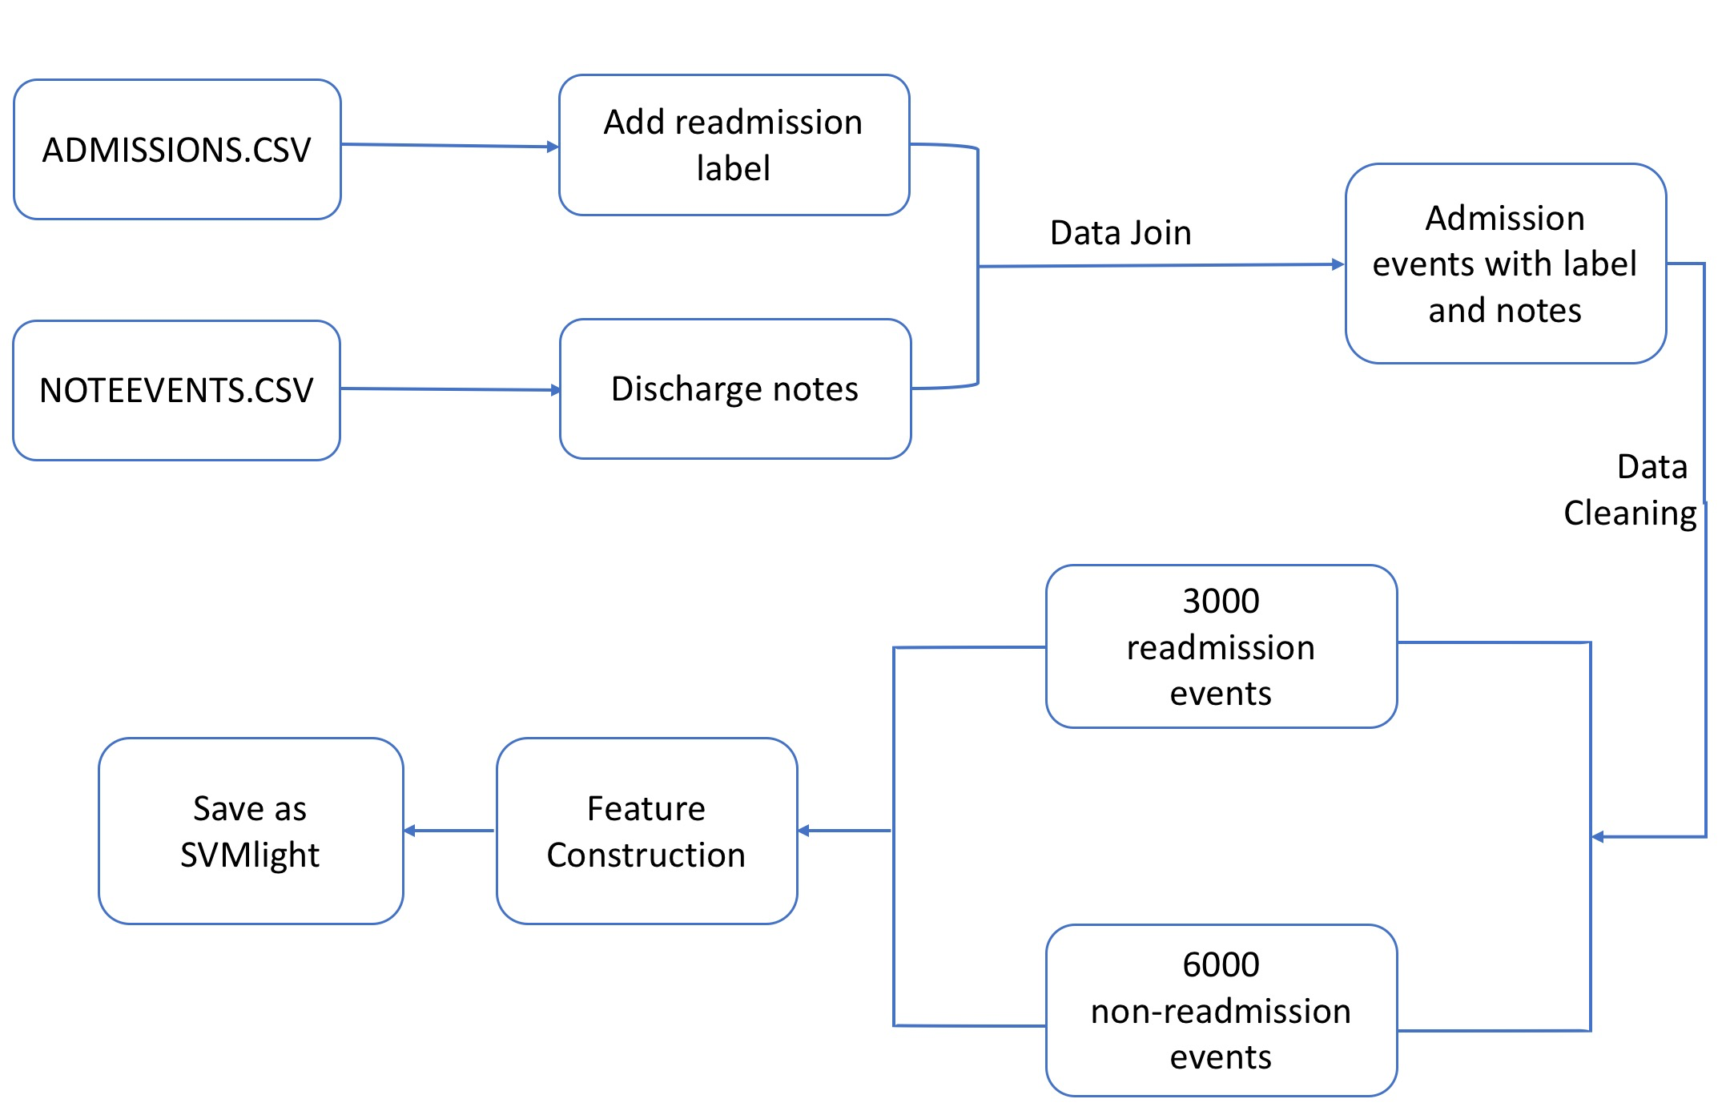
Overview of Data Processing and Feature Construction

Slide 5
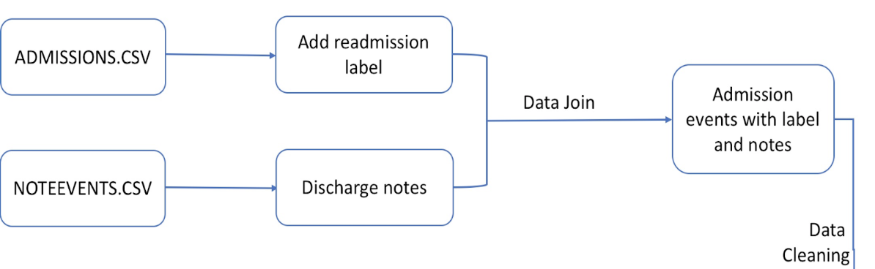
3. Predictive model
3.1 Data Join
Identify readmissions, label each admission event by readmission(1) or not(0),
then joined by corresponding text in Discharge note.

Slide 6
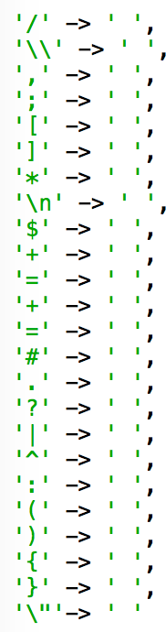
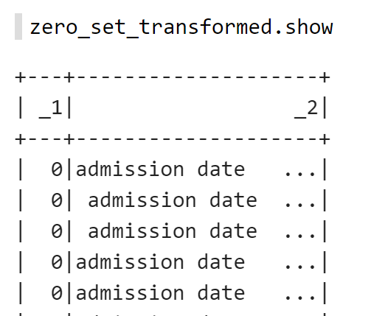
3. Predictive model
3.2 Data Cleaning
Transforming the texts into lowercase
Removing numbers and various symbols, including

Slide 7
3. Predictive model
3.3 Feature Construction
[Select non-readmission samples]
3939 readmission records
6000 non-readmission records
[TF-IDF feature construction]
a sparse matrix of 9693 rows and 73670 columns.
Univariate selection---4000 features.
[Word2vec feature construction]
7 words context window
each word: 2000 dimensions vector to representation
sum up every word vector to represent the text.

Slide 8
3. Predictive model
3.3 Feature Constrution
[Combined feature construction]
each 2000 features from TF-IDF and Word2vec,
a new combine features vector space of 4,000.
[Save to SVMLight]

Slide 9
3. Predictive model
3.4 Evaluation of the Models
Logistic Regression
SVM
Random Forest

Slide 10
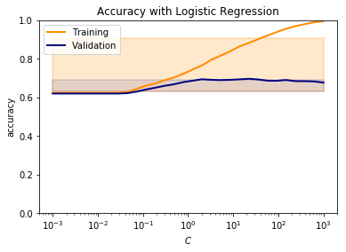
3. Predictive model
3.4 Evaluation of the Models
GridSearchCV
Tune a single parameter
C = 22.15

Slide 11
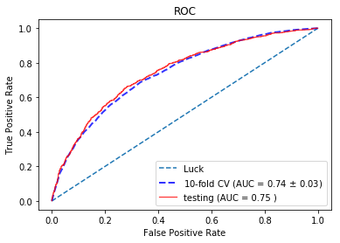
3. Predictive model
3.4 Evaluation of the Models
Experimented with TF-IDF features
Logistic Regression

Slide 12
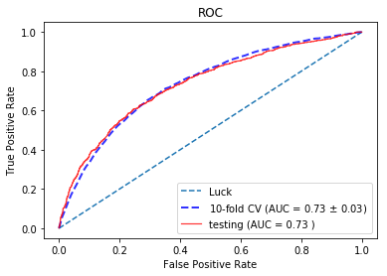
3. Predictive model
3.4 Evaluation of the Models
Experimented with TF-IDF features
SVM

Slide 13
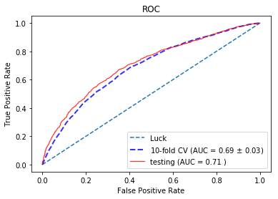
3. Predictive model
3.4 Evaluation of the Models
Experimented with TF-IDF features
Random Forest

Slide 14
3. Predictive model
3.4 Evaluation of the Models
Metrics using TF-IDF features
 | Accuracy | Precision | Recall | F1-Score
Logistic Regression | 0.705 | 0.661 | 0.493 | 0.564
SVM | 0.698 | 0.668 | 0.438 | 0.529
Random Forests | 0.676 | 0.668 | 0.325 | 0.438

Slide 15
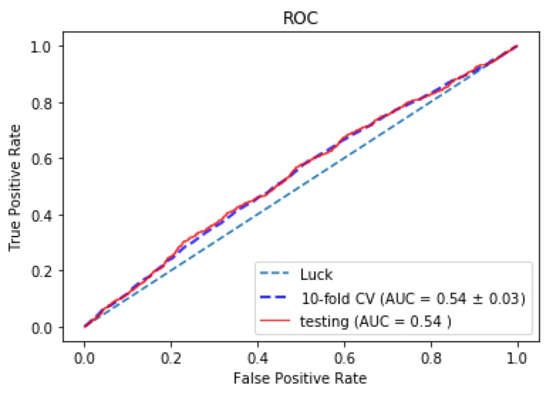
3. Predictive model
3.4 Evaluation of the Models
Experimented with Word2vec features
Logistic Regression
Not better than guessing

Slide 16

3. Predictive model
3.4 Evaluation of the Models
Metrics using Combined features
 | Accuracy | Precision | Recall | F1-Score
Logistic Regression | 0.697 | 0.661 | 0.493 | 0.564
SVM | 0.663 | 0.624 | 0.415 | 0.503
Random Forests | 0.647 | 0.619 | 0.232 | 0.338

Slide 17
3. Predictive model
3.4 Evaluation of the Models
Feedforward neural network
2-hidden-layer
250 hidden unit for each hidden layer

Slide 18
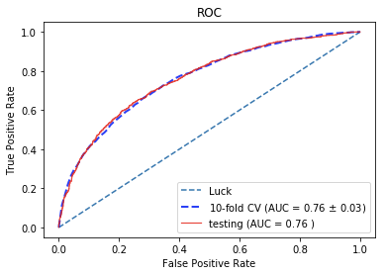
3. Predictive model
3.4 Evaluation of the Models
Results with Feedforward neural network
TF-IDF
Best performance so far
71.6% True Positive Rate
at a False Positive Rate (FPR) of 28%

Slide 19
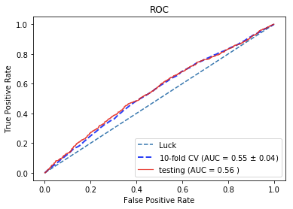
3. Predictive model
3.4 Evaluation of the Models
Results with Feedforward neural network
Word2vec
no better than guessing

Slide 20
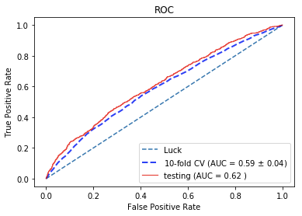
3. Predictive model
3.4 Evaluation of the Models
Results with Feedforward neural network
combined features
Dominated by word2vec features
TF-IDF features: sparse
word2vec features: dense
Neural Networks generally more sensitive to the sparsity

Slide 21
3. Predictive model
Our best performed model:
Feedforward neural network with TF-IDF features
Conclusion:
At a false positive rate of 28%, able to predict 71.6% of the total readmission correctly.
The false positives provided valuable insight, since they represent records with high risks of future readmission.

Slide 22
4. Further Discussion and Future Work
Unable to distinguish planned readmission from unplanned readmission.
4,000 most relevant word features, Limited lexicon.
Summed-up word vectors as features in Word2vec didn’t perform well.
Categorize the data as unplanned and planned readmission
Other sentiment-related feature extraction approaches like ontology domain knowledge
Add other factors like drug use or patient satisfaction as features
Building an app or a website tool for practical use
Notes:
A typical medical dictionary contains more than 100,000 entries, which limits our prediction capability on a more general case.

Slide 23
THANK YOU

