Slide 1
Parallel Circuits Simulation of Adders
Wenjie Yao
Chengcheng Zhang
Jidong Li
Yiou Zhu

Slide 2
Overview
Problem Description and Conceptual Model
Implementation of 1-bit Adder
Multi-bit Adders Simulation
Parallel Computation
Experiments and Analysis of Results

Slide 3
Problem Description
How does a computer add numbers?
Number------Binary Number------Logic Circuit
30+4 00011110+00000100
AND OR NOT

Slide 4
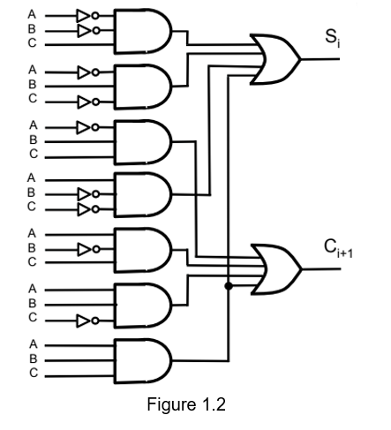
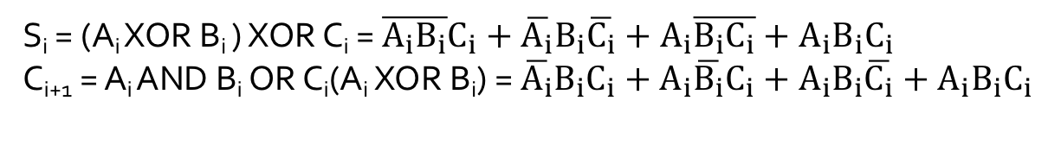
Logic Circuit (1-bit adder)
S_{i} = (A_{i} XOR B_{i} ) XOR C_{i} = $\overline{A_{i}B_{i}}C_{i}+\overline{A_{i}}B_{i}\overline{C_{i}}+A_{i}\overline{B_{i}C_{i}}+A_{i}B_{i}C_{i}$
C_{i+1} = A_{i} AND B_{i} OR C_{i}(A_{i} XOR B_{i}) = $\overline{A_{i}}B_{i}C_{i}+A_{i}\overline{B_{i}}C_{i}+A_{i}B_{i}\overline{C_{i}}+A_{i}B_{i}C_{i}$
Ai | Bi | Sum (S_{i}) | Carry (C_{i+1})
0 | 0 | 0 | 0
1 | 0 | 1 | 0
1 | 1 | 0 | 1
1 | 0 | 0 | 1
1 | 0 | 0 | 1
0 | 0 | 1 | 0
0 | 0 | 0 | 0
0 | 0 | 0 | 0
30: 00011110
4: 00000100
34: 00100010

Slide 5
Conceptual model
Entities:
Resource:
Whole Simulator: combination of multiple 1 bit adder
Each 1-bit adder: consisting of several AND/OR/NOR/XOR gates.
Consumer:
Digits of the specific pairs of numbers A_{i}, B_{i}. And the output from the last adder C_{i}.
Queue: queue of numbers waiting for processing.
queues of digits waiting to enter each 1-bit adder.
Attributes:
Data: numbers and their digits.
Timestamp of each number.
Precision of the input numbers in binary form.

Slide 6
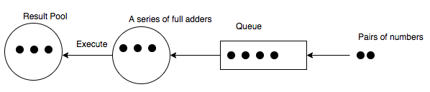
Conceptual model
Events:
Receive a message from the last 1-bit adder.
Process digits A_{i}, B_{i}, C_{i} using AND/OR/NOR/XOR gates
Send a message to the next 1-bit adder
Activity: Executing a pair of digits, beginning with receiving the message from the last 1-bit adder and ends with getting the summary and sending a message to the next 1-bit adder.

Slide 7
How to realize a 1-bit adder in C++

Slide 8
Classes
Gnode: logic gates (NOT, OR, AND)
SimObj: data and basic function for GNode
Event: electric signal
Graph: one-bit adder, 15 GNodes

Slide 9
Code Structure
InNeighbour/outNeibour
InputEvents
GNode
SimObj
InputTimes
Input
clock
Value(0,1)
Event
RecvTime

Slide 10
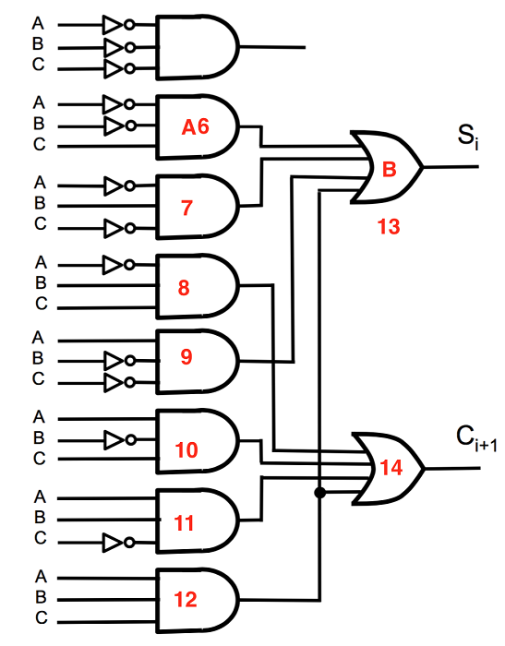

Slide 11
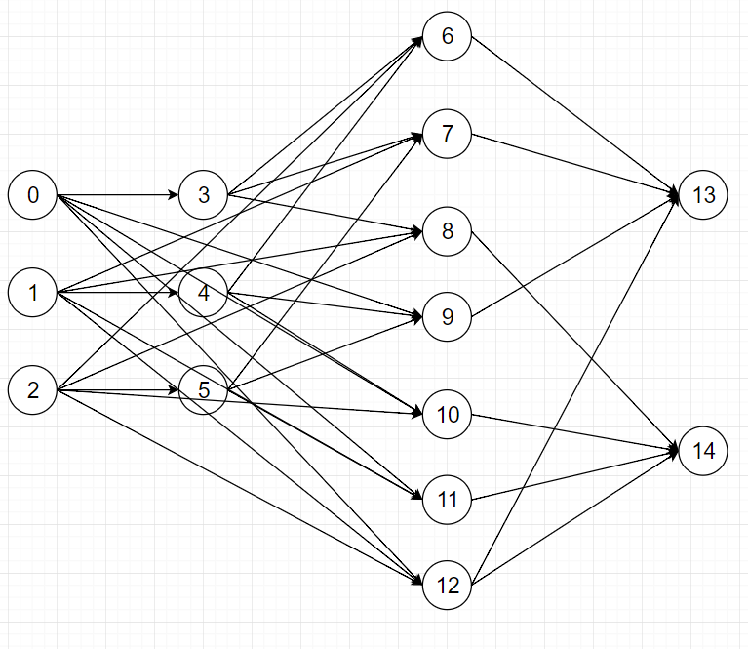

Slide 12
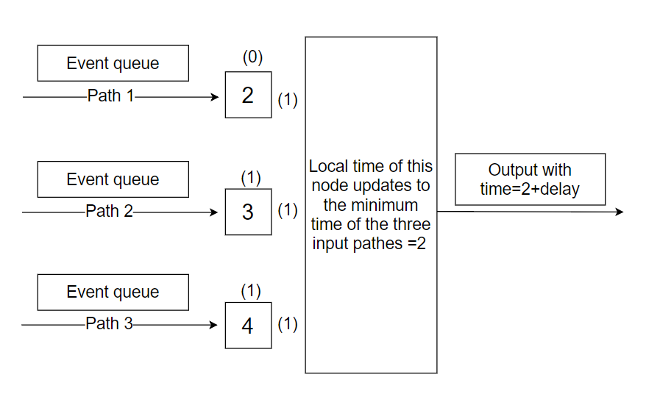
Time control
5(1)
0
0
1
1
1

Slide 13
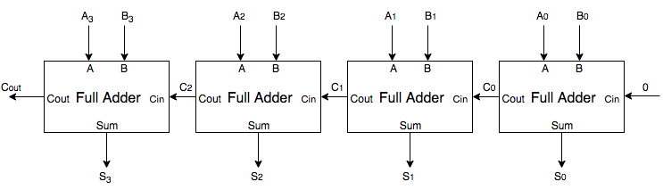
Architecture of Multi-bit Adder
Queue
When adding a pair of numbers, each Full Adder (1-bit adder) can operate independent but sequentially.

Slide 14
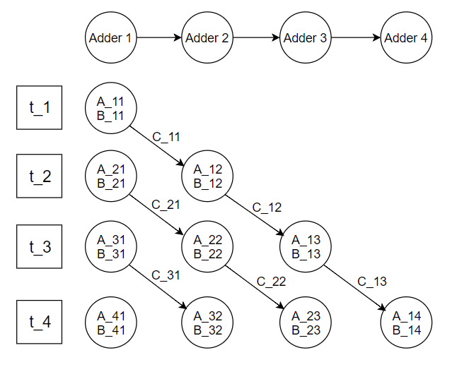
Parallel Computing
Assume that:
A_ij, B_ij=the jth digit of the ith number
C_ij=the overflowed number from the jth digit of the ith number

Slide 15
What can we do with the results?

Slide 16
Validation and Verification
Take an example with 31+37=68
(in binary expressions 00011111+00100101=01000100)
Graph[6] Node[13] output=1 time=18

Slide 17
Outputs in Time=18
Graph | Node[13] | Node[14]
0 | 0 | 1
1 | 0 | 1
2 | 1 | 1
3 | 0 | 1
4 | 0 | 1
5 | 0 | 1
6 | 1 | 0
7 | 0 | 0

Slide 18
Focus on the “and” gates of each graph
Graph | Input a | Input b | Input c | “And” gate output=1
0 | 1 | 1 | 0 | 11
1 | 1 | 0 | 1 | 10
2 | 1 | 1 | 1 | 12
3 | 1 | 0 | 1 | 10
4 | 1 | 0 | 1 | 10
5 | 0 | 1 | 1 | 8
6 | 0 | 0 | 1 | 6
7 | 0 | 0 | 0 | \

Slide 19
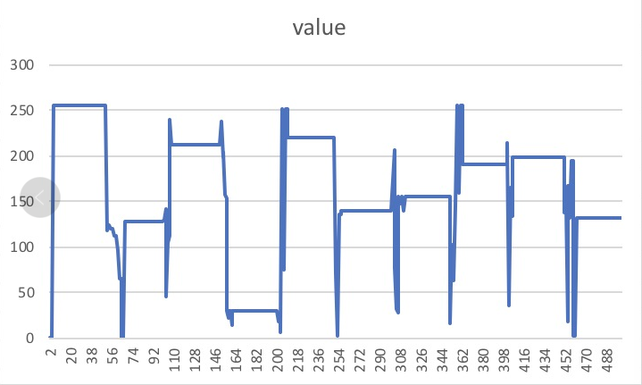
Results change over time

Slide 20
Relationship between convergence time and bits
Bits | Convergence time
2 | 2 | 4 | 1 | 3 | 2 | 1 | 4 | 3 | 1 | 1
3 | 5 | 2 | 5 | 4 | 4 | 3 | 1 | 3 | 3 | 5
4 | 5 | 4 | 5 | 2 | 11 | 2 | 3 | 5 | 7 | 5
5 | 5 | 2 | 3 | 4 | 6 | 8 | 3 | 3 | 9 | 5
6 | 8 | 5 | 11 | 10 | 7 | 3 | 3 | 3 | 8 | 12
7 | 16 | 9 | 19 | 20 | 8 | 8 | 9 | 5 | 5 | 10
8 | 10 | 9 | 8 | 9 | 5 | 8 | 8 | 11 | 10 | 13

Slide 21
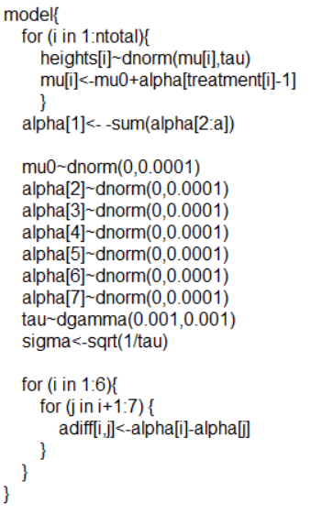
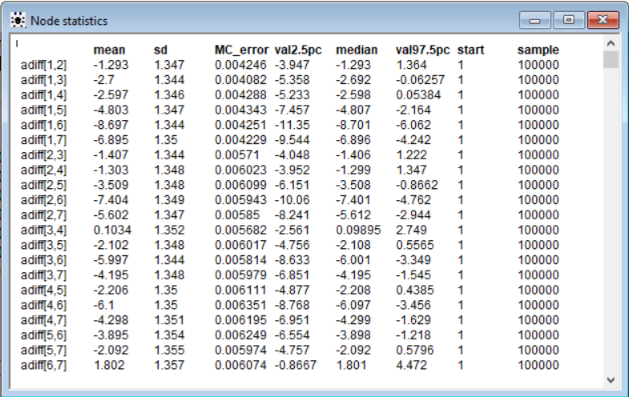
ANOVA based on Bayesian way (normal prior)

Slide 22
Q & A

Slide 23
Thank you!

