Slide 1
SimpleSEDML
Joseph L. Hellerstein, Lucian P Smith , Herbert M Sauro
June 16, 2025

Slide 2
Why?
The Simulation Execution Description Markup Language (SED-ML) provides a community standard for describing computational experiments
Key considerations in reproducibility and credibility
Issues
SED-ML is verbose and difficult for humans to generate
Alternatives, such as PhraSED-ML improve matters but adoption is low
No API to help programmers create SED-ML
Access many sources of models (string vs file vs URL, SBML vs Antimony)
Leverage programming environments (datatypes, iteration)
Provide task-oriented abstractions (e.g., simulate a model; compare two models)

Slide 3
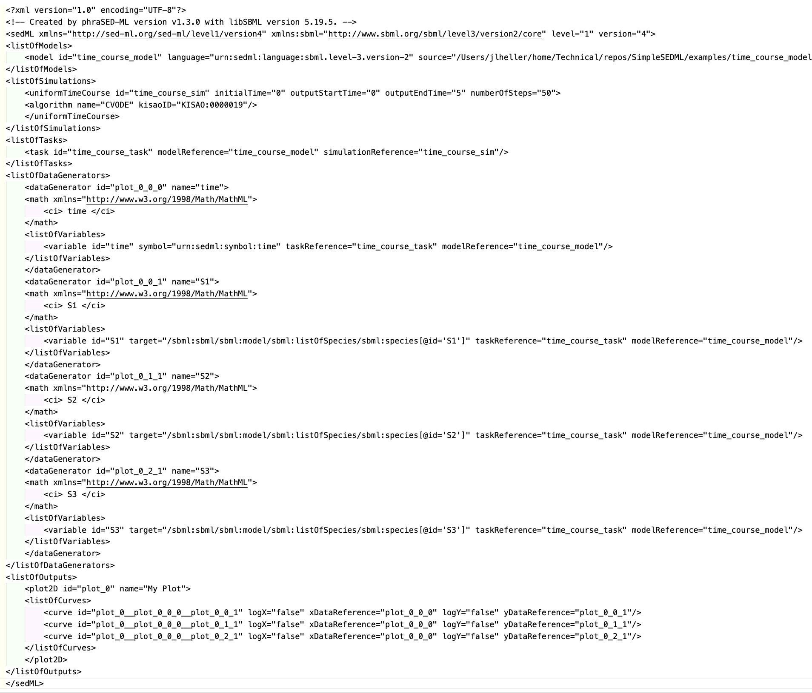
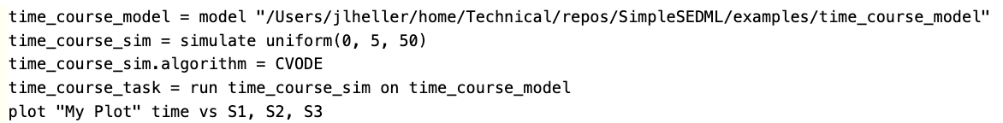
Simulate a time course for a single model
SED-ML
PhraSED-ML
Issues
Convert model to SBML
Convert PhraSED-ML to SED-ML
SimpleSEDML
import SimpleSEDML as ss
sedml_str = ss.makeSingleModelTimeCourse(model)

Slide 4
Structure of SimpleSEDML
Task Oriented API
Singe Model Time Course
Multiple Model Time Course
Single Model Parameter Scan
Multiple Model Parameter Scan
Virtualization API
Base API
Python interface to PhraSED-ML abstractions
Generalize model source (file, string, URL, Antimony, SBML)
phrasedml
tellurium

Slide 5
Template for Task Oriented API
One required argument: Model(s)
Models can be specified in many ways
SBML or Antimony
String, local file, URL
PhraSED-ML only accepts a local SBML file.
Methods for the task-oriented API
getPhraSEDML
getSEDML
execute
makeOMEX

Slide 6
Example

