Slide 1
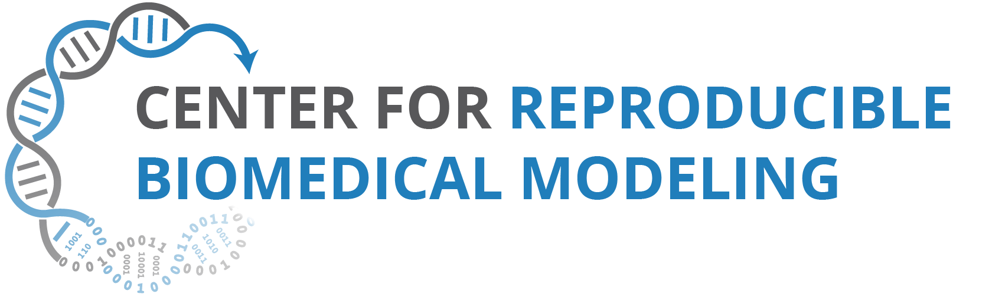
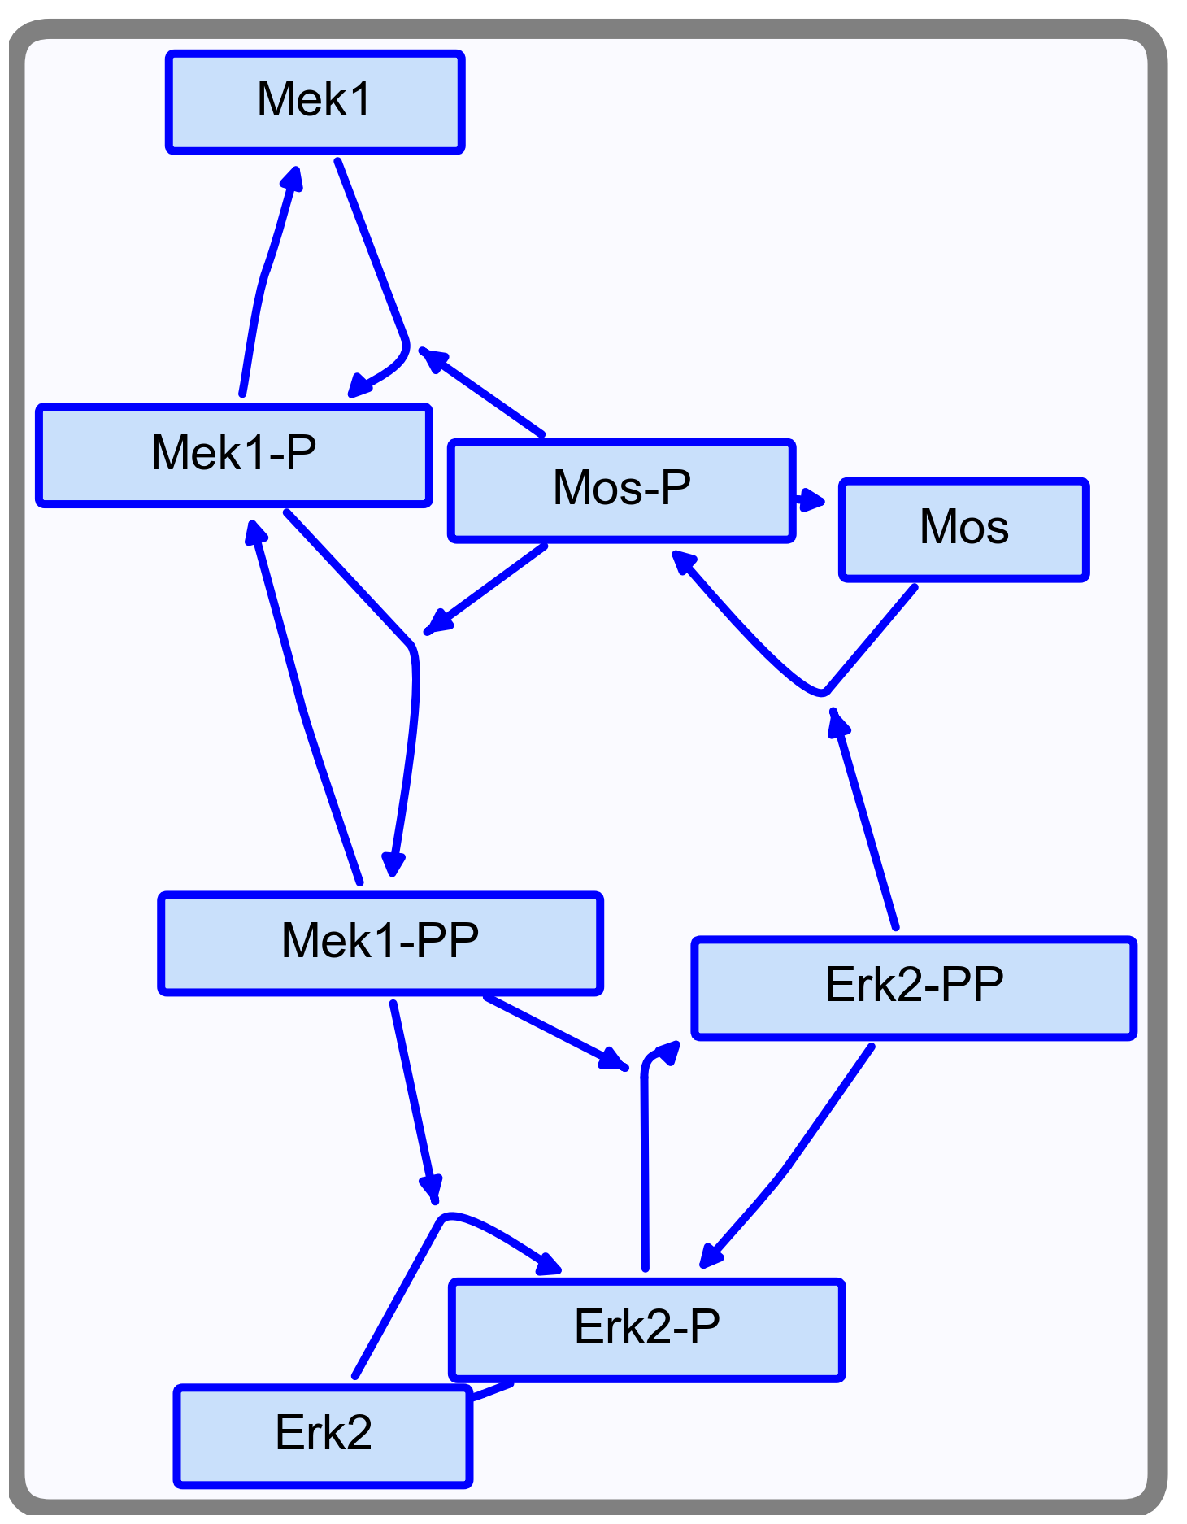
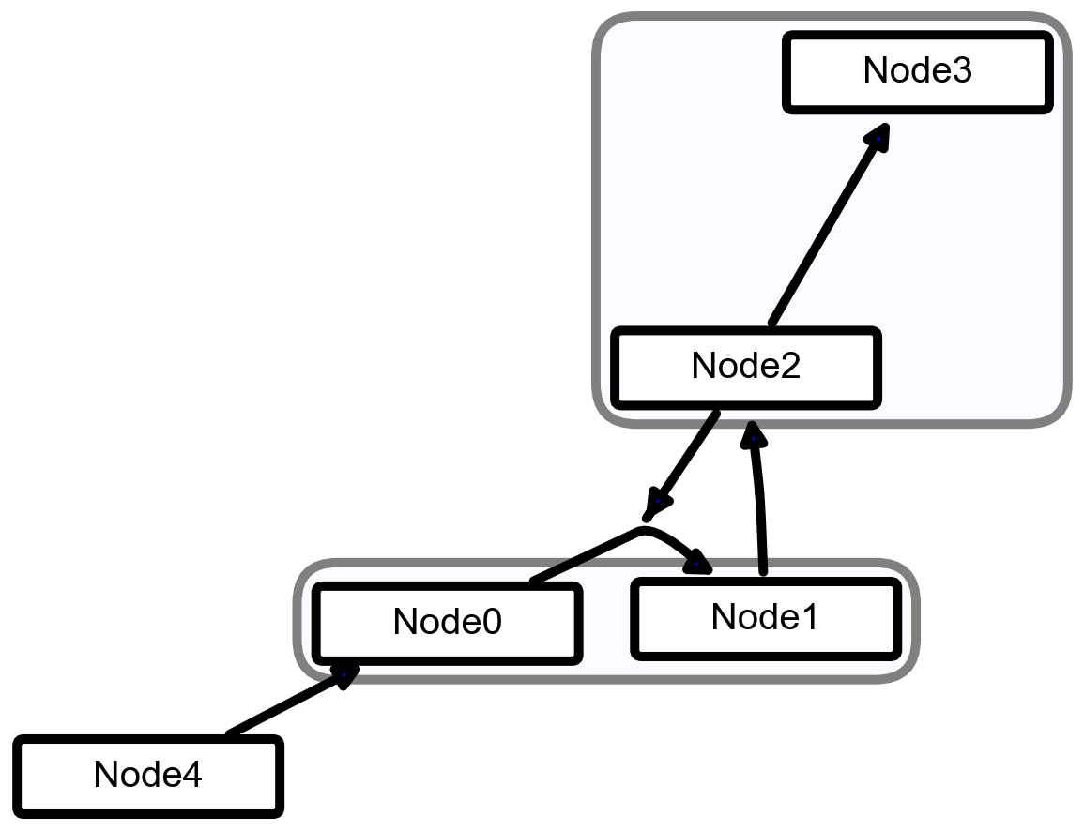
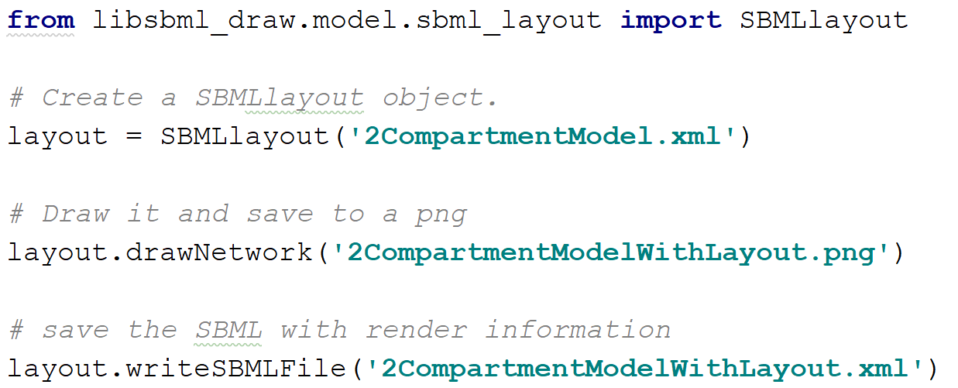
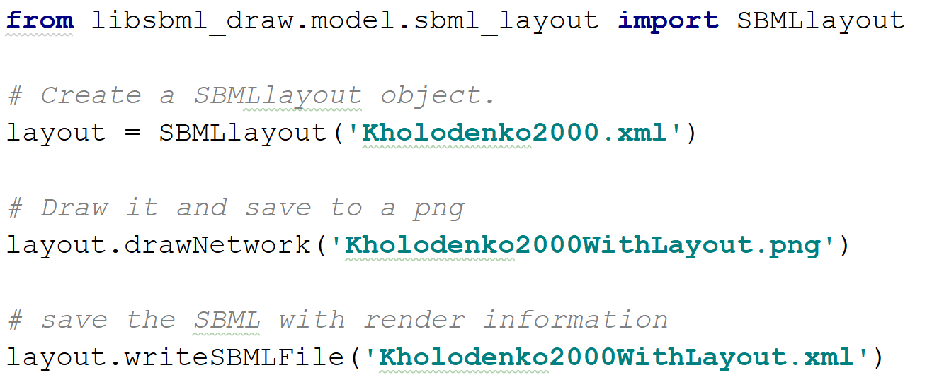
Reproducibility of SBML network diagrams
Natale Hawkins¹ J. Kyle Medley¹ Kiri Choi¹ Herbert Sauro¹
¹University of Washington, Department of Bioengineering
Abstract
The SBML layout and render extensions enable SBML models to encode information about the graphical depiction of model elements. The “Layout” extension provides information about the positions of model elements, whilst the “Render” extension describes their physical characteristics, such as their shape, color, line width, and font attributes. Libsbml-draw is a Python library that supports the SBML Layout and Render extensions. Libsbml-draw uses a C/C++ backend library called SBNW (unpublished work) and a Python user interface for manipulating the physical characteristics of SBML models. The rendering information can then saved back to the SBML model, thus enabling the reproduction of the SBML diagram.
Example 1
Example 2

