Slide 1



Modeling With Uncertainty:
Overview
Joseph L. Hellerstein^{1,2}
¹eScience Institute
²Department of Computer Science & Engineering
July, 2021

Slide 2
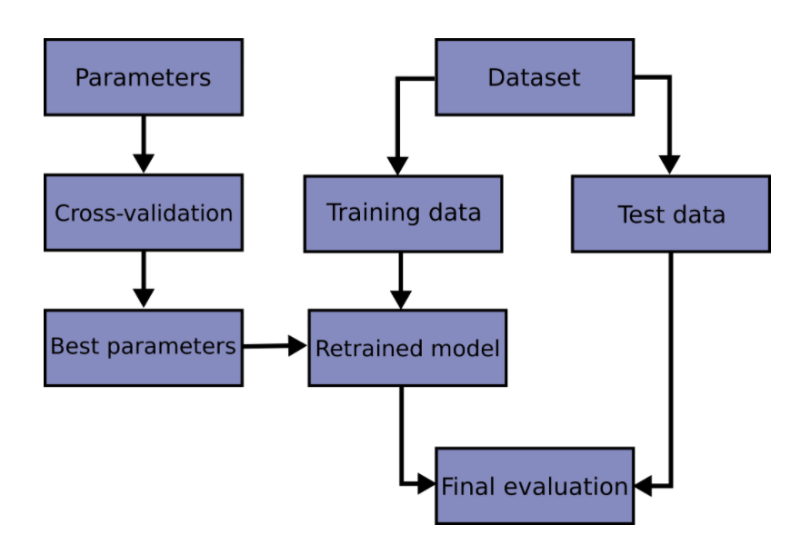
Workflow For Fitting With Uncertainty

Slide 3
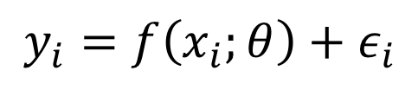

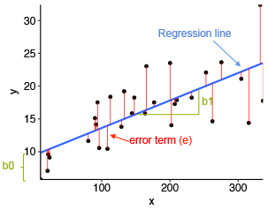




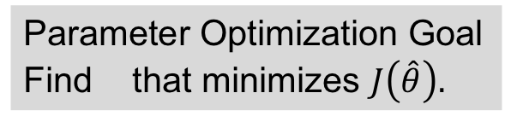
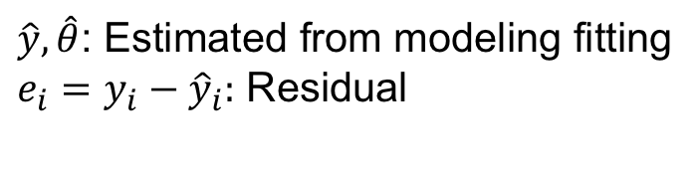


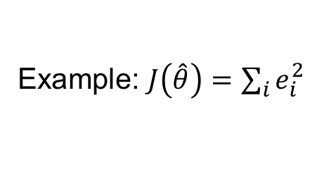
Parameter Optimization Summary
The Model
Ex: Linear Model
Observations
residuals
Model
Explanatory variables
K Parameters
predicted
Noise (random variable) – i.i.d.

Slide 4
Agenda
Statistical philosophy for modeling
Assessing model quality
R², Chi-Square, AIC, cross validation
Parameter confidence intervals
Cross validation, bootstrapping

Slide 5
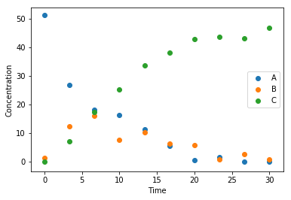
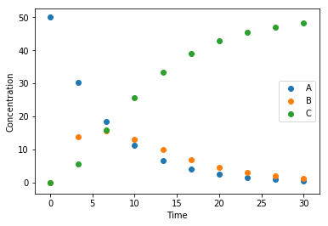
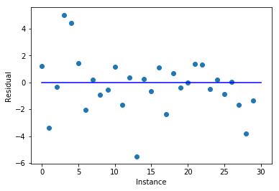
Statistical Philosophy of Models It’s All About Residuals
Observations
A statistical model is good if
Residuals have small magnitude
Residuals are i.i.d.
Residuals have no pattern
Ideally, residuals are normally distributed
Model
Residuals

Slide 6
Assessing Model Quality

Slide 7

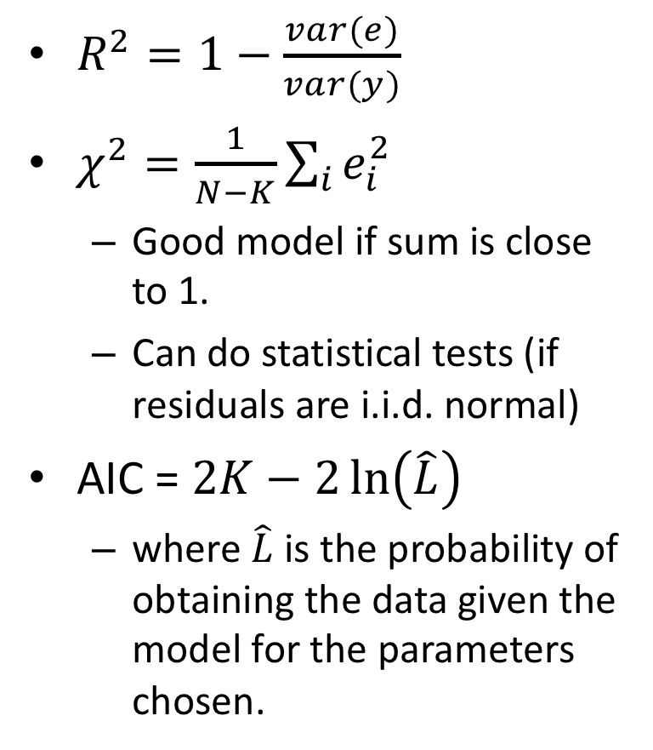
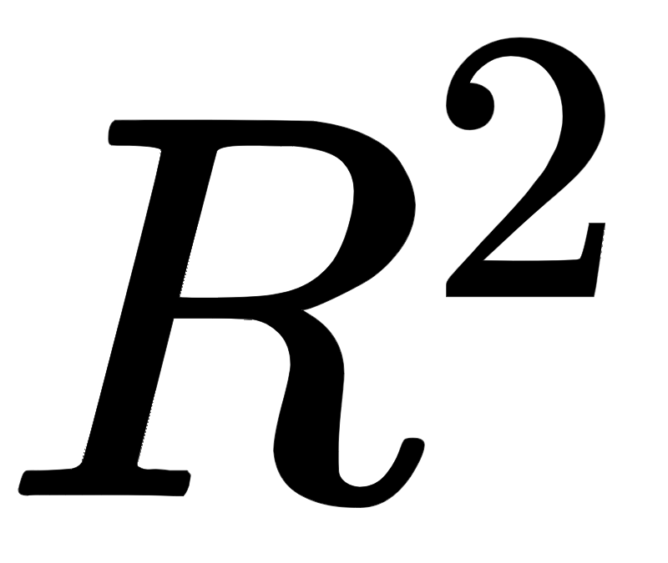
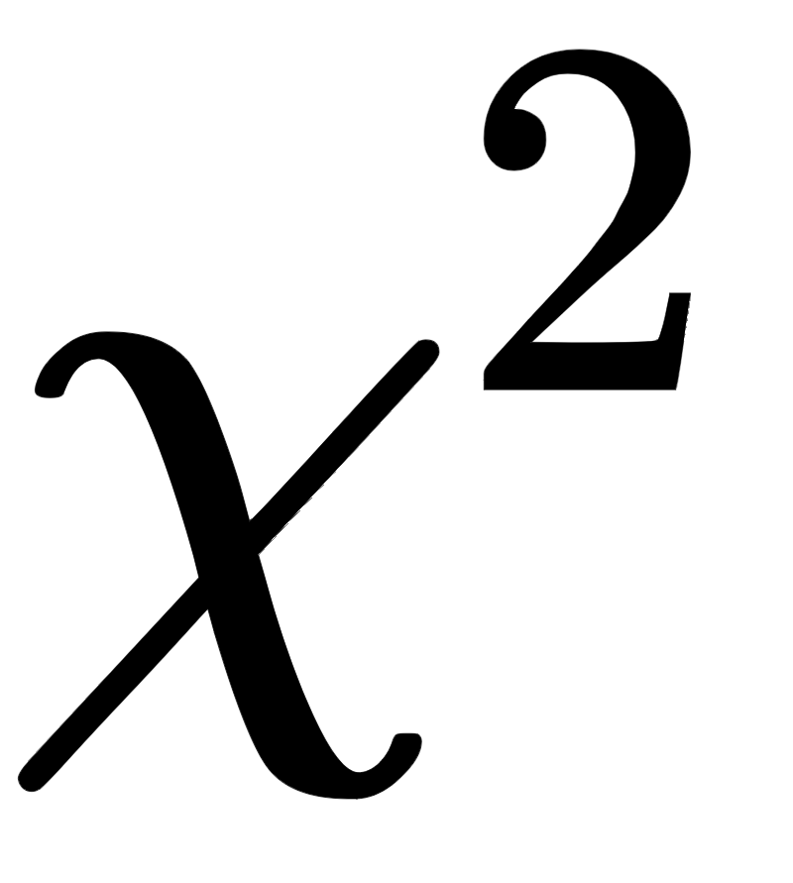


Considerations |  |  | AIC
Residuals
Parameters
Statistical test
Compare models
AIC

Slide 8






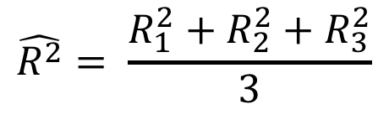
Cross Validation Summary
Divide full data set into N Folds
Data
Train 1
Test 1
{
Construct N training data sets and N test data sets
Train 2
Test 2
{
Obtain N parameter fits and model evaluations
Train 3
Test 3
{
Report statistics of the evaluations

Slide 9
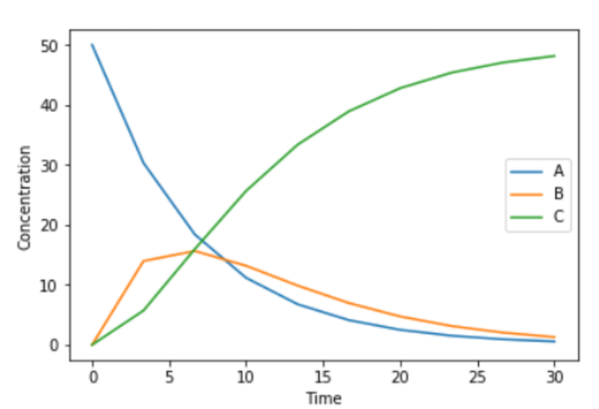
Choosing Folds Choose Wisely
X
Folds have very different dynamics
Folds have similar dynamics

Slide 10
Python Support for Cross Validation
import numpy as np
from sklearn.model_selection import train_test_split
from sklearn import datasets
from sklearn import svm
X, y = datasets.load_iris(return_X_y=True)
X_train, X_test, y_train, y_test = train_test_split(
X, y, test_size=0.4)
But be careful because folds are chosen randomly.

