Slide 1
XoX Price Prediction Model
Helping Our Customers Make Informed Purchasing Decisions

Slide 2
Introduction: Business Context
Our agency helps customers purchase XoX products from various makers
Price is a critical factor in customer decision-making
Previously, price estimations varied based on employee experience
We needed a consistent, data-driven approach to price prediction
Machine learning provides accurate, reliable price estimates

Slide 3
Understanding Our Data
What We Learned from XoX Sales Data
Our dataset contains detailed information about XoX products
Numerical features: cost, weight, dimensions (height, width, depth)
Categorical features: Produce type, produce level, maker, ingredient
Temporal features: purchase year, month, day of week, day of month

Slide 4
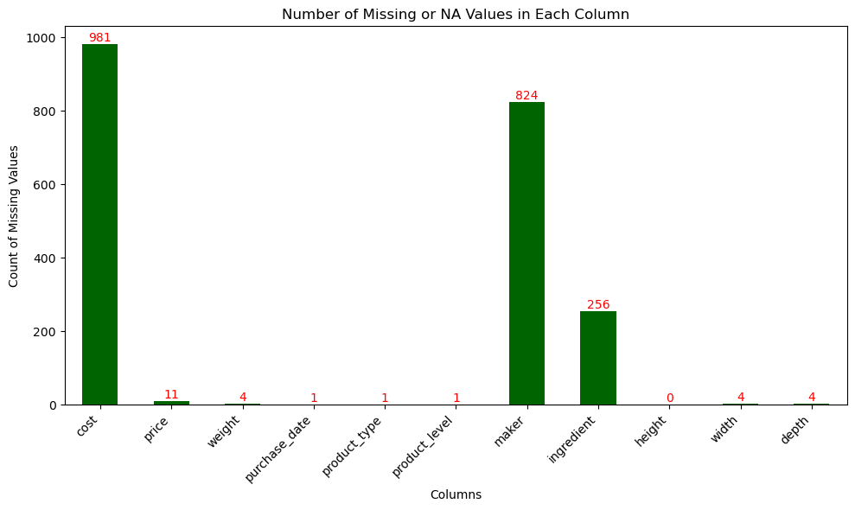
Missing values
Data required cleaning and preprocessing for optimal model performance

Slide 5
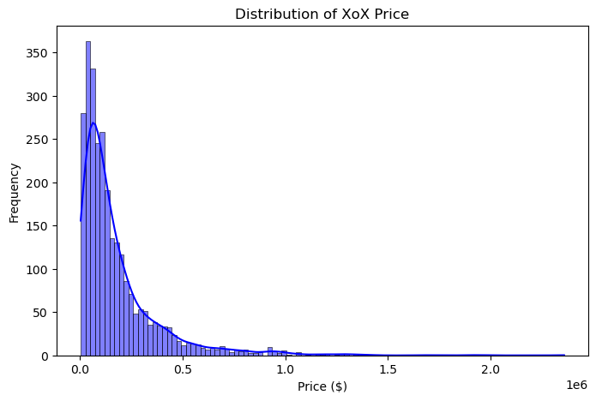
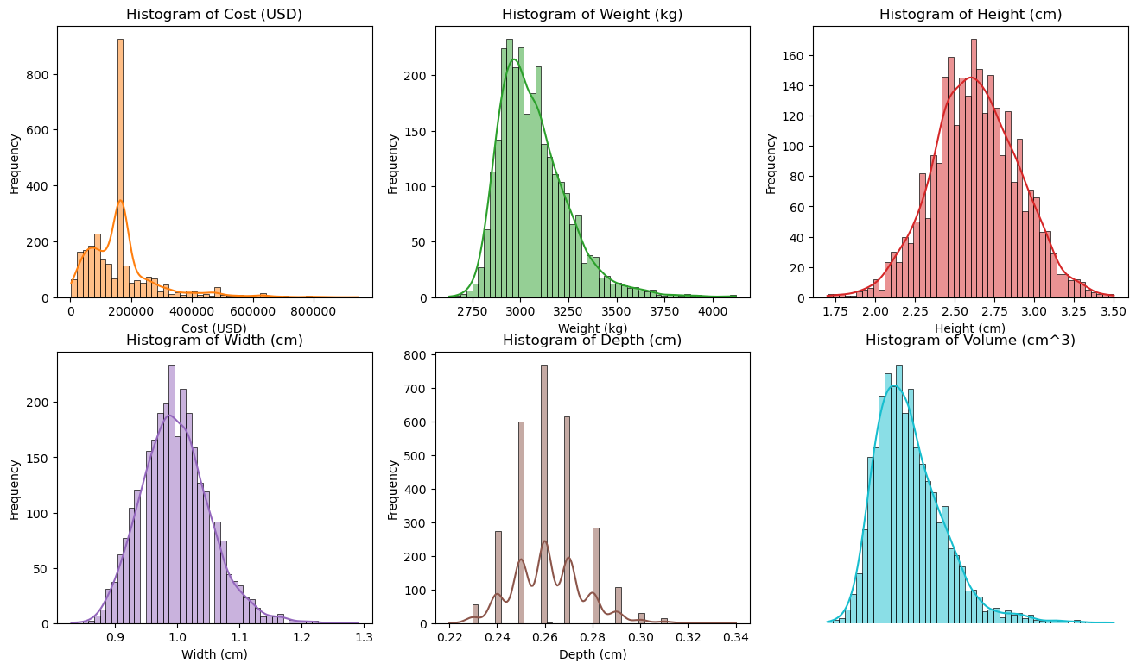
Numerical value (feature) analysis
Price distribution is right-skewed (many lower-priced items, fewer premium items)

Slide 6
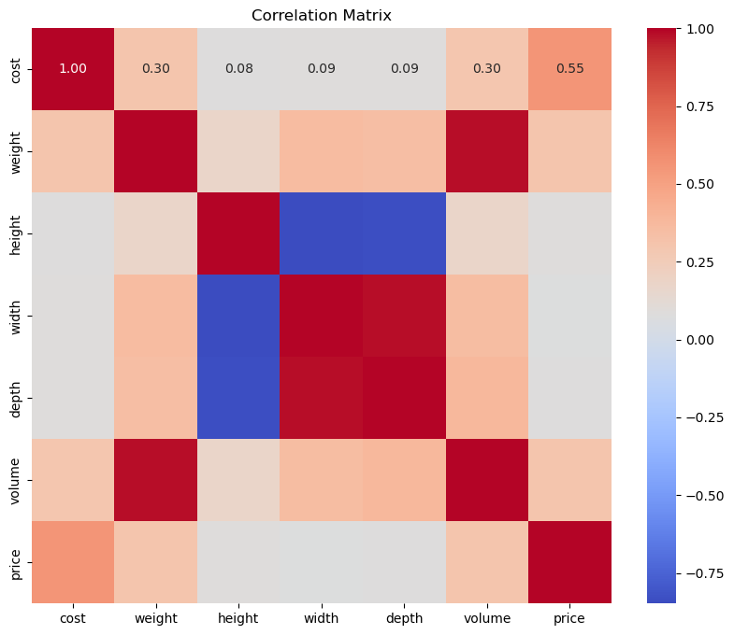
Correlation analysis of numerical values

Slide 7
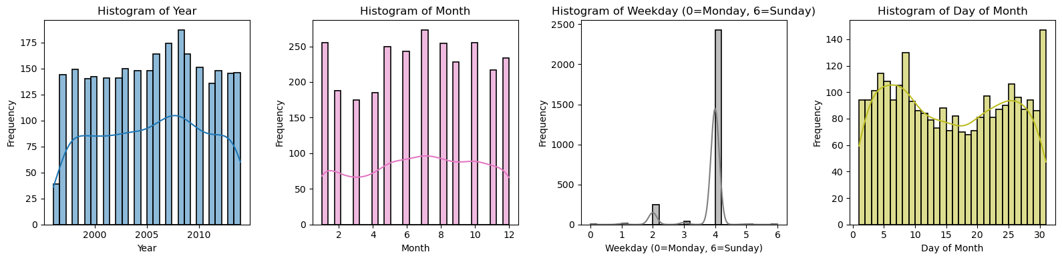
Time feature analysis: frequence

Slide 8
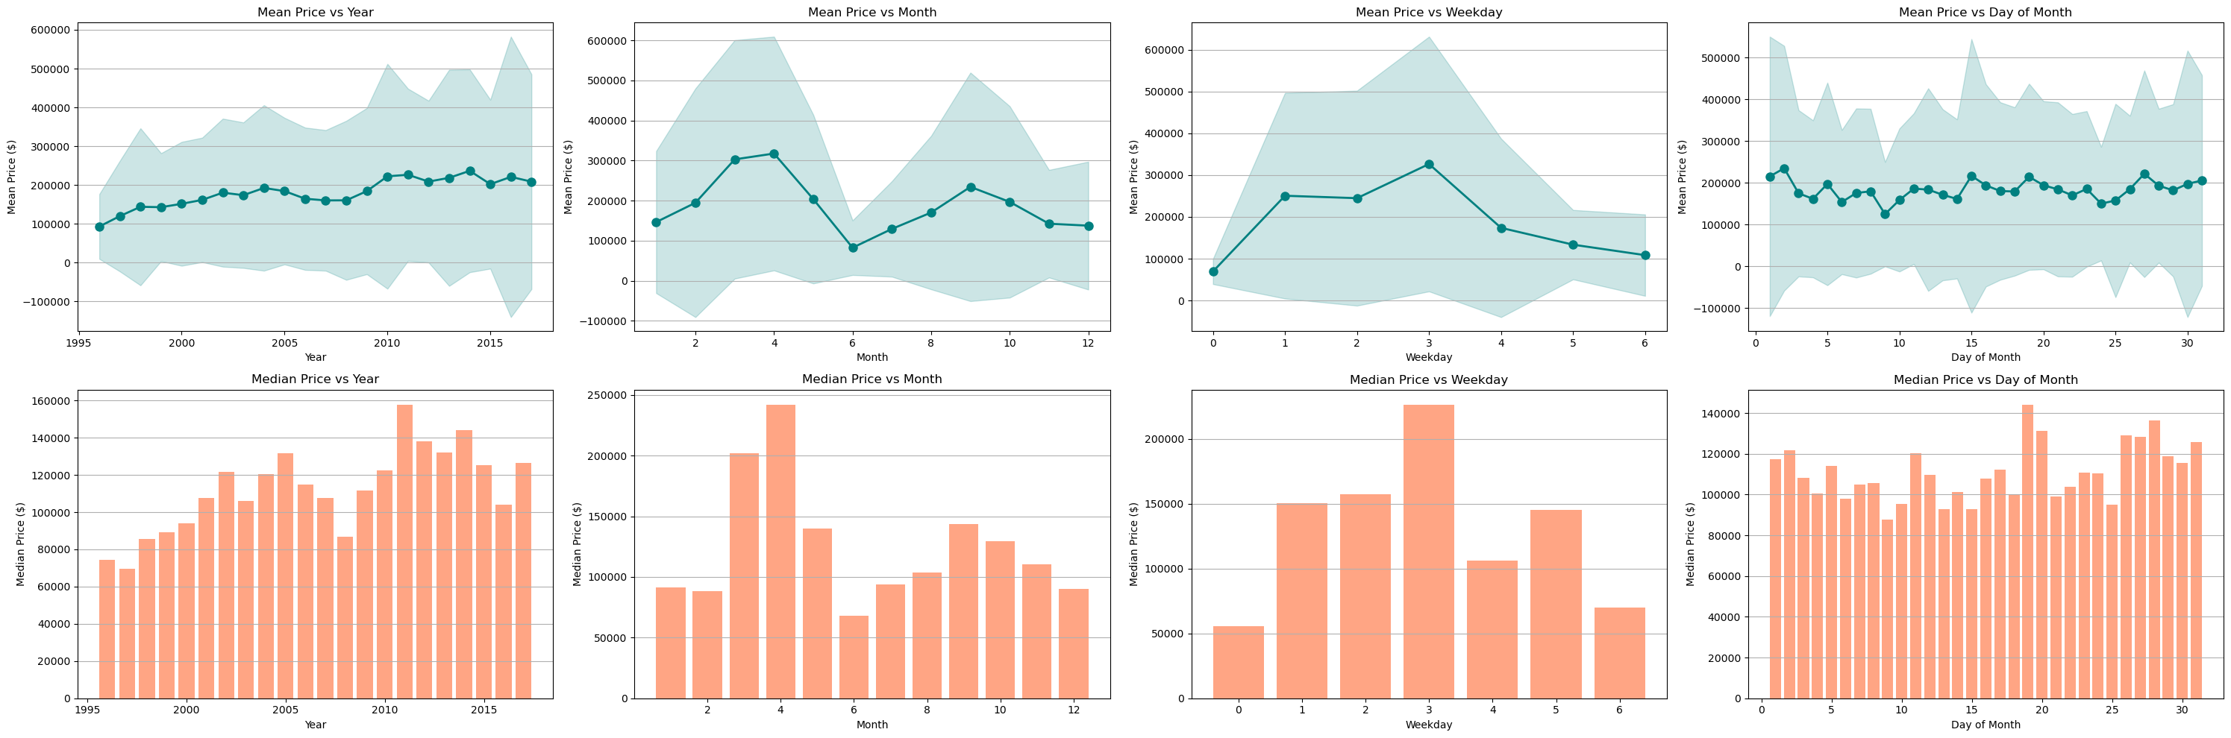
Time feature analysis: time vs price
Mean
Median

Slide 9
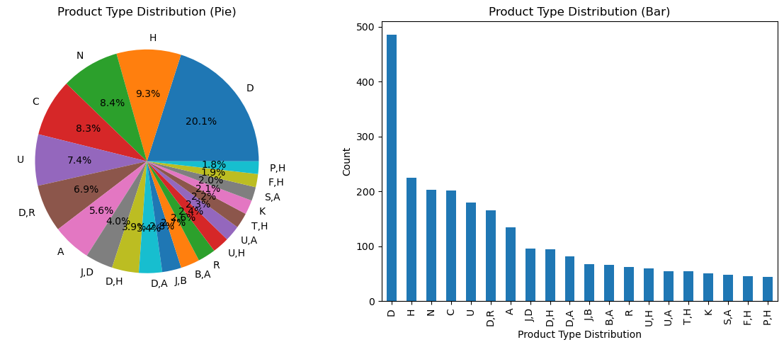
Categorical feature: product type

Slide 10
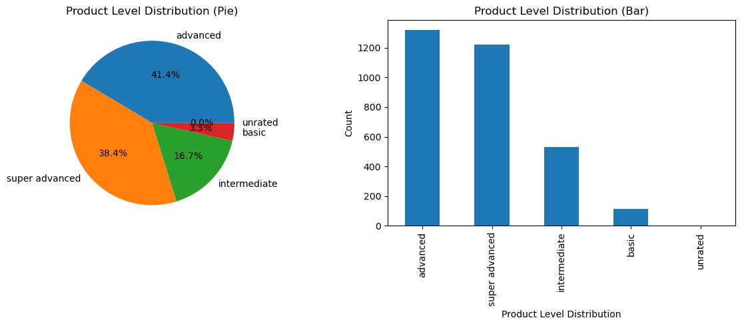
Categorical feature: product level

Slide 11
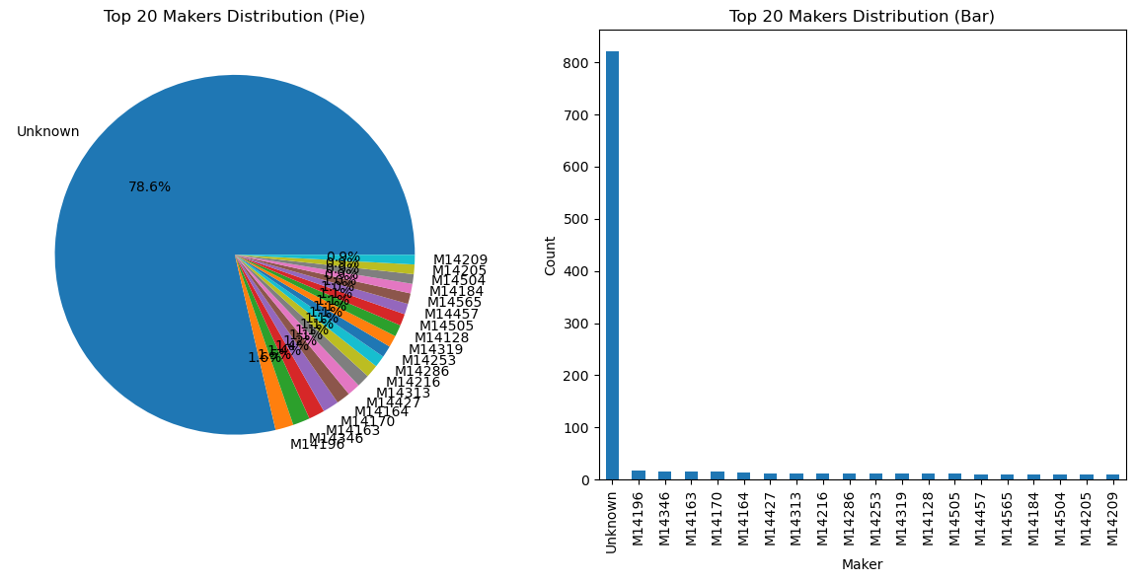
Categorical feature: maker

Slide 12
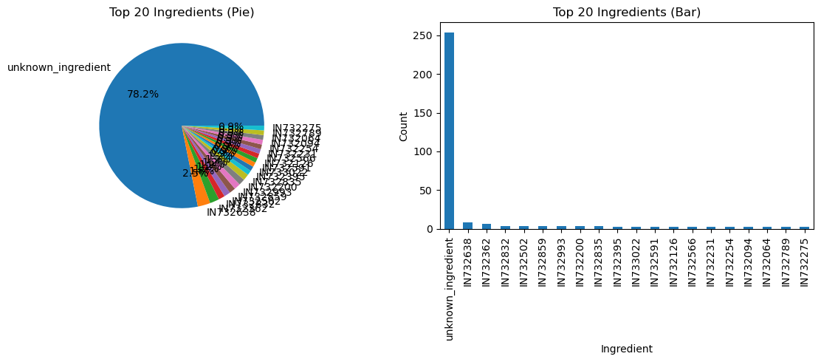
Categorical feature: ingredient

Slide 13
What Drives XoX Pricing?
Key Price Factors
Cost (strongest correlation with price)
Volume (significant impact)
Weight (moderate influence)
Physical dimensions (height, width, depth)
Temporal factors (when purchased)
Feature Relationships
Cost and price show strong positive correlation (0.55)
Volume and weight are closely related to each other
Physical dimensions have complex relationships
Some features have non-linear relationships with price
Understanding these relationships improves prediction accuracy

Slide 14
Feature Selection
numerical_features = ['cost', 'weight', 'volume']
categorical_features = ['product_type', 'product_level']
temporal_features = ['year', 'month','weekday']
all_features = numerical_features + categorical_features + temporal_features

Slide 15
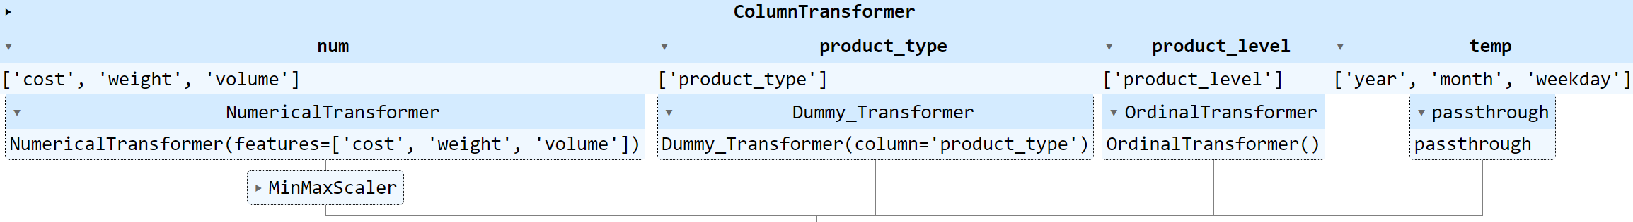
Feature Engineering

Slide 16
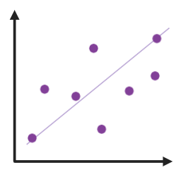

Building the Prediction Model
Linear regression
Decision tree

Slide 17
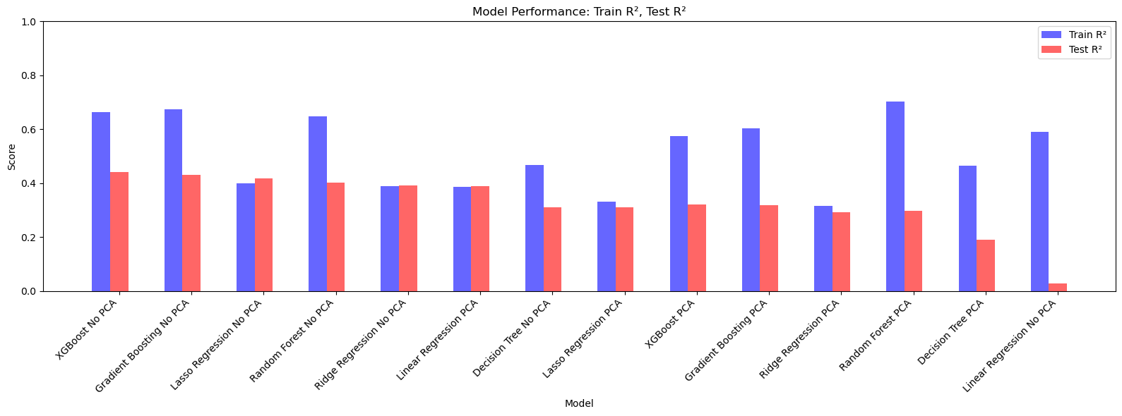
Model Performance: R²
Top-rank models explain about 40% of price variations (Test R²), which is strong for complex products.

Slide 18
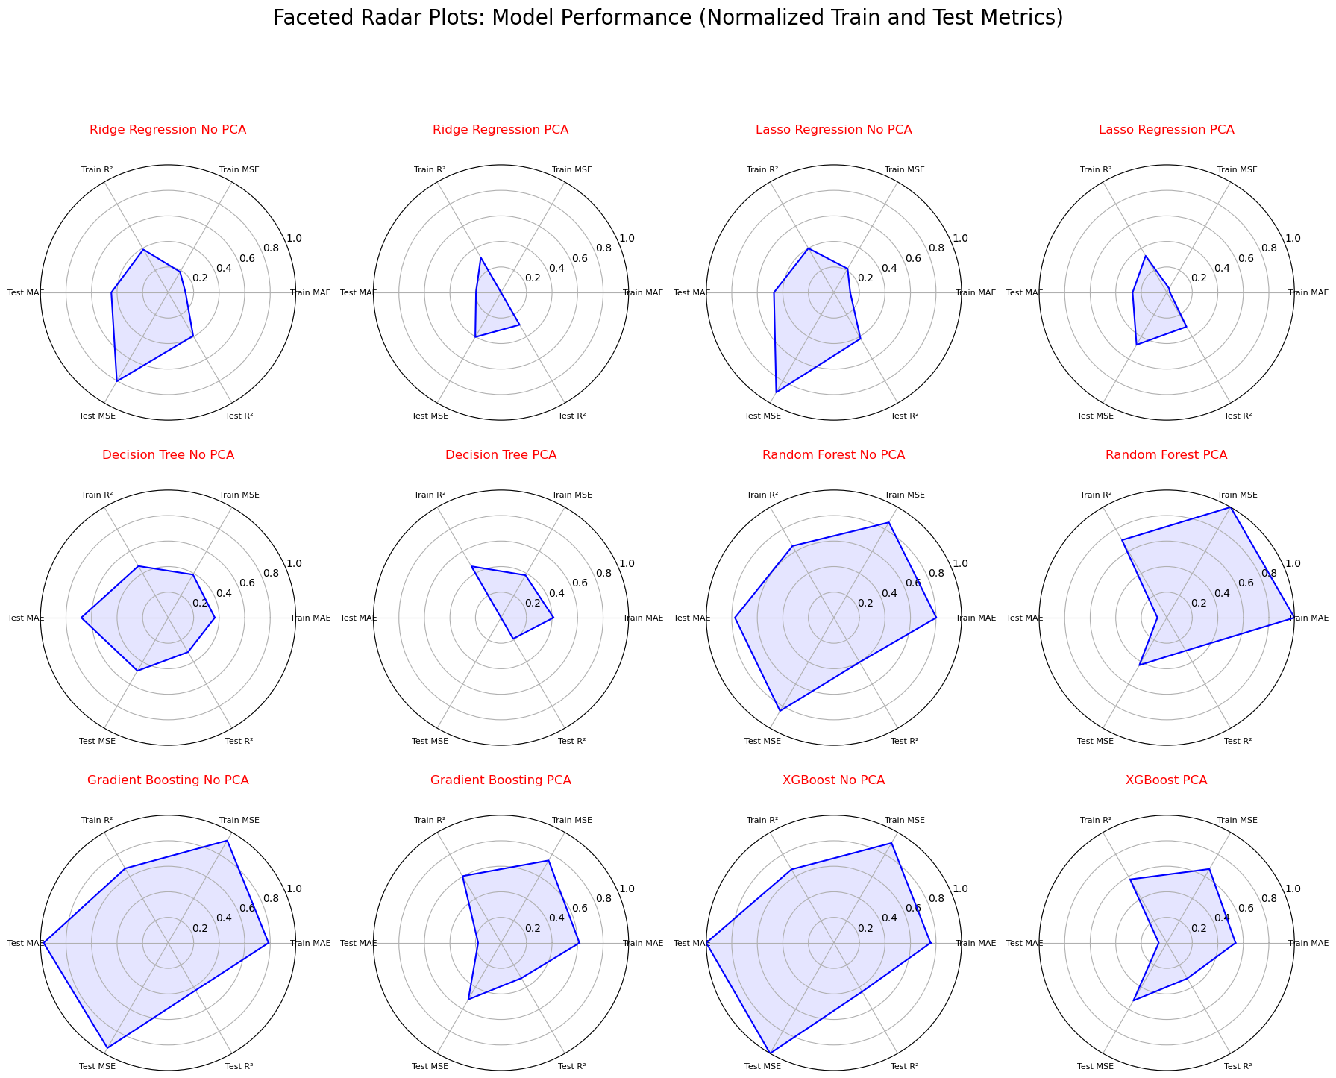
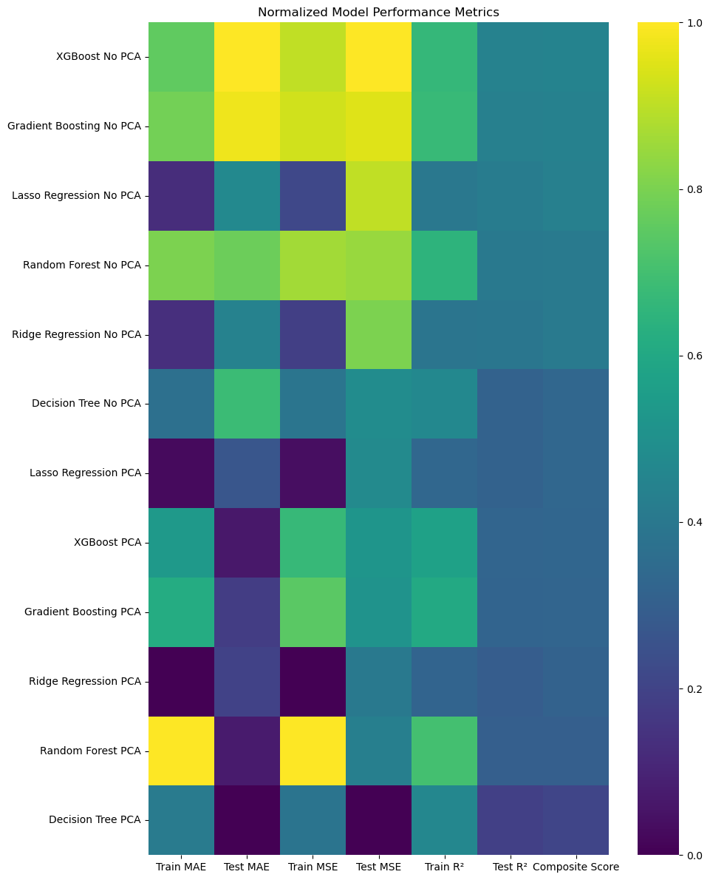
Model Performance: Overall

Slide 19
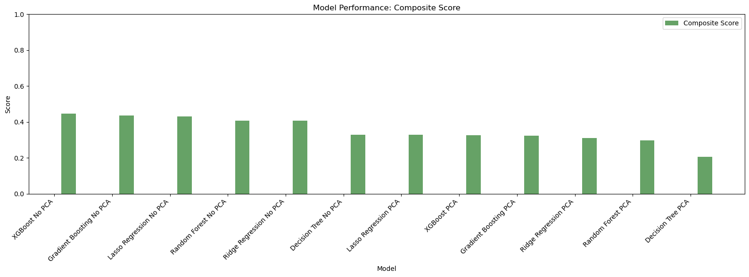
Select best model: XGBoost

Slide 20
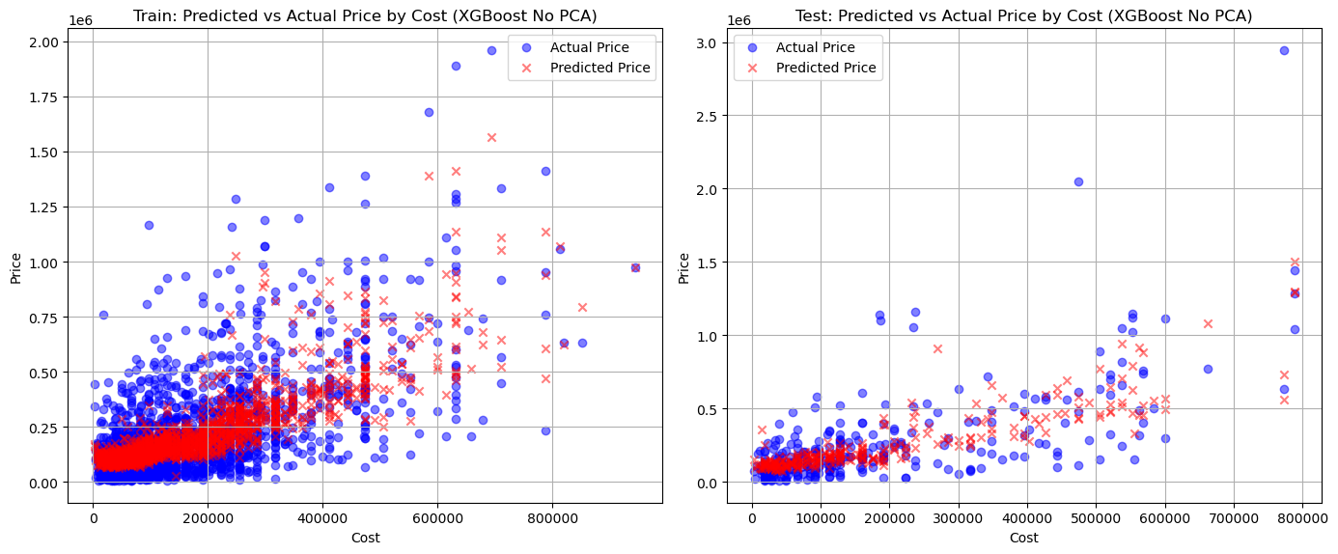
XGBoost: How Prices Are Predicted
The model looks at product details like cost, weight, size, and type.
It combines these factors to estimate a fair price, similar to how an expert would evaluate a product.
For example, a heavier, advanced XoX with high cost tends to have a higher price.
We provide clear insights so you understand what drives the price.
Visual: A simple diagram showing inputs (cost, weight, etc.) → Model → Predicted Price.

Slide 21
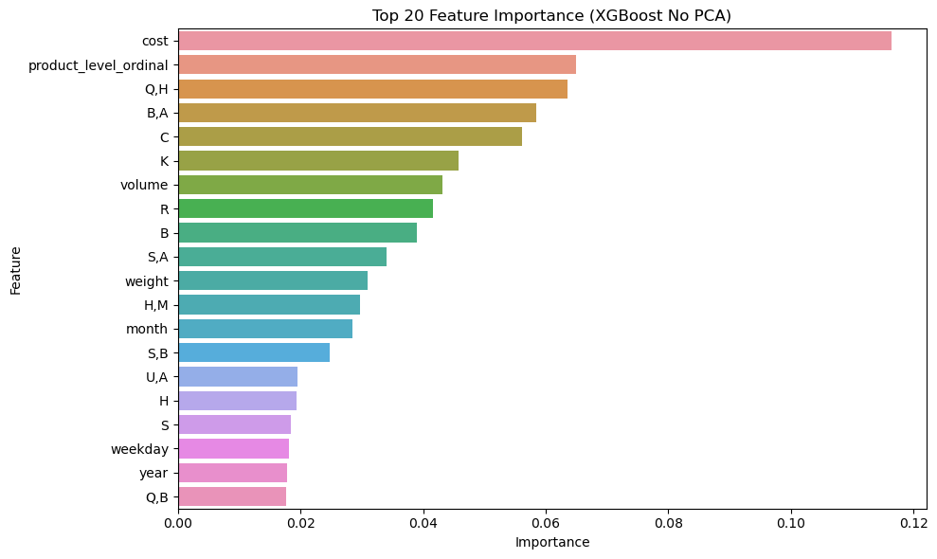
XGBoost: Feature importance

Slide 22
Stacking regressor
meta_regressor = XGBRegressor(random_state=42, n_estimators=100, max_depth=5, learning_rate=0.1, verbosity=0)
stacking_regressor = StackingRegressor(
estimators=base_learners,
final_estimator=meta_regressor,
cv=5,
n_jobs=-1
)

Slide 23
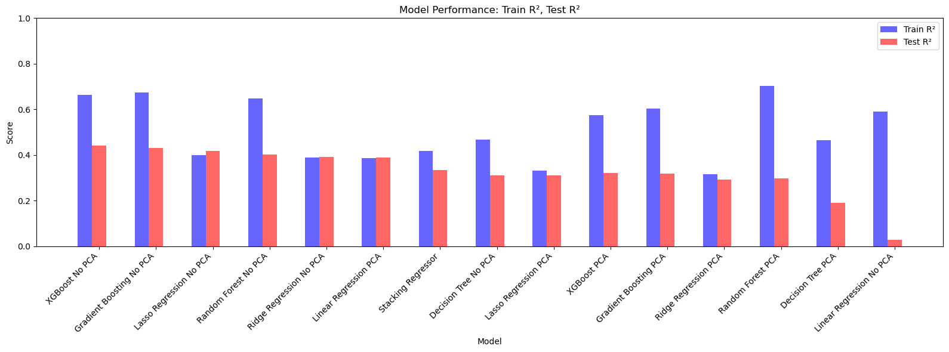
Results

Slide 24

Stacking regressor vs other models

Slide 25
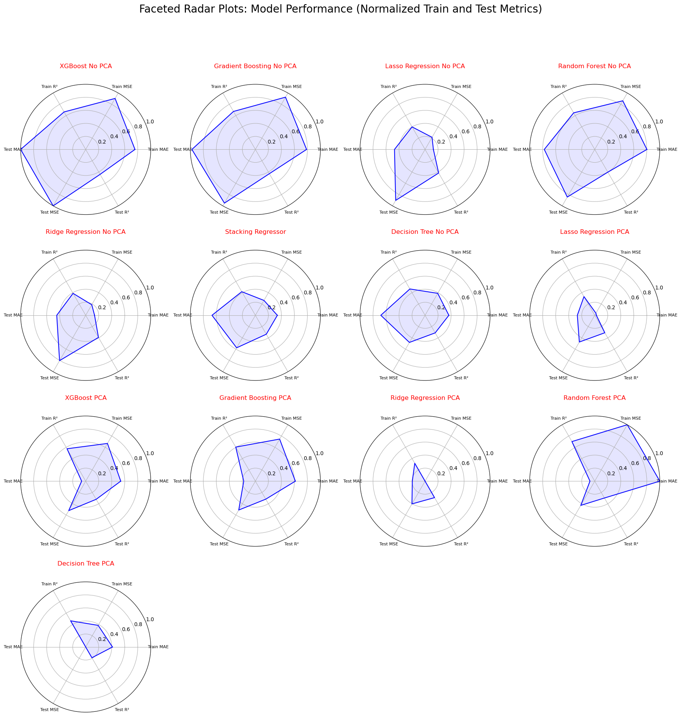
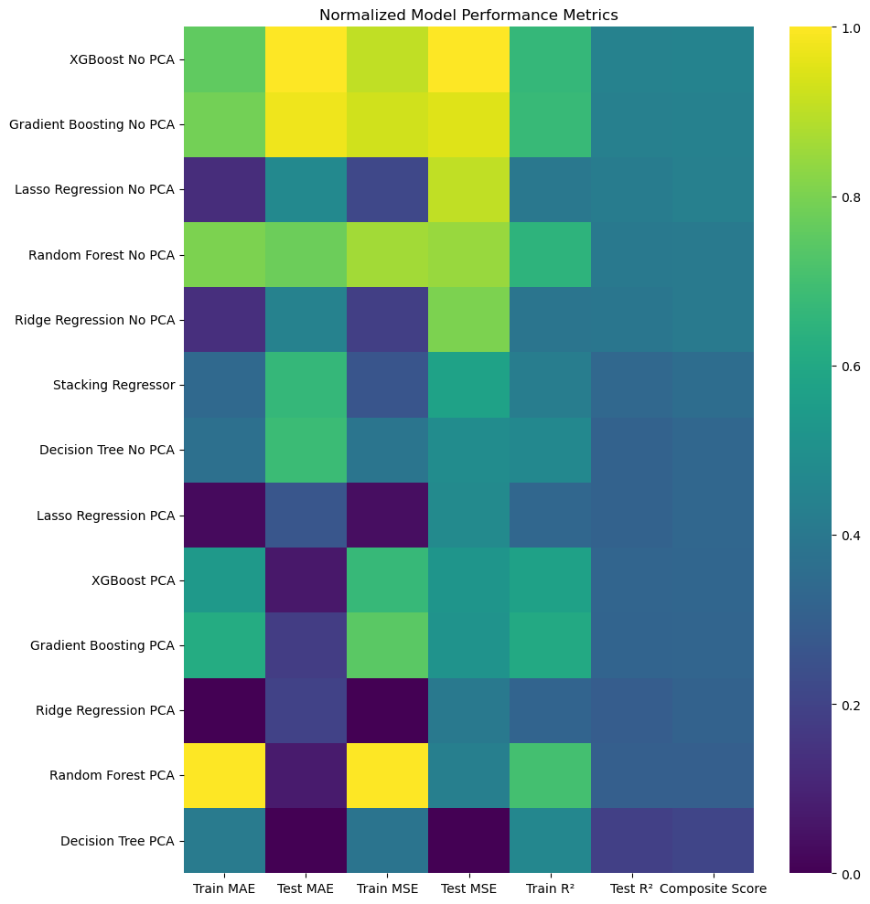
Stacking regressor vs other models

Slide 26
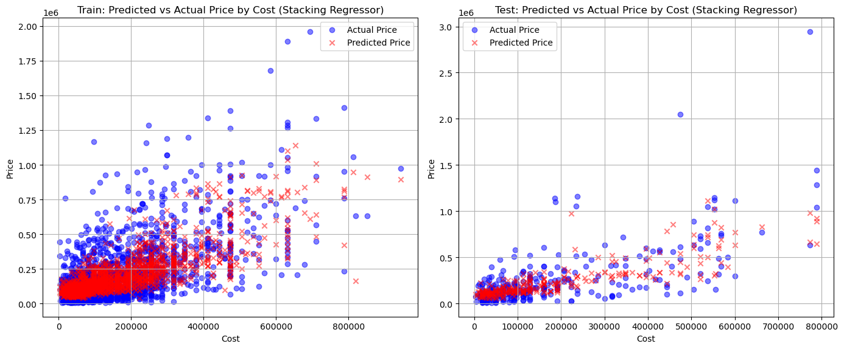
Stacking regressor: How Prices Are Predicted

Slide 27
How Well Does Our Model Perform?
High accuracy in predicting XoX prices across different price ranges
Low average prediction error (within acceptable range for business needs)
Consistent performance across different product categories
Outperforms traditional estimation methods by significant margin
Regularly updated with new data to maintain accuracy

Slide 28
Benefits for Our Business
Consistent price estimates across all customer interactions
Reduced time spent on manual price research
Increased customer trust through accurate predictions
Better negotiation position with suppliers
Data-driven insights for inventory and purchasing decisions

Slide 29
Next Steps
Model is ready for immediate implementation
Training for team members on using the prediction tool
Regular model updates as new data becomes available
Potential expansion to predict other product attributes
Continuous improvement based on feedback and results

Slide 30
Thank You
Questions? Contact the Data Science Team

