Slide 1
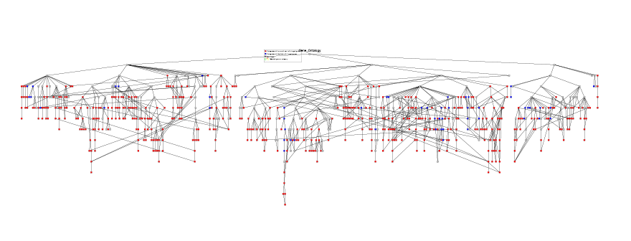
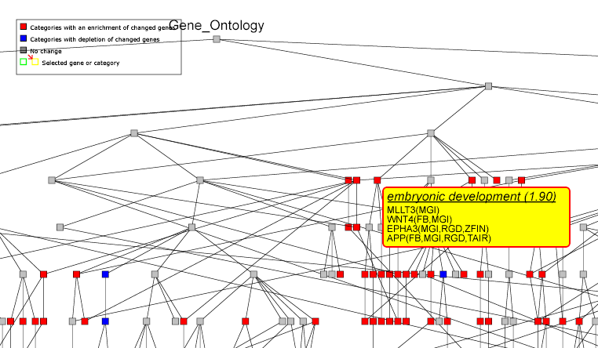

Slide 2
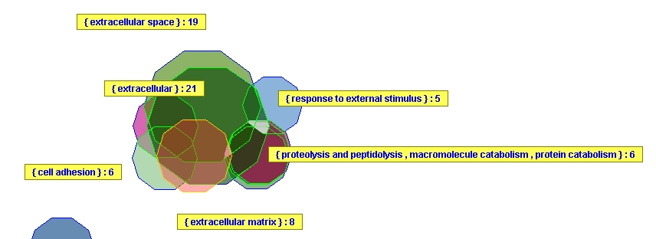
Genes differentially expressed between a specialized mesenchymal cell type (stellate cells) and normal skin fibroblasts (minimum total: 100; max p-value: 0.05): Although a total of 9 GO categories were reported to be significantly overrepresented among the changed genes, VennMaster analysis revealed that these categories strongly overlap and form a single large cluster of cell surface/extracellular matrix related categories

Slide 3
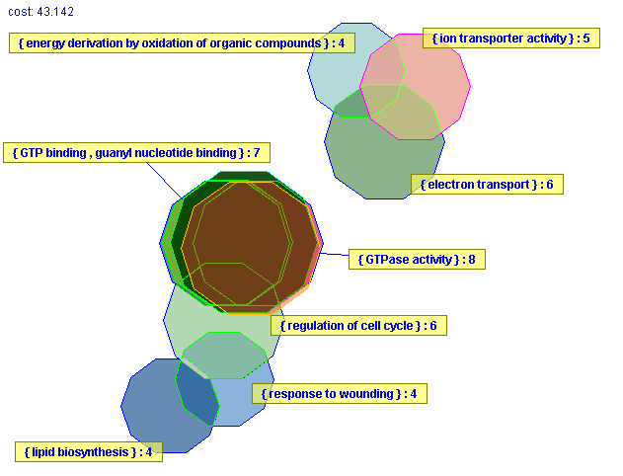
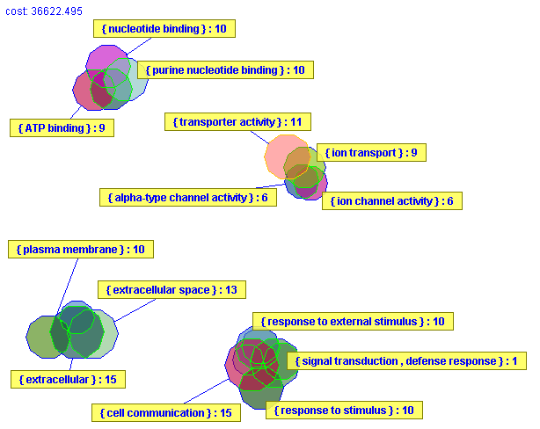
A
B
Genes overexpressed (A) or underexpressed (B) in pancreatic ductal carcinoma as compared to normal pancreatic duct cells (minimum total: 50; max p-value: 0.05): VennMaster analysis identifies distinct clusters of biologically relevant GO categories overrepresented among the overexpressed and underexpressed genes, respectively.

