Slide 1

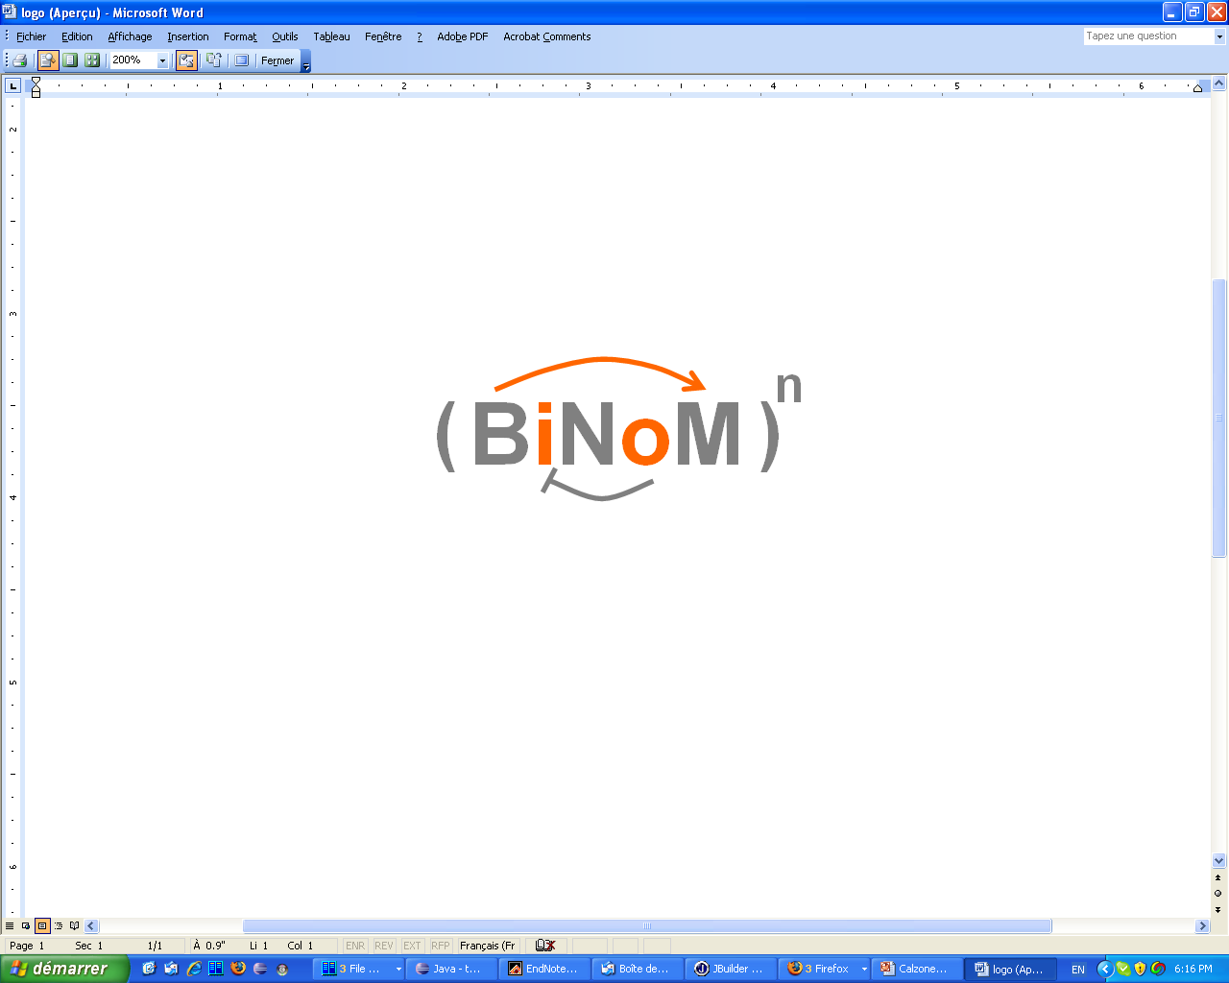
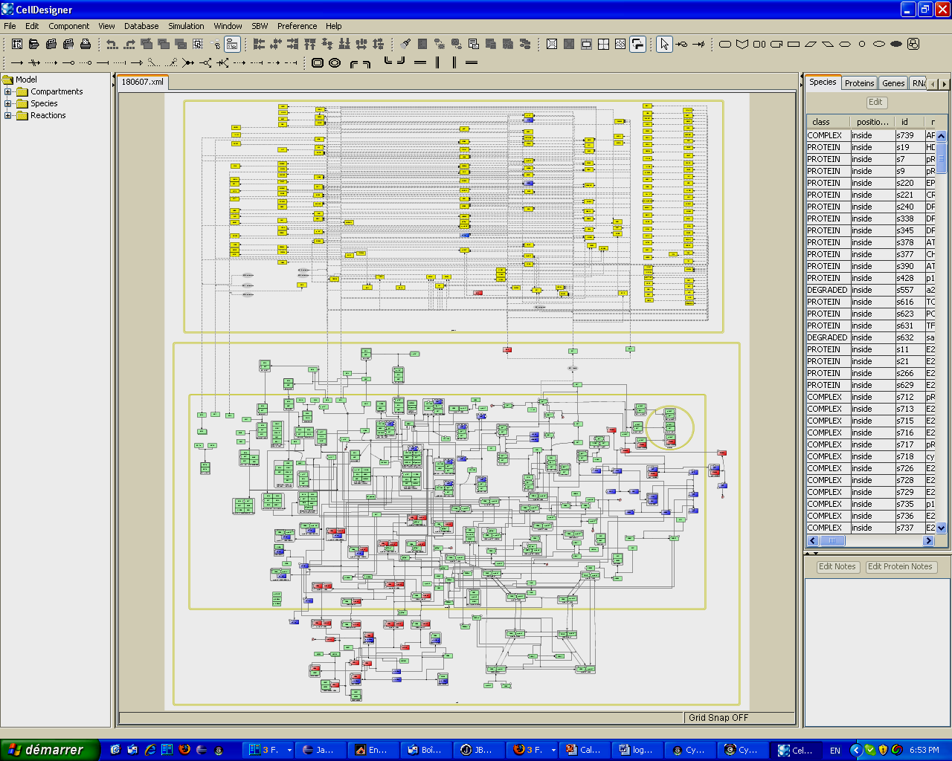
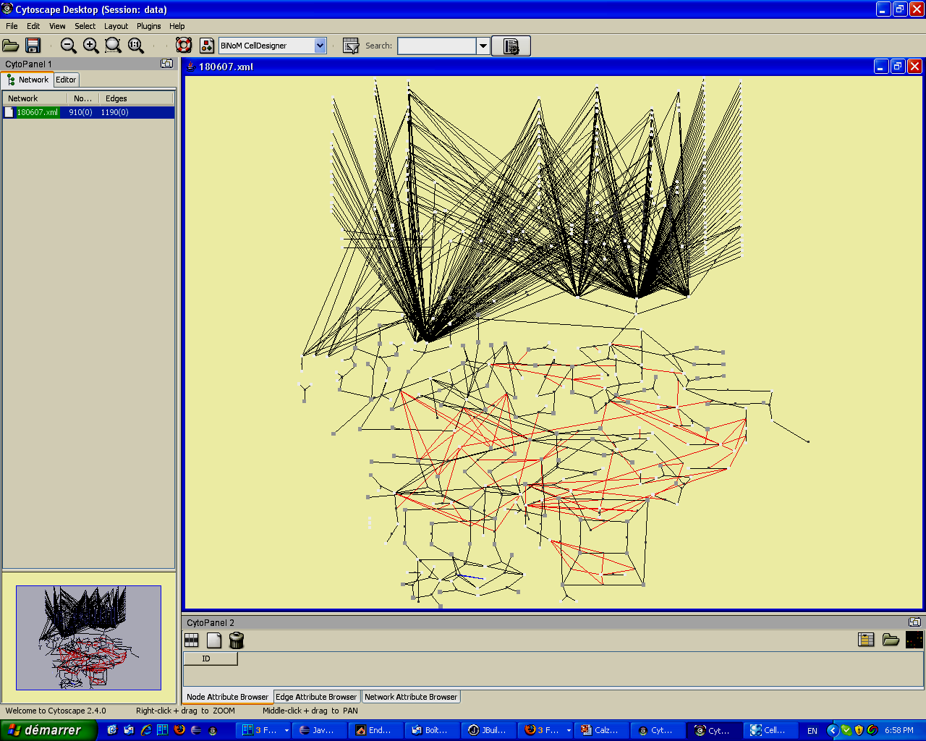
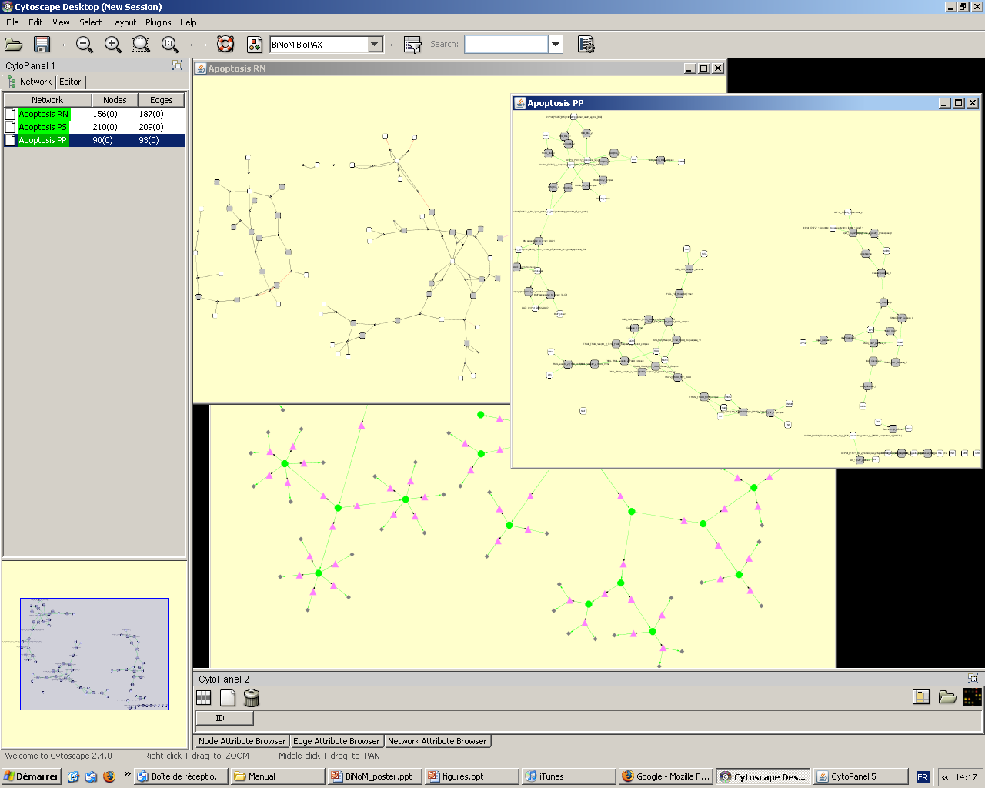
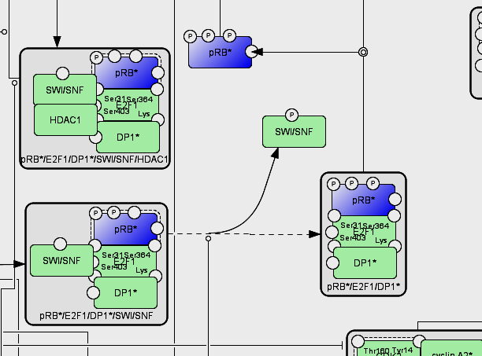
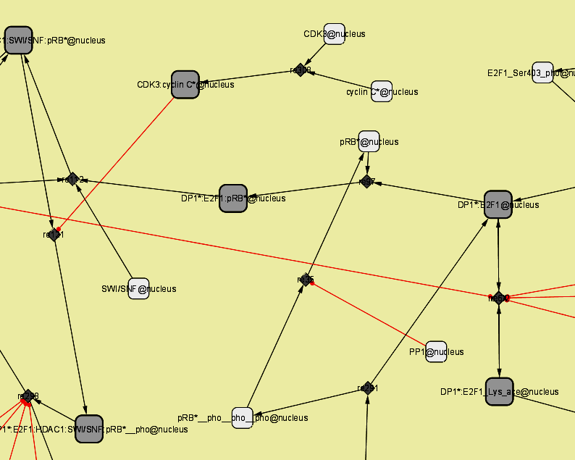
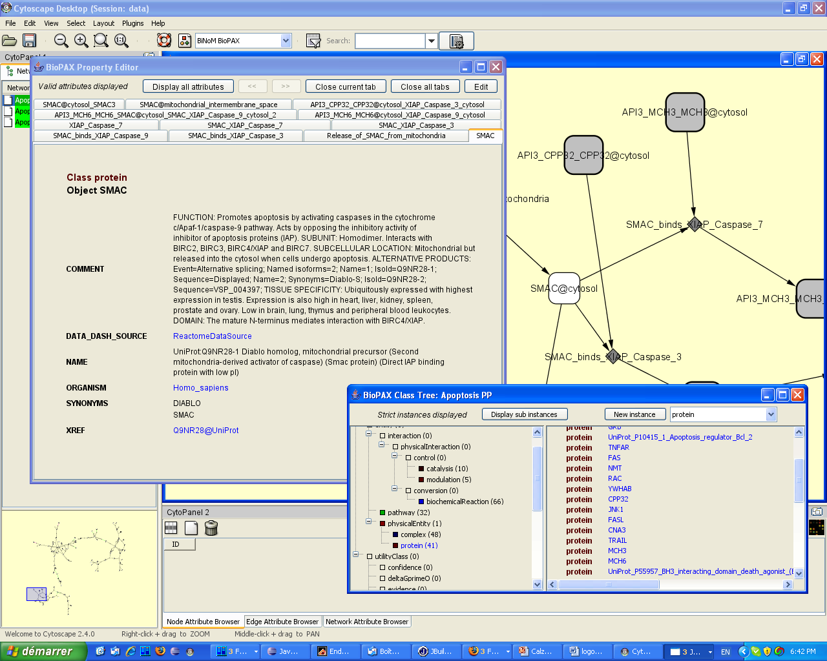
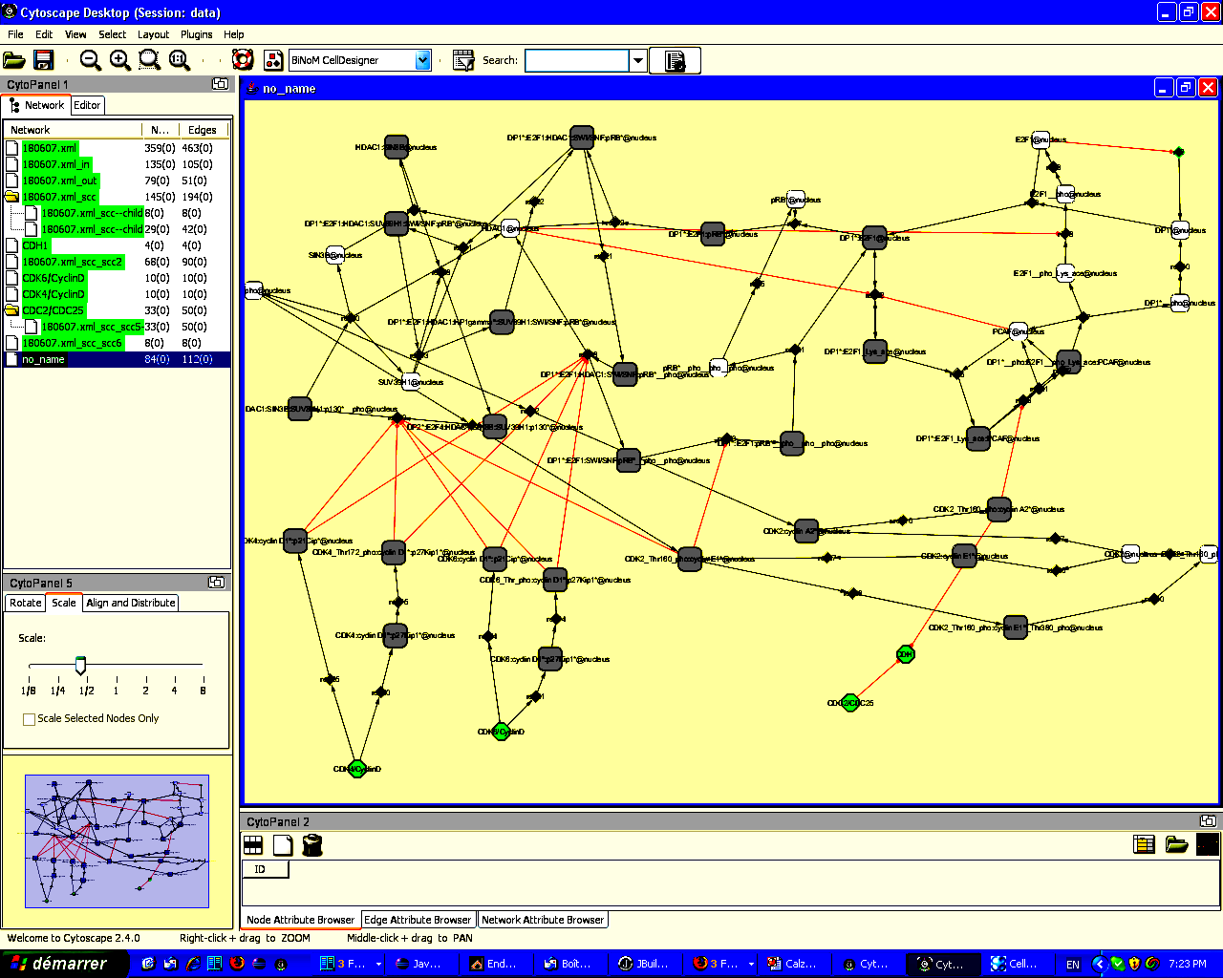
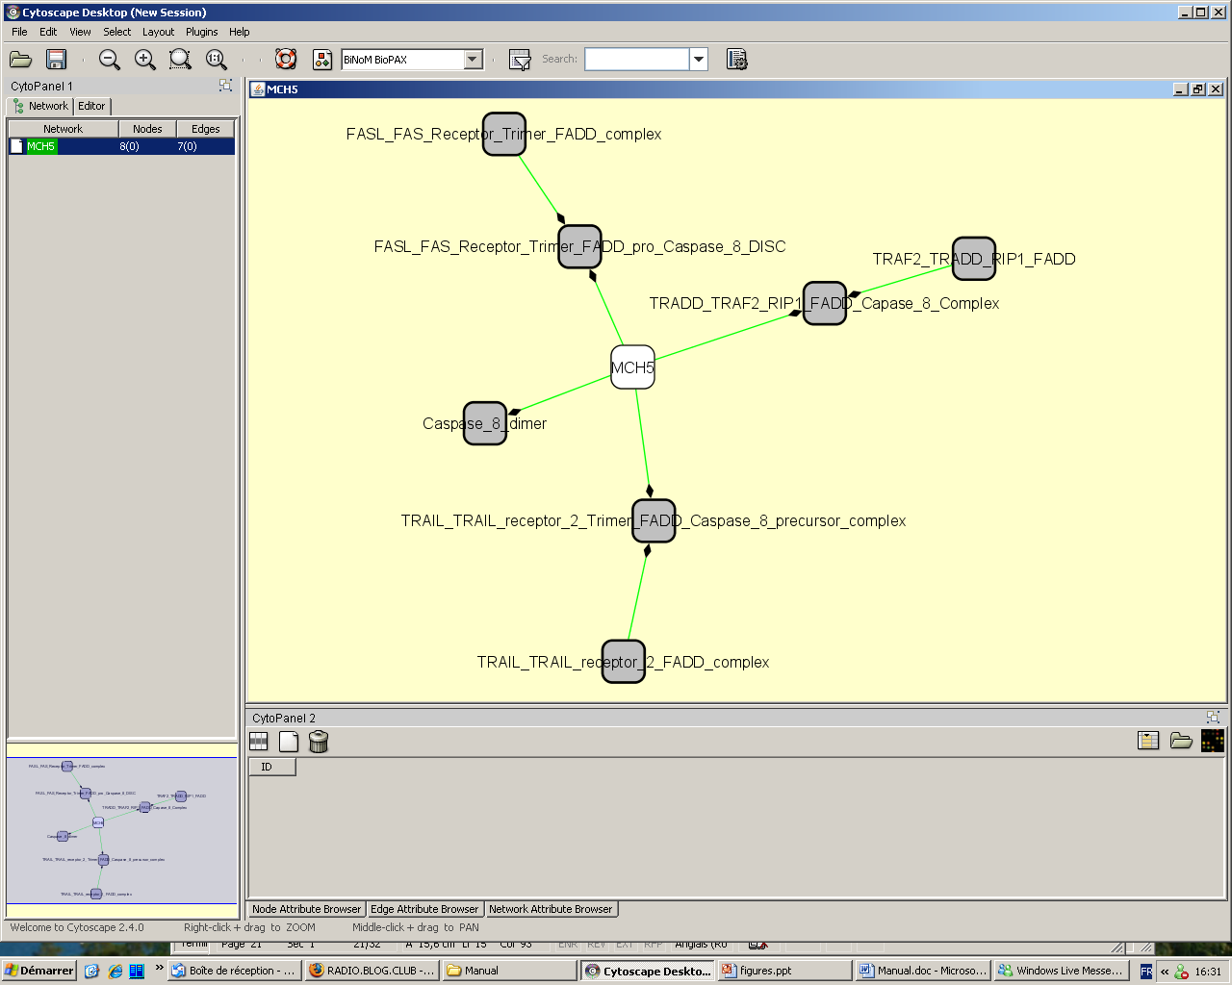
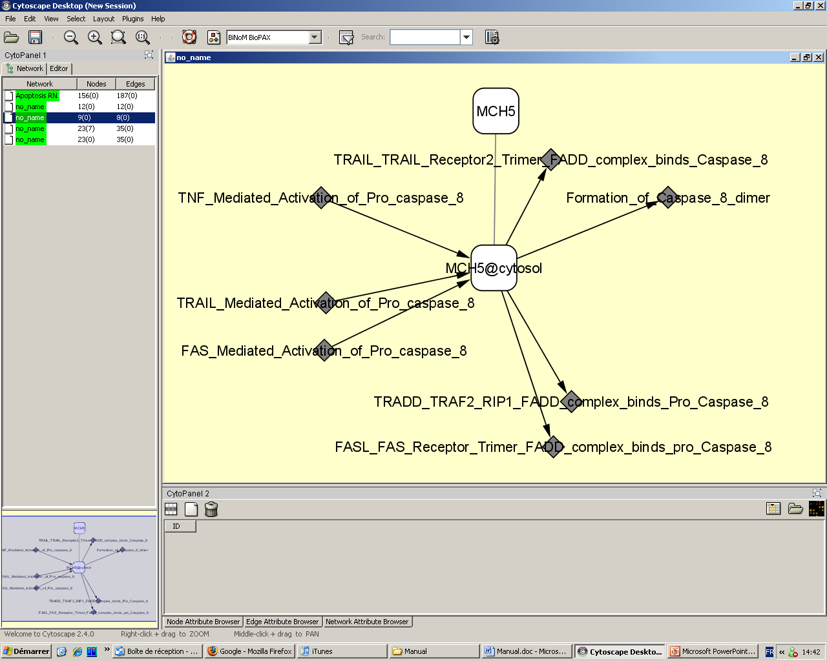
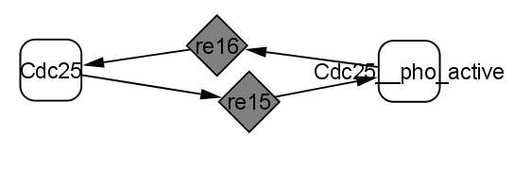
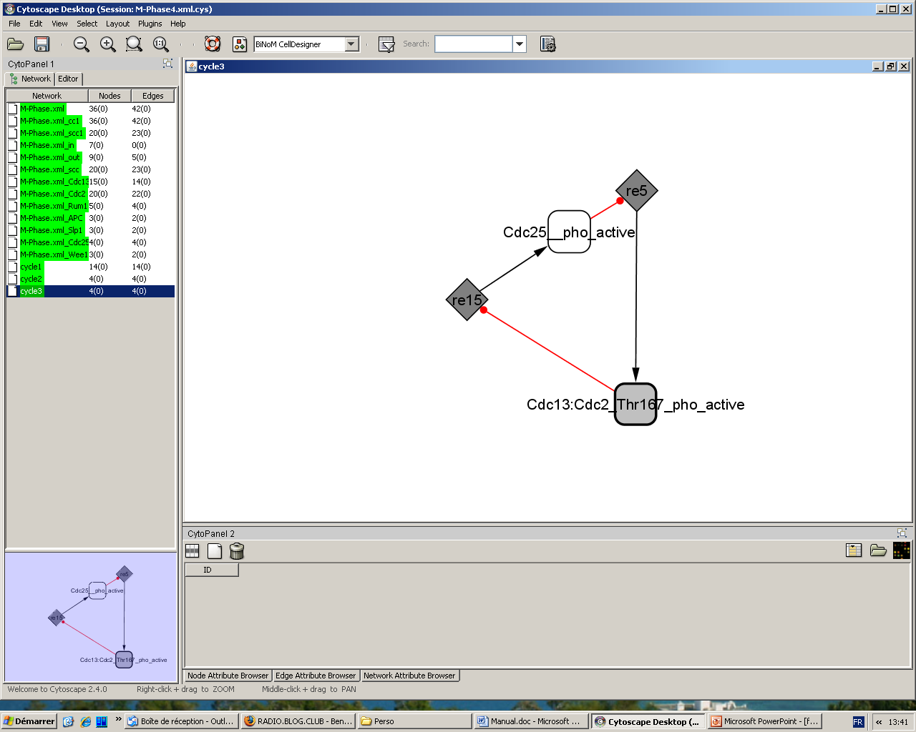
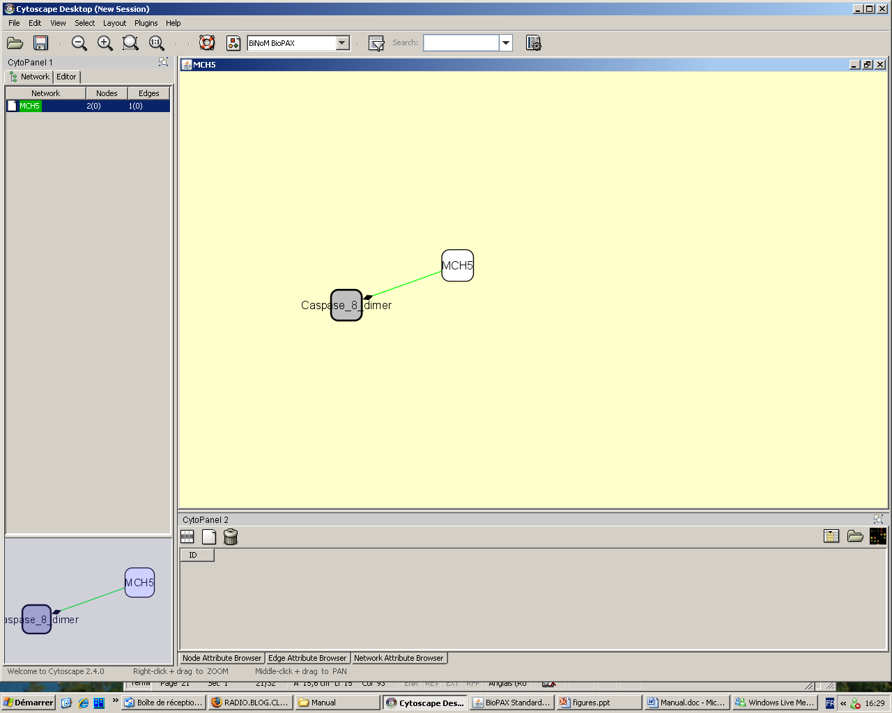
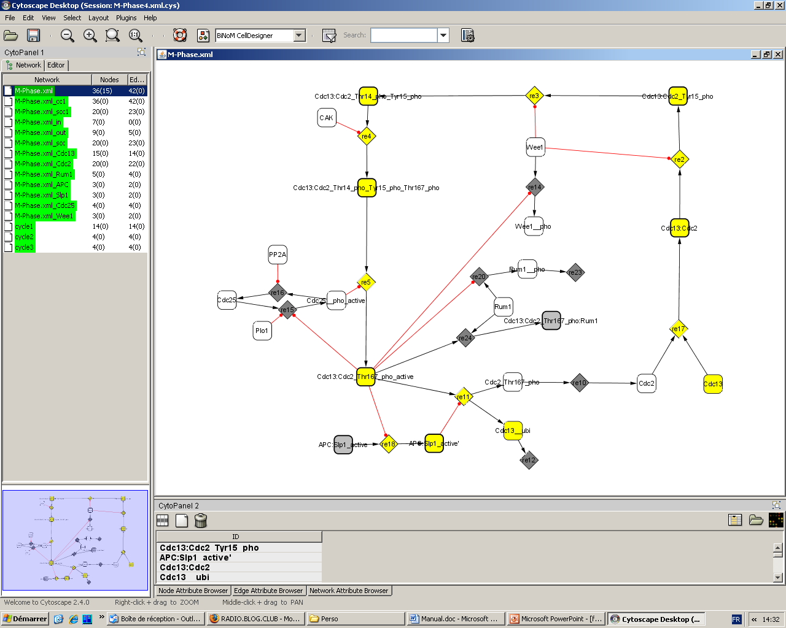
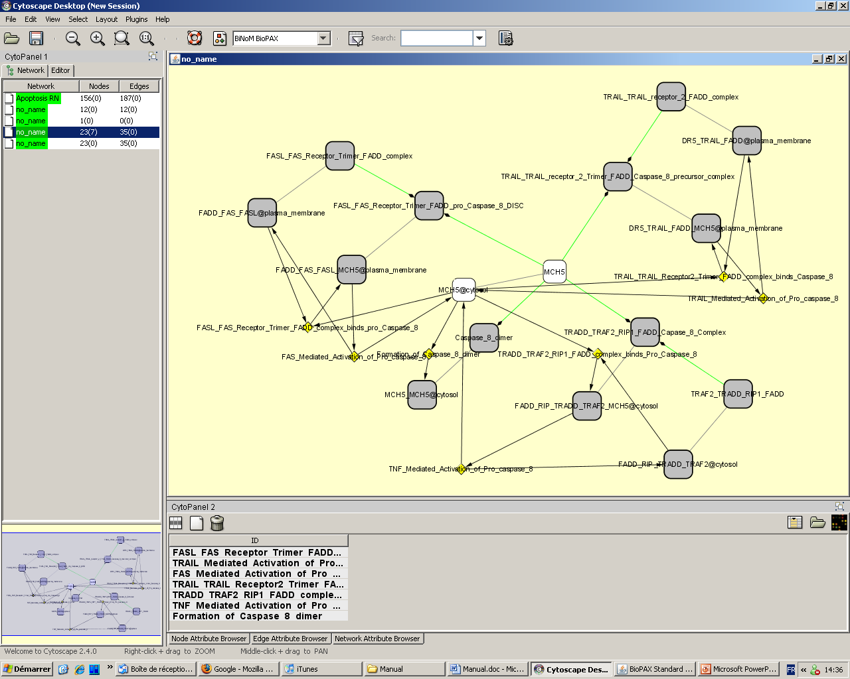
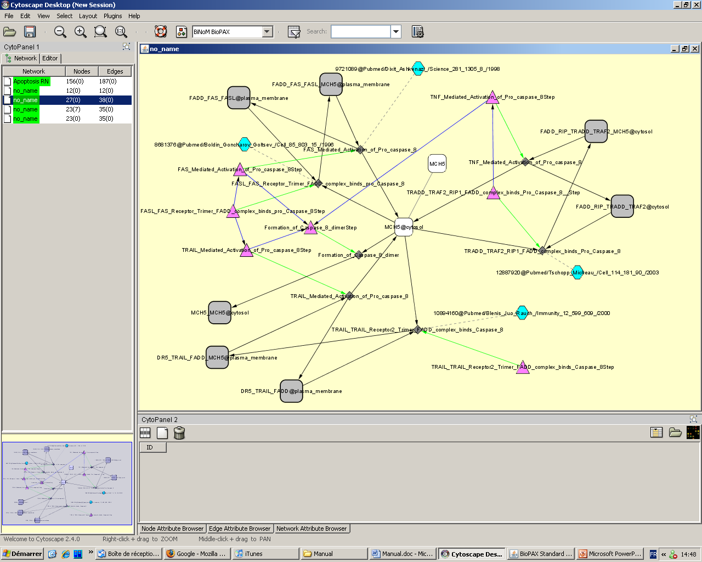
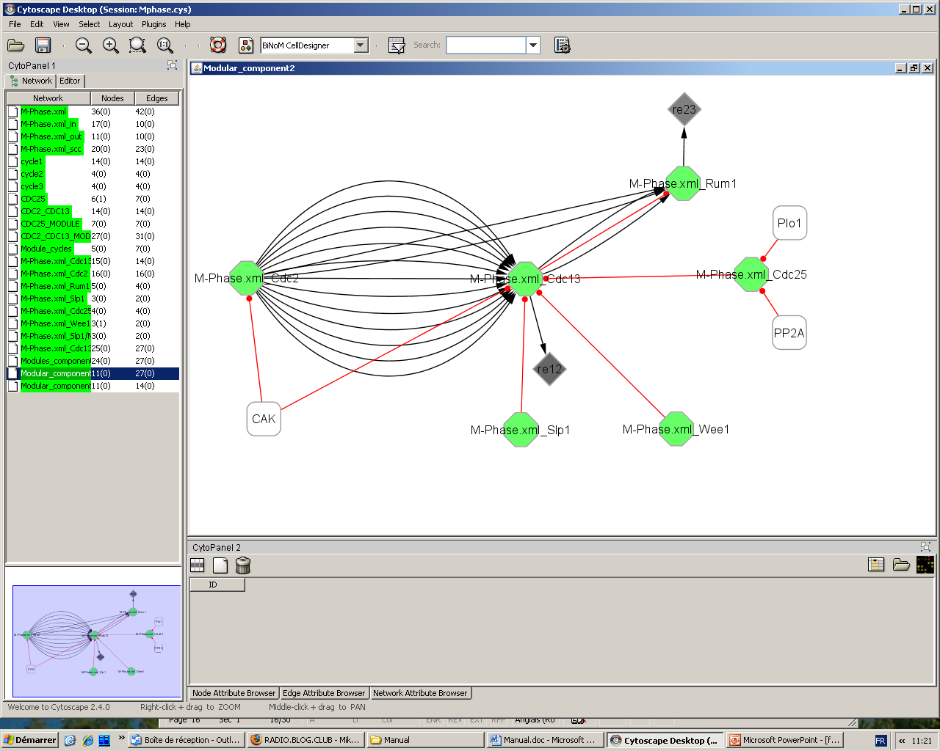
BiNoM: a Cytoscape plugin for using and analyzing
biological networks
Andrei Zinovyev, Eric Viara, Laurence Calzone, Emmanuel Barillot
Institut Curie / Service de Bioinformatique / Paris
BiNoM, a Cytoscape plugin
BiNoM Modules
BiNoM (BIological NetwOrk Manager) is a Cytoscape plugin, developed to facilitate the visualization and manipulation of biological networks represented in standard systems biology formats (BioPAX, SBML, etc.) and answer some network structural issues.
BiNoM provides the user with a complete interface for the analysis of biological networks in Cytoscape environment.
BiNoM I/O
BiNoM Structure analysis
BiNoM
Utilities
BiNoM BioPAX
Utilities
BiNoM BioPAX Query
BiNoM I/O
BiNoM imports CellDesigner and BioPAX files; exports and manipulates CellDesigner, BioPAX and SBML files
From CellDesigner to Cytoscape using BiNoM
From BioPAX to Cytoscape using BiNoM
CellDesigner
CellDesigner
Manipulations
in BiNoM
using Cytoscape
BioPAX
BioPAX
SBML
BiNoM generates 3 standard interfaces:
Reaction Network (RN), Pathway Structure (PS), and Protein-Protein interaction (PP).
BiNoM BioPAX Utilities
BiNoM BioPAX Queries
BiNoM Structural Analysis
Retrieve, modify and save BioPAX information:
BioPAX Property Editor reviews all the available information about a protein, a gene, a pathway, etc. contained in BioPAX
The query interface proposes to work with huge BioPAX files.
BiNoM maps BioPAX content onto a map
=> Creation of an index, which contains the totality of BioPAX objects and relations.
BiNoM extracts parts of the BioPAX content and exports it into a separate self-containing BioPAX file
EXAMPLE:
BiNoM offers many features of structural analysis techniques. Among them:
Network decomposition
Material or cycle decomposition
Path analysis
Create modular view or clusters from network
IN
A network is decomposed into incoming components (IN), ougoing components (OUT) and a central cyclic part (Strongly Connected Components) (cf. Bow-tie structure)
OUT
SCC
MCH5 (Caspase 8) extracted with all the species - homodimers or complexes - in which it is involved
MCH5 in all its cellular locations extracted with the reactions in which it participates
CDC25 phosphorylated and the active complex CDC13/CDC2 form a cycle
The life cycle of a protein is isolated (here CDC25)
BioPAX Class Tree shows all instances of BioPAX classes (proteins, complexes, conversions, catalyses, etc.)
MCH5 in all its cellular locations, the reactions in which it particpates along with the other components
MCH5 and all the infomation attached to it (reactions, species, locations, publications, etc.)
Given a source (starting protein: CDC13) and a target (endin protein (CDC13-phosphorylated), BiNoM highlights the path according to pre-defined criteria (shortest, (non)oriented, (sub)optimal, paths)
BiNoM Utilities
List of functions that faciliate the manipulation of networks: selecting, copying and pasting parts of networks, comparing networks, updating networks or subnetworks, etc.
Networks with a high percentage of shared proteins are grouped into clusters and form modules (green nodes).
The connections between nodes are represented by arrows (one arrow for one reaction)
BiNoM plugin with documentation, API and source code is available for download at:
http://bioinfo.curie.fr/projects/binom/
Institut Curie Bioinformatics Lab: http://bioinfo.curie.fr/
System Biology Group: http://bioinfo.curie.fr/sysbio

