Slide 1
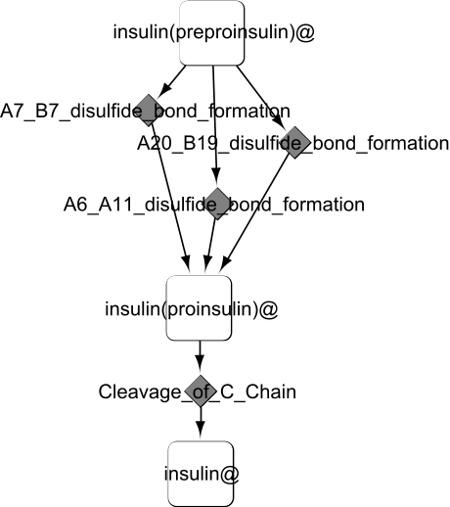
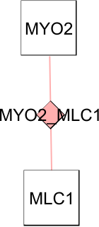
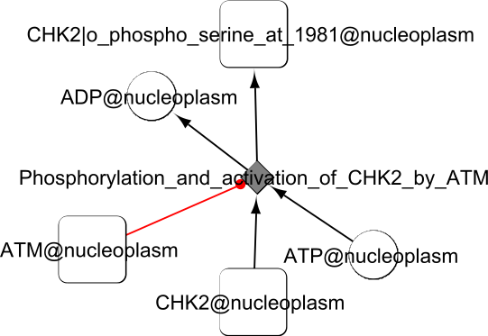
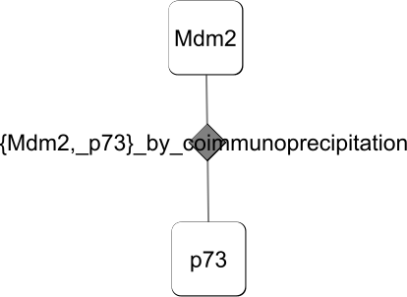
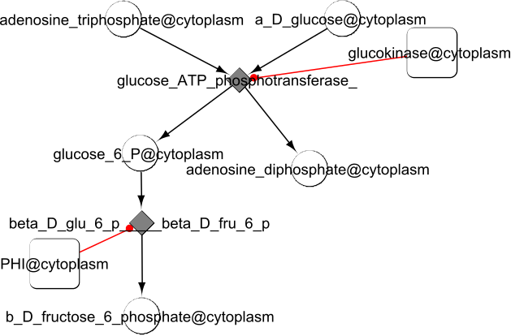
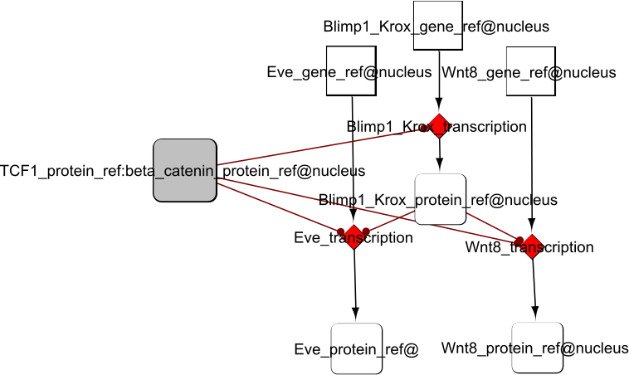
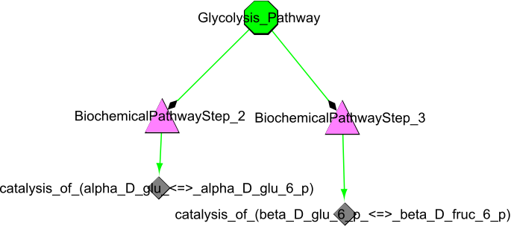
genetic-interaction
Ineraction Map
protein-interaction
Interaction Map
phosphorylation-reaction
Reaction Network
insulin-maturation
Reaction Network
short-metabolic-pathway
Reaction Network
short-metabolic-pathway
Pathway Structure
template-reaction
Reaction Network

