Slide 1
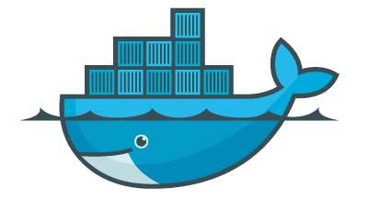
Docker for reproducibility
Package software into standardized units for development, shipment and deployment
Parts:
Image -> server
Docker engine -> local machine
Builds Container from Image
As developer, ship software that can be used in different computers
Write and deliver the container’s Dockerfile
Defines an Image
Receive less angry mail
As user, get software that comes with all dependencies
Install Docker engine, know Image name
Send less angry mail

Slide 2
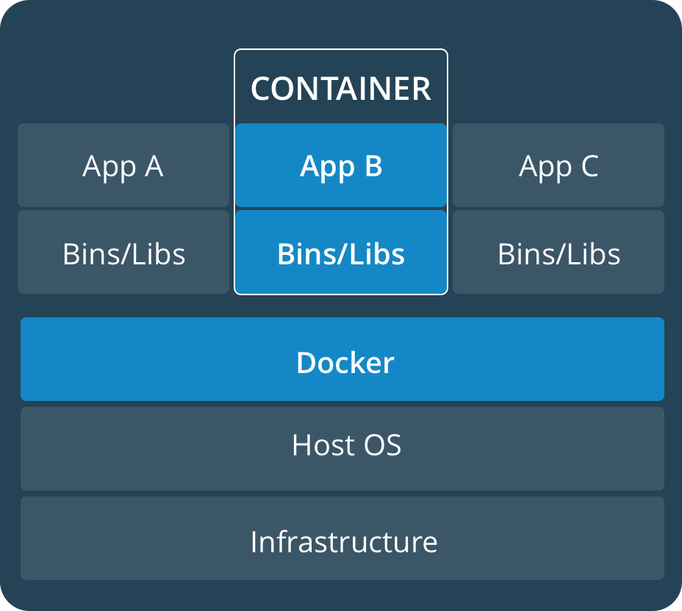
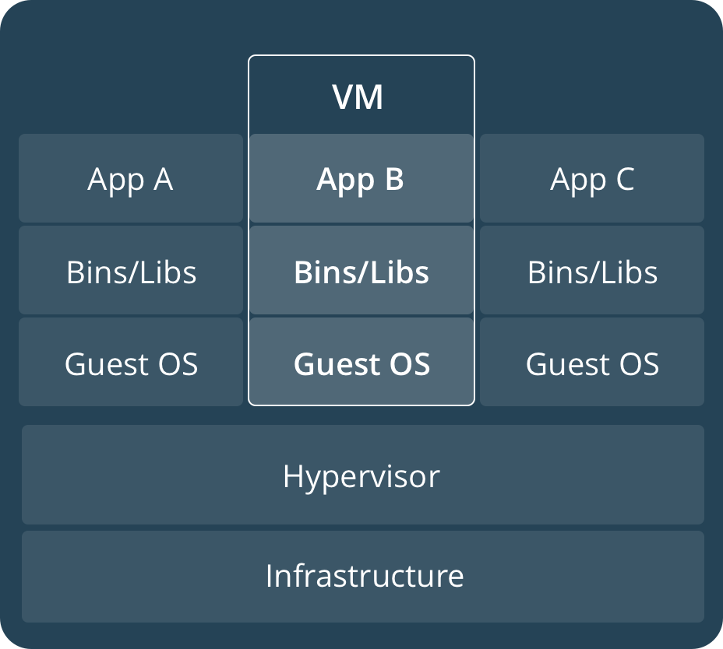
Docker
Docker container
Virtual machine
Oversimplification: container is lightweight, less intense, more versatile VM

Slide 3
Typical process
Write a Dockerfile
You can take someone else’s
Many flavours
Build an Image
~ compilation
Offline or online (DockerHub)
Host it on DockerHub
Pull from Docker engine
Run it from Docker engine
Pipeline example:
Debian stretch + java + R-3.4.1 (includes perl) + rstudio
https://hub.docker.com/r/arnaumontagud/logical_modelling_pipeline/~/dockerfile/
FROM debian:stretch
Only one FROM, “root OS”
All other tools have to be in debian:stretch
Developer
User

Slide 4
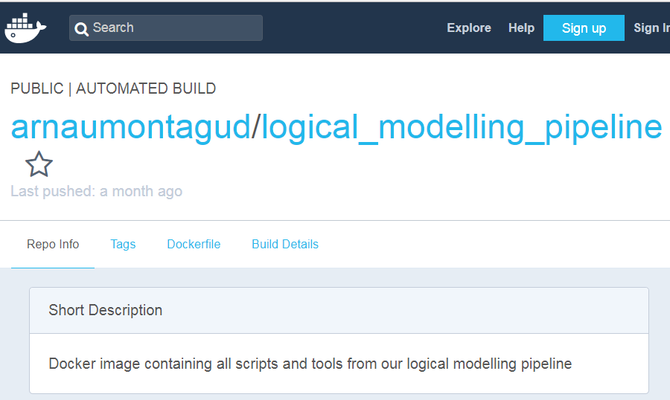
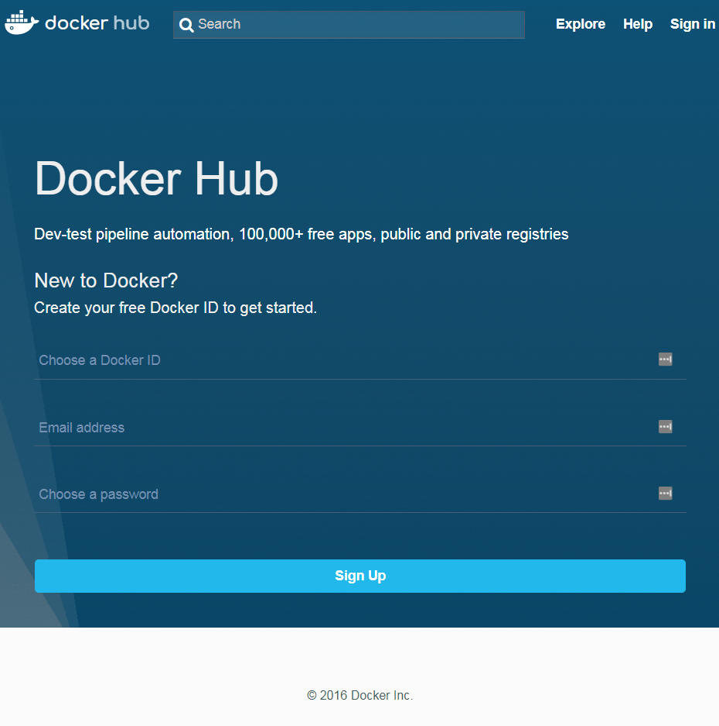
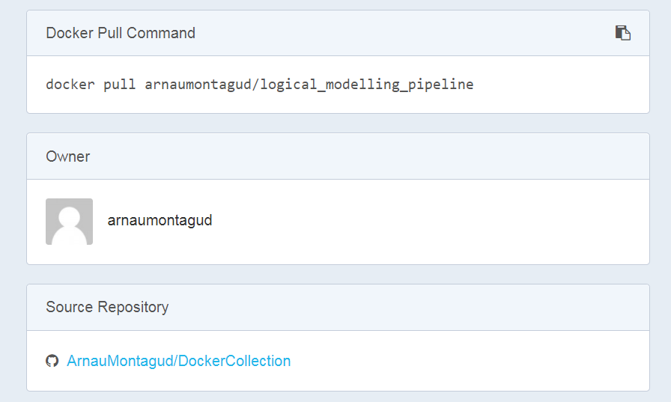
Docker hub: explore containers

Slide 5

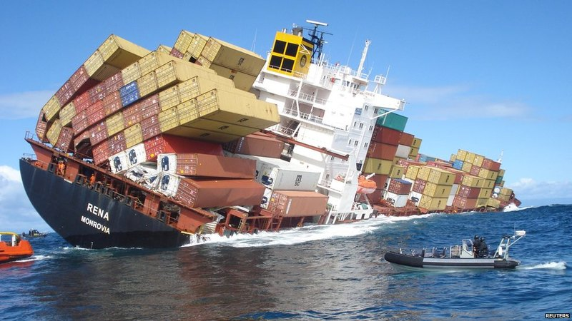
Containers can still sink
Docker engine must be installed
Windows < 10 can have problems
Re-using Docker containers can be tricky
Need to fetch up-stream container and add all dependencies
Java, R, Rstudio, flex, bison
Memory problems
Java heap space must be specified
It does not upgrade your machine
It won’t be faster than local CPU
From Curie you cannot build the Image (compile)
It has to be done through DockerHub
Docker container can be big (>3GB)
Tendency towards “Tiny Docker” Images
Minimal OS with only the strictly needed tools → less versatility
https://www.inovex.de/blog/docker-a-comparison-of-minimalistic-operating-systems/

