Slide 1
Towards reproducible research in SysBio group’s projects: specifying the challenge, assessing the tools, outlining solutions

Slide 2
Problem of reproducible research
General problem of reproducibility in science
Reproducibility is a fundamental concept in the philosophy and practice of science. For hundreds of years, care has been taken over the reliability of experimental methods and results.
However, today, “a reproducibility crisis in science” is sometimes claimed
Example: Amgen pharmaceutical company reported that its scientists had repeated experiments in 53 'landmark' papers, but managed to confirm findings from only six of the studies (Begley, C. G. & Ellis, L. M. Nature 483, 531–533 (2012))
Reproducibility is now being enforced by funding agencies, governmental structures and journals. This becomes a legal issue all researchers should be trained and should practice reproducible research. Students should be trained to do so.
Specific problems of computational bioinformatics

Slide 3
Bibliography on reproducibility in computational science
Stodden, V., Leisch, F., and Peng, R. D. (2014). Implementing reproducible research (CRC Press)
Lewis, J., Breeze, C. E., Charlesworth, J., Maclaren, O. J., and Cooper, J. (2016). Where next for the reproducibility agenda in computational biology? BMC Systems Biology 10, 52
Stodden, V., Guo, P., and Ma, Z. (2013). Toward reproducible computational research: an empirical analysis of data and code policy adoption by journals. PLOS ONE 8, e67111.
Cohen-Boulakia, S., Belhajjame, K., Collin, O., Chopard, J., Froidevaux, C., Gaignard, A., et al. (2017). Scientific workflows for computational reproducibility in the life sciences: Status, challenges and opportunities. Future Gener. Comput. Syst. 75, 284–298.
Drummond, C. (2009). Replicability is not reproducibility: nor is it good science. In Proc. of the Evaluation Methods for Machine Learning Workshop at the 26th ICML
Freire, J., Bonnet, P., and Shasha, D. (2012). Computational reproducibility: state-of-the-art, challenges, and database research opportunities. In Proceedings of the 2012 ACM SIGMOD international conference on management of data (ACM), 593–596.
Freire, J., Fuhr, N., and Rauber, A. (2016). Reproducibility of data-oriented experiments in e-science. In Dagstuhl Seminar 16041. 108–159.
Goodman, S. N., Fanelli, D., and Ioannidis, J. P. (2016). What does research reproducibility mean? Sci. Transl. Med. 8, 341ps12.

Slide 4
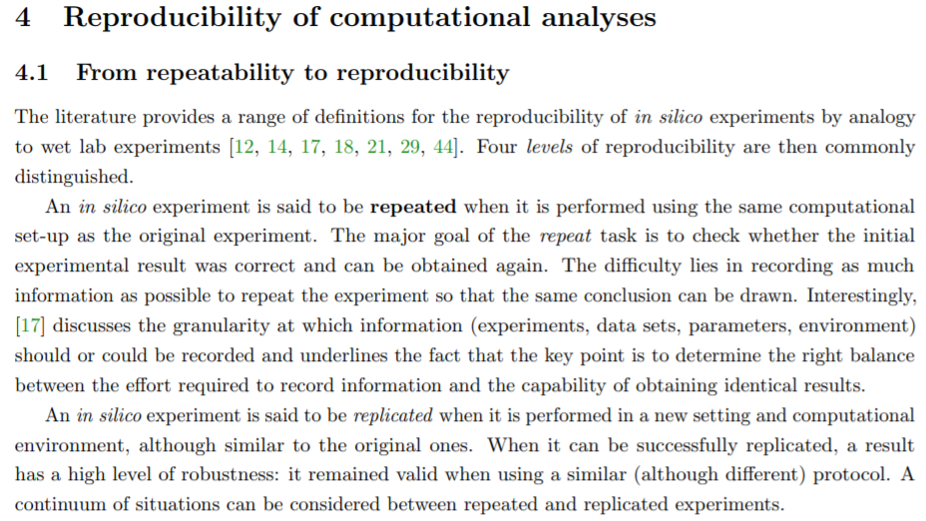
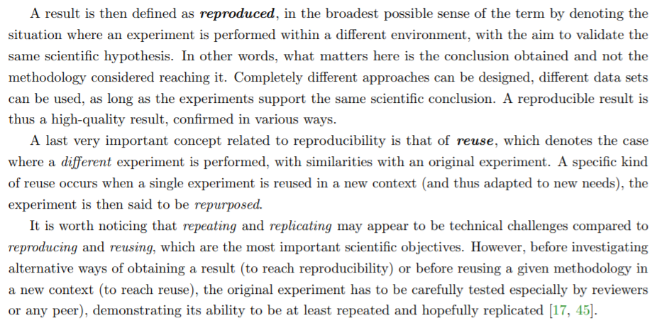
From Naldi et al, The CoLoMoTo Interactive
Notebook: Accessible and Reproducible
Computational Analyses for Qualitative
Biological Networks.
https://www.biorxiv.org/content/early/2018/04/02/ 290411

Slide 5
Goals of reproducible research, assessing the level of reproducibility
Levels of reproducibility: personal->collaborator->reviewer->user->scientific community
Transparent workflow for other group members, at any stage
Permanently exposing intermediate results and conclusions to other group members
Detailed documentation: code, data transformations, intermediate results
Reusing results by people building on your results
State when, together with a publication, we provide everything which is necessary to reproduce exact results (transformed data, summary tables, figures)

Slide 6
Examples of good practice:
Nature Protocols
Creation and analysis of biochemical constraint-based models: the COBRA Toolbox v3. 0L Heirendt, S Arreckx, T Pfau, SN Mendoza, A Richelle, A Heinken, ... arXiv preprint arXiv:1710.04038
Publications using Jupiter notebooks
The CoLoMoTo Interactive Notebook: Accessible and Reproducible Computational Analyses for Qualitative Biological Networks. A Naldi, C Hernandez, N Levy, G Stoll, PT Monteiro, C Chaouiya, ... bioRxiv, 290411
Using Dockers
Conceptual and computational framework for logical modelling of biological networks deregulated in diseasesA Montagud, P Traynard, L Martignetti, E Bonnet, E Barillot, A Zinovyev, ... Briefings in bioinformatics

Slide 7
Ultimate goal and practice
Our goal is to define and use an homogeneous reproducible research environment for all members of the team (while coping with specificities of each main activity: maps, models, data).
Long and short term run benefits:
Scientific: increasing rigour of the results, potentially more systematic exploration of the data – less chance to miss important points, collective science (at the level of the group or international consortia)
Practical: reduced time for a new team member integration/teaching, ease of sharing results with collaborators, reusing methodological findings for future projects, reduced paper preparation cycle (when generating the same images is frequently needed)

Slide 8
Possible obstacles (repeatability and reproducibility)
Constraints in terms of time
Using stochastic algorithms (sometimes possible to fix the seed)
Manual curation steps in the analysis
Difficulty to assemble reusable pipelines
Very long computation time (sometimes possible to keep the intermediate results)
What else?

Slide 9
Discussing the price and terms of reproducibility
Short term and long term benefits and constraints
Defining time scales : project lifetimes, code maintenance
What we can and can not afford

Slide 10
Listing and assessing the tools
Development
SVN
Git
Exposing workflows, intermediate reports, work communication
EverNote
Slack
Jupiter notebooks
Deployment
R packaging
Docker
NextFlow

Slide 11
Concrete projects for improving reproducibility
Discussion on reusable code organization for the group
Implementing practice of “reproducibility reviewers”
Something else?

