Slide 1
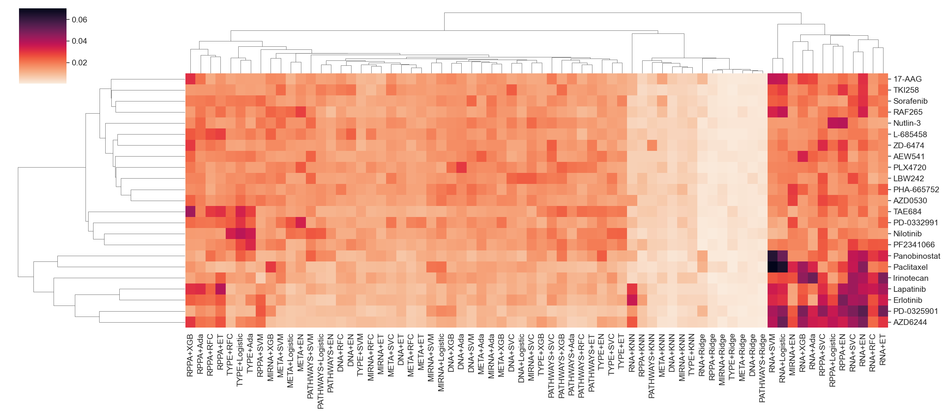

Slide 2
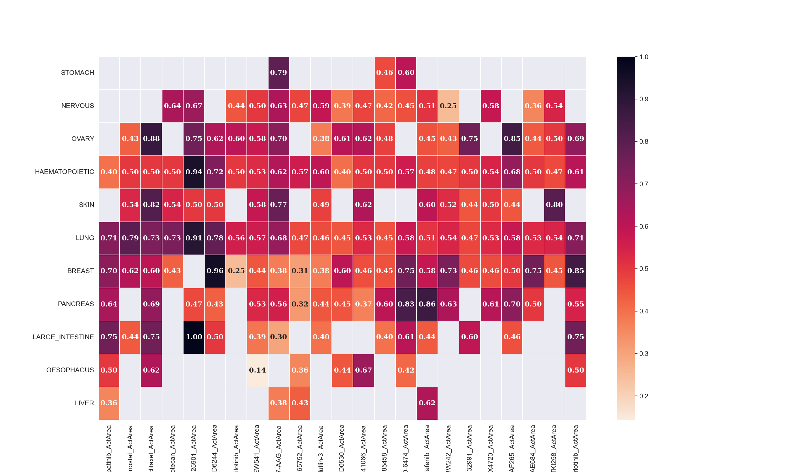

Slide 3
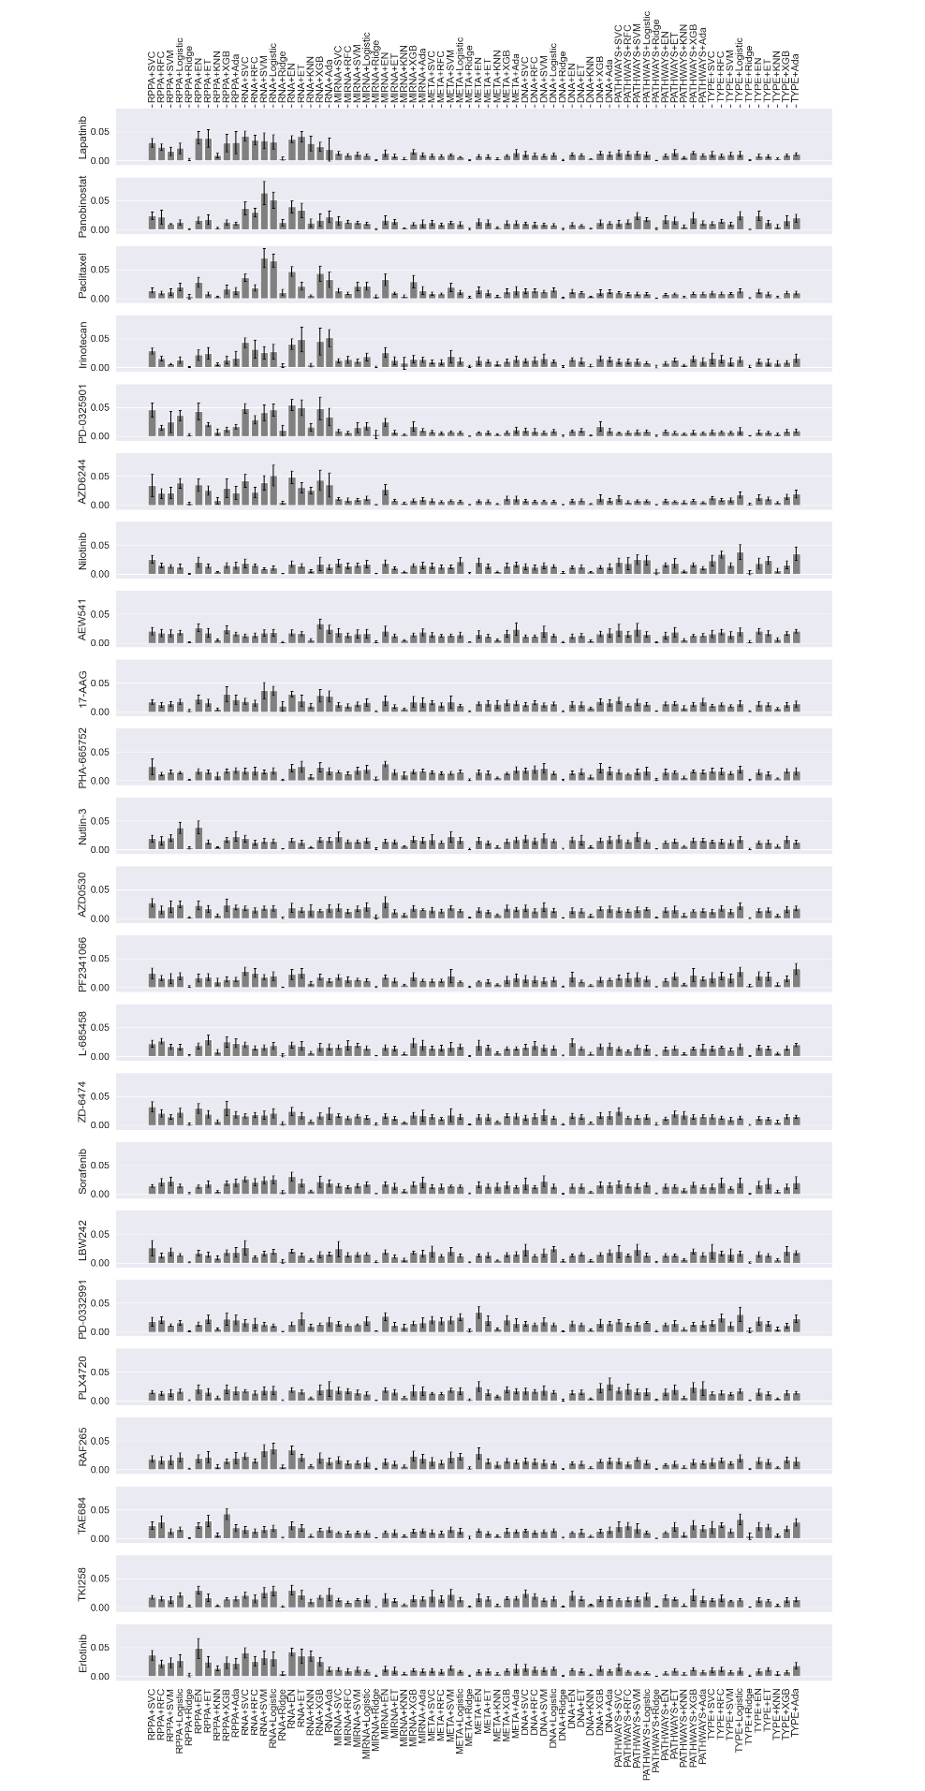

Slide 4
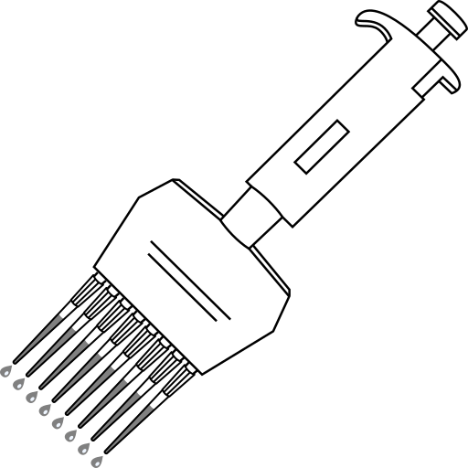
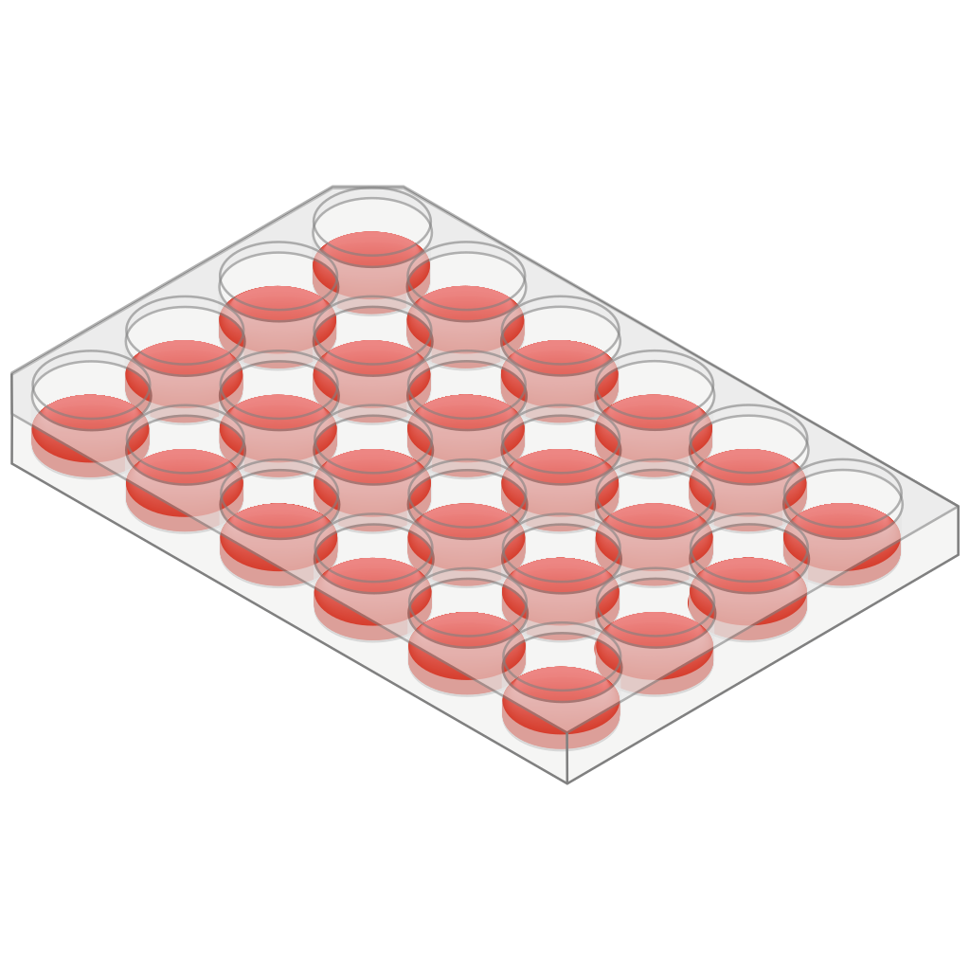

CCLE dataset
First-level algorithms
Ensemble
For each compound:
10 algorithms 70 predictions
+
23 compounds
324 cell lines
Random Forest
cross-validation
Viability
log [compound]
genomics
transcriptomics
proteomics
7 data types
miRNomics
metabolomics
pathway activity
tissue of origin

