Slide 1

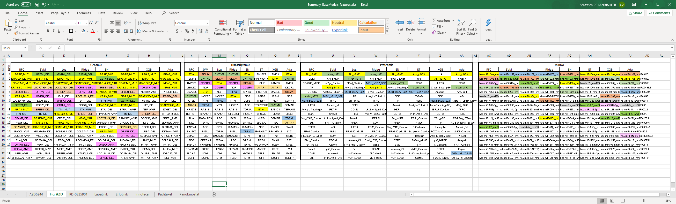
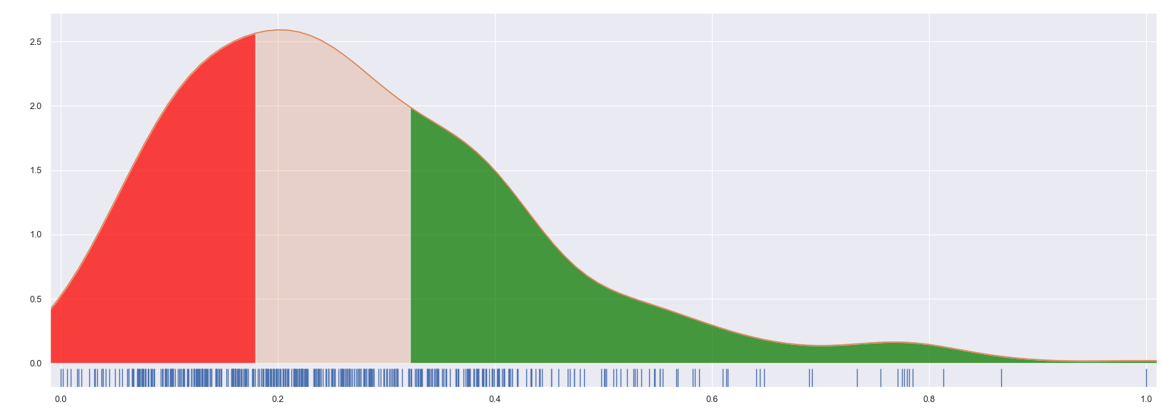
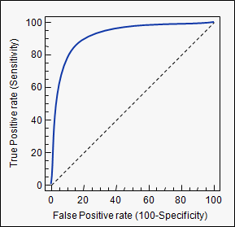
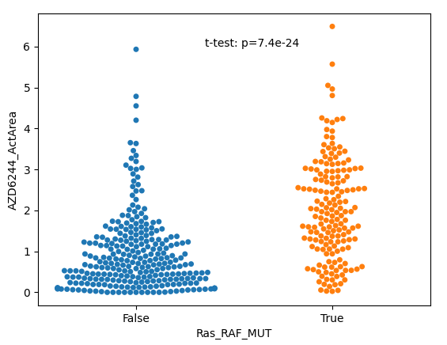
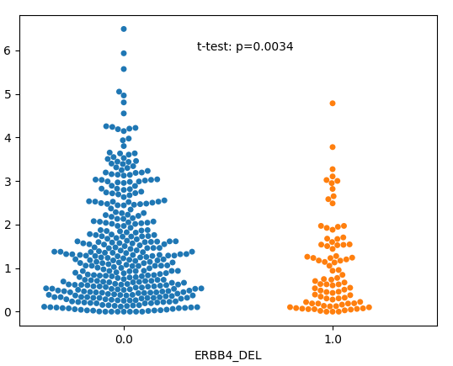
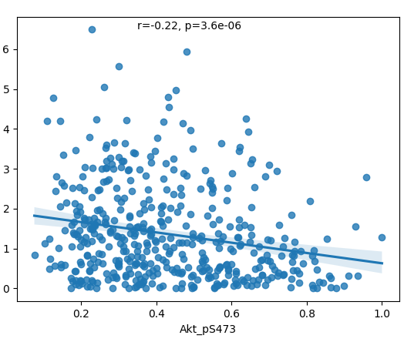
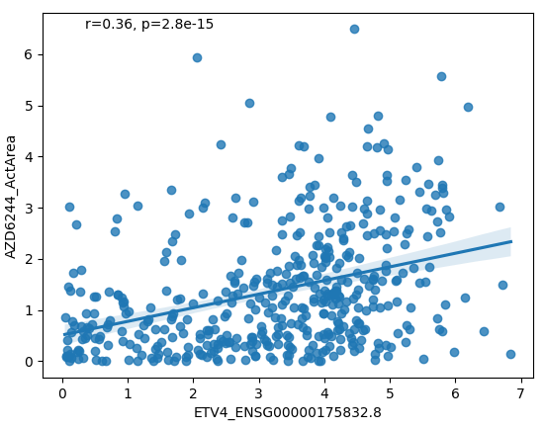
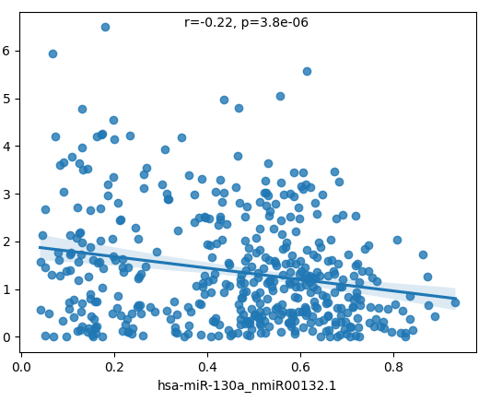
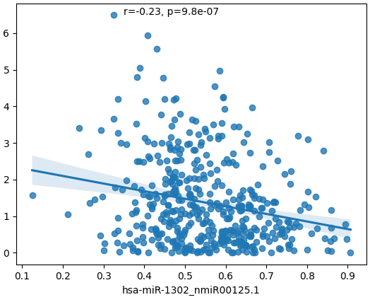
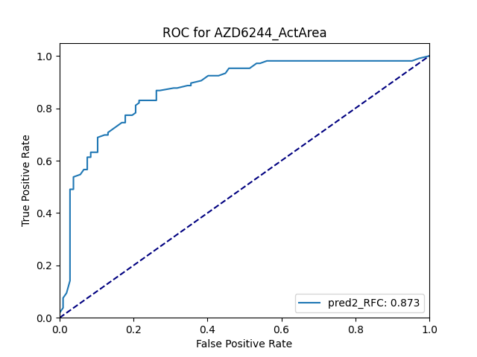
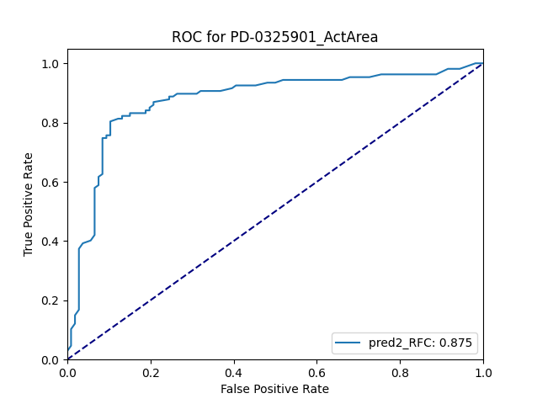
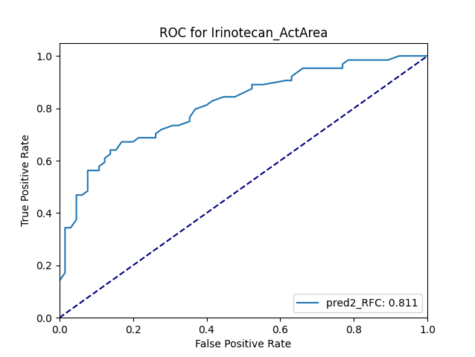
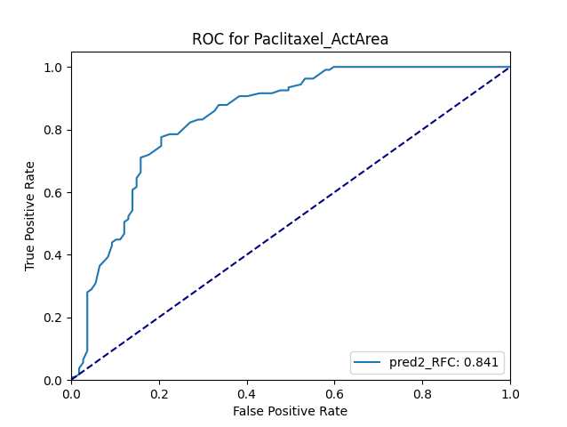

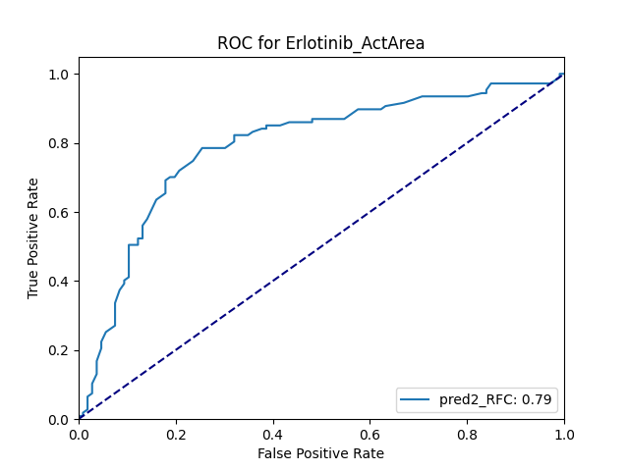





Model Ensembling as a Tool to Form Interpretable Multi-Omic Predictors of Cancer Pharmacosensitivity
Sébastien De Landtsheer¹, Apurva Badkas¹, Dagmar Kulms² and Thomas Sauter¹
¹Systems Biology group, Life Sciences Research Unit, University of Luxembourg, Luxembourg
²Experimental Dermatology, Department of Dermatology, Technical University Dresden, Dresden, Germany
Project summary
Clinical response to targeted and chemotoxic cancer therapies is highly variable, and many patients never achieve complete response.
Cell line screens can provide multi-omic datasets partially resuming the characteristics of tumors and allowing measurements of functional response across a large array of chemotherapeutic compounds.
Multiple statistical learning algorithms were applied separately to the CCLE genomic, transcriptomic, phosphoproteomic, and metabolomic datasets.
Individual predictions were combined via Random Forests to form final estimates of chemosensitivity for each of 23 drug across various cancer types.
Feature importances analysis of individual classifiers point to known and new markers of chemosensitivity.
Area above the D-R curve as a proxy for sensitivity
Retrieving correlations from individual models: example of Selumetinib (MEK inhibitor)
899 cell lines
23 drugs
growth
‘Activity Area’ :
Area above the inhibition curve
Advantage vs IC₅₀: takes fractional killing into account
IC₅₀
[inhibitor]
Distribution of normalized ActArea
Statistical problem formulation:
Classification of Resistant (bottom 1/3 quantile) versus Sensitive (upper 1/3 quantile)
Advantages:
balanced dataset
no intermediate phenotypes
Resistant
Removed from analysis
Sensitive
1/3 1/3 1/3
Pipeline
Omic Algorithm Prediction Integration
Genomic
Random Forest
P_{S}(RF)(omic)
Transcriptomic
AdaBoost
P_{S}(Ada)(omic)
Metabolomic
XGBoost
P_{S}(XGB)(omic)
+
Extra-Trees
P_{S}(ET)(omic)
Meta Classifier (Random Forests)
Proteomic
SVM
P_{S}(SVM)(omic)
Pathway Analysis
Logistic
P_{S}(Log)(omic)
Tumor origin
Ridge
P_{S}(R)(omic)
Integrated classifier with explainable structure
Elastic-Net
P_{S}(EN)(omic)
Performance
(10x10 nested cross-validation)
Highlights
High-performance cross-validated predictions for 7 out of 23 drugs (>80% ROCAUC).
High accuracy for major cancer types reveals new opportunities for N-of-one trials.
Explainable models rediscover known markers of chemosensitivity and point to novel biomarkers and/or targets.
 |  | Lapatinib_ActArea | Panobinostat_ActArea | Paclitaxel_ActArea | Irinotecan_ActArea | PD-0325901_ActArea | AZD6244_ActArea | Nilotinib_ActArea | AEW541_ActArea | 17-AAG_ActArea | PHA-665752_ActArea | Nutlin-3_ActArea | AZD0530_ActArea | PF2341066_ActArea | L-685458_ActArea | ZD-6474_ActArea | Sorafenib_ActArea | LBW242_ActArea | PD-0332991_ActArea | PLX4720_ActArea | RAF265_ActArea | TAE684_ActArea | TKI258_ActArea | Erlotinib_ActArea
 | STOMACH | 0.78 | 0.80 | 0.67 | 0.00 | 0.86 | 0.78 | 0.86 | 0.20 | 0.90 | 0.75 | 0.50 | 0.44 | 0.50 | 0.50 | 0.73 | 0.75 | 0.20 | 0.71 | 0.22 | 0.71 | 0.43 | 0.60 | 0.75
 | NERVOUS | 1.00 | 1.00 | 0.50 | 0.91 | 0.88 | 0.85 | 0.73 | 0.75 | 0.57 | 0.71 | 0.69 | 0.55 | 0.54 | 0.67 | 0.83 | 0.53 | 0.64 | 0.67 | 0.58 | 0.57 | 0.33 | 0.57 | 1.00
 | OVARY | 0.75 | 0.54 | 0.92 | 1.00 | 0.64 | 0.73 | 0.64 | 0.71 | 0.86 | 0.89 | 0.67 | 0.54 | 0.69 | 0.45 | 0.40 | 0.50 | 0.29 | 0.77 | 0.78 | 0.64 | 0.50 | 0.80 | 0.75
 | HAEMATOPOIETIC | 0.63 | 0.94 | 0.81 | 0.96 | 0.93 | 0.70 | 0.88 | 0.62 | 0.61 | 0.85 | 0.63 | 0.53 | 0.83 | 0.86 | 0.61 | 0.78 | 0.52 | 0.91 | 0.66 | 0.67 | 0.74 | 0.67 | 0.67
 | SKIN | 0.93 | 0.55 | 0.80 | 0.50 | 0.88 | 0.94 | 0.38 | 0.58 | 0.71 | 0.67 | 0.54 | 1.00 | 0.64 | 0.78 | 0.64 | 0.60 | 0.69 | 0.67 | 0.94 | 0.69 | 1.00 | 0.64 | 0.91
 | LUNG | 0.71 | 0.78 | 0.82 | 0.73 | 0.81 | 0.81 | 0.53 | 0.60 | 0.74 | 0.45 | 0.45 | 0.45 | 0.61 | 0.42 | 0.59 | 0.66 | 0.68 | 0.58 | 0.63 | 0.69 | 0.52 | 0.60 | 0.76
 | BREAST | 0.71 | 0.69 | 0.71 | 0.60 | 0.93 | 0.92 | 0.33 | 0.58 | 0.50 | 0.45 | 0.71 | 0.73 | 0.73 | 0.54 | 0.86 | 0.64 | 0.67 | 0.54 | 0.73 | 0.58 | 0.87 | 0.65 | 0.87
 | PANCREAS | 0.58 | 0.80 | 1.00 | 1.00 | 0.88 | 0.80 | 0.62 | 0.43 | 0.67 | 0.40 | 0.64 | 0.64 | 0.56 | 0.67 | 0.79 | 0.67 | 0.63 | 0.78 | 0.50 | 0.83 | 0.67 | 0.89 | 0.54
 | LARGE_INTESTINE | 0.85 | 0.55 | 0.71 | 0.75 | 1.00 | 1.00 | 0.78 | 0.80 | 0.64 | 0.44 | 0.60 | 0.78 | 0.33 | 0.40 | 0.83 | 0.42 | 0.11 | 0.40 | 0.44 | 0.58 | 1.00 | 0.89 | 0.83
 | OESOPHAGUS | 0.82 | 0.89 | 0.60 | 0.33 | 0.57 | 1.00 | 0.00 | 0.50 | 0.56 | 0.30 | 0.67 | 0.82 | 0.75 | 0.67 | 0.50 | 0.67 | 0.40 | 0.67 | 0.20 | 0.75 | 0.89 | 0.33 | 0.92
 | LIVER | 0.45 | 1.00 | 0.63 | 0.50 | 0.71 | 1.00 | 0.80 | 0.78 | 0.60 | 0.82 | 0.33 | 0.67 | 0.63 | 0.67 | 0.56 | 0.50 | 0.67 | 0.80 | 0.25 | 0.88 | 0.67 | 0.78 | 0.75
 |  | Classifiers accuracy for cancer types with N>10
Perspectives
Experimental validation of novel biomarkers: correlation or causation?
Clinical evaluation of our pipeline on patient samples (organoids)
Integration of additional data (epigenetic, network analysis)

