Slide 1

University of Luxembourg
Sébastien De Landtsheer
Model Ensembling as a Tool to Form Interpretable Multi-Omic Predictors of Cancer Pharmacosensitivity
October 2022
ICSB, Berlin
Systems Biology Group

Slide 2
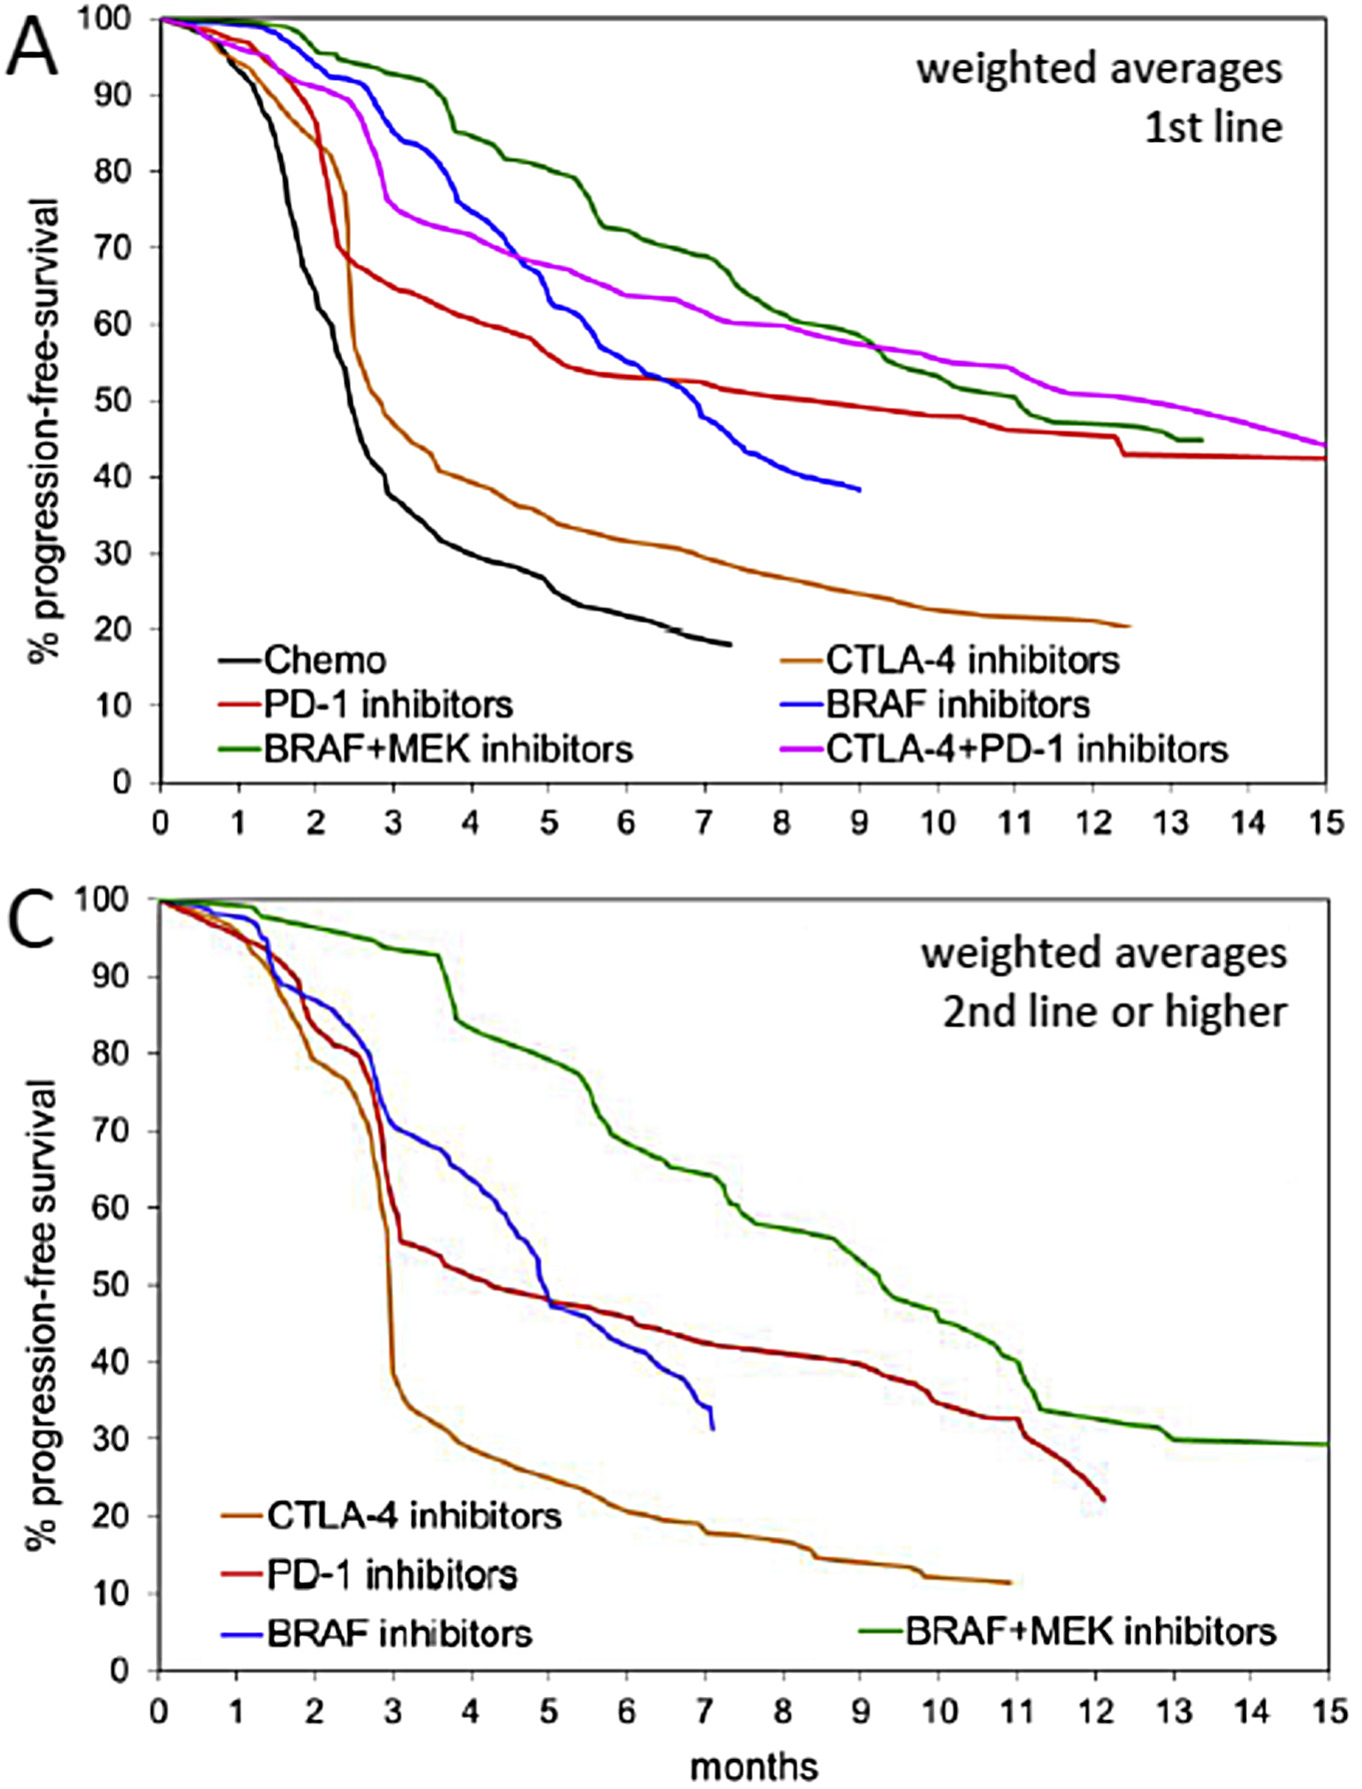
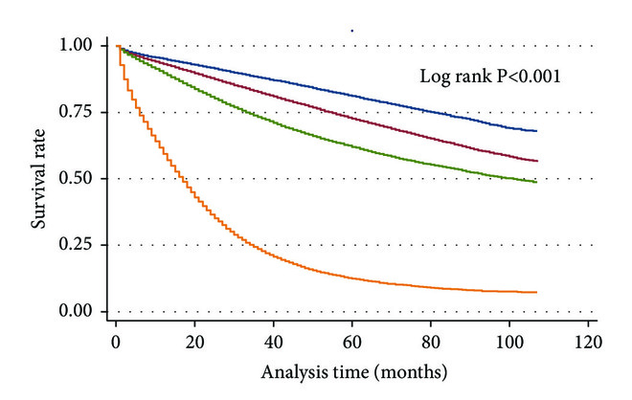
Patient responses to chemotherapies
Melanoma
Colon carcinoma
Unmet need for improvement of care of cancer patients
Nearly all biomarkers are genomic
Goal of the project
Ugurel et al., Eur. J. Cancer (2016), 53; 125-34
Ulanja et al., J. Oncol. (2019):4315032

Slide 3

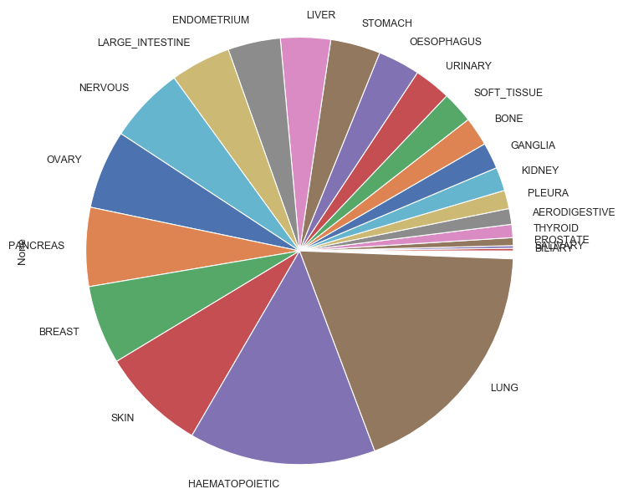
CCLE dataset
1000+ cell lines with near-complete multi-omics:
Genomics / Transcriptomics / Metabolomics / miRNA and others
Dose-responses for 23 drugs

Slide 4

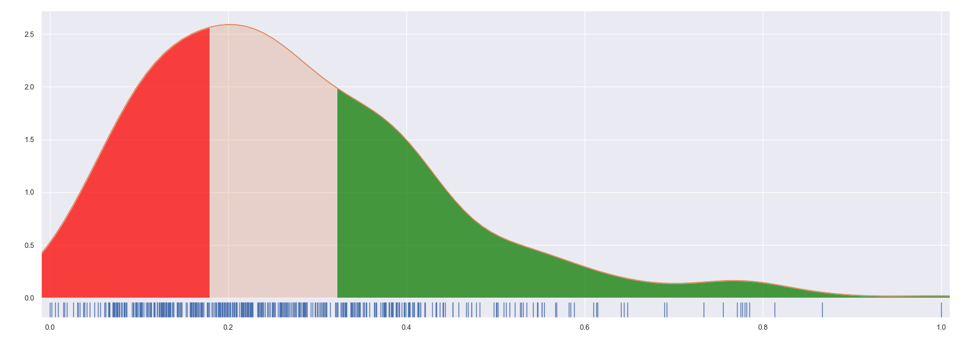
CCLE dataset
cell lines
‘Activity Area’ :
Area above the inhibition curve
Advantage vs IC₅₀: takes fractional killing into account
growth
IC₅₀
[inhibitor]
Distribution of normalized ActArea
Removed from analysis
Resistant
Sensitive
1/3 1/3 1/3

Slide 5
Pipeline : Ensemble of omic-specific models
Omic Algorithm
Random Forest
Genomic
AdaBoost
Transcriptomic
XGBoost
Metabolomic
Extra-Trees
+
Proteomic
SVM
Pathway Analysis
Logistic
Tumor origin
Ridge
Elastic-Net

Slide 6
Pipeline : Ensemble of omic-specific models
Omic Algorithm Prediction
Random Forest
P_{S}(RF)(omic)
Genomic
AdaBoost
P_{S}(Ada)(omic)
Transcriptomic
XGBoost
P_{S}(XGB)(omic)
Metabolomic
Extra-Trees
P_{S}(ET)(omic)
+
Proteomic
SVM
P_{S}(SVM)(omic)
Pathway Analysis
Logistic
P_{S}(Log)(omic)
Tumor origin
Ridge
P_{S}(R)(omic)
Elastic-Net
P_{S}(EN)(omic)

Slide 7
Pipeline : Ensemble of omic-specific models
Omic Algorithm Prediction Integration
Random Forest
P_{S}(RF)(omic)
Genomic
AdaBoost
P_{S}(Ada)(omic)
Transcriptomic
XGBoost
P_{S}(XGB)(omic)
Metabolomic
Extra-Trees
P_{S}(ET)(omic)
Meta Classifier (Random Forest)
+
Proteomic
SVM
P_{S}(SVM)(omic)
Pathway Analysis
Logistic
P_{S}(Log)(omic)
Tumor origin
Ridge
P_{S}(R)(omic)
Elastic-Net
P_{S}(EN)(omic)

Slide 8
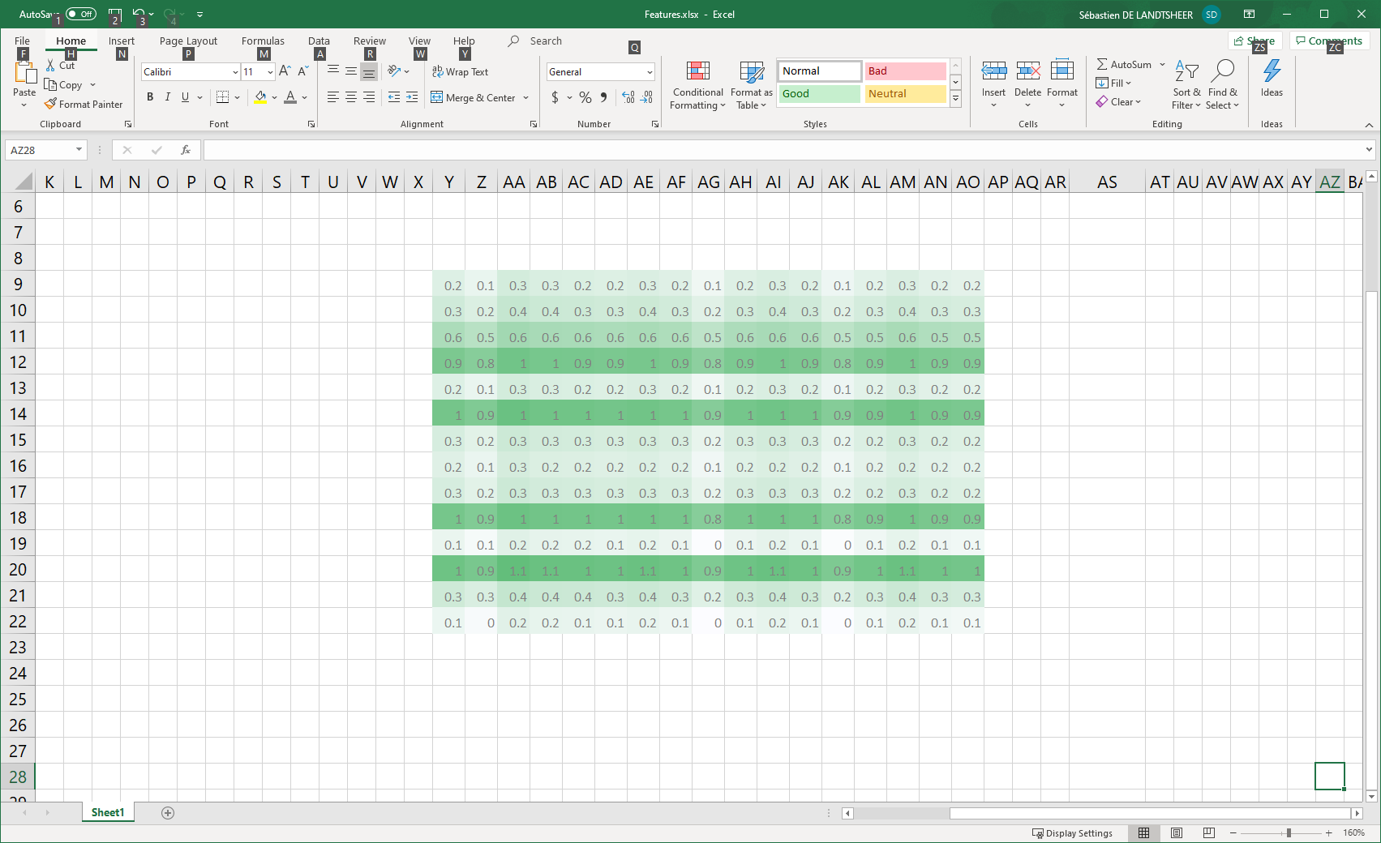
Validation procedure: nested cross-validation
transcriptomics
genomics
typing
pathways
proteomics
metabolomics
miRNomics
N samples
Current dataset
1) 10% Validation set is excluded
transcriptomics – model 1
transcriptomics – model 2
transcriptomics – model 3
genomics – model 1
genomics – model 2
genomics – model 3
typing – model 1
typing – model 2
typing – model 3
pathways – model 1
pathways – model 2
pathways – model 3
…
Repeat 10x
Model A1
Model A3
Model A2
2) 10% test set is excluded
3) each 1st-level model forms a prediction for the excluded test set
Repeat 10x
model B1
model B2
model B3
…
TP
4) Each 2nd-level model tries to predict the validation set
Model B1
Model B3
Model B2
FP

Slide 9
Validation procedure: nested cross-validation
transcriptomics
genomics
typing
pathways
proteomics
metabolomics
miRNomics
N samples
Current dataset
1) 10% Validation set is excluded
transcriptomics – model 1
transcriptomics – model 2
transcriptomics – model 3
genomics – model 1
genomics – model 2
genomics – model 3
typing – model 1
typing – model 2
typing – model 3
pathways – model 1
pathways – model 2
pathways – model 3
…
Repeat 10x
Model A1
Model A3
Model A2
2) 10% test set is excluded
3) each 1st-level model forms a prediction for the excluded test set
Repeat 10x
model B1
model B2
model B3
…
TP
4) Each 2nd-level model tries to predict the validation set
Model B1
Model B3
Model B2
FP

Slide 10
Validation procedure: nested cross-validation
transcriptomics
genomics
typing
pathways
proteomics
metabolomics
miRNomics
N samples
Current dataset
1) 10% Validation set is excluded
transcriptomics – model 1
transcriptomics – model 2
transcriptomics – model 3
genomics – model 1
genomics – model 2
genomics – model 3
typing – model 1
typing – model 2
typing – model 3
pathways – model 1
pathways – model 2
pathways – model 3
…
Repeat 10x
Model A1
Model A3
Model A2
2) 10% test set is excluded
3) each 1st-level model forms a prediction for the excluded test set
Repeat 10x
model B1
model B2
model B3
…
TP
4) Each 2nd-level model tries to predict the validation set
Model B1
Model B3
Model B2
FP

Slide 11
Overall results

Slide 12
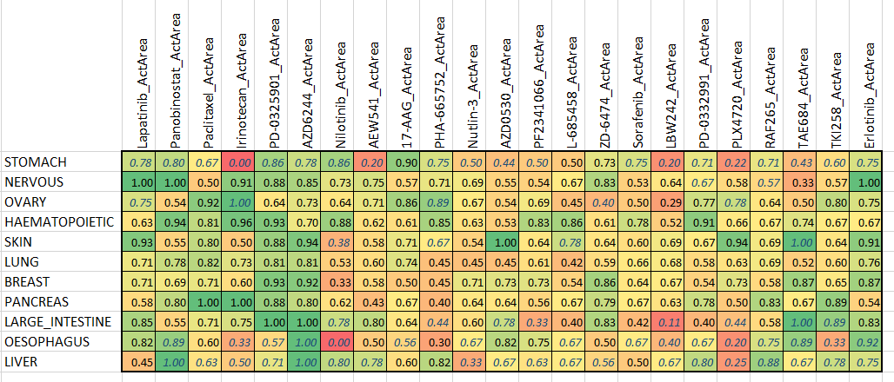
Type-specific results
Italics: N < 10

Slide 13
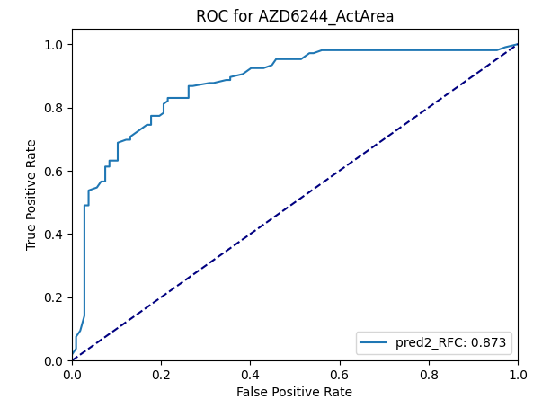
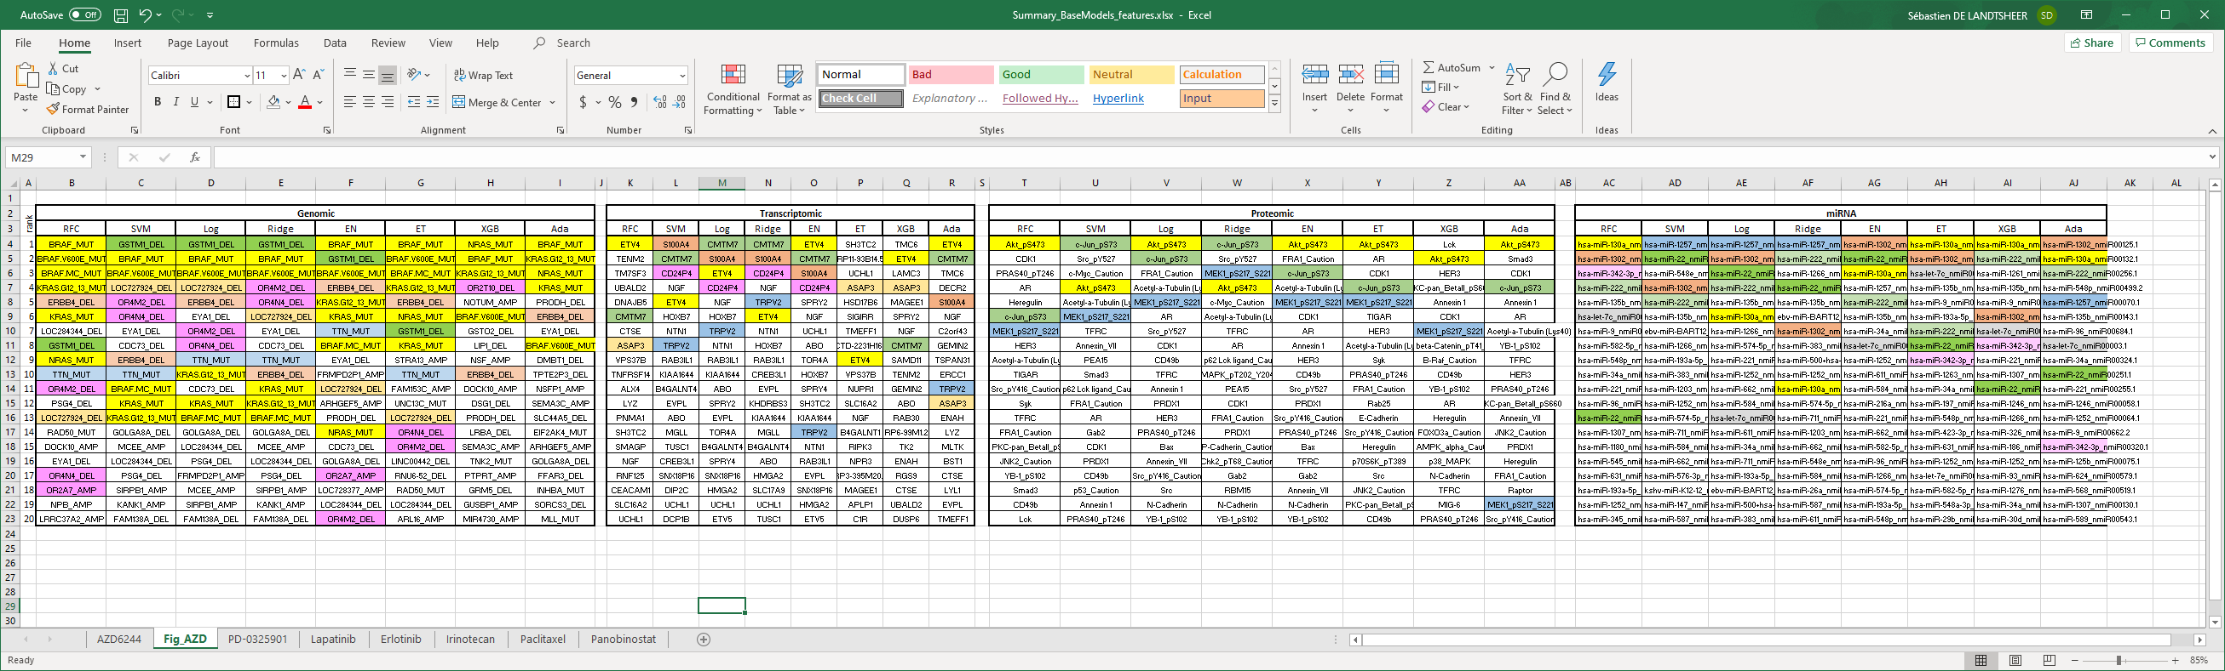
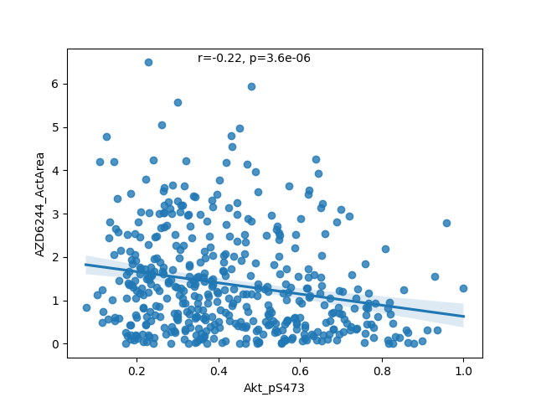
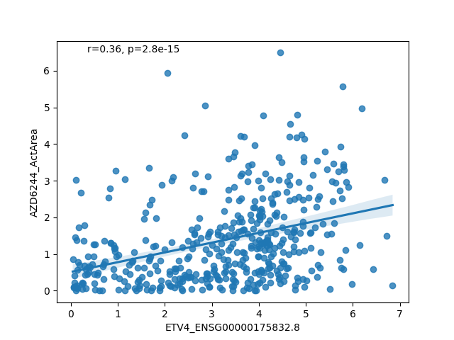
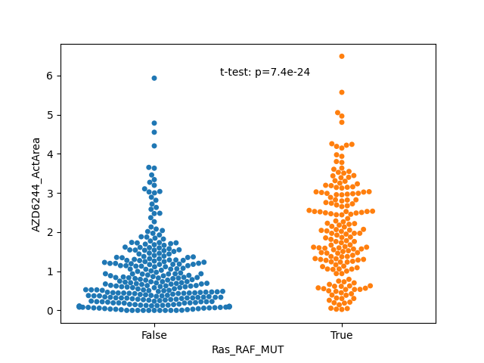
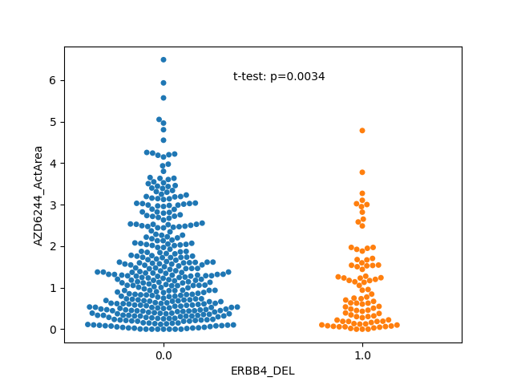
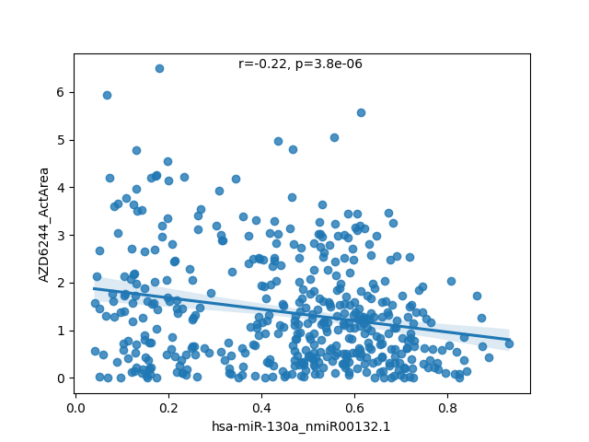
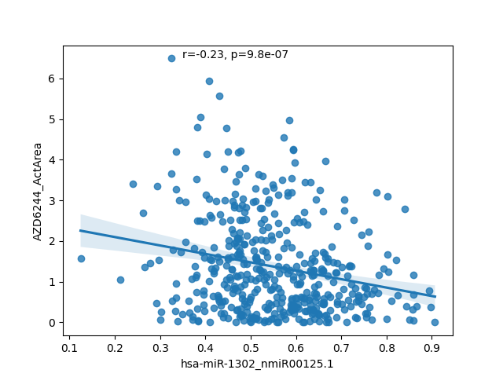
Model analysis points to specific markers of sensitivity 1: Selumetinib (MEK inhibitor) + boxplots

Slide 14
Model analysis: example 2

Slide 15




Conclusions and perspectives
High-performance predictors of sensitivity for 7 out of 23 drugs + others?
High accuracy for specific cancer types
Explainable models point to putative novel markers and/or targets
=> experimental validation: causality of markers
=> clinical evaluation on patient data (organoids)

Slide 16
THANK YOU FOR YOUR ATTENTION

