Slide 1
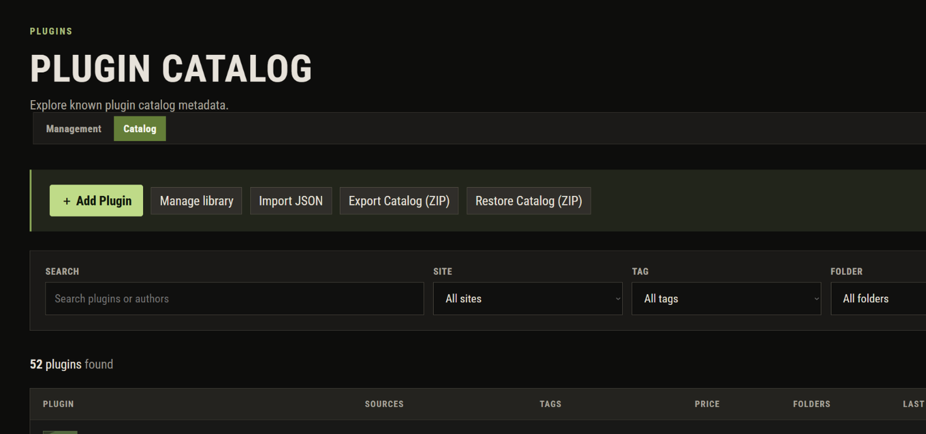
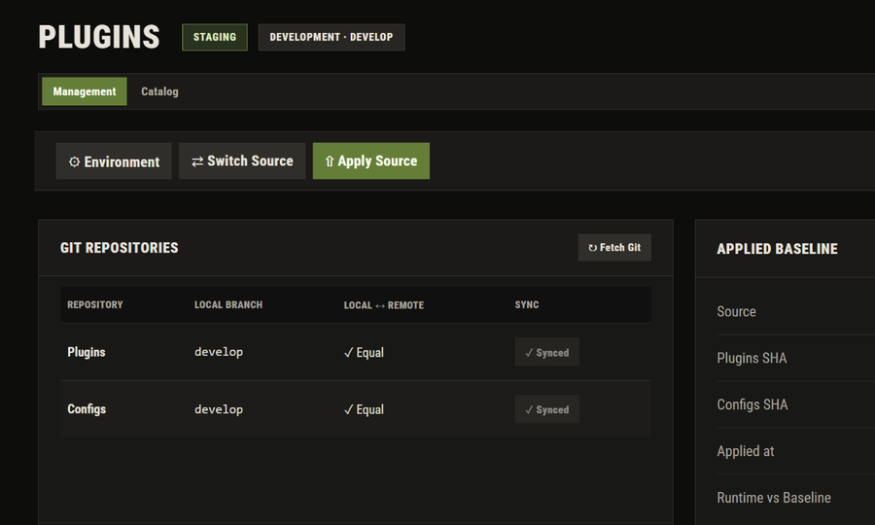
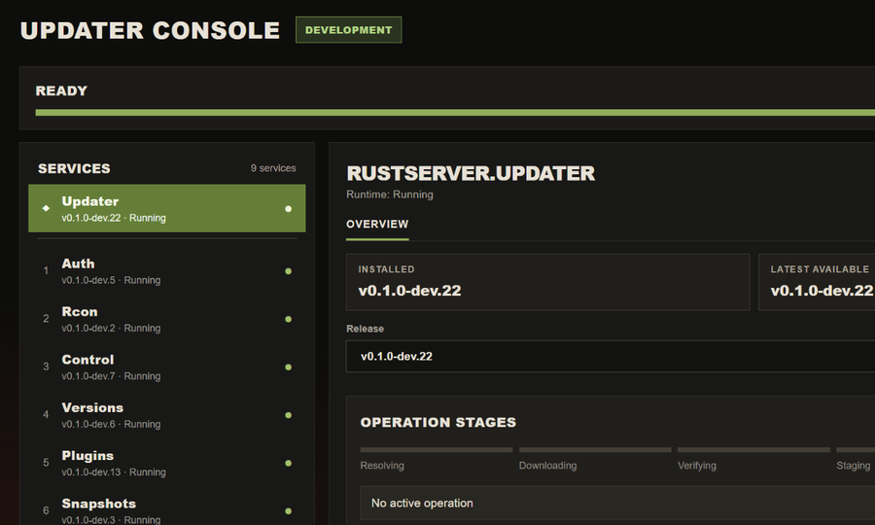
ACTUAL WEB INTERFACE
01 PLUGIN CATALOG
ENGINEERING PROJECT
RUSTSERVER
PLATFORM
Self-hosted administration and deployment platform for Rust Dedicated Server.
02 GIT-BACKED PLUGIN MANAGEMENT
03 RELEASE UPDATER
PLUGINS • DEPLOYMENT • OPERATIONS
ASP.NET Core / React / gRPC
PostgreSQL / MySQL / Docker
Ubuntu Linux / Microsoft Azure

Slide 2


















02 / SYSTEM DESIGN
PLATFORM ARCHITECTURE
One web interface. Independent services. A dedicated game runtime.
ACCESS & CONTROL
ADMIN
NGINX
WEB CONTROL PANEL
AUTH
Browser
Routing
React / TypeScript
Login / access
ACCESS CHECK
API ROUTING
UBUNTU LINUX HOST
INDEPENDENT ASP.NET CORE SERVICES / SYSTEMD
GAME CONNECTION
RCON
CONTROL
VERSIONS
PLUGINS
CATALOG
SNAPSHOTS
gRPC service
Server ops
Update checks
Git files
Plugin library
Backup / restore
RUST SERVER
gRPC → RCON
Git repositories
PostgreSQL
ZIP snapshots
Docker container
Control + Versions → RCON → Rust
SEPARATE DEPLOYMENT PATH
GITHUB RELEASES
BOOTSTRAP
UPDATER
PLATFORM APPS
Provisioning
Install / rollback
Installed with systemd
RUSTSERVER PLATFORM / ENGINEERING PROJECT
ARCHITECTURE

Slide 3
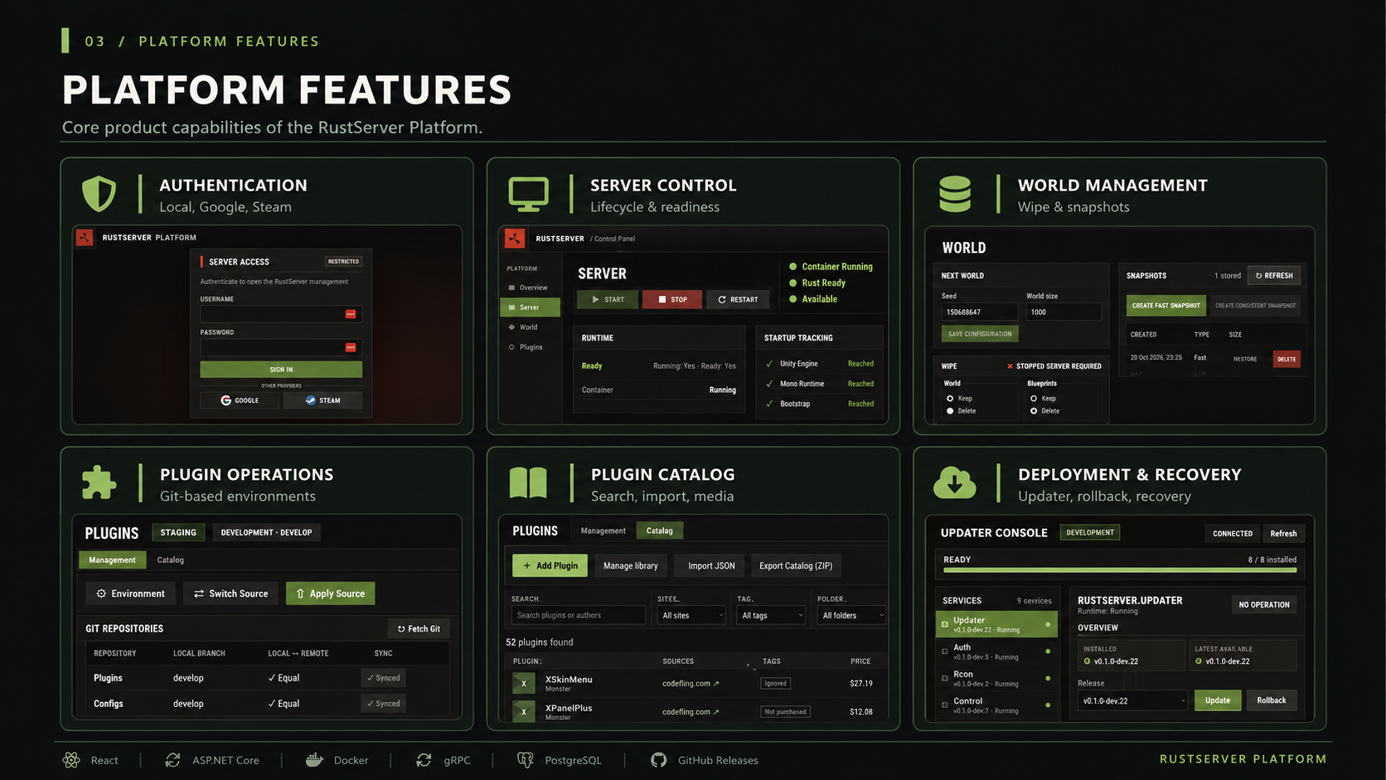

Slide 4















04 / USER SCENARIOS
OPERATIONAL SCENARIOS
Three real-world workflows, from preparation to verified results.
01 / SAFE SERVER MAINTENANCE
02 / WORLD RESET & RECOVERY
Update Rust / Oxide while public access stays controlled.
Create a backup before starting a new game world.
ACCESS OFF
UPDATE
START
READY
STOP
SNAPSHOT
WIPE
START
Maintenance mode
Rust + Oxide
Track 9 stages
Access restored
Required first
Consistent ZIP
World only
New world
MAINTENANCE ENTRY POINT STAYS SEPARATE
BLUEPRINTS PRESERVED · RESTORE POINT AVAILABLE
03 / FULL PLATFORM ROLLOUT
From one operator entry point to an operational Rust server.
PLATFORM SETUP
GAME PROVISIONING / VIA WEB
OPERATOR
BOOTSTRAP
UPDATER
WEB + APIS
RUST + OXIDE
PLUGINS
SERVER READY
PowerShell / SSH
Ubuntu setup
Install releases
Platform online
SteamCMD / Docker
Git-managed files
Playable & managed
Bootstrap provisions Updater • Updater installs platform apps • Game and plugin setup continues through the Web UI
RUSTSERVER PLATFORM / ENGINEERING PROJECT
DEMO SCENARIOS

