Slide 1
MarkLogic

Slide 2
Template Architecture
MarkLogic template is divided into three sections
Shared Resources
Network Resources
Virtual Machines
Each of these sections will deploy the respective resources
All the deployments start from the a main template (mainTemplate.json), which in turn calls all the sub templates.

Slide 3
mainTemplate.json
shared-resources
network-resources
virtual-machines
shared-resources.json
osDiskStorageAccountDeployment
dataDiskStorageAccountDeployment
virtualNetworkSubnetDeployment
availabilitySetDeployment
network-resources.json
clusterPublicIPsDeployment
externalLoadBalancerPublicIPDeployment
loadBalancerDeployment
nodeNetworkSecurityGroup
nodeNetworkInterfaces
virtual-machine-deployment-cluster.json
virtualMachineDeployment
virtualMachineDataDiskExtensionDeployment
virtualMachineFirstNodeConfigExtensionDeployment
virtualMachineAdditionalNodesConfigExtensionDeployment
virtual-machine-deployment-cluster.json
virtualMachineDeployment
virtualMachineDataDiskExtensionDeployment
virtualMachineFirstNodeConfigExtensionDeployment
virtualMachineAdditionalNodesConfigExtensionDeployment

Slide 4
Shared Resources
Shared resources section will deploy resources that are shared across the deployment
Storage Accounts
OS Disk storage account (Standard storage)
Data Disk storage account (Standard or Premium storage)
Virtual Network
Virtual network with one subnet (new)
Use existing Virtual network and subnet
Availability Set
Availability where all the nodes in the cluster reside

Slide 5
storage-account.json
Deploys either premium or standard storage account
vnet-new.json
Deploys a virtual network and a subnet
shared-resources.json
osDiskStorageAccountDeployment
dataDiskStorageAccountDeployment
virtualNetworkSubnetDeployment
availabilitySetDeployment
vnet-existing.json
Deploys nothing, but used when user selects to use existing virtual network & subnet
availability-set.json
Deploys availability set where all the VM’s in the cluster reside

Slide 6
Network Resources
Network resources section will deploy all network resources that are part of over all deployment
Public IP’s
Public IP’s for all the nodes
Public IP for external load balancer (if applicable)
Load Balancer
Either external or internal load balancer based on user selection
Network Security Group
Network security group for that has all the allowed inbound and outbound rules to allow traffic to virtual machine.
Network Interface
Network interfaces for all the nodes in the cluster

Slide 7
publicip-multi.json
Deploys multiple public IP’s for MarkLogic based on user selected cluster size
publicip.json
Deploys public IP for external Load balancer
network-resources.json
clusterPublicIPsDeployment
externalLoadBalancerPublicIPDeployment
loadBalancerDeployment
nodeNetworkSecurityGroup
nodeNetworkInterfaces
publicip-empty.json
Deploys nothing but used when internal load balancer is deployed
loadbalancer-external.json
Deploys external load balancer.
loadbalancer-internal.json
Deploys internal load balancer
network-security-group.json
Deploys network security group
network-interface-multi.json
Deploys multiple network interfaces

Slide 8
Virtual Machines (single node/cluster)
Virtual Machines section will deploy all virtual machines and the extensions that go on virtual machines.
Virtual Machines
Virtual machines with MarkLogic 8.0 image and 1 TB data disk. User can select VM size and cluster node count
Extensions
Extensions to mount data disk, configure first node and configure additional nodes.

Slide 9
virtual-machine-password.json
Deploys multiple VM’s with password as authentication
virtual-machine-sshkey.json
Deploys multiple VM’s with ssh key as authentication
virtual-machine-deployment-cluster.json
virtualMachineDeployment
virtualMachineDataDiskExtensionDeployment
virtualMachineFirstNodeConfigExtensionDeployment
virtualMachineAdditionalNodesConfigExtensionDeployment
extension-multi-index-0.json
Deploys Data disk mount extension on all the VM’s
data-disk-mount.sh
Data disk mount script
extension-multi-index-0.json
Deploys first node config extension on master node (ml0)
setup-first-node.sh
First node config script on master node (ml0)
extension-multi-index-1.json
Deploys additional node config extension on additional nodes in cluster
Setup-additional-nodes.sh
Additional nodes config script

Slide 10
virtual-machine-password.json
Deploys multiple VM’s with password as authentication
virtual-machine-sshkey.json
Deploys multiple VM’s with ssh key as authentication
virtual-machine-deployment-singlenode.json
virtualMachineDeployment
virtualMachineDataDiskExtensionDeployment
virtualMachineFirstNodeConfigExtensionDeployment
extension-multi-index-0.json
Deploys Data disk mount extension on all the VM’s
data-disk-mount.sh
Data disk mount script
extension-multi-index-0.json
Deploys first node config extension on master node (ml0)
setup-first-node.sh
First node config script on master node (ml0)

Slide 11
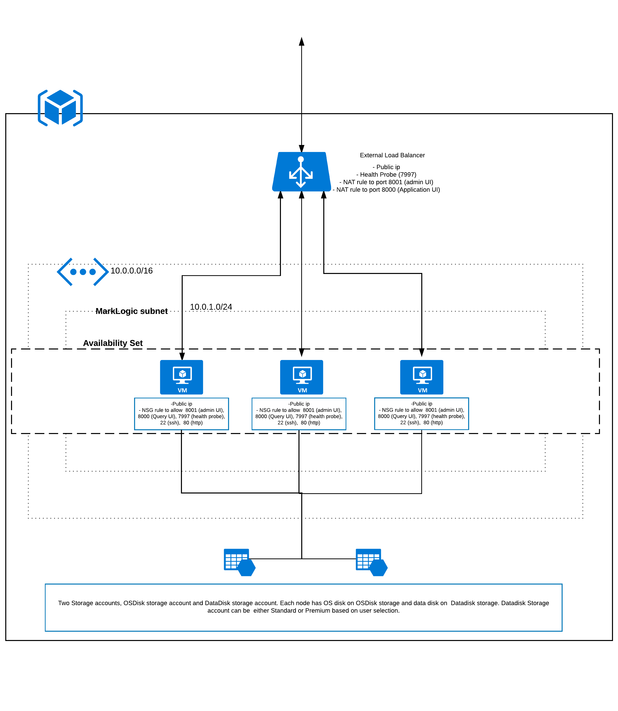
Deployment Architecture – External Load Balancer

Slide 12
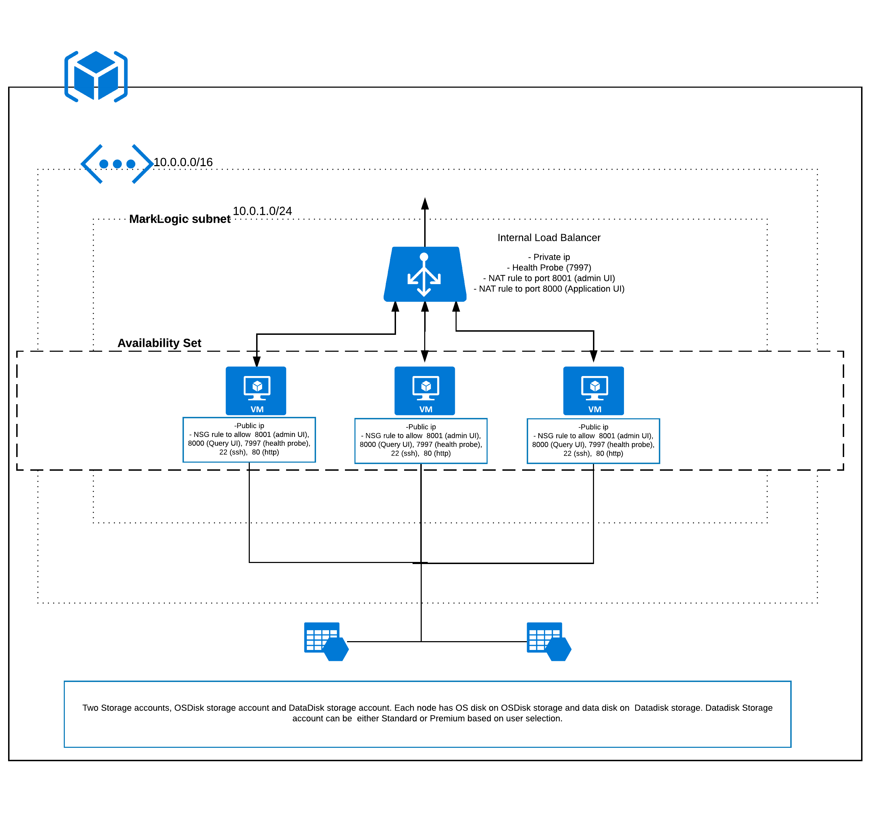
Deployment Architecture – Internal Load Balancer

Slide 13
Thank You!!

