Slide 1
A project on Library Management System
SRS (Software Required Specification)

Slide 2
Welcome to My Project Library Management System.
Submitteb By:
Sumaiya Yasmin
Supervised By:
Md. Rajaul Karim

Slide 3
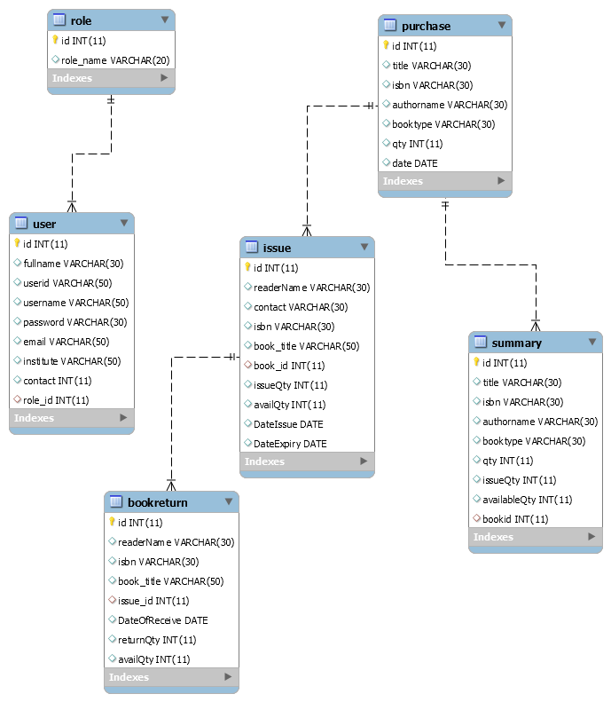

Slide 5
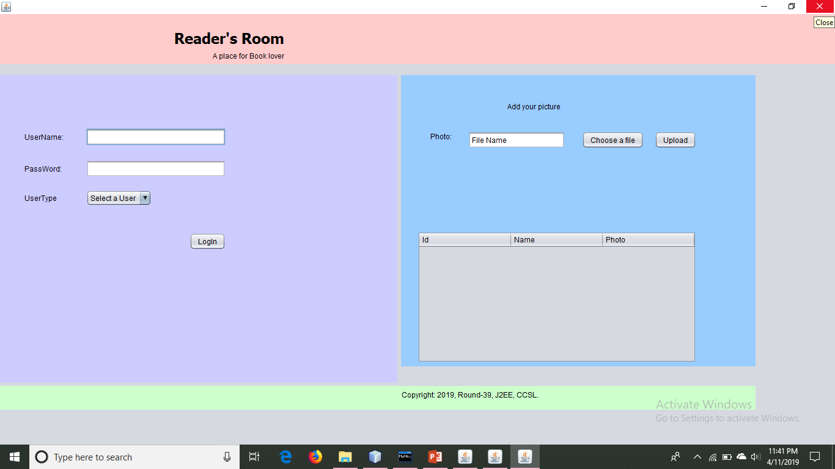

Slide 6
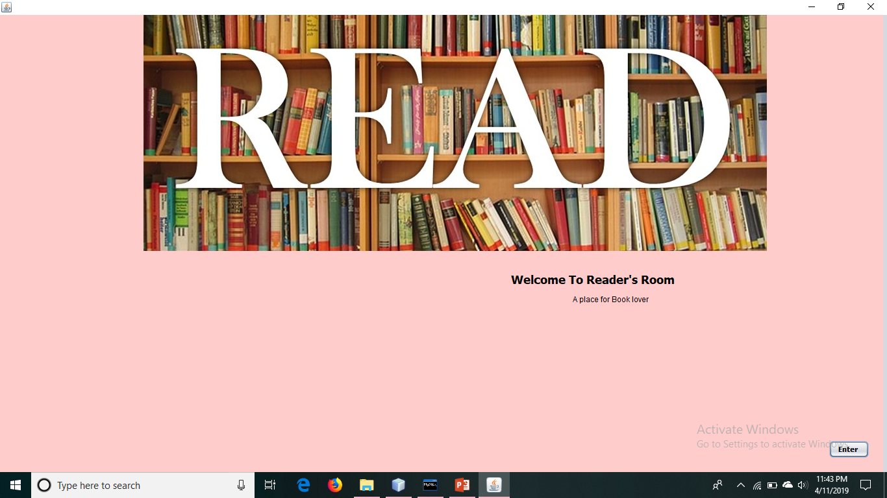

Slide 7
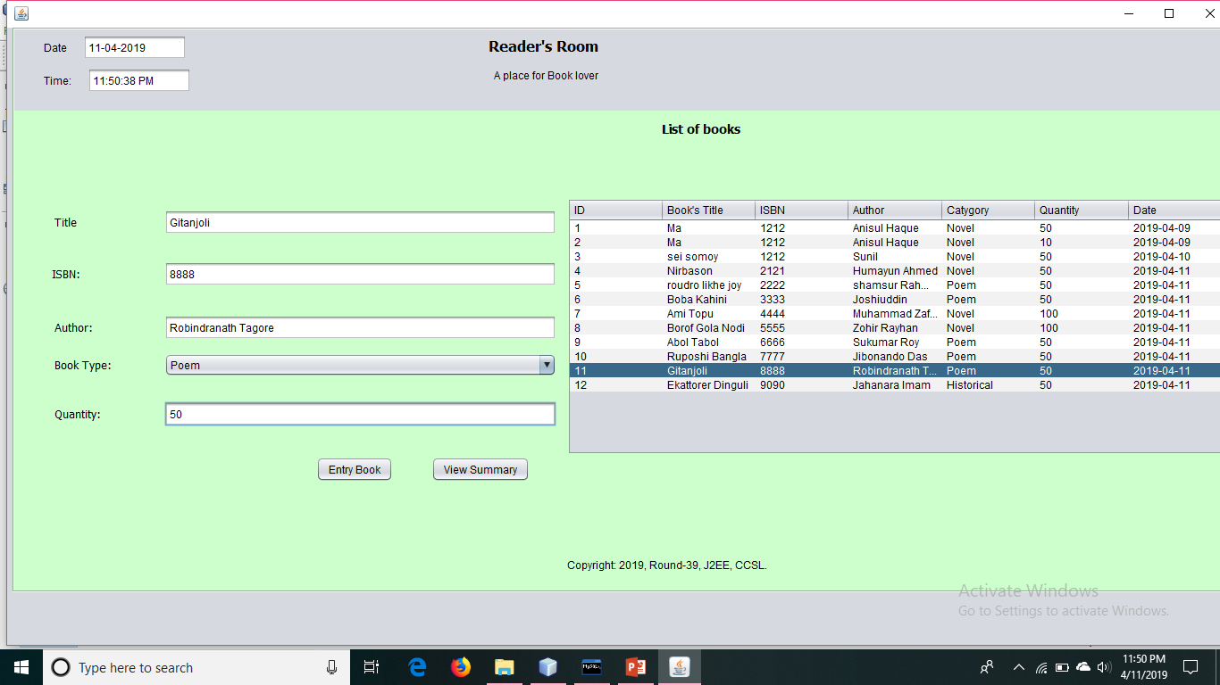
Entry New Book:
Every new entry book contribute to the summary table.

Slide 8
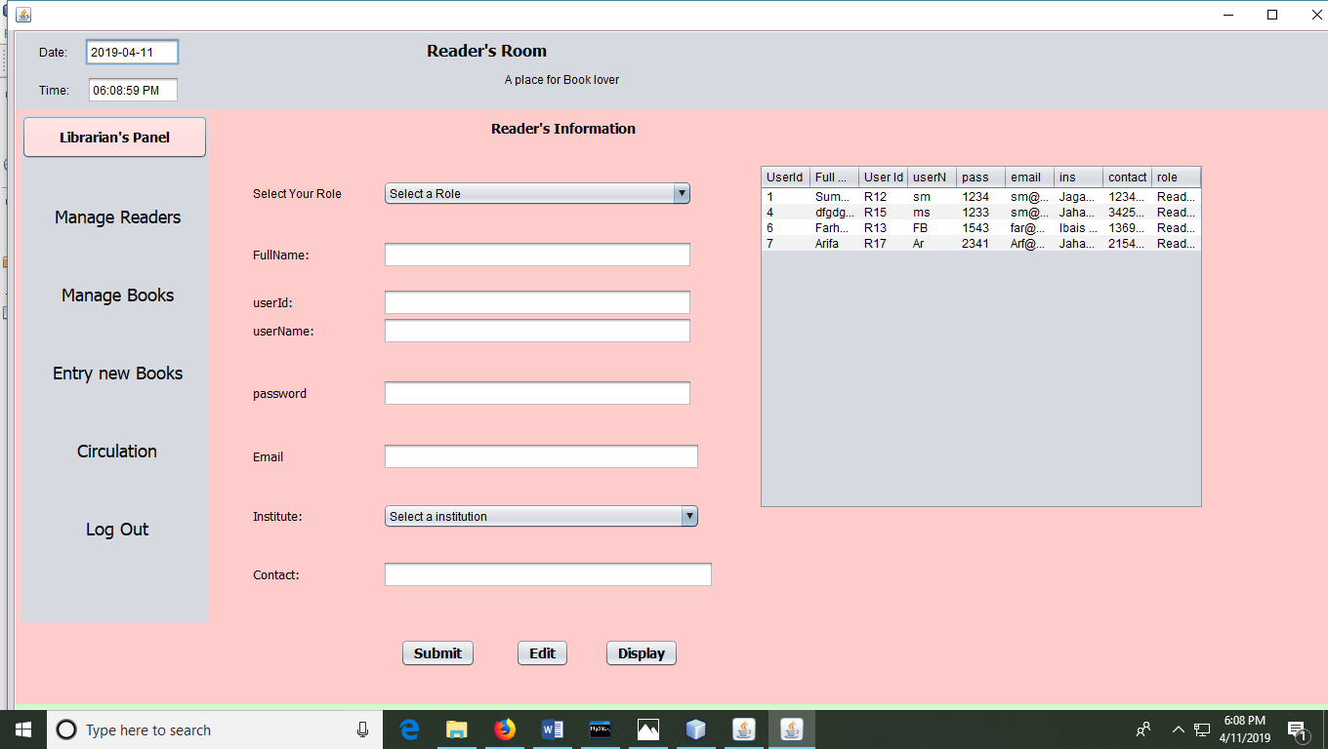
Manage Readers:
Here the system will register reader for the library. Here I have used reader information relevant to be a member of a library.

Slide 9
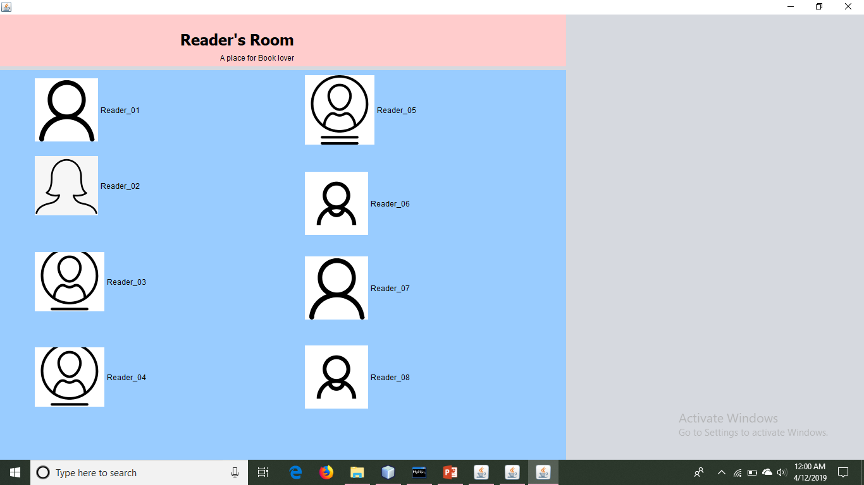

Slide 10
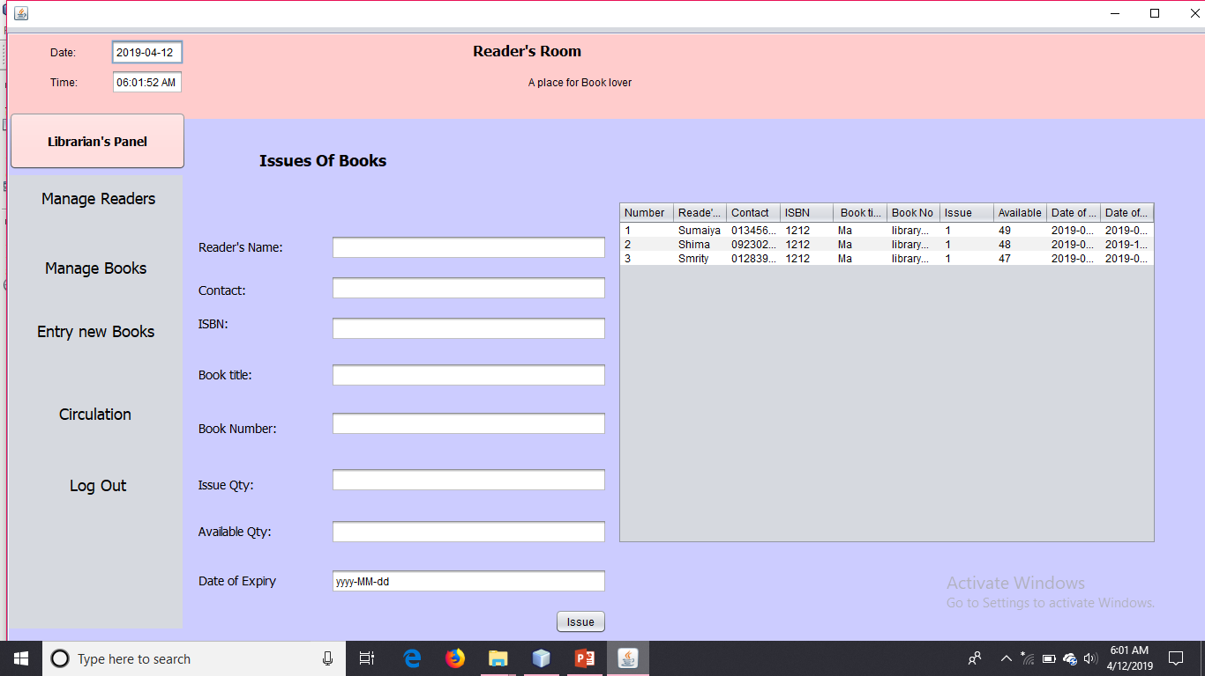
Issue books to Readers:
Here I have registered reader for the library. Here I have used reader information relevant to be a member of a library.

Slide 11
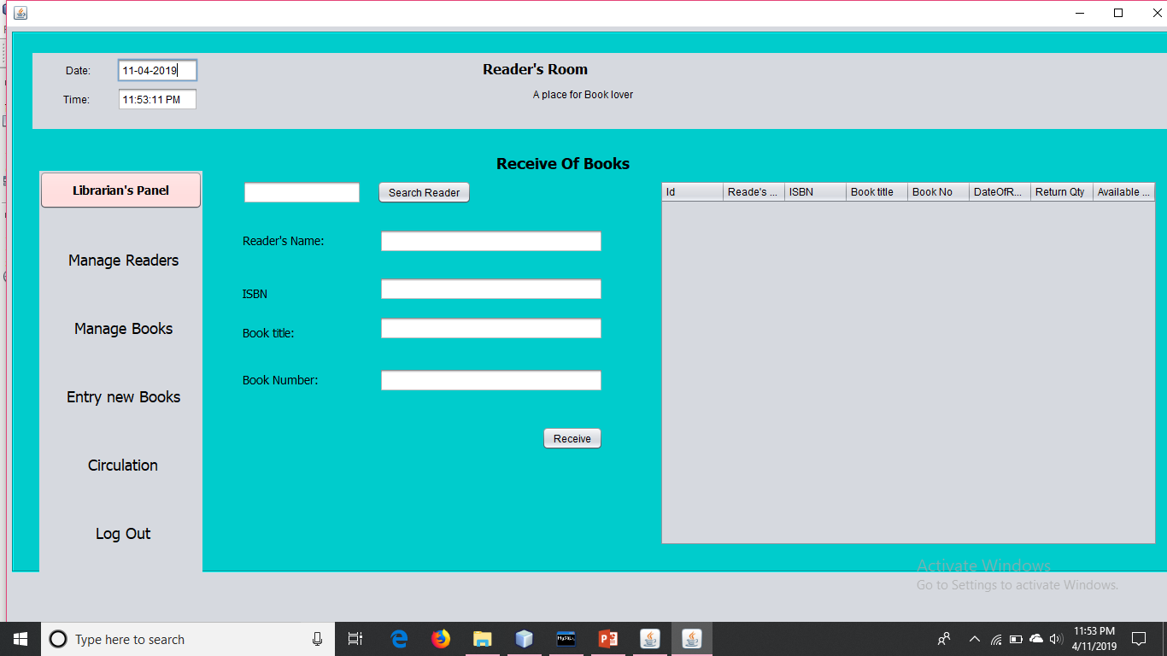
Receive the issued
Book from reader.
Here the system receive book from the reader.
The receive book will saved in the system’s Summary table.

Slide 12
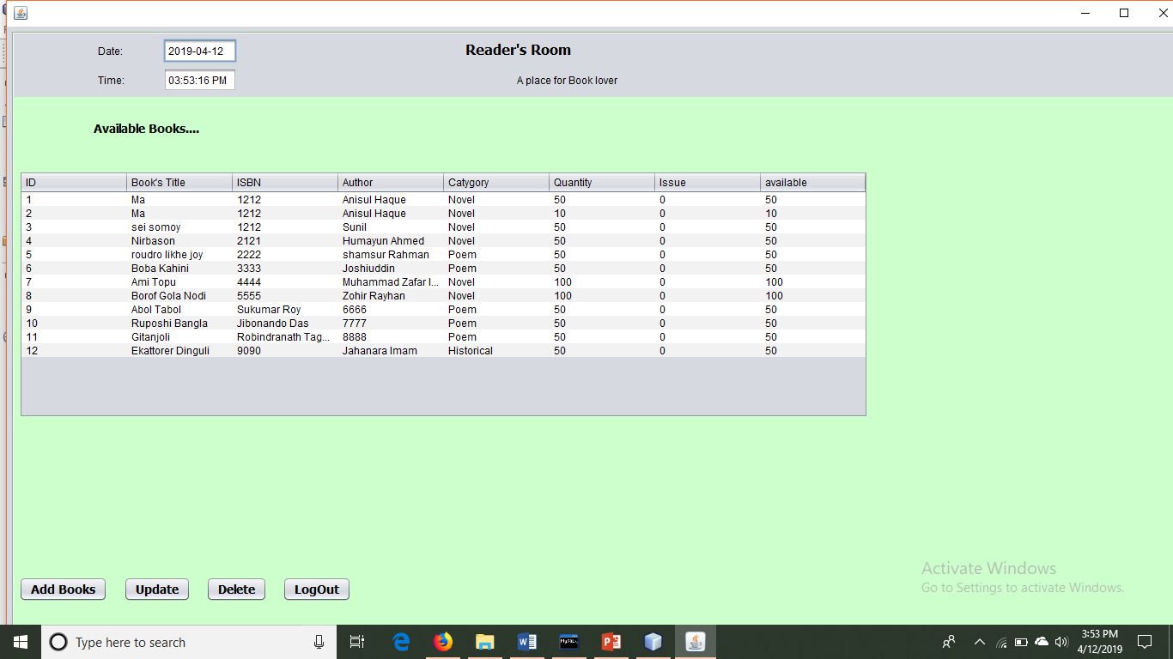
Summary Table.
Here the system will represent the available books of the library.

