Slide 1
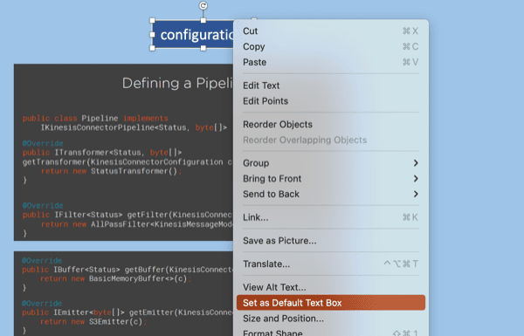
Default Textbox
Hello World

Slide 2
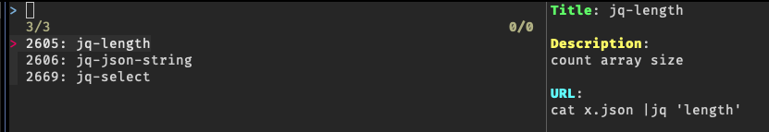
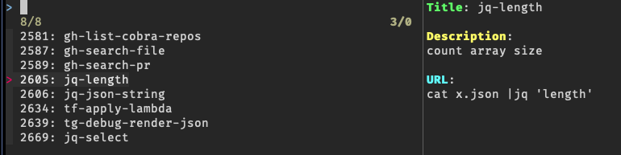
FTS5: find ”jq” in column “metadata” as prefix
FTS5: find ”jq” anywhere in the snippet data

Slide 3
