Slide 1
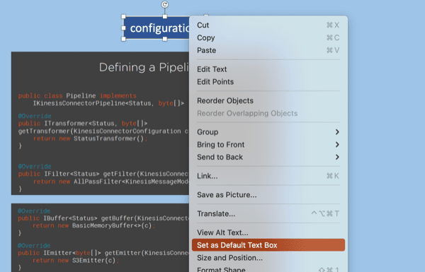
Default Textbox
Hello World

Slide 2
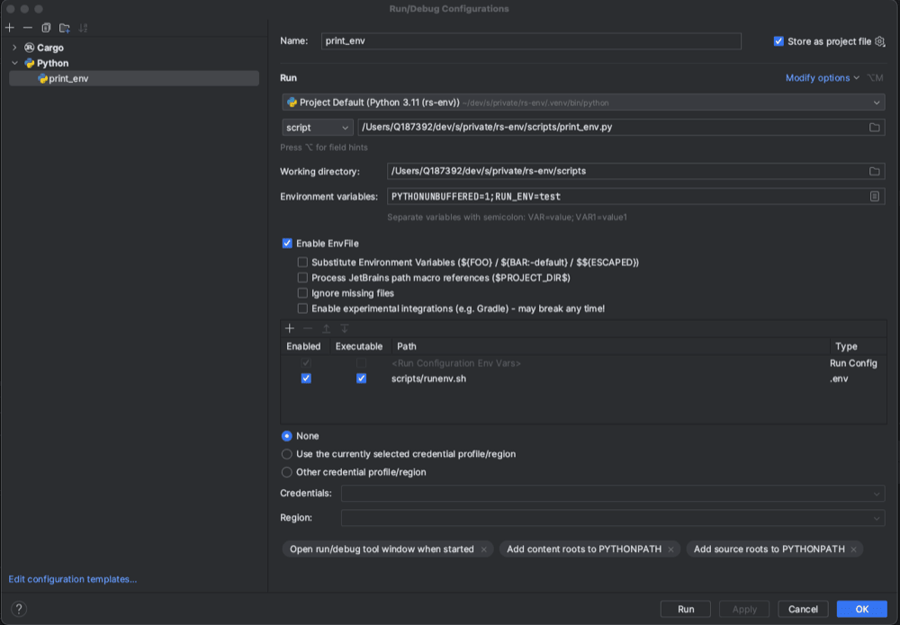
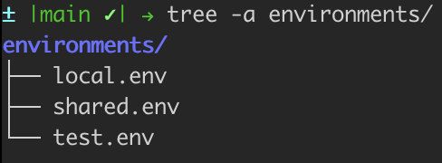
Intellij EnvFile: Inject variables live into RunConfig.
directory with environment config
control which set of variables to choose
command which outputs the variables to stdout.

