Slide 1
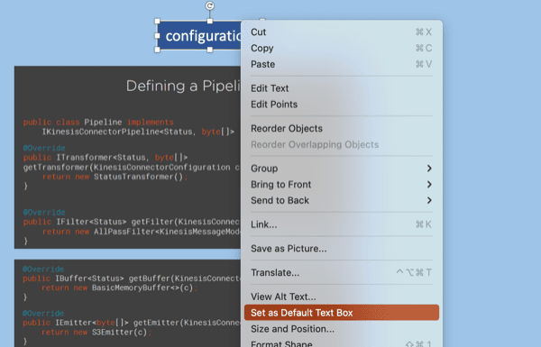
Default Textbox
Hello World

Slide 2
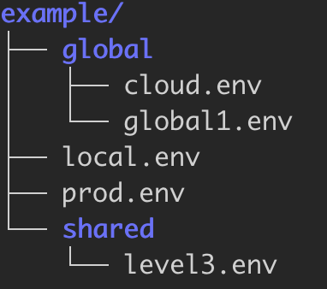
Hierarchical environment variable definiton.
No Link to parent: Tree Root
shared/level3.env
global/global1.env
# rsenv: ../global/cloud.env
# Level3 overwrite
export VAR_5=var_53
export VAR_6=var_63
export VAR_1=var_11
export VAR_2=var_21
export VAR_3=var_31
Link to parent
Link to parent
global/cloud.env
local.env
# rsenv: global.env
# Level2 overwrite
export VAR_4=cloud_42
export VAR_5=cloud_52
# rsenv: shared/level3.env
other stuff
# comments
# new variables just added
export VAR_6=local_64
export VAR_7=local_74
Link to parent
rsenv calculates recursively the resulting set of variables.
Child definition trumps parent definition.

Slide 3
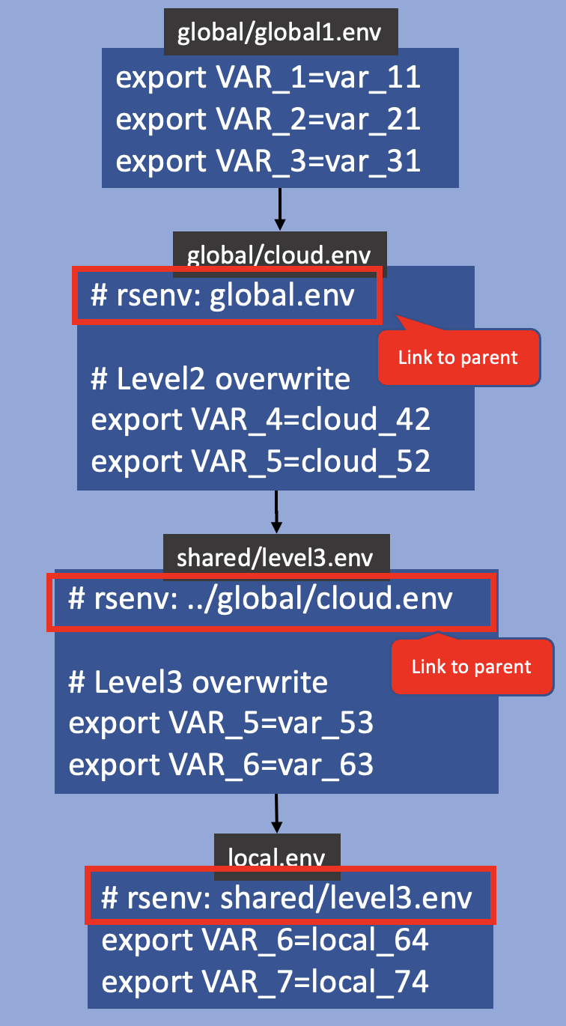
global/global1.env
export VAR_1=var_11
export VAR_2=var_21
export VAR_3=var_31
global/cloud.env
# rsenv: global.env
# Level2 overwrite
export VAR_4=cloud_42
export VAR_5=cloud_52
Link to parent
shared/level3.env
# rsenv: ../global/cloud.env
# Level3 overwrite
export VAR_5=var_53
export VAR_6=var_63
Link to parent
local.env
# rsenv: shared/level3.env
export VAR_6=local_64
export VAR_7=local_74

Slide 4
readme
Filesystem Layout
Logical Dependency
Resulting Variable Set
export VAR_1=var_11
export VAR_2=var_21
export VAR_3=var_31
export VAR_4=cloud_42
export VAR_5=var_53
export VAR_6=local_64
export VAR_7=local_74

Slide 5
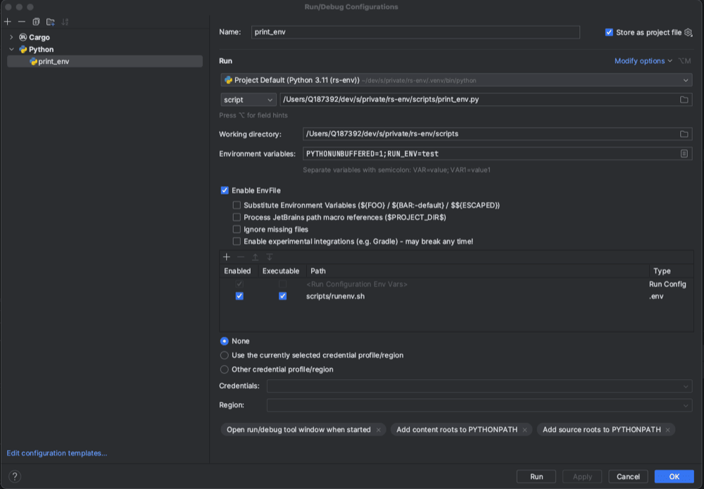
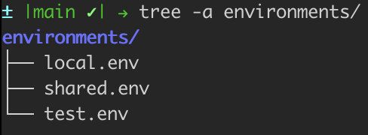
Intellij EnvFile: Inject variables live into RunConfig.
directory with environment config
control which set of variables to choose
command which outputs the variables to stdout.

Slide 6
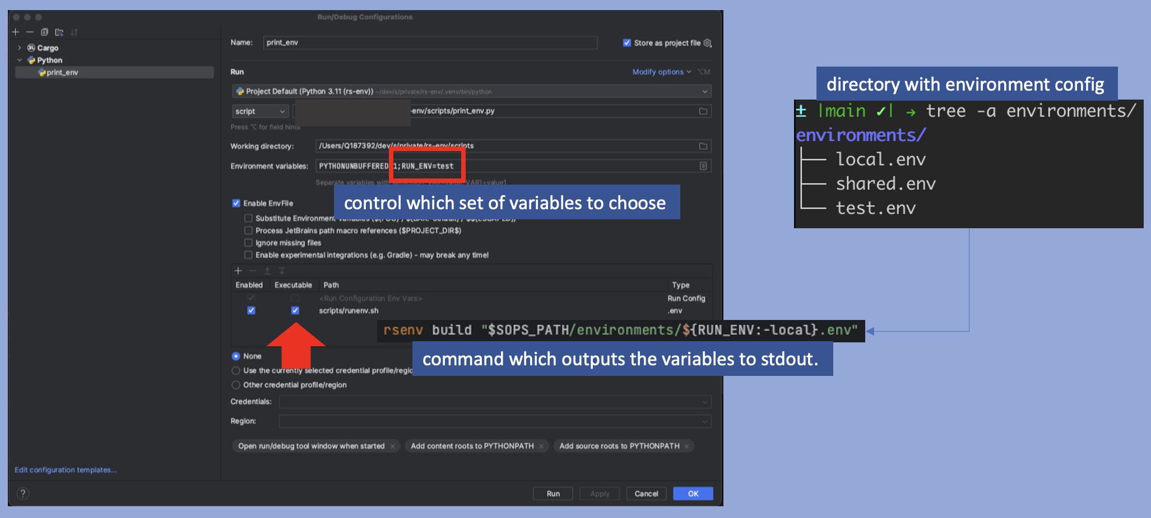

Slide 7
graph.
root:
root=root
level11:
var11=11
level12:
var12=12
level13:
var13=13
level21:
var21=21
root=21
level31:
var31=31
root=31

