Slide 1
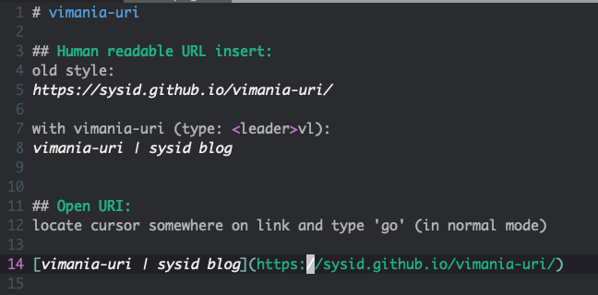
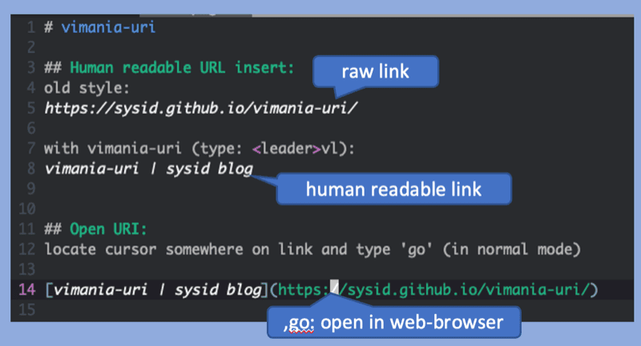
raw link
human readable link
,go: open in web-browser

Slide 2
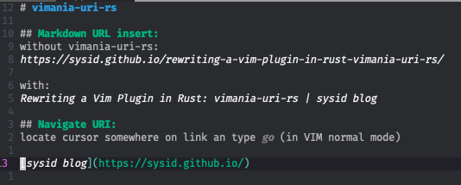
raw link (no metadata)
markdown link with title
,go: open in web-browser

