Slide 1


Slide 3
OUTLINE
DEFINITION OF THE PROBLEM
ALGORITHMIC DETAILS AND IMPLEMENTATION
BFS
IDDFS
A*
GUI
Text-based UI
Web-based GUI
DEMO
RESULTS
CONCLUSION

Slide 4
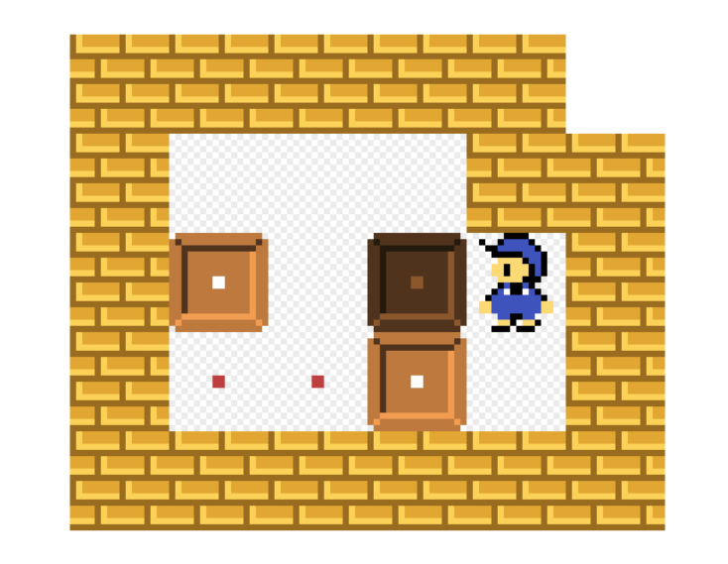
DEFINITION OF THE PROBLEM
Sokoban
Means warehouse keeper in Japan
Transport puzzle game which player tries to put boxes in designated locations by pushing them around a maze

Slide 5
DEFINITION OF THE PROBLEM
Rules of the Game
Only one box can be pushed at a time.
Boxes cannot be pulled.
# desired locations = # boxes
Expected to fill desired locations with boxes

Slide 6
ALGORITHMIC DETAILS AND IMPLEMENTATION
Data Representation
C++ / Matlab
puzzle data: char array
position of the player
last action
bool move_up()
void successors(list result)
bool is_solved
bool deadlock()
int distance(method)

Slide 7
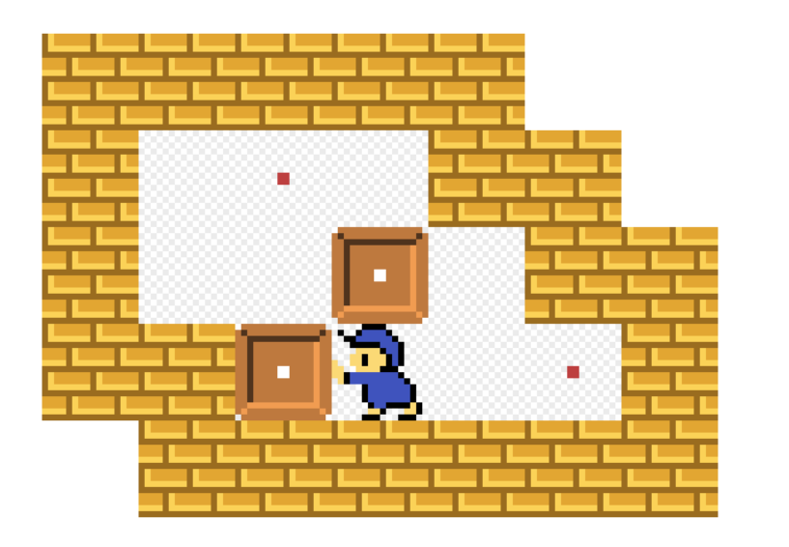
ALGORITHMIC DETAILS AND IMPLEMENTATION
BFS/DCBFS/IDDFS
pseudocodes given in lecture notes
DCBFS:
if a box is pushed to a non-desired corner, no solution can result from its succesors
do not push successors with deadlock into queue

Slide 8
ALGORITHMIC DETAILS AND IMPLEMENTATION
A* Algorithm
deadlock check
infinity if deadlock, 0 otherwise
for h=0, A* reduces to Dijkstra > deadlock checking Dijkstra
no need to keep visited nodes
Manhattan distance
heuristic is admissible (Junghanns, 1999)
Euclidean distance
shorter than Manhattan distance > also admissible
deadlock check + Manhattan distance
max of two or more admissible heuristics is admissible

Slide 9
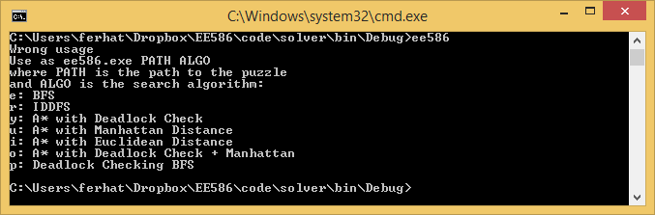
GUI
Text-based UI
@ : the player
space : empty square
$ : movable box
# : wall
. : desired location
+ : the player at a desired location
* : box at a desired location

Slide 10

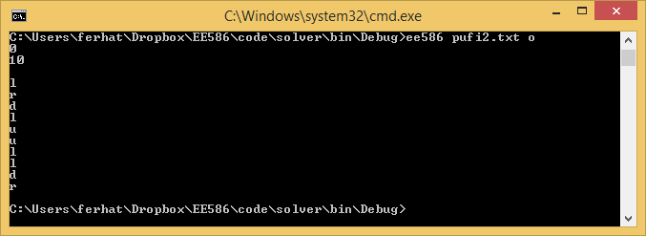
GUI
Text-based UI
Example input:
ee586.exe sokobanGame.txt o
--> Solve the problem in sokobanGame.txt using Deadlock and Manhattan Heuristic

Slide 11
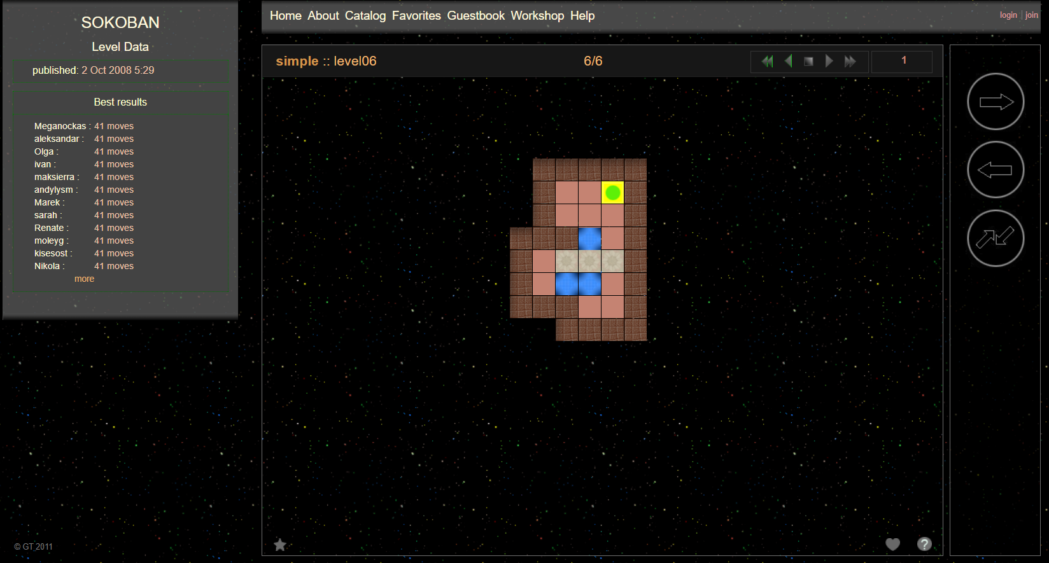
GUI
Web-based GUI

Slide 12
DEMO

Slide 13
RESULTS
BFS, IDDFS, A* with 4 different heuristics
Tested the algorithms on 170 different levels
Optimal step sizes for solutions change from 10 to 178

Slide 14
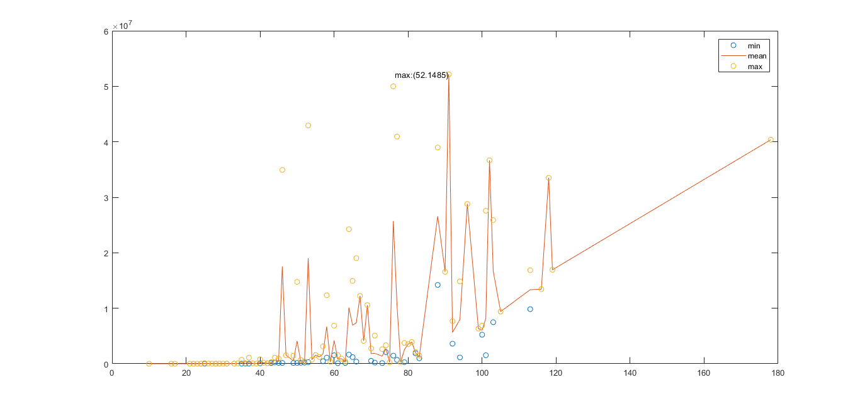
RESULTS
BFS

Slide 15
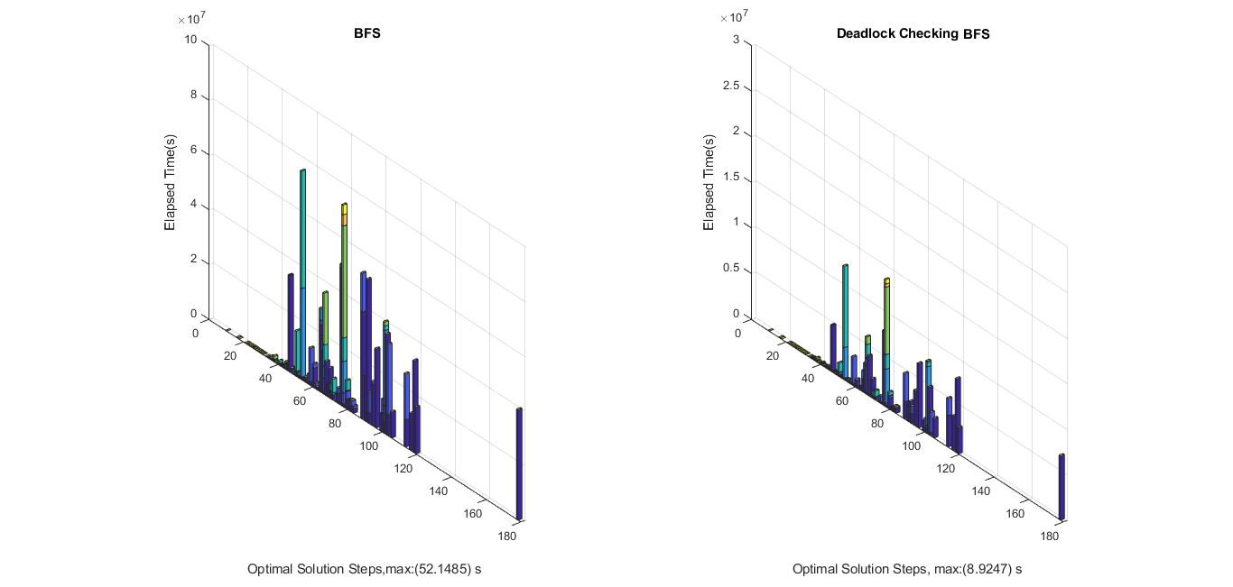
RESULTS
BFS vs BFS with Deadlock Checking

Slide 16
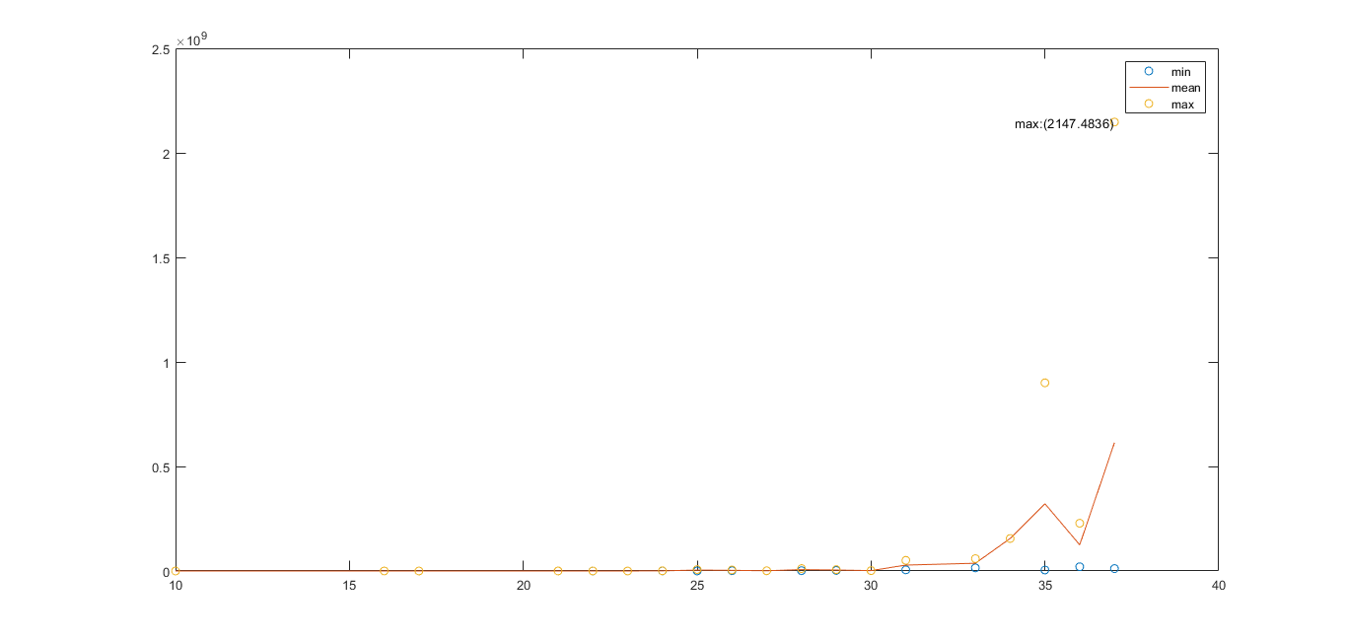
RESULTS
IDDFS

Slide 17
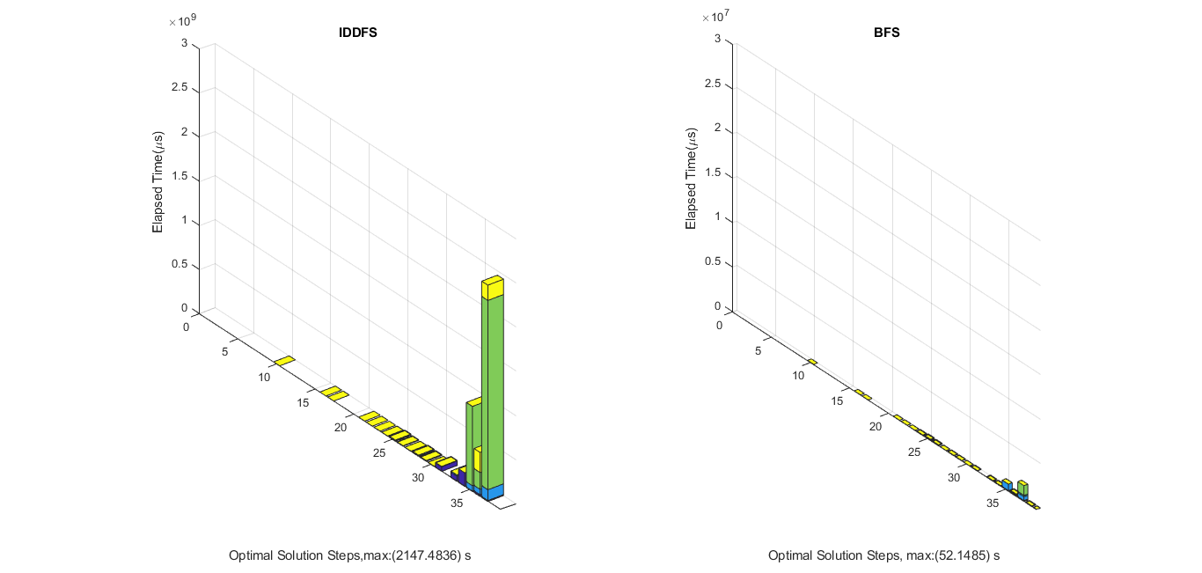
RESULTS
IDDFS vs. BFS

Slide 18
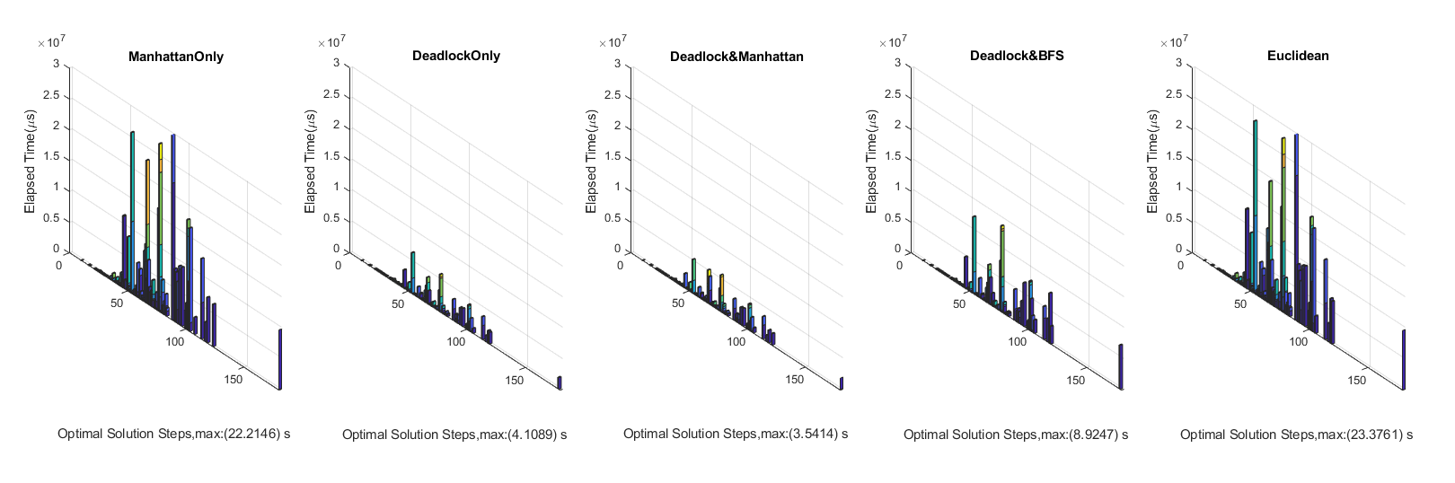
RESULTS
A* with Different Heuristics

Slide 19
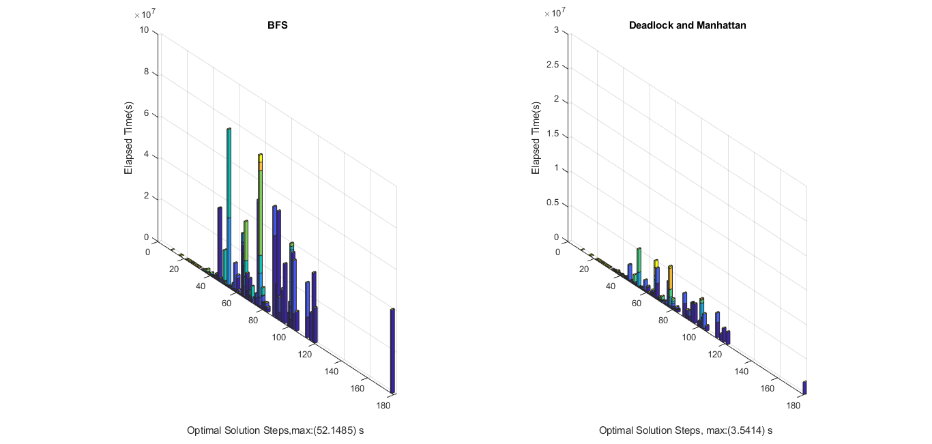
RESULTS
BFS vs. A* with Deadlock and Manhattan Heuristic

Slide 20
CONCLUSION
Practiced our C++, Matlab and Python skills on an entertaining game
Learned how to model a search problem from given definition
In moderately large maps, our algorithms take too much time to solve
Encountered some memory problems. To solve it, iterative deepening A* may be used.
There may be better heuristics which causes less number of nodes expanded.
Instructive experience
Good insight on how to solve AI problems

