Slide 1

Introduction to Linux (Day 2)
Muhammad Arif
http://muharif.net

Slide 2
2nd Exercise: Text File Exploration

Slide 3
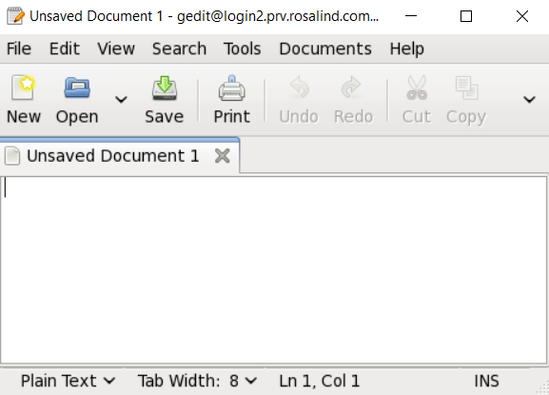
Text file editor
Graphical editor: gedit
Command line editor: vi, nano, emacs, …
30 min for practice

Slide 4
Displaying content of file
cat file1 → printing all contents of file1
less file1 → brief file viewer → you can see next page by “space bar” and escape by “q”
head file1 → printing first few lines of file
tail file1 → printing last few lines of file
grep “pattern” file1 → searching a file for “pattern”
wc –l → count line number

Slide 5
Tasks
1) Make a folder in your home directory, 2) make 3 random files (tip: touch) and 3) show list of files you made
1) Change the content of the file (tip: nano), 2) copy any text from any webpage (find long one) to the file, and 3) explore the files using head, tail, less, etc
Count how many lines that you have
Try to find if a word/phrase exists or not in the file (hint: grep)
20 min for practice
Notes:
http://www.hypexr.org/linux_scp_help.php

Slide 6
3rd Exercise: how to control your files/directories

Slide 7
Copying and moving files/directories
Copy file1 to file2:
cp file1 file2
example: touch test1.txt mkdir test_dir cp test1.txt test_dir/test1.txt
Copy all contents of dir1 to dir2
cp -r dir1 dir2
Move file1 to file2 (or directories)
mv file1 file2
It can also rename your file
Example: mv /users/kXXX/test_dir/test1.txt /users/kXXX/test1.txt

Slide 8
Removing files and directories
rm file1 → remove file 1
rmdir directory1 → remove directory1 (please note that directory1 should not have any files)
WARNING: commands below should be carefully executed → deleted files will not be retrieved, especially in your own computer
rm test* → removing files of names beginning with “test”
rm * → remove all files
“*” called a wildcard, which matches all patterns
Most dangerous command in Linux:
rm –rf *
It deletes all of your files and directories if you executed at the root or home folder

Slide 9
Tasks
1) Make a folder (FOLDER_A) in your home directory, 2) make 3 random files (tip: touch) and 3) show list of files you made
Repeat the previous step but with other names (FOLDER_B)
Delete the content from (FOLDER_A)
Copy the content (only) of FOLDER_B to FOLDER_A
Rename FOLDER_B as FOLDER_C
Copy FOLDER_C and give it a name is FOLDER_D
Move FOLDER_C to FOLDER_A
Make a new directory (FINAL)
Move FOLDER_A and FOLDER_D to Final (hint: use * wildcard)
Delete FINAL
20 min for practice
Notes:
http://www.hypexr.org/linux_scp_help.php

Slide 10
4th Exercise: Controlling Processes

Slide 11
How to control your processes
Foreground vs background
Your jobs can be executed as background (multi-tasking)
command & → running command in background
Ctrl + C → killing job in the foreground
Ctrl + Z → suspending job running in the foreground
bg → background the suspended job
ps → list current processes
jobs → list current jobs
kill -9 1231 → kill process number 1231
kill %1 → kill job number 1
history → list commands you typed previously

Slide 12
How much resource are you using
How much space you are using at Rosalind
lfs quota -h /mnt/lustre
Which processes are running now
top, htop (escaping by “q”)

Slide 13
Tasks
Execute the command “sleep 1000” and kill it after 10 seconds (hint: ^c)
Execute the command “sleep 1000” and make it to run in the background (hint: ctrl+z and bg).
Execute the command “sleep 2000” in the background (hint: &)
Check if there’s any familiar process (hint: top)
Find the process ID (PID) of “sleep 1000 then kill the process.
Find the job ID of “sleep 2000” and kill the job.
20 min for practice
Notes:
http://www.hypexr.org/linux_scp_help.php

Slide 14
5th Exercise: Shell Scripting

Slide 15
Shell scripting
Declaration of variables:
var1=341
(there is no space between =, var1, and 341)
var2=$(($var1 + 12))
Printing value of variables:
echo $var1
echo ${var1}
Printing environment variables:
echo $PWD
echo $HOME

Slide 16
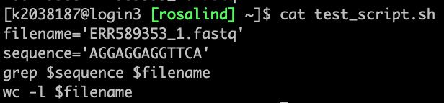
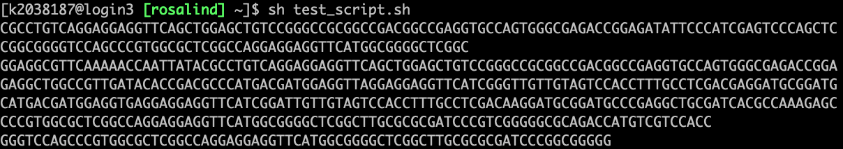
Task
Open an empty file with nano and write a script to perform task 2 final part:
Use variables to define the word and the file name
Perform the previous grep command using shell script
In the last line, calculate how many lines the file has
.
.
.
20 min for practice

Slide 17
Credits
Many were adopted from C3SE introduction course

