Slide 1

Introduction to Linux (Day 2)
Muhammad Arif
http://muharif.net

Slide 2
2nd Exercise: Text File Exploration

Slide 3
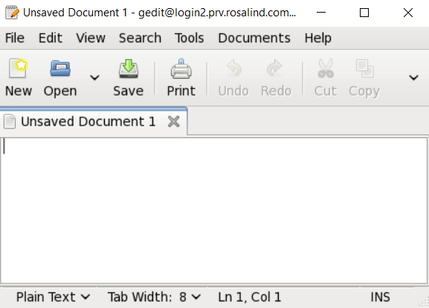
Text file editor
Graphical editor: gedit
Command line editor: vi, nano, emacs, …
30 min for practice

Slide 4
Displaying content of file
cat file1 → printing all contents of file1
less file1 → brief file viewer → you can see next page by “space bar” and escape by “q”
head file1 → printing first few lines of file
tail file1 → printing last few lines of file
grep “pattern” file1 → searching a file for “pattern”
wc –l → count line number

Slide 5
Tasks
1) Make a folder in your home directory, 2) make 3 random files (tip: touch) and 3) show list of files you made
1) Change the content of the file (tip: nano), 2) copy any text from any webpage (find long one) to the file, and 3) explore the files using head, tail, less, etc
Count how many lines that you have
Try to find if a word/phrase exists or not in the file (hint: grep)
20 min for practice
Notes:
http://www.hypexr.org/linux_scp_help.php

Slide 6
3rd Exercise: how to control your files/directories

Slide 7
Copying and moving files/directories
Copy file1 to file2:
cp file1 file2
example: touch test1.txt mkdir test_dir cp test1.txt test_dir/test1.txt
Copy all contents of dir1 to dir2
cp -r dir1 dir2
Move file1 to file2 (or directories)
mv file1 file2
It can also rename your file
Example: mv /users/kXXX/test_dir/test1.txt /users/kXXX/test1.txt

Slide 8
Removing files and directories
rm file1 → remove file 1
rmdir directory1 → remove directory1 (please note that directory1 should not have any files)
WARNING: commands below should be carefully executed → deleted files will not be retrieved, especially in your own computer
rm test* → removing files of names beginning with “test”
rm * → remove all files
“*” called a wildcard, which matches all patterns
Most dangerous command in Linux:
rm –rf *
It deletes all of your files and directories if you executed at the root or home folder

Slide 9
Tasks
1) Make a folder (FOLDER_A) in your home directory, 2) make 3 random files (tip: touch) and 3) show list of files you made
Repeat the previous step but with other names (FOLDER_B)
Delete the content from (FOLDER_A)
Copy the content (only) of FOLDER_B to FOLDER_A
Rename FOLDER_B as FOLDER_C
Copy FOLDER_C and give it a name is FOLDER_D
Move FOLDER_C to FOLDER_A
Make a new directory (FINAL)
Move FOLDER_A and FOLDER_D to Final (hint: use * wildcard)
Delete FINAL
20 min for practice
Notes:
http://www.hypexr.org/linux_scp_help.php

Slide 10
4th Exercise: Controlling Processes

Slide 11
How to control your processes
Foreground vs background
Your jobs can be executed as background (multi-tasking)
command & → running command in background
Ctrl + C → killing job in the foreground
Ctrl + Z → suspending job running in the foreground
bg → background the suspended job
ps → list current processes
jobs → list current jobs
kill -9 1231 → kill process number 1231
kill %1 → kill job number 1
history → list commands you typed previously

Slide 12
How much resource are you using
How much space you are using at Rosalind
lfs quota -h /mnt/lustre
Which processes are running now
top, htop (escaping by “q”)

Slide 13
Tasks
Execute the command “sleep 1000” and kill it after 10 seconds (hint: ^c)
Execute the command “sleep 1000” and make it to run in the background (hint: ctrl+z and bg).
Execute the command “sleep 2000” in the background (hint: &)
Check if there’s any familiar process (hint: top)
Find the process ID (PID) of “sleep 1000 then kill the process.
Find the job ID of “sleep 2000” and kill the job.
20 min for practice
Notes:
http://www.hypexr.org/linux_scp_help.php

Slide 14
5th Exercise: Shell Scripting

Slide 15
Shell scripting
Declaration of variables:
var1=341
(there is no space between =, var1, and 341)
var2=$(($var1 + 12))
Printing value of variables:
echo $var1
echo ${var1}
Printing environment variables:
echo $PWD
echo $HOME

Slide 16
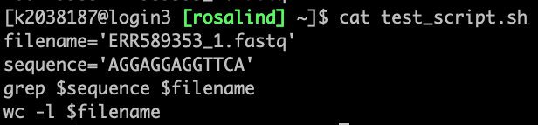
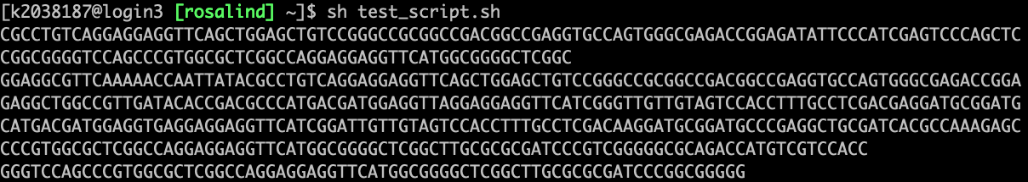
Task
Open an empty file with nano and write a script to perform task 2 final part:
Use variables to define the word and the file name
Perform the previous grep command using shell script
In the last line, calculate how many lines the file has
.
.
.
20 min for practice

Slide 17
Rosalind

Slide 18
How to access Rosalind HPC server (Linux)
SSH protocol → via command
SFTP protocol → via files
HTTP protocol → via webpage

Slide 19
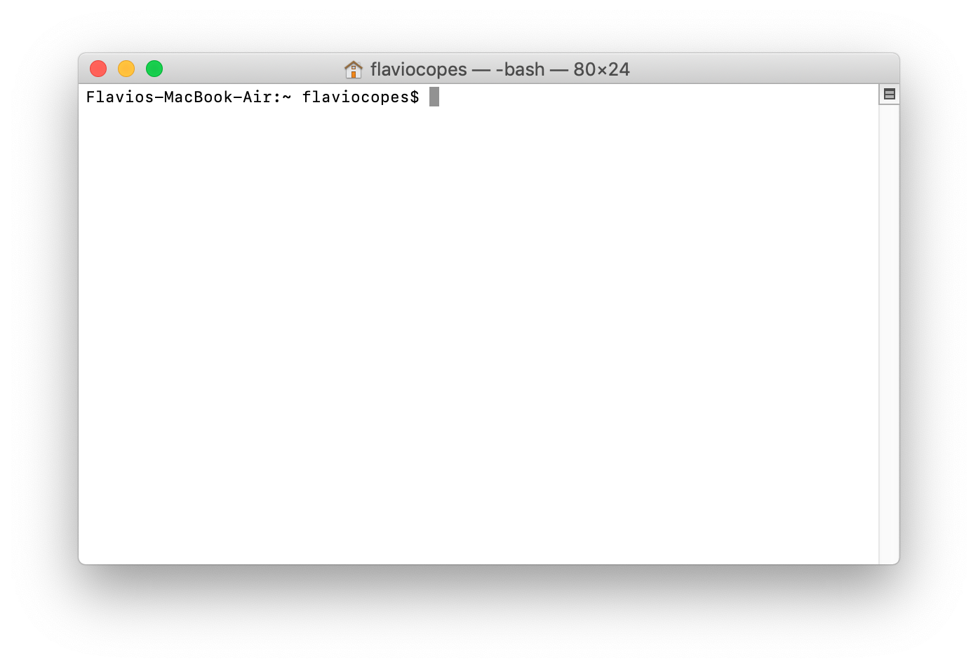
How to access Rosalind HPC server (Linux)
Macbook → Use Terminal → providing Unix/Linux commands and SSH terminal

Slide 20
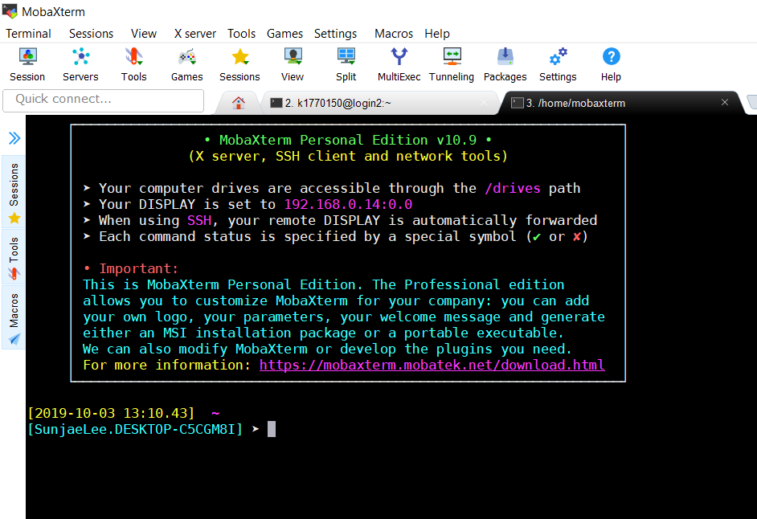
How to access Rosalind HPC server (Linux)
Windows laptop → Install Moba-Xterm software → providing Unix/Linux commands on Windows & SSH terminal

Slide 21
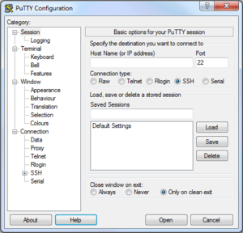
How to access Rosalind HPC server (Linux)
Putty → free and most simple program for SSH terminal

Slide 22
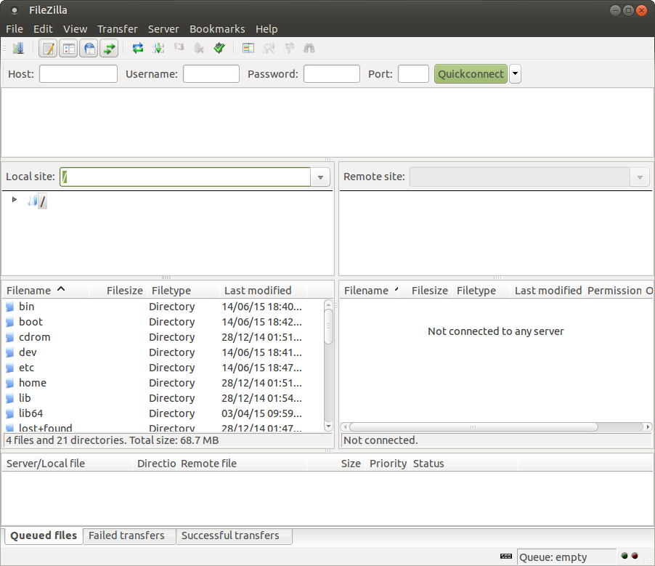
Transferring Data To Rosalind
Download FileZilla (Client) to connect via SFTP
https://filezilla-project.org/
MobaXterm supports SFTP transfer as well (Slow)

Slide 23
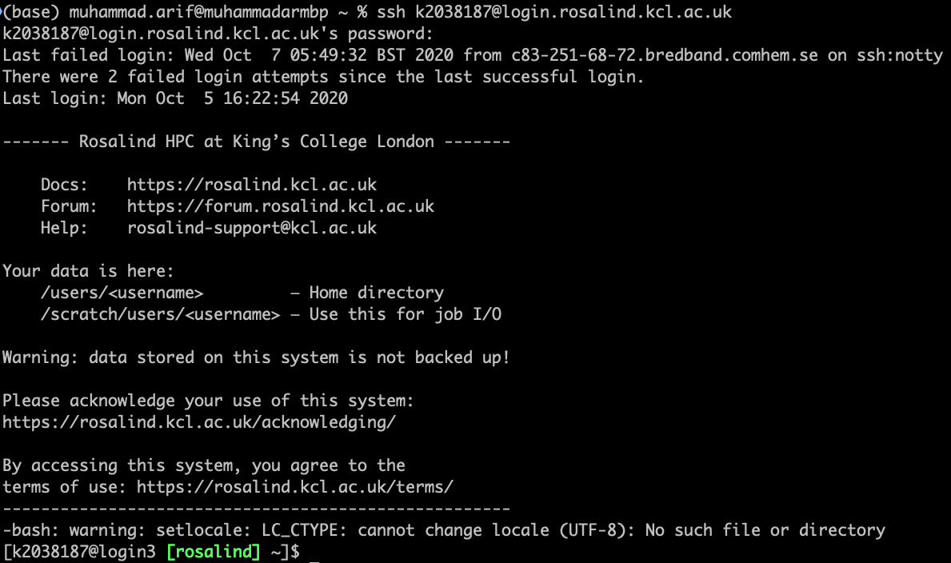
How to login Rosalind
Open SSH client program (MobaXterm, Putty, Terminal)
Login command:
ssh (YOUR_ID)@(SSH address)
ssh kxxxxx@login.rosalind.kcl.ac.uk
and type your password!

Slide 24

Architecture of HPC
Login node
CPU
Memory
Network drive
Grid Engine Scheduler
Computational node
Computational node
Computational node
x 100

Slide 25
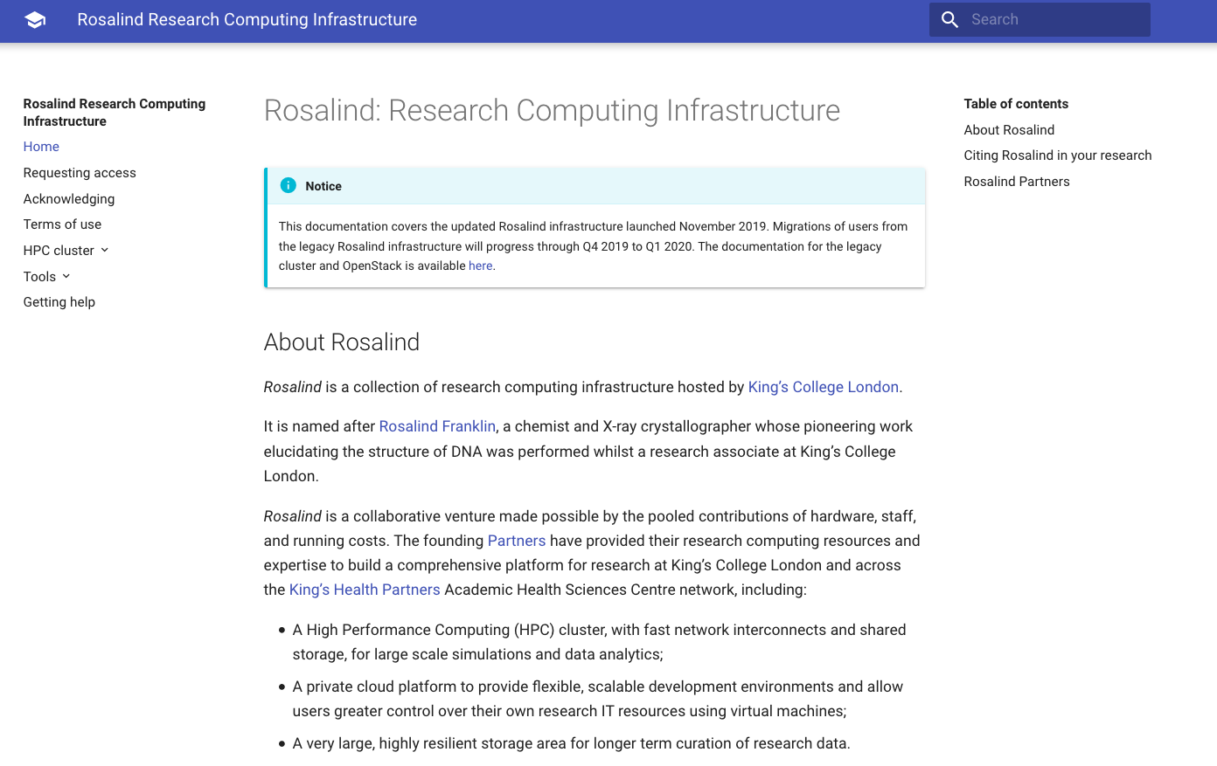
Rosalind Documentation
https://rosalind.kcl.ac.uk

Slide 26
Tasks
1) Make a folder in your home directory, 2) make 3 random files (tip: touch) and 3) show list of files you made
1) Change the content of the file (tip: nano), 2) copy any text from any webpage (find long one) to the file, and 3) explore the files using head, tail, less, etc that we’ve learned yesterday
1) upload any files of your laptop or desktop to your home location at Rosalind server and 2) show list of files you uploaded
30 min for practice
Notes:
http://www.hypexr.org/linux_scp_help.php

Slide 27
How to load installed packages
Several applications are not available by default → you should check pre-installed module on the system (module), otherwise you should install it by yourself or ask root administrator to install it
module avail → you can check all possible applications to load
module load package_name
module load bioinformatics/R
module load general/matlab/2015b
module load general/python/2.7.10
module unload package_name
module list → it shows currently loaded applications

Slide 28
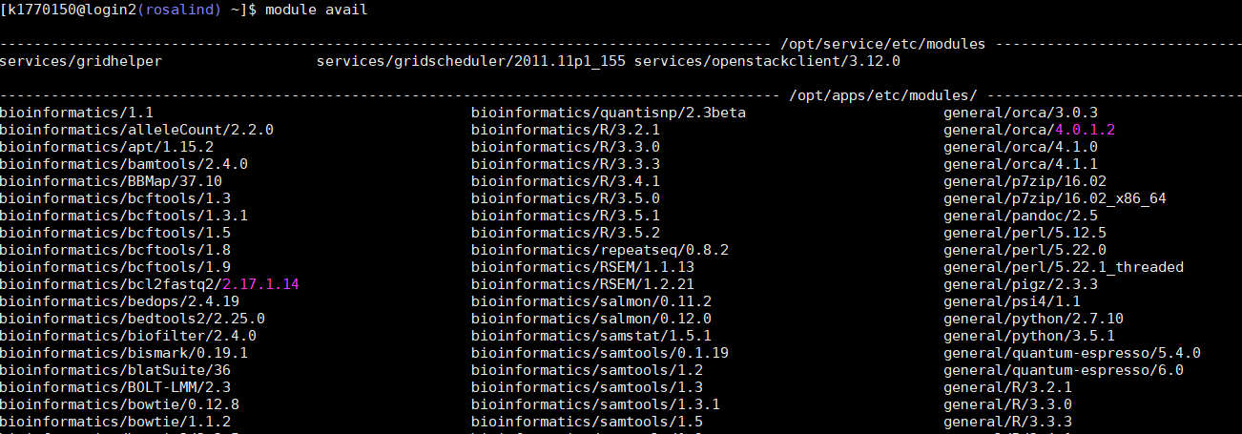

Slide 29
Job submission
Interactive mode vs Batch mode
Login node
Grid Engine Scheduler
Computational node (interactive)
Computational node
Computational node

Slide 30
Job submission
Interactive mode vs Batch mode
Login node
Grid Engine Scheduler
Computational node (interactive)
Computational node
Computational node

Slide 31
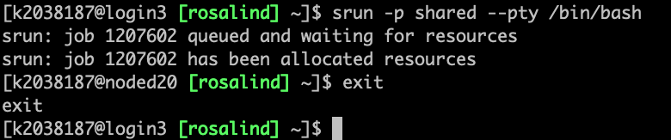
Interactive Mode
Interactive mode:
srun -p shared --pty /bin/bash
Use “exit” command to quit from the interactive mode

Slide 32
Credits
Many were adopted from C3SE introduction course

Slide 33
Rosalind

Slide 34
How to access Rosalind HPC server (Linux)
SSH protocol → via command
SFTP protocol → via files
HTTP protocol → via webpage

Slide 35
How to access Rosalind HPC server (Linux)
Macbook → Use Terminal → providing Unix/Linux commands and SSH terminal

Slide 36
How to access Rosalind HPC server (Linux)
Windows laptop → Install Moba-Xterm software → providing Unix/Linux commands on Windows & SSH terminal

Slide 37
How to access Rosalind HPC server (Linux)
Putty → free and most simple program for SSH terminal

Slide 38
Transferring Data To Rosalind
Download FileZilla (Client) to connect via SFTP
https://filezilla-project.org/
MobaXterm supports SFTP transfer as well (Slow)

Slide 39
How to login Rosalind
Open SSH client program (MobaXterm, Putty, Terminal)
Login command:
ssh (YOUR_ID)@(SSH address)
ssh kxxxxx@login.rosalind.kcl.ac.uk
and type your password!

Slide 40
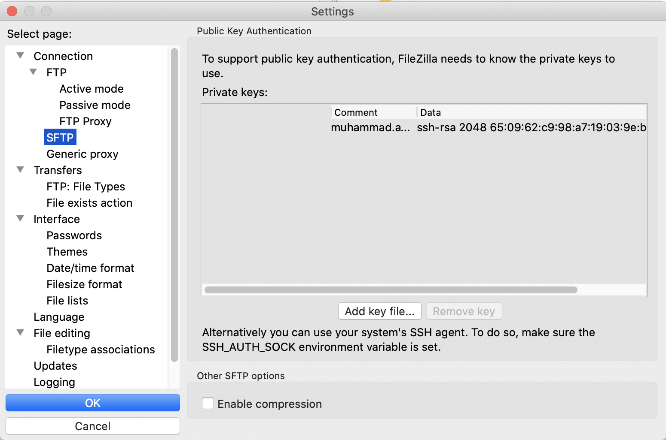
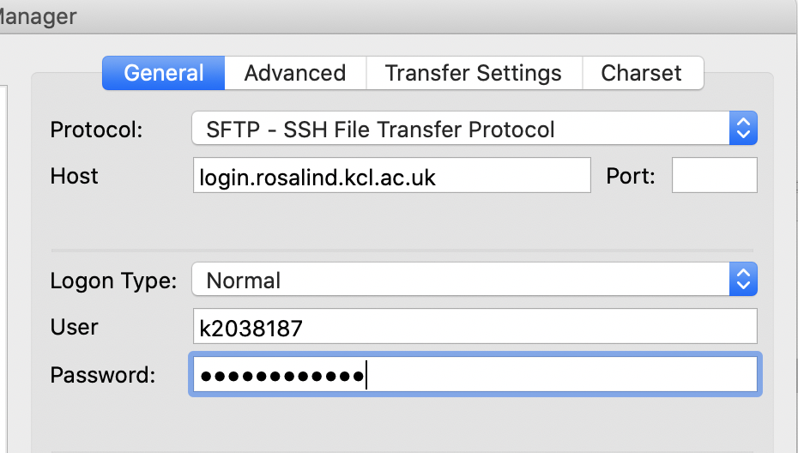
Transferring Data To Rosalind
Always add your private key first (Once)
Edit → Setting → SFTP → Add Key file
Select your id_rsa (not id_rsa.pub)
Reminder:
C:\Users\your_username\.ssh\id_rsa (Windows)
/Users/your_username/.ssh/id_rsa (MacOS)
You can also open terminal, then copy the id_rsa to desktop
cp ~/.ssh/id_rsa ~/Desktop/
Then Load it to filezilla from desktop
After that, add Rosalind into the Site Manager
File → Site Manager (or the top left corner icon)

Slide 41
Architecture of HPC
Login node
CPU
Memory
Network drive
Grid Engine Scheduler
Computational node
Computational node
Computational node
x 100

Slide 42
Rosalind Documentation
https://rosalind.kcl.ac.uk

Slide 43
Tasks
1) Make a folder in your home directory, 2) make 3 random files (tip: touch) and 3) show list of files you made
1) Change the content of the file (tip: nano), 2) copy any text from any webpage (find long one) to the file, and 3) explore the files using head, tail, less, etc that we’ve learned yesterday
1) upload any files of your laptop or desktop to your home location at Rosalind server and 2) show list of files you uploaded
30 min for practice
Notes:
http://www.hypexr.org/linux_scp_help.php

Slide 44
How to load installed packages
Several applications are not available by default → you should check pre-installed module on the system (module), otherwise you should install it by yourself or ask root administrator to install it
module avail → you can check all possible applications to load
module load package_name
module load bioinformatics/R
module load general/matlab/2015b
module load general/python/2.7.10
module unload package_name
module list → it shows currently loaded applications

Slide 46
Job submission
Interactive mode vs Batch mode
Login node
Grid Engine Scheduler
Computational node (interactive)
Computational node
Computational node

Slide 47
Job submission
Interactive mode vs Batch mode
Login node
Grid Engine Scheduler
Computational node (interactive)
Computational node
Computational node

Slide 48
Interactive Mode
Interactive mode:
srun -p shared --pty /bin/bash
Use “exit” command to quit from the interactive mode

Slide 49
Batch Mode
job.sh
#!/bin/bash –l
#SBATCH --output=/scratch/users/%u/%j.out
echo "Hello, World! From $HOSTNAME"
sleep 15
echo "Goodbye, World! From $HOSTNAME"
Batch mode:
Make job script, job.sh
Submitting job:
sbatch –p shared job.sh
Checking status of job
squeue -u yourKNumber
Checking the result of your job (explore the folder)
/scratch/users/yourKnumber/

Slide 50
How much resource are you using
How much space you are using at Rosalind
lfs quota -h /mnt/lustre
How much space that you have in your home directory
quota -s
Which processes are running now
top, htop (escaping by “q”)

Slide 51
Tasks
Download file by job submission (batch mode)
Tip: use wget function
File link: ftp.sra.ebi.ac.uk/vol1/fastq/ERR589/ERR589353/ERR589353_1.fastq.gz
Check it’s status (tip: squeue –u Knumber), wait until the job is done
Check if the file is already there and check its size (tip: ls –alth)

Slide 52
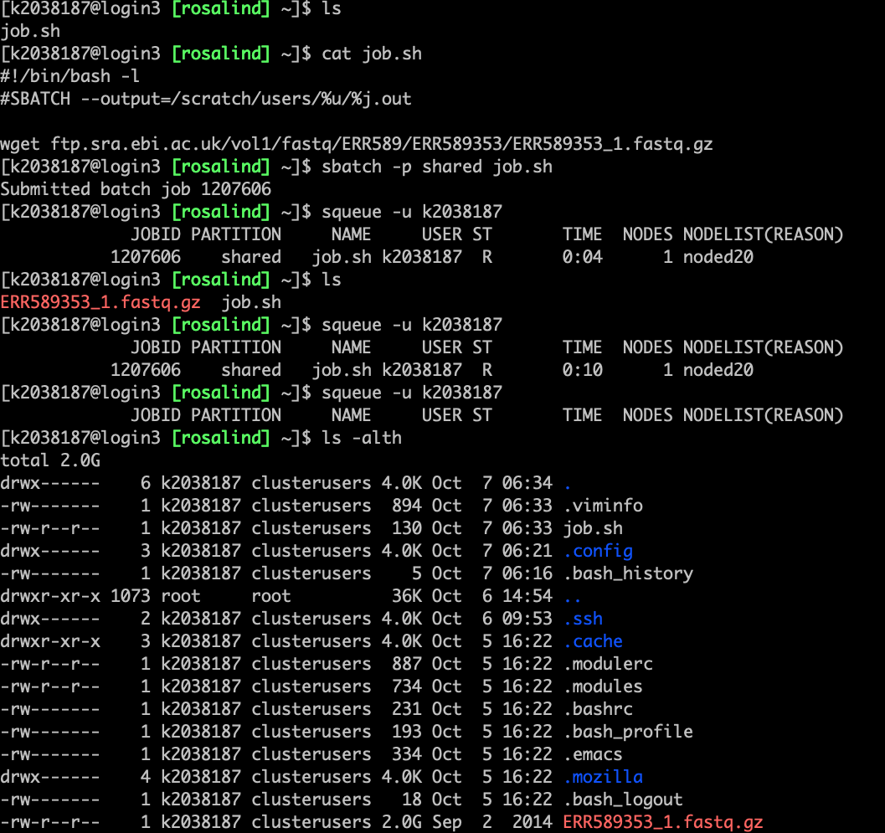

Slide 53
Tasks
Check the usage of your space in the home directory
Decompress downloaded gzip file:
Tip: gzip -d file
Check if the file is extracted there and check its size (tip: ls –alth)
Make a folder named “Dataset” in your home directory and move both files there (remember about wildcard? *)
Move to the new directory
Delete the compressed file (tip: rm, file suffix .gz)
Printing head of file:
Tip: head filename
Find any sequence pattern of your interest from a file
Tip: grep AGGAGGAGGTTCA filename (you can change the sequences)

Slide 54
Tasks
Move to interactive mode
Printing head of file:
Tip: head filename
Check for the format of FASTQ file (standard NGS format)
Read about fastq format to understand the what each line means
https://emea.support.illumina.com/bulletins/2016/04/fastq-files-explained.html
Find any sequence pattern of your interest from a file
Tip: grep AGGAGGAGGTTCA filename (you can change the sequences)
Bonus: count how many lines of your sequence are there?
(tip: grep sequence file | wc –l)

Slide 55
Shell scripting
Declaration of variables:
var1=341
(there is no space between =, var1, and 341)
var2=$(($var1 + 12))
Printing value of variables:
echo $var1
echo ${var1}
Printing environment variables:
echo $PWD
echo $HOME

Slide 56
Task
Make sure that you are in the interactive mode (if not, move there)
Open an empty file with nano
Perform the previous grep command using shell script
In the last line, calculate how many lines the file has
.
.
.

Slide 57
Credits
Many were adopted from C3SE introduction course

