Slide 1
Metagenomics statistical analysis
Updated 2021

Slide 2
Contents
Diversity estimators: Alpha and beta diversity
Statistical analysis for diversity estimators
Difference
Correlation

Slide 3
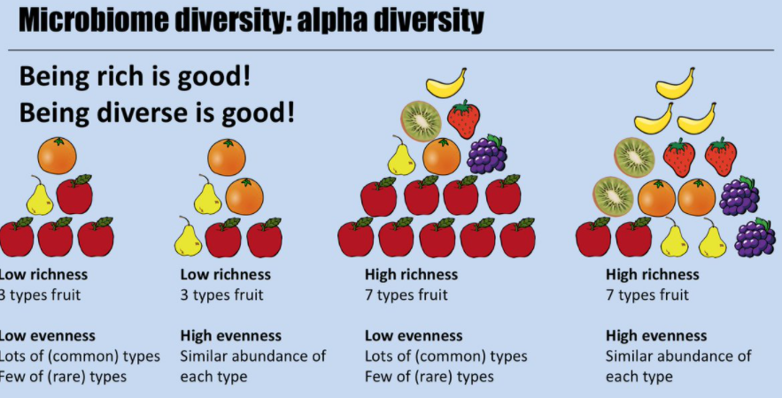
Alpha Diversity
Alpha diversity: within sample
Richness: what are there?
Evenness: how much is there?

Slide 4
Alpha diveristy: richness
Observed species: how many species are there?
Species | Sample 1 (Abundance)
s__Varibaculum_cambriense | 0
s__Corynebacterium_accolens | 10
s__Rothia_dentocariosa | 0
s__Propionibacterium_granulosum | 20
s__Pseudomonas_putida | 55
Observed species?
3

Slide 5

Alpha Diversity: richness
Chao1 index:
n₁: the number of species with abundance = 1
n₂: the number of species with abundance = 2
The observed number of species
Estimated number of unobserved species, which is esimated by rare species (abundance=1 or 2).
Note: Chao1 estimator is particularly useful for estimating the richness of samples with low-abandance species.
Species | Sample 1 (Abu) | Sample 2 (Abu)
s__Varibaculum_cambriense | 1 | 1
s__Corynebacterium_accolens | 10 | 1
s__Rothia_dentocariosa | 0 | 1
s__Propionibacterium_granulosum | 1 | 20
s__Pseudomonas_putida | 2 | 8
Calculate the Chao1 value for sample 1 and 2?
Sample 1: Chao1=4+2* (2-1)/2*(1+1)=4.5
Sample 2: Chao1=5+3* (3-1)/2*(0+1)=8
Ref: Chao A . Nonparametricestimation of the number of classes in a population[J]. Scandinavian Journal of Statistics, 1984, 11: 265-270.
Notes:
OUT: Operational Taxonomic Units, can understand as abundance. The Chao richness estimator tend to use the rare species to infer the number of missing species.
Chao 1 is very sensitive to rare species.
Reference: https://www.jianshu.com/p/cd248f795c52
Chao 1984, chao指数越大，OTU数目越多

Slide 6
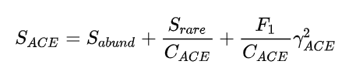
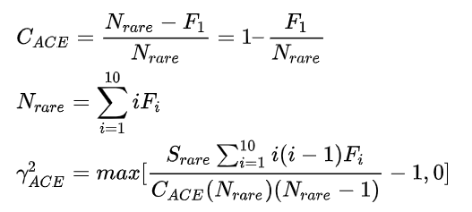
Alpha Diversity: richness
ACE index:
Abundance-based
coverage estimator
The observed number of abundant species with abundance>10
The estimated number of rare species with 2<=abundance<=10
The estimated number of rare species with abundance=1
S_{abund}: the observed number of abundant species (abundance>10).
S_{rare}: the observed number of rare species (abundance≤10).
F_{i}: the number of species with abundance=i. Thus, F₁ is the number of species with abundance=1.
C_{ACE}: abundance coverage (proportion) for the species with 2 ≤ abundance ≤ 10.
N_{rare}: total abundance for rare species
Notes:
Chao and Yang 1993, ACE index: Abundance-based coverage estimator of species richness

Slide 7
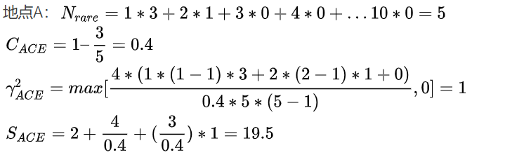

Alpha Diversity: richness
ACE index
S_{abund}: the number of abundant species (abundance>10).
S_{rare}: the number of rare species (abundance≤10).
F_{i}: the number of species with abundance=i. Thus, F₁ is the number of species with abundance=1.
C_{ACE}: abundance coverage for the species with 2 ≤ abundance ≤ 10.
Species | Sample 1 (Abu)
s__Varibaculum_cambriense | 1
s__Corynebacterium_accolens | 1
s__Rothia_dentocariosa | 1
s__Propionibacterium_granulosum | 2
s__Pseudomonas_putida | 11
s__Ureaplasma_parvum | 15
S_{abund}=2
S_{rare}=4
$γ_{ACE}^{2}$=max[$\frac{4∗(1∗\left(1−1\right)∗3+2∗\left(2−1\right)∗1+0)}{0.4∗5∗(5−1)}−$1, 0] = 0
$S_{ACE}=2+\frac{4}{0.4}+0=1$2
When is the ACE value not available?
Notes:
Chao and Yang 1993, ACE index: Abundance-based coverage estimator of species richness
When Nrare or CACE is 0 , ACE is NAN. For example, there is no species OUT<=10, or only one species with OUT=1 and all other species OUT>10.

Slide 8
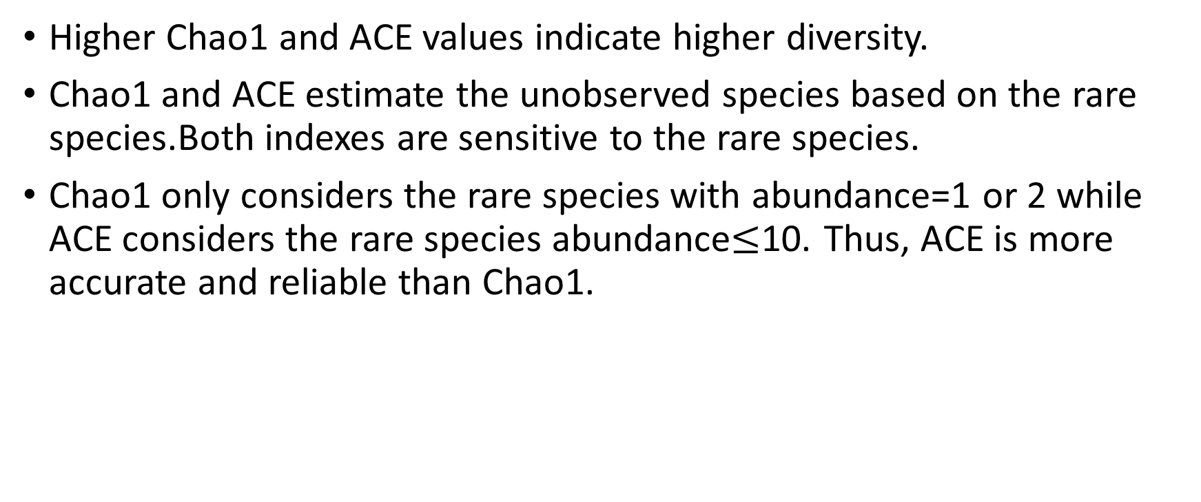
Chao1 vs ACE
Higher Chao1 and ACE values indicate higher diversity.
Chao1 and ACE estimate the unobserved species based on the rare species.Both indexes are sensitive to the rare species.
Chao1 only considers the rare species with abundance=1 or 2 while ACE considers the rare species abundance$≤$10. Thus, ACE is more accurate and reliable than Chao1.

Slide 9


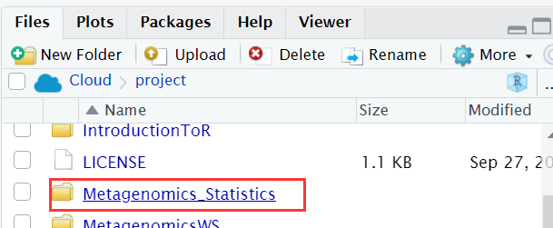
R studio cloud (Method 1)
Step 2
Step 1
Step 3
Step 6
Step 4
Step 5

Slide 10
If slide 9 (method 1) doesn’t work for you please use slide 11-12 (method 2).

Slide 11
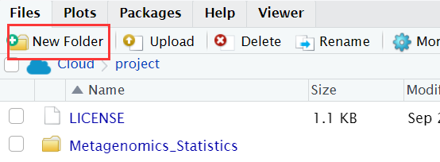
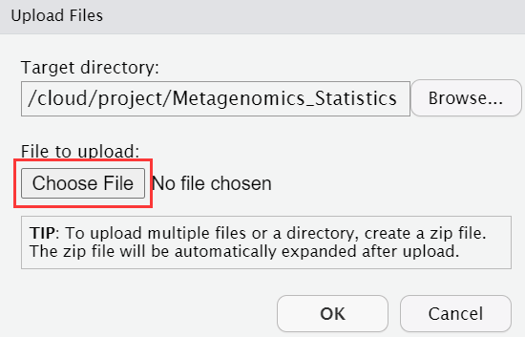
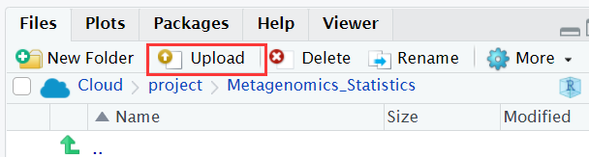
R studio cloud (Method 2)
1.Open your R studio cloud, go to “your workspace” and create a new project
2. Create a new folder called “Metagenomics_Statistics”
3. Go to above folder and upload the data by using ‘Upload’ icon. Data links: https://github.com/sysmedicine/KCLModule2_2021/tree/main/Metagenomics_Statistics
Please upload:
phyloseq_object_data_1.Rdata
Phyloseq_object_data_2.Rdata

Slide 12

4. Click ‘More’ icon and then click ‘Set As Working Directory’

Slide 13
#clean all the variables in the environment
#skip it if you don’t want to clean them
rm(list=ls())

Slide 14
#load all the packages
library(tidyr)
library(dplyr)
library(tibble)
library(phyloseq)
library(microbiome)
library(vegan)

Slide 15
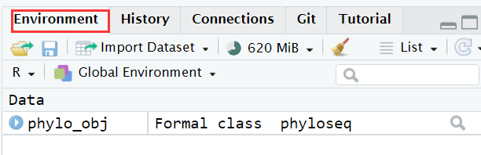
Load Rdata file
#load the phyloseq object data
load("phyloseq_object_data_1.Rdata")
In the evironment, you will see:

Slide 16
Extract data from phyloseq object
#extract abundance profiles
OTUdata <- abundances(phylo_obj)
#extract meta data
SampleData <- meta(phylo_obj)
#extract taxonomy of microbiome
TAXAData <- as.data.frame(tax_table(phylo_obj)@.Data)

Slide 17
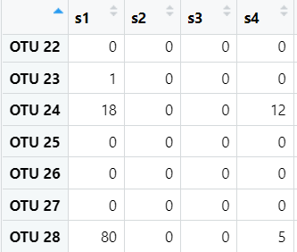
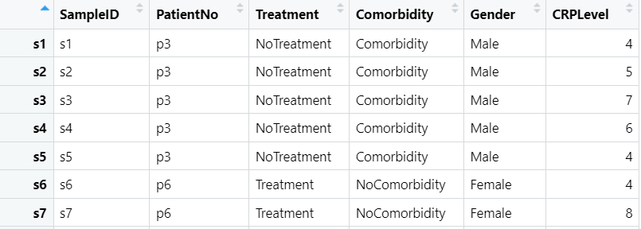
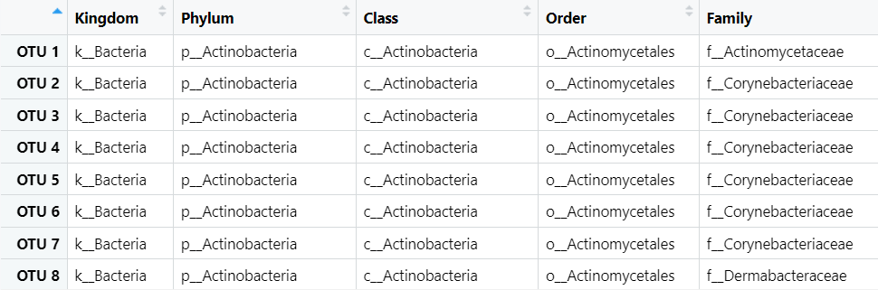
OTUdata: abuandance
SampleData: Metadata for liver disease pateints
TAXAData: taxonomy of microbiome

Slide 18
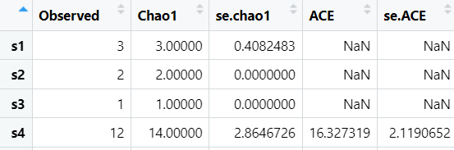
Alpha diversity: richness
#calculate observed species, Chao1 and ACE indexes
Adiv <- estimate_richness(phylo_obj, measures=c("Observed","Chao1","ACE") )
#visualize ‘Adiv’
View(Adiv)
Standard error of Chao1;
e.g. Chao 1 of S1: 3±0.408
Observed species
Why this ACE is NaN?
Notes:
index<-which(OTUdata[,1]!=0)
OTUdata[index,1]
OTU 23 OTU 24 OTU 28: 1, 18, 80

Slide 19
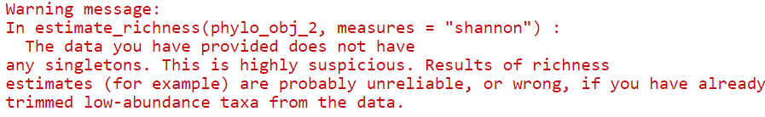
Task 1
15 mins
Load ” phyloseq_object_data_2.Rdata”
Extract the meta data, taxonomy of microbiome and abundance data
Calculate the observed species, Chao1 and ACE indexes for all samples
It is fine if you get this warning since we don’t have the rare species with singleton which means the species with abundance=1.

Slide 20
Break

Slide 21
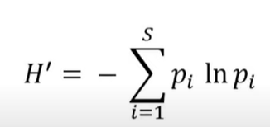
Alpha diversity: richness and evenness
Shannon index:
i: the i_{th} species
S is the number of all species
p_{i} is the proportion of abudance for the i_{th} species
ln is a natural logarithm
H1=-(1*ln(1)+0) = 0
H2=-(0.99*ln(0.99)+0.01*ln(0.01)) = 0.056
H3=-(0.5*ln(0.5)+ 0.5*ln(0.5)) = 0.693
Species | Sample 1 (Abu) | Sample 2 (Abu) | Sample 3 (Abu)
s__Varibaculum_cambriense | 100 | 99 | 50
s__Corynebacterium_accolens | 0 | 1 | 50

Slide 22
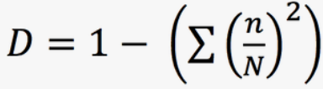
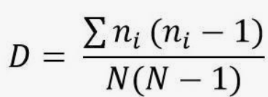
Alpha diversity: richness and evenness
Simpson index:
or
Simpson =1-D
InvSimpson=1/D
InvSimpson= 1/(1-Simpson)
n is the abundance of the i_{th} species
N is the total abundance of all species
n/N is the proportion (P_{i}) of abundance for the i_{th} species
Note: if we randomly select one species from the community, the probability that we catch the specific species i is equal to n/N.
Simpson 1=1-1=0; InvSimpson=1
Simpson 2=1-(0.99*0.99+0.01*0.01)=0.0198; InvSimpson=1.02
Simpson 3=1-(0.5*0.5+0.5*0.5)=0.5; InvSimpson=1/(1-0.5)=2
Species | Sample 1 (OTU) | Sample 2 (OTU) | Sample 3 (OTU)
s__Varibaculum_cambriense | 100 | 99 | 50
s__Corynebacterium_accolens | 0 | 1 | 50
In phyloseq package: high simpson and invsimpson values indicate higher diversity.
Notes:
http://www.countrysideinfo.co.uk/simpsons.htm
(n/N)² is the probability we catch the same species if we do the radomly selectinf for twice. It the value is high, diversity is low.

Slide 23
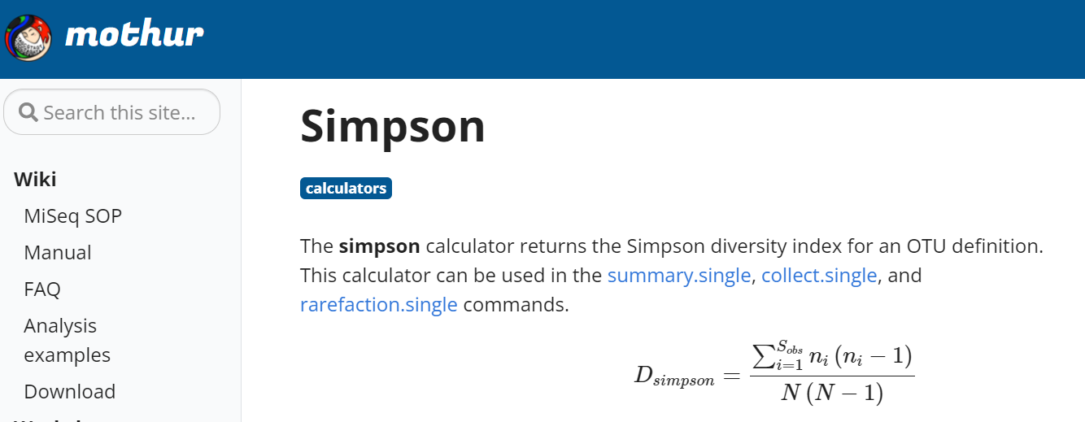
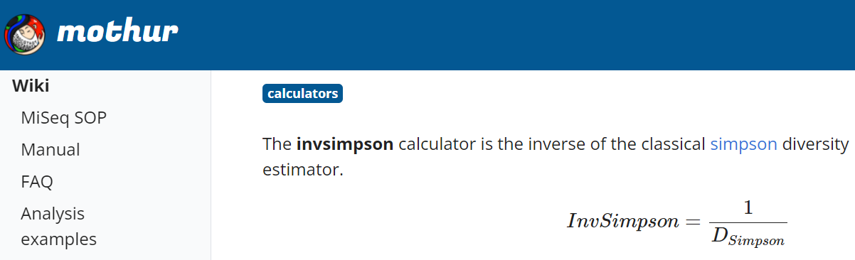
Be careful the formula of Simpson and InvSimpson in different packages!
In package mothur
In mothur package:
high simpson indicates low diversity
high invsimpson indicates high diversity

Slide 24
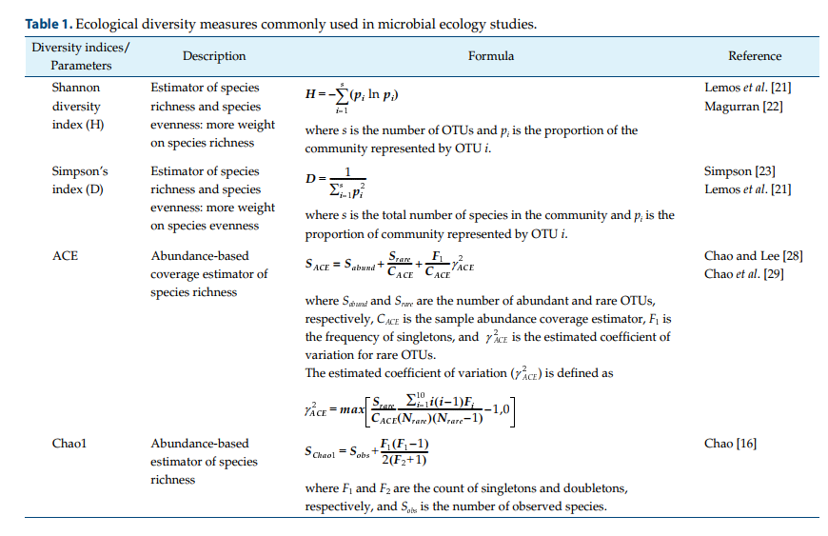
Conclusion
Kim, Bo-Ra, et al. "Deciphering diversity indices for a better understanding of microbial communities." Journal of Microbiology and Biotechnology 27.12 (2017): 2089-2093.

Slide 25
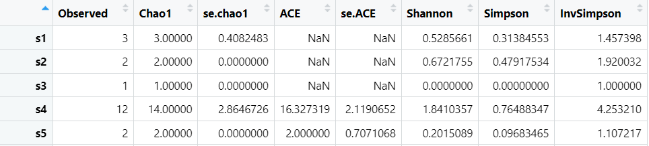
Q: Based on “phyloseq_object_data_1.Rdata”, calculate the Shannon, Simpson and InvSimpson?
Adiv <- estimate_richness(phylo_obj, measures=c("Observed","Chao1","ACE","Shannon","Simpson","InvSimpson"))

Slide 26
Task 2
Based on ’phyloseq_object_data_2.Rdata’, calculate the "Shannon", "Simpson” and "InvSimpson” values?

Slide 27
Break

Slide 28
Statistical Test
Applicable requirement
Null hypothesis (H₀)
P value: the probability that null hyperthesis is true.
Please reject H0 if P<0.05!
Notes:
P<0.05:

Slide 29
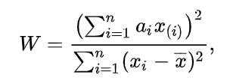
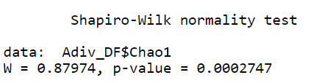
Normal distribution test
Shapiro–Wilk test
H0: the samples x₁, ..., x_{n} came from a normally distributed population.
H1: not from a normally distributed population.
#add a new column called 'SampleID'
Adiv$SampleID <- rownames(Adiv)
#merge Metadata and Adiv
Adiv_DF <- full_join(SampleData,Adiv,by="SampleID)
#Test for normal distribution
result<-shapiro.test(Adiv_DF$Chao1)
What is the conclusion if p<0.05?

Slide 30
Task 3
For ”phyloseq_object_data_2.Rdata”, could you please test whether Chao1, Shannon, Simpson and InvSimpson indexes are normally distributed by Shapiro–Wilk test ?

Slide 31
Difference analysis
Student’s t test
Wilcoxon rank sum test

Slide 32
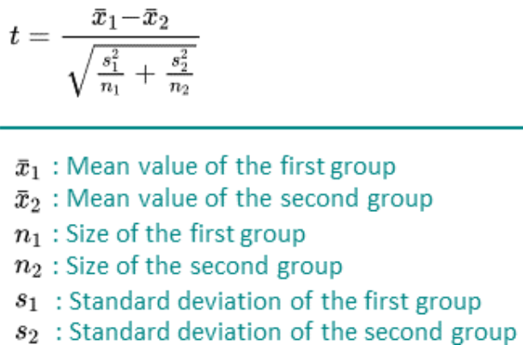
Unpaired student’s t test
Parametric method
Normal distribution
H0: The mean shannon values are equal between two groups.
H1: Not equal.

Slide 33
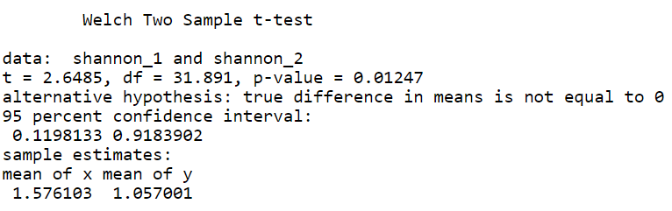
Q: Are the mean shannon values significantly different between the female and male samples?
#get location (rows) of female
index_1<-which(Adiv_DF$Gender=="Female")
#get location (rows) of male
index_2<-which(Adiv_DF$Gender=="Male")
#extract the shannon values of female samples
shannon_1<-Adiv_DF$Shannon[index_1]
#extract the shannon values of male samples
shannon_2<-Adiv_DF$Shannon[index_2]
t.test(shannon_1,shannon_2)
t>0 and p<0.05, the estimator is significantly higher in female group.
t<0 and p<0.05, the estimator is significantly lower in the male group.

Slide 34
Wilcoxon rank sum test
Non-parametric method
Not require a specific distribution
H0: The median shannon values are equal between two groups
H1: Not equal.
1. Put the values together and rank them based on a increasing order.
2. Calculate the rank for each value.
3. Calculate the sum of rank for each group (W1 and W2)
4. If sample size n1<n2, W=W1; if n1=n2, W=W1 or W2.

Slide 35
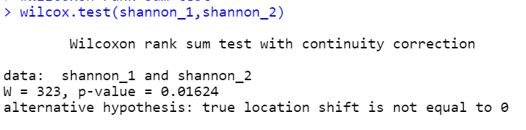
wilcox.test(shannon_1,shannon_2)
Note: median value of shannon in each group can be used to decide which group is higher or lower.

Slide 36
Task 4
Based on the ”phyloseq_object_data_2.Rdata”, is there significant difference of the Shannon values between the Control-HFD and Contro-Chow groups?

Slide 37
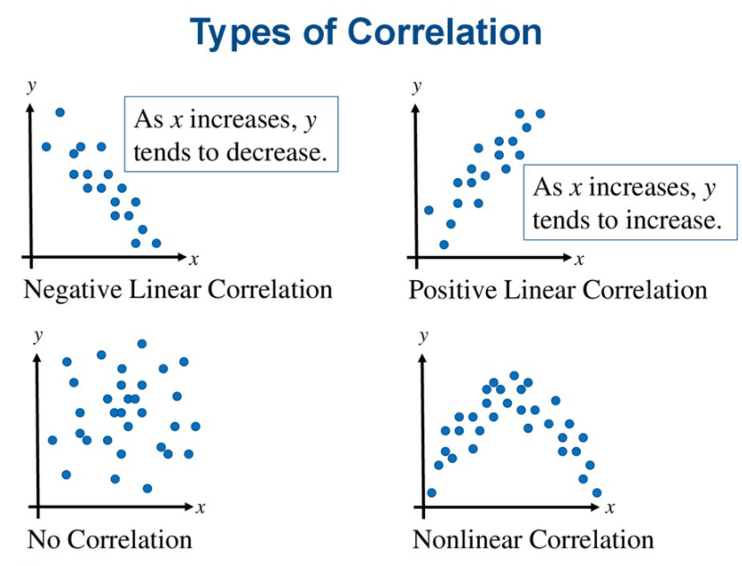
Linear correlation vs non linear correlation
Linear correlation: the ratio of change is constant.
Notes:
Coefficient r is t distribution. This we could caluculate the p value based on statistic t.

Slide 38
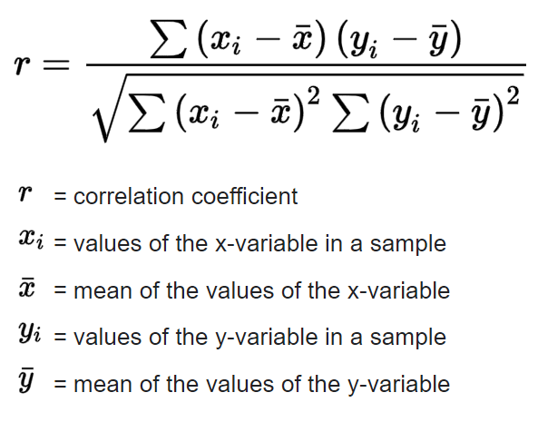
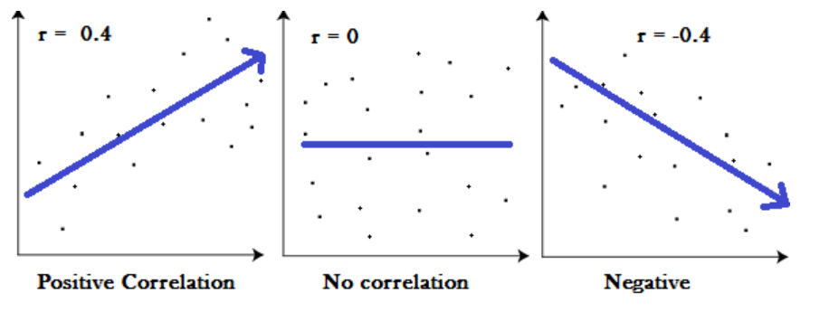
Linear correlation
Pearson correlation
Normal distribution
Spearman correlation
No required distribution
H₀: The correlation coefficient is equal to 0.
H₁: Not equal to 0.
Pearson correlation coefficient
Notes:
Pearson's correlation coefficient follows Student's t-distribution

Slide 39
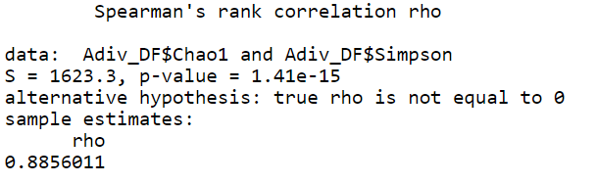
#Spearman correlation
cor.test(Adiv_DF$Chao1,Adiv_DF$Simpson,method="spearman")
R tips:
cor.test(x, y, method=”spearman”)
cor.test(x, y, method=”pearson”)
Range of rho: -1≤r ≤1

Slide 40
Task 5
Based on the ”phyloseq_object_data_2.Rdata”, calculate the correlation between shannon and simpson indexes(r and p value)?

Slide 41
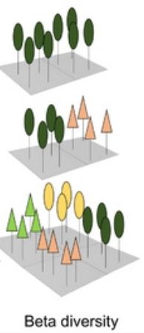
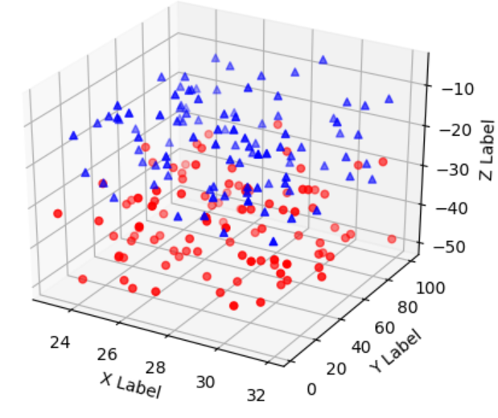
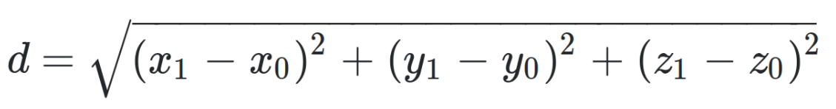
Beta diversity
Beta-diversity is measurement to characterize the diversity between two samples.
Beta-diversity is measured by distance.
Sample 1
Red: samples in group 1
Blue: samples in group 2
X, Y and Z are three different species
Sample 2
Euclidean distance:
Sample 3

Slide 42
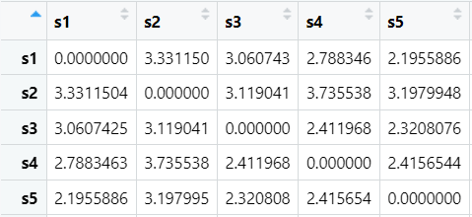
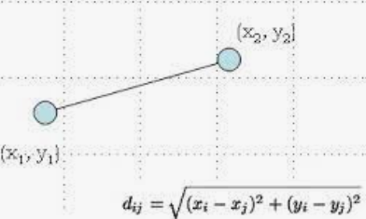
Beta diversity
#log10 transformation for the abundance data
phyobj_shift <- microbiome::transform(phylo_obj,transform="log10")
#beta diversity based on euclidean distance
Betdiv <- as.matrix(phyloseq::distance(phyobj_shift, method="euclidean"))<- microbiome::transform(phylo_obj)
If we measured two species
If we measured three species
Beta diversity can be considered as a distance.
High distance means more difference between two samples.

Slide 43
Compare beta diversity between two or more groups
.
Permutational multivariate analysis of variance (PERMANOVA)
Non-parametric test
No required distribution
H0: The centroids and dispersion of the groups are equal.
H1: Not equal.
Red: samples in group 1
Blue: samples in group 2
X, Y and Z are three different species

Slide 44

Biological difference between groups
Individual difference
if the variance between groups is significantly higher than variance within groups (P<0.05), there are biological difference between two groups.

Slide 45
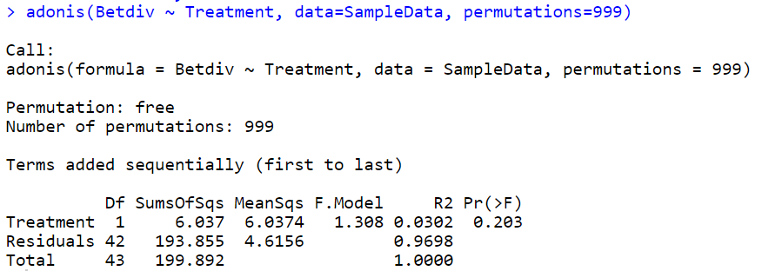
Aim: test whether there is significant difference of beta diversity between treated and untreated groups
adonis(Betdiv ~ Treatment, data=SampleData, permutations=999)
P=0.203, >0.05: not significant. No difference
F value 1.308, which is closed to 1
R²=3.02%: Variance between groups only account for 3.02% of total variance, which is very small proportion.
Conclusion:
No significant difference of beta diversity between the treated and untreated groups.
Closed to 1? Waht does it mean?

Slide 46
Task 6
Based on the ”phyloseq_object_data_2.Rdata”, calculate the beta diveristy and test whether beta diverity values are significantly different between groups?

