Slide 1
Metagenomics statistical analysis
Updated 2021

Slide 2
Contents
Diversity estimators: Alpha and beta diversity
Statistical analysis for diversity estimators
Difference
Correlation

Slide 3
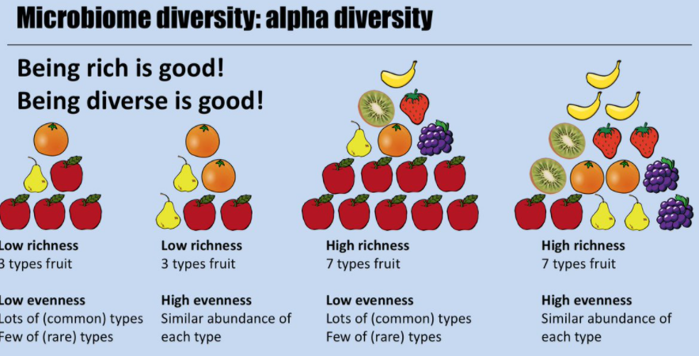
Alpha Diversity
Alpha diversity: within sample
Richness: what are there?
Evenness: how much is there?

Slide 4
Alpha diveristy: richness
Observed species: how many species are there?
Species | Sample 1 (Abundance)
s__Varibaculum_cambriense | 0
s__Corynebacterium_accolens | 10
s__Rothia_dentocariosa | 0
s__Propionibacterium_granulosum | 20
s__Pseudomonas_putida | 55
Observed species?
3

Slide 5

Alpha Diversity: richness
Chao1 index:
n₁: the number of species with abundance = 1
n₂: the number of species with abundance = 2
The observed number of species
Estimated number of unobserved species, which is esimated by rare species (abundance=1 or 2).
Note: Chao1 estimator is particularly useful for estimating the richness of samples with low-abandance species.
Species | Sample 1 (Abu) | Sample 2 (Abu)
s__Varibaculum_cambriense | 1 | 1
s__Corynebacterium_accolens | 10 | 1
s__Rothia_dentocariosa | 0 | 1
s__Propionibacterium_granulosum | 1 | 20
s__Pseudomonas_putida | 2 | 8
Calculate the Chao1 value for sample 1 and 2?
Sample 1: Chao1=4+2* (2-1)/2*(1+1)=4.5
Sample 2: Chao1=5+3* (3-1)/2*(0+1)=8
Ref: Chao A . Nonparametricestimation of the number of classes in a population[J]. Scandinavian Journal of Statistics, 1984, 11: 265-270.
Notes:
OUT: Operational Taxonomic Units, can understand as abundance. The Chao richness estimator tend to use the rare species to infer the number of missing species.
Chao 1 is very sensitive to rare species.
Reference: https://www.jianshu.com/p/cd248f795c52
Chao 1984, chao指数越大，OTU数目越多

Slide 6
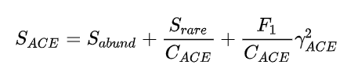
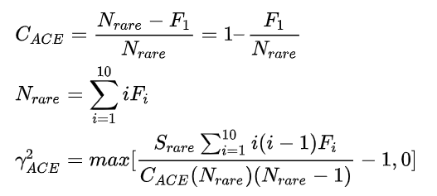
Alpha Diversity: richness
ACE index:
Abundance-based
coverage estimator
The observed number of abundant species with abundance>10
The estimated number of rare species with 2<=abundance<=10
The estimated number of rare species with abundance=1
S_{abund}: the observed number of abundant species (abundance>10).
S_{rare}: the observed number of rare species (abundance≤10).
F_{i}: the number of species with abundance=i. Thus, F₁ is the number of species with abundance=1.
C_{ACE}: abundance coverage (proportion) for the species with 2 ≤ abundance ≤ 10.
N_{rare}: total abundance for rare species
Notes:
Chao and Yang 1993, ACE index: Abundance-based coverage estimator of species richness

Slide 7
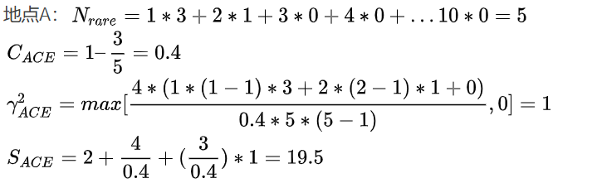

Alpha Diversity: richness
ACE index
S_{abund}: the number of abundant species (abundance>10).
S_{rare}: the number of rare species (abundance≤10).
F_{i}: the number of species with abundance=i. Thus, F₁ is the number of species with abundance=1.
C_{ACE}: abundance coverage for the species with 2 ≤ abundance ≤ 10.
Species | Sample 1 (Abu)
s__Varibaculum_cambriense | 1
s__Corynebacterium_accolens | 1
s__Rothia_dentocariosa | 1
s__Propionibacterium_granulosum | 2
s__Pseudomonas_putida | 11
s__Ureaplasma_parvum | 15
S_{abund}=2
S_{rare}=4
$γ_{ACE}^{2}$=max[$\frac{4∗(1∗\left(1−1\right)∗3+2∗\left(2−1\right)∗1+0)}{0.4∗5∗(5−1)}−$1, 0] = 0
$S_{ACE}=2+\frac{4}{0.4}+0=1$2
When is the ACE value not available?
Notes:
Chao and Yang 1993, ACE index: Abundance-based coverage estimator of species richness
When Nrare or CACE is 0 , ACE is NAN. For example, there is no species OUT<=10, or only one species with OUT=1 and all other species OUT>10.

Slide 8
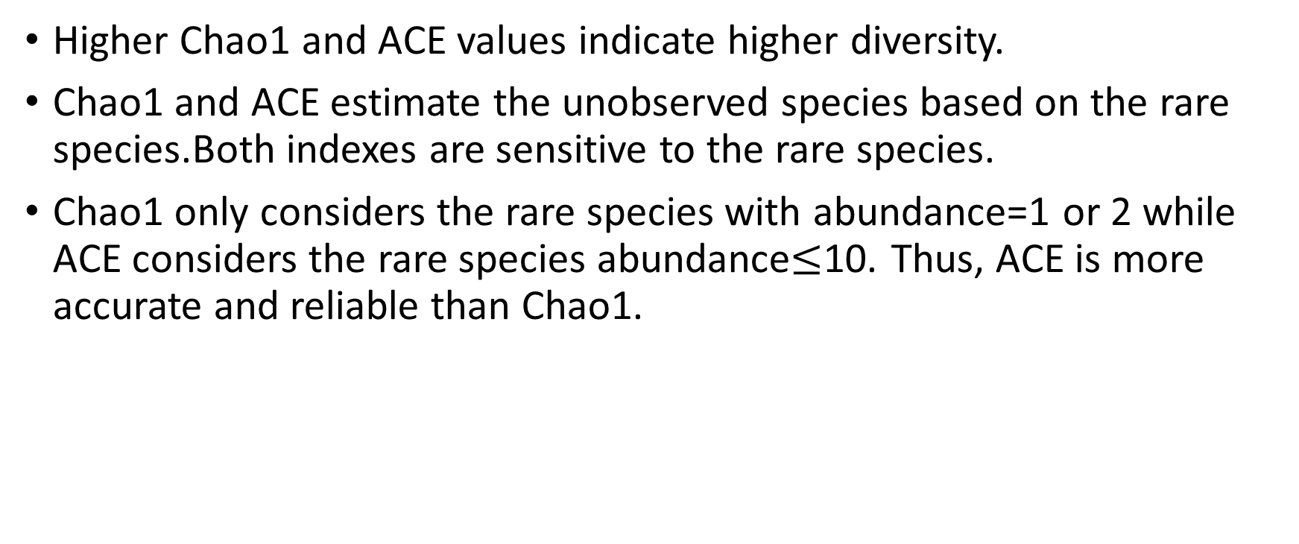
Chao1 vs ACE
Higher Chao1 and ACE values indicate higher diversity.
Chao1 and ACE estimate the unobserved species based on the rare species.Both indexes are sensitive to the rare species.
Chao1 only considers the rare species with abundance=1 or 2 while ACE considers the rare species abundance$≤$10. Thus, ACE is more accurate and reliable than Chao1.

Slide 9


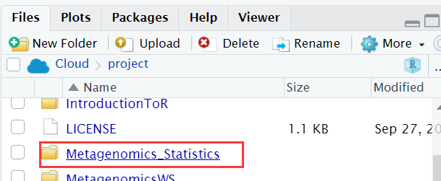
R studio cloud (Method 1)
Step 2
Step 1
Step 3
Step 6
Step 4
Step 5

Slide 10
If slide 9 (method 1) doesn’t work for you please use slide 11-12 (method 2).

Slide 11
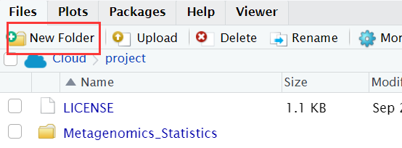
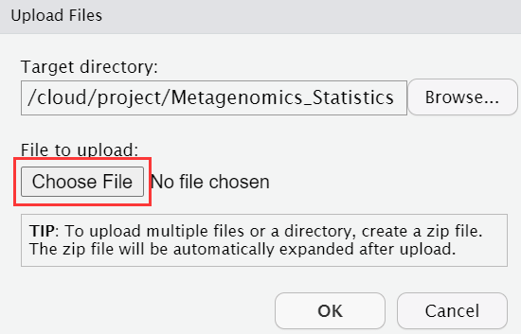
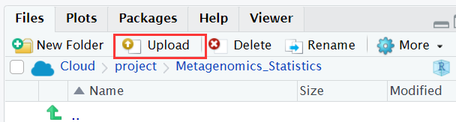
R studio cloud (Method 2)
1.Open your R studio cloud, go to “your workspace” and create a new project
2. Create a new folder called “Metagenomics_Statistics”
3. Go to above folder and upload the data by using ‘Upload’ icon. Data links: https://github.com/sysmedicine/KCLModule2_2021/tree/main/Metagenomics_Statistics
Please upload:
phyloseq_object_data_1.Rdata
Phyloseq_object_data_2.Rdata

Slide 12

4. Click ‘More’ icon and then click ‘Set As Working Directory’

Slide 13
#clear all the variables in the environment
#skip it if you don’t want to clear them
rm(list=ls())

Slide 14
#load all the packages we need
library(tidyr)
library(dplyr)
library(tibble)
library(phyloseq)
library(microbiome)
library(vegan)

Slide 15
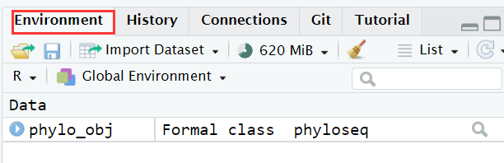
Load Rdata file
#load the phyloseq object data
load("phyloseq_object_data_1.Rdata")
In the evironment, you will see:

Slide 16
Extract data from phyloseq object
#extract abundance profiles
OTUdata <- abundances(phylo_obj)
#extract meta data
SampleData <- meta(phylo_obj)
#extract taxonomy of microbiome
TAXAData <- as.data.frame(tax_table(phylo_obj)@.Data)

Slide 17
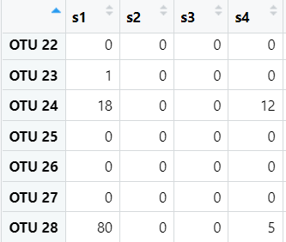
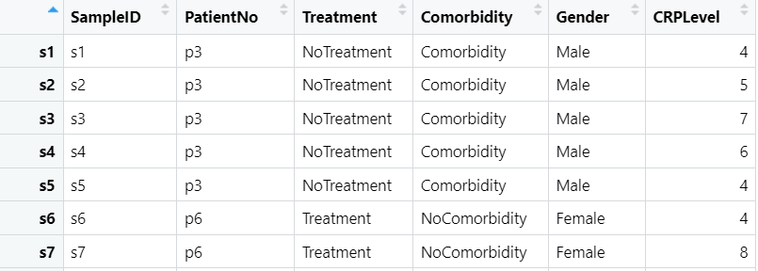
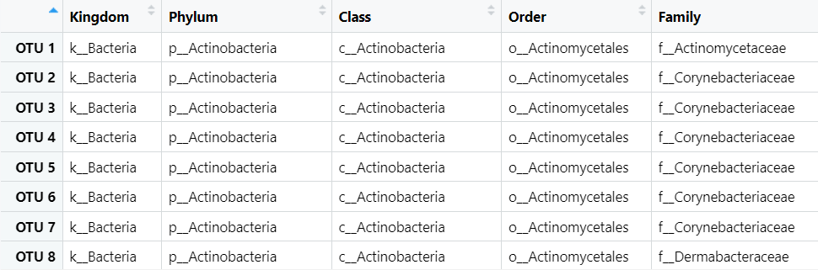
OTUdata: abuandance
SampleData: Metadata for liver disease pateints
TAXAData: taxonomy of microbiome

Slide 18
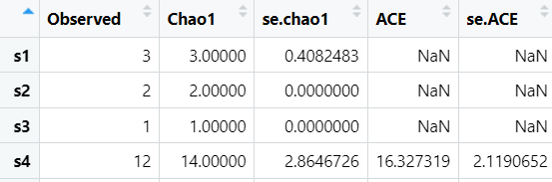
Alpha diversity: richness
#calculate observed species, Chao1 and ACE indexes
Adiv <- estimate_richness(phylo_obj, measures=c("Observed","Chao1","ACE") )
#visualize ‘Adiv’
View(Adiv)
Standard error of Chao1;
e.g. Chao 1 of S1: 3±0.408
Observed species
Why this ACE is NaN?
Notes:
index<-which(OTUdata[,1]!=0)
OTUdata[index,1]
OTU 23 OTU 24 OTU 28: 1, 18, 80

Slide 19
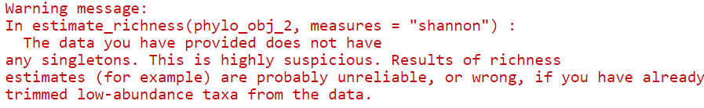
Task 1
15 mins
Load ” phyloseq_object_data_2.Rdata”
Extract the meta data, taxonomy of microbiome and abundance data
Calculate the observed species, Chao1 and ACE indexes for all samples
It is fine if you get this warning since we don’t have the rare species with singleton which means the species with abundance=1.

Slide 20
Break

Slide 21
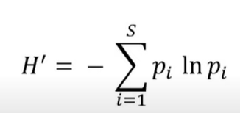
Alpha diversity: richness and evenness
Shannon index:
S is the number of total species
p_{i} is the proportion of abudance for each species
ln is a natural logarithm
H1=-(1*ln(1)+0) = 0
H2=-(0.5*ln(0.5)+ 0.5*ln(0.5)) = 0.693
H3=-(0.99*ln(0.99)+0.01*ln(0.01)) = 0.056
Species | Sample 1 (Abu) | Sample 2 (Abu) | Sample 3 (Abu)
s__Varibaculum_cambriense | 100 | 50 | 99
s__Corynebacterium_accolens | 0 | 50 | 1

Slide 22
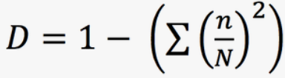
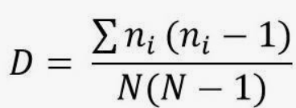
Alpha diversity: richness and evenness
Simpson index:
or
Simpson =1-D
InvSimpson=1/D
InvSimpson= 1/(1-Simpson)
n is the abundance value of each species
N is the sum abundance value of all species
n/N is the proportion of abundance of each species
Simpson 1=1-1=0; InvSimpson=1
Simpson 2=1-(0.5*0.5+0.5*0.5)=0.5; InvSimpson=1/(1-0.5)=2
Simpson 3=1-(0.99*0.99+0.01*0.01)=0.0198; InvSimpson=1.02
Species | Sample 1 (OTU) | Sample 2 (OTU) | Sample 3 (OTU)
s__Varibaculum_cambriense | 100 | 50 | 99
s__Corynebacterium_accolens | 0 | 50 | 1
In phyloseq package: high simpson and invsimpson values indicate higher diversity.
Notes:
http://www.countrysideinfo.co.uk/simpsons.htm
Fisher's alpha - a diversity index, defined implicitly by the formula S=a*ln(1+n/a) where S is number of taxa, n is number of individuals and a is the Fisher's alpha.

Slide 23
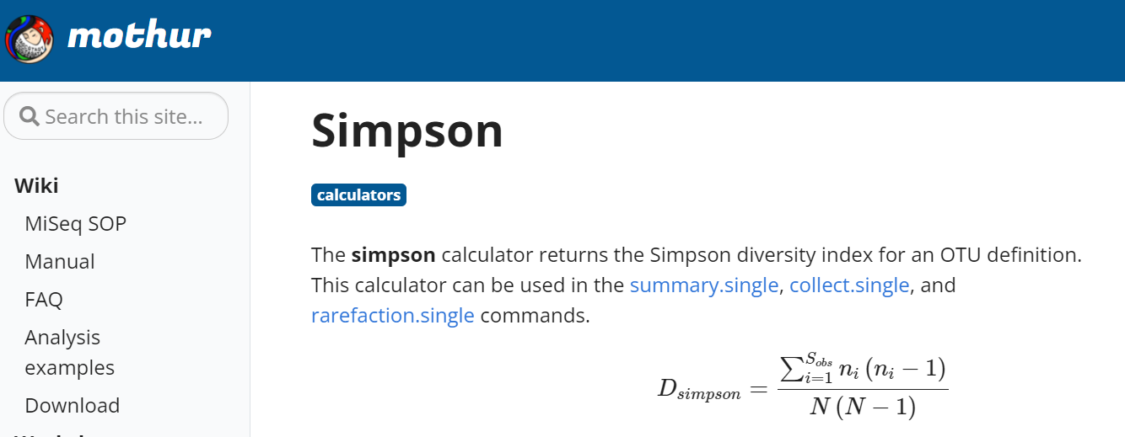
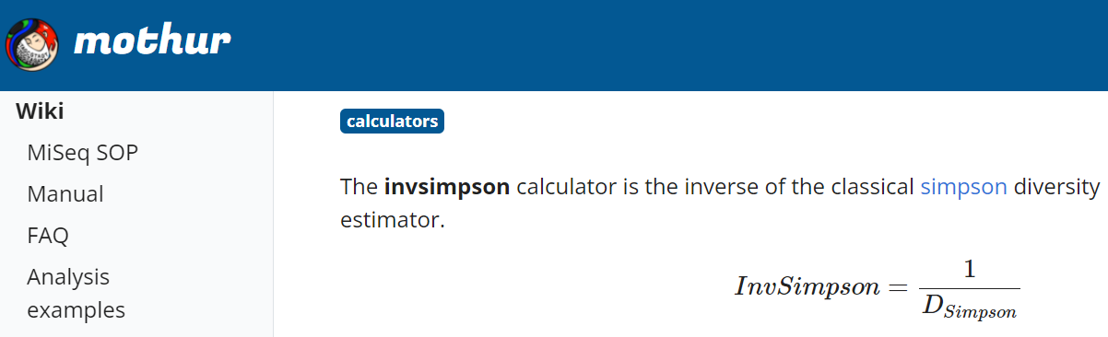
Be careful the formula of Simpson and InvSimpson in different packages!
In package mothur
In mothur package:
high simpson indicates low diversity
high invsimpson indicates high diversity

Slide 24
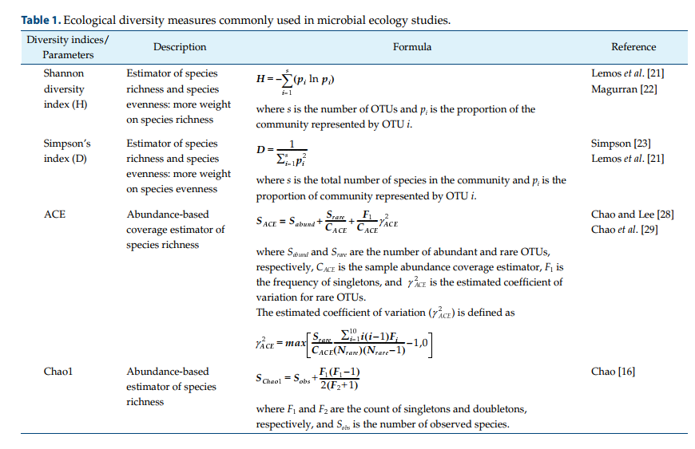
Conclusion
Kim, Bo-Ra, et al. "Deciphering diversity indices for a better understanding of microbial communities." Journal of Microbiology and Biotechnology 27.12 (2017): 2089-2093.

Slide 25
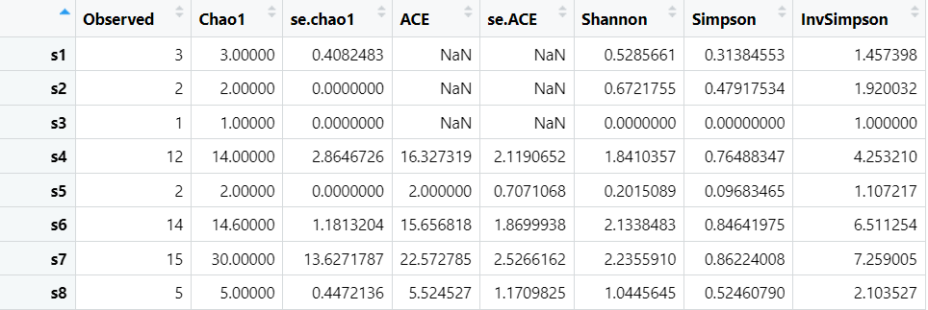
Q: Based on “phyloseq_object_data_1.Rdata”, calculate the Shannon, Simpson and InvSimpson?
Adiv <- estimate_richness(phylo_obj, measures=c("Observed","Chao1","ACE","Shannon","Simpson","InvSimpson"))

Slide 26
Task 2
Based on ’phyloseq_object_data_2.Rdata’, calculate the "Shannon", "Simpson” and "InvSimpson” values?

Slide 27
Break

Slide 28
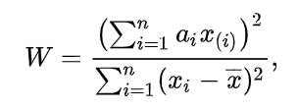
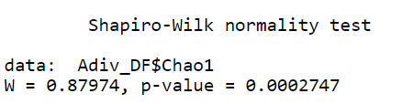
Normal distribution test
Shapiro–Wilk test
H0: the samples x₁, ..., x_{n} came from a normally distributed population.
H1: not from a normally distributed population.
#add a new column called 'SampleID'
Adiv$SampleID <- rownames(Adiv)
#merge Metadata and Adiv
Adiv_DF <- full_join(SampleData,Adiv,by="SampleID)
#Test for normal distribution
result<-shapiro.test(Adiv_DF$Chao1)
What is the conclusion if p<0.05?

Slide 29
Task 3
For ”phyloseq_object_data_2.Rdata”, could you please test whether Chao1, Shannon, Simpson and InvSimpson indexes are normally distributed by Shapiro–Wilk test ?

Slide 30
Difference analysis
Student’s t test
Wilcoxon rank sum test

Slide 31
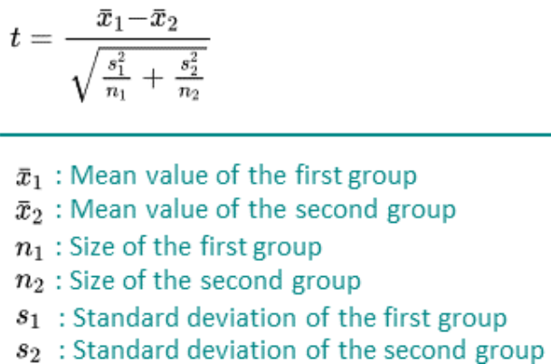
Unpaired student’s t test
Parametric method
Normal distribution
H0: The mean shannon values are equal between two groups.
H1: Not equal.

Slide 32
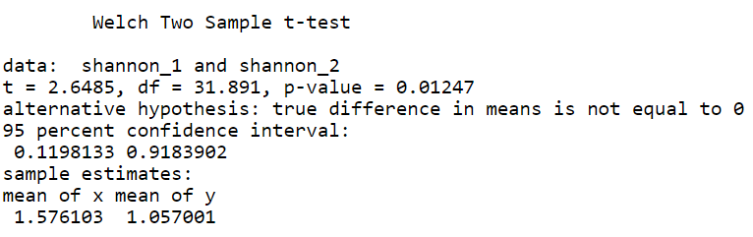
Q: Is the mean shannon value significantly different between the female and male samples?
#get location (rows) of female
index_1<-which(Adiv_DF$Gender=="Female")
#get location (rows) of male
index_2<-which(Adiv_DF$Gender=="Male")
#extract the shannon values of female samples
shannon_1<-Adiv_DF$Shannon[index_1]
#extract the shannon values of male samples
shannon_2<-Adiv_DF$Shannon[index_2]
t.test(shannon_1,shannon_2)
t>0 and p<0.05, the estimator is significantly higher in female group.
t<0 and p<0.05, the estimator is significantly lower in the male group.

Slide 33
Wilcoxon rank sum test
Non-parametric method
Not require a specific distribution
H0: The median shannon values are equal between two groups
H1: Not equal.
1. Put the values together and rank them based on a increasing order.
2. Calculate the rank for each value.
3. Calculate the sum of rank for each group (W1 and W2)
4. If sample size n1<n2, W=W1; if n1=n2, W=W1 or W2.

Slide 34
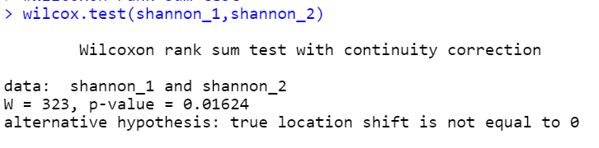
wilcox.test(shannon_1,shannon_2)
Note: median value of shannon in each group can be used to decide which group is higher or lower.

Slide 35
Task 4
Based on the ”phyloseq_object_data_2.Rdata”, is there significant difference of the Shannon values between the Control-HFD and Contro-Chow groups?

Slide 36
Break

Slide 37
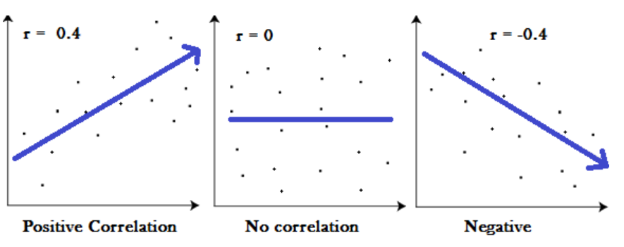
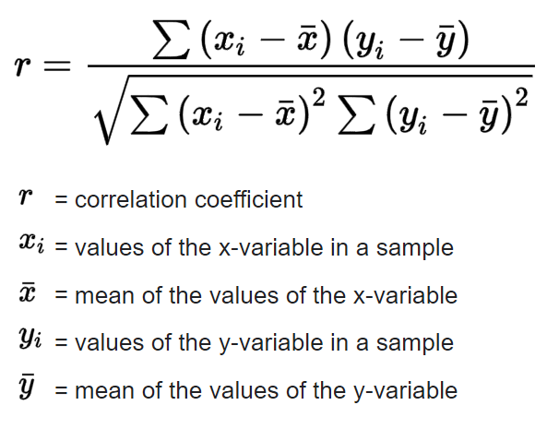
Linear Correlation
Pearson correlation (normal distribution)
Spearman correlation
Pearson correlation coefficient
Range of r: -1≤r ≤1
Notes:
Coefficient r is t distribution. This we could caluculate the p value based on statistic t.

Slide 38
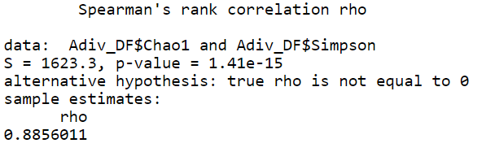
#Spearman correlation
cor.test(Adiv_DF$Chao1,Adiv_DF$Simpson,method="spearman")
R tips:
cor.test(x, y, method=”spearman”)
cor.test(x, y, method=”pearson”)

Slide 39
Task 5
Based on the ”phyloseq_object_data_2.Rdata”, calculate the correlation between shannon and simpson indexes(r and p value)?

Slide 40
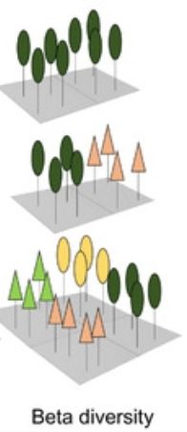
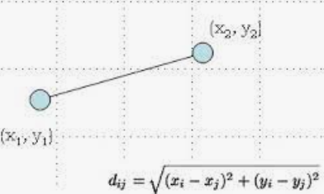
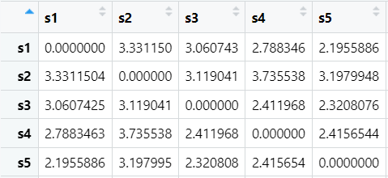
Beta diversity
Beta-diversity is to compare the diversity between two samples.
High beta diversity means more difference.
#log10 transformation for the abudance data
phyobj_shift <- microbiome::transform(phylo_obj,transform="log10")
#beta diversity based on euclidean distance
Betdiv <- as.matrix(phyloseq::distance(phyobj_shift, method="euclidean"))<- microbiome::transform(phylo_obj)
Beta diversity can be considered as a distance.
High distance means more difference between two samples.

Slide 41

Compare beta diversity between two or more groups
.
Permutational multivariate analysis of variance (PERMANOVA)
Non-parametric test
No required distribution
Idea: if the variance between groups is significantly higher than variance within groups, there are biological difference between two groups.
Biological difference between groups
Individual difference

Slide 42
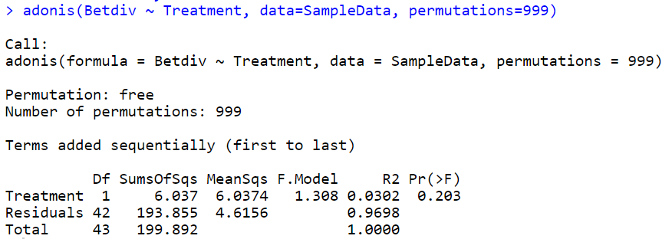
Aim: test whether there is significant difference of beta diversity between treated and untreated groups
adonis(Betdiv ~ Treatment, data=SampleData, permutations=999)
P=0.203, >0.05: not significant. No difference
F value 1.308, which is closed to 1
R²=3.02%: Variance between groups only account for 3.02% of total variance, which is very small proportion.
Conclusion:
No significant difference of beta diversity between the treated and untreated groups.
Closed to 1? Waht does it mean?

Slide 43
Task 6
Based on the ”phyloseq_object_data_2.Rdata”, calculate the beta diveristy and test whether beta diverity values are significantly different between groups?

