Slide 1
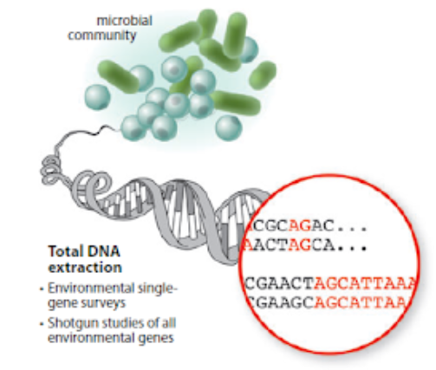

METAGENOMICS
http://hulab.ucf.edu/research/projects/metagenomics/introduction.html
OZLEM ALTAY, MD, PhD
Notes:
https://envgen.github.io/metagenomics.html
http://hulab.ucf.edu/research/projects/metagenomics/introduction.html

Slide 2
10:00-10:50*
10:50-11:05
11:05-11:55
11:55-12:10
12:10-13:00
13:00-14:00
14:00-14:50
14:50-15:05
15:05-15:55
16:55-16:10
16:10-17:00
Workshop 50 min
Short break 15 min
Workshop 50 min**
Short break 15 min
Workshop 50 min
Long break 60 min
Workshop 50 min
Short break 15 min
Workshop 50 min***
Short break 15 min
Workshop 50 min
* UK time
** 25 Oct Monday workshop starts here (11:00-17:00)
*** 01 Nov Monday additional starts here (15:00-17:00)

Slide 3
Ozlem | Sweden | Aleksandra Pilcicka, Xueqi Li
Xiangyu | Sweden | Lamiah Kareem, Kerry Lin
Hong | Sweden | Miranda Pryce, Yixuan Peng
Meng | Sweden | Yash Bancil, Darvina Magandran
Bouchra | UK | JungIm Choi, Lilianeleny Meoli
Simon | UK | Benjamin Williams, Ho Yan Lam
Frederick | UK | Georgia Milbourne, Phoebe Cheong
Abdulahad | UK | Xinmeng Liao
Ali | UK | Xiaoye Wang
Mengnan | Sweden | --

Slide 4
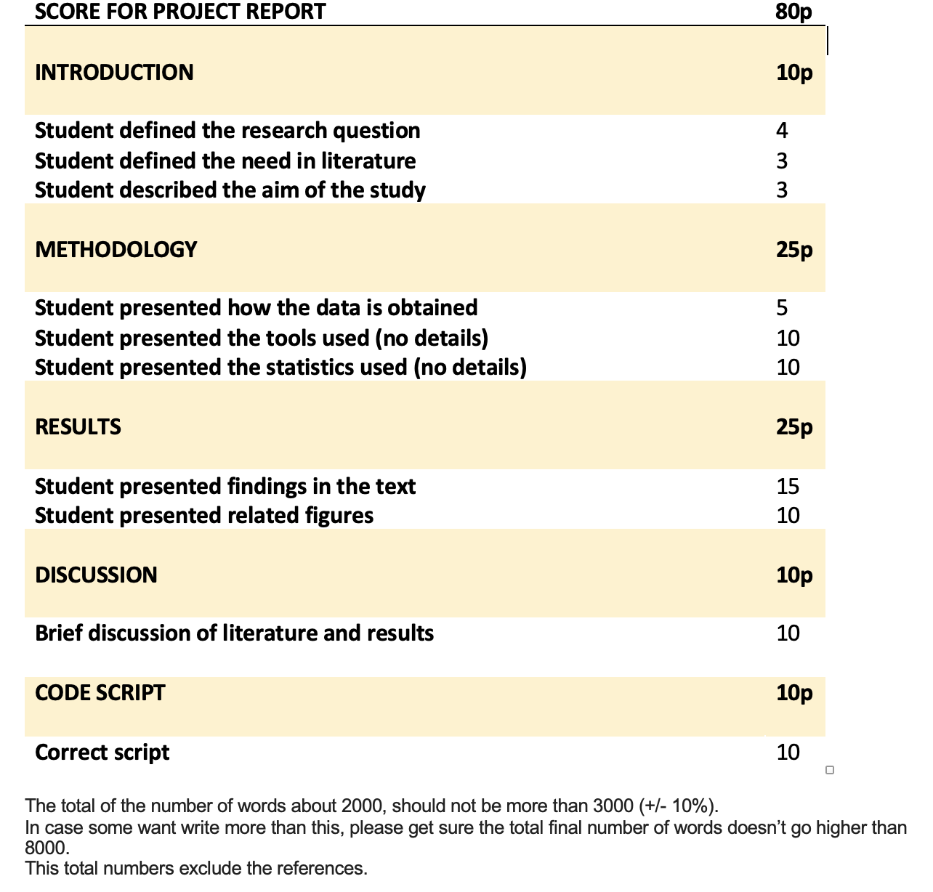
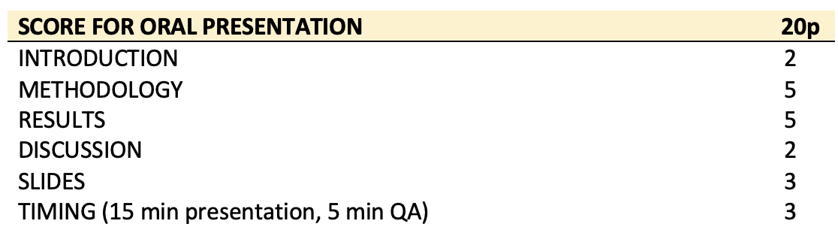

Slide 5
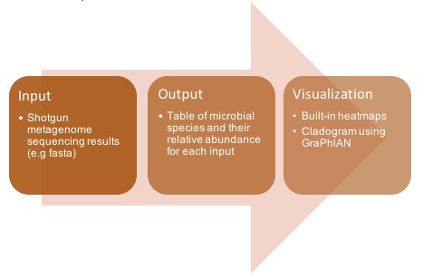
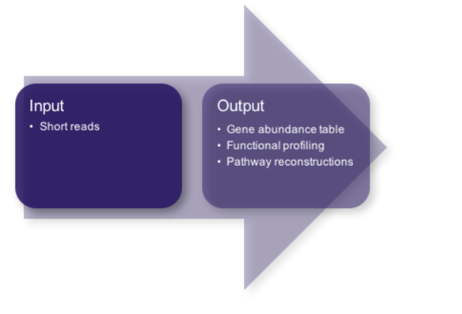
Compositional profiling
MetaPhlAn: Metagenomic Phylogenetic Analysis
Nicola Segata, Levi Waldron, Annalisa Ballarini, Vagheesh Narasimhan, Olivier Jousson, Curtis Huttenhower. Metagenomic microbial community profiling using unique clade-specific marker genes. Nature Methods, 8, 811–814, 2012

Slide 6
INSTALLATION

Slide 7
TASK 1
module load devtools/anaconda
conda config --add channels defaults
conda config --add channels bioconda
conda config --add channels conda-forge
conda create --name mpa -c bioconda python=3.7 Metaphlan
conda activate mpa

Slide 8
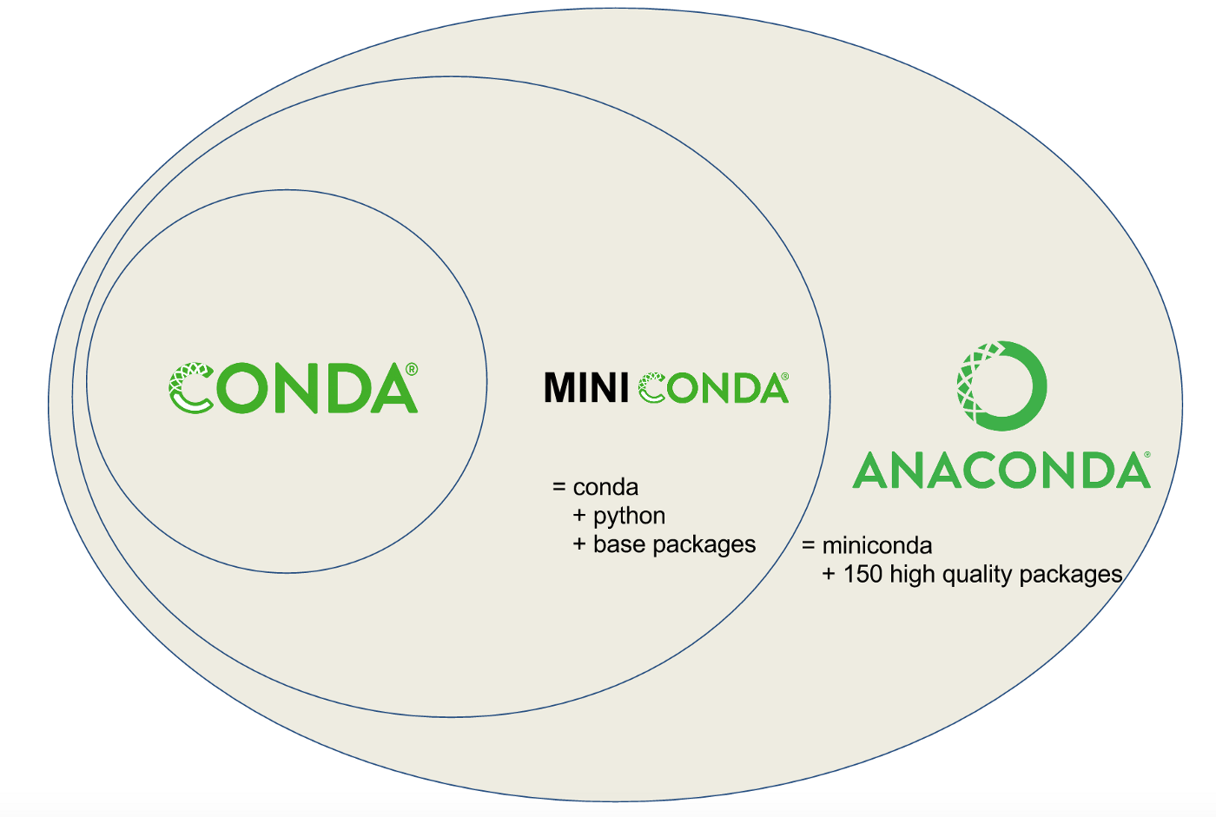
CONDA - MINICONDA - ANACONDA
A distribution of packages built for data science.
A bunch of data science packages → all set to start working with data
Reduce future issues dealing with the various libraries you’ll be using
conda
Create environments
Isolating projects that use different versions of Python and/or different version of packages
Install, uninstall, and update packages in our project environments.
https://towardsdatascience.com/managing-project-specific-environments-with-conda-b8b50aa8be0e
A package
Environment manager
Notes:
https://medium.com/pankajmathur/what-is-anaconda-and-why-should-i-bother-about-it-4744915bf3e6
Firstly, since Anaconda comes with a bunch of data science packages, you’ll be all set to start working with data. Secondly, using conda to manage your packages and environments will reduce future issues dealing with the various libraries you’ll be using. In most of the real world Data Science projects, conda based package and environments are widely used and I personally preferred conda based package installation and maintenance of project then installing and maintaining directly PIP based packages. So, Why Anaconda? Anaconda is a distribution of packages built for data science. It comes with conda, a package, and environment manager. We usually used conda to create environments for isolating our projects that use different versions of Python and/or different version of packages. We also use it to install, uninstall, and update packages in our project environments. When you download Anaconda first time it comes with conda, Python, and over 150 scientific packages and their dependencies. Anaconda is a fairly large download (~500 MB) because it comes with the most common data science packages in Python, for people who are conservative about disk space, there is also Miniconda, a smaller distribution that includes only conda and Python. You can still install any of the available packages with conda, that comes by default with the standard version. Conda is a program we will be using exclusively from the command line, so if you aren’t comfortable using it, check out these learn by doing videos on Lynda.com command prompt tutorial for Windows and Linux Command Line Basics for Mac OSX/Linux

Slide 9
Conda channels
Locations where packages are stored.
They serve as the base for hosting and managing packages.
Different channels can have the same package, so conda must handle these channel collisions
By default, conda prefers packages from a higher priority channel over any version from a lower priority channel
conda config --add channels new_channel
Adds the channel "new_channel" to the top of the channel list, making it the highest priority
https://conda.io/projects/conda/en/latest/user-guide/tasks/manage-channels.html

Slide 10
conda create
Environment
With conda, you can create, export, list, remove, and update environments that have different versions of Python and/or packages installed in them.
Switching or moving between environments is called activating the environment.
You can also share an environment file.
conda create --name mpa -c bioconda python=3.7 Metaphlan
Create env
Env
name
Channel
Phyton version
PACKAGE

Slide 11

module load devtools/anaconda
conda config --add channels defaults
conda config --add channels bioconda
conda config --add channels conda-forge
conda create --name mpa -c bioconda python=3.7 Metaphlan
30-40 min

Slide 12
SAMPLES

Slide 13
wget https://github.com/biobakery/biobakery/raw/master/demos/biobakery_demos/data/metaphlan3/input/SRS014476-Supragingival_plaque.fasta.gz
URL
wget
Computer program that retrieves content from web servers HTTP, HTTPS, FTP and FTPS
Its name derives from "World Wide Web" and "get."
Notes:
wget https://github.com/biobakery/biobakery/raw/master/demos/biobakery_demos/data/metaphlan3/input/SRS014464-Anterior_nares.fasta.gz
wget https://github.com/biobakery/biobakery/raw/master/demos/biobakery_demos/data/metaphlan3/input/SRS014470-Tongue_dorsum.fasta.gz
wget https://github.com/biobakery/biobakery/raw/master/demos/biobakery_demos/data/metaphlan3/input/SRS014472-Buccal_mucosa.fasta.gz
wget https://github.com/biobakery/biobakery/raw/master/demos/biobakery_demos/data/metaphlan3/input/SRS014494-Posterior_fornix.fasta.gz
wget https://github.com/biobakery/biobakery/raw/master/demos/biobakery_demos/data/metaphlan3/input/SRS014459-Stool.fasta.gz

Slide 14

TASK 2
wget https://github.com/biobakery/biobakery/raw/master/demos/biobakery_demos/data/metaphlan3/input/SRS014476-Supragingival_plaque.fasta.gz
SRS014464-Anterior_nares.fasta.gz
SRS014470-Tongue_dorsum.fasta.gz
SRS014472-Buccal_mucosa.fasta.gz
SRS014494-Posterior_fornix.fasta.gz
SRS014459-Stool.fasta.gz
10-15 min
Notes:
wget https://github.com/biobakery/biobakery/raw/master/demos/biobakery_demos/data/metaphlan3/input/SRS014464-Anterior_nares.fasta.gz
wget https://github.com/biobakery/biobakery/raw/master/demos/biobakery_demos/data/metaphlan3/input/SRS014470-Tongue_dorsum.fasta.gz
wget https://github.com/biobakery/biobakery/raw/master/demos/biobakery_demos/data/metaphlan3/input/SRS014472-Buccal_mucosa.fasta.gz
wget https://github.com/biobakery/biobakery/raw/master/demos/biobakery_demos/data/metaphlan3/input/SRS014494-Posterior_fornix.fasta.gz
wget https://github.com/biobakery/biobakery/raw/master/demos/biobakery_demos/data/metaphlan3/input/SRS014459-Stool.fasta.gz

Slide 15
RUN METAPHLAN

Slide 16
conda activate mpa
module load apps/bowtie2/2.3.5.1
metaphlan SRS014476-Supragingival_plaque.fasta.gz --input_type fasta > SRS014476-Supragingival_plaque_profile_count.txt -t rel_ab_w_read_stats
Notes:
metaphlan SRS014464-Anterior_nares.fasta.gz --input_type fasta > SRS014464-Anterior_nares_profile_count.txt -t rel_ab_w_read_stats
metaphlan SRS014470-Tongue_dorsum.fasta.gz --input_type fasta > SRS014470-Tongue_dorsum_profile_count.txt -t rel_ab_w_read_stats
metaphlan SRS014472-Buccal_mucosa.fasta.gz --input_type fasta > SRS014472-Buccal_mucosa_profile_count.txt -t rel_ab_w_read_stats
metaphlan SRS014494-Posterior_fornix.fasta.gz --input_type fasta > SRS014494-Posterior_fornix_profile_count.txt -t rel_ab_w_read_stats
metaphlan SRS014459-Stool.fasta.gz --input_type fasta > SRS014459-Stool_profile_count.txt -t rel_ab_w_read_stats

Slide 17
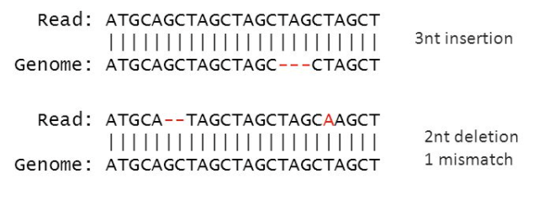
module load apps/bowtie2/2.3.5.1
bowtie2
Aligning sequencing reads to long reference sequences
Ultrafast and memory-efficient tool
Good at aligning reads of about 50 up to 100s or 1,000s of characters
Good at aligning to relatively long (e.g. mammalian) genomes.

Slide 18
metaphlan SRS014476-Supragingival_plaque.fasta.gz --input_type fasta > SRS014476-Supragingival_plaque_profile_count.txt -t rel_ab_w_read_stats
Run command
Input file
Input file type
Output file
Analysis type

Slide 19

TASK 3
conda activate mpa
module load apps/bowtie2/2.3.5.1
metaphlan SRS014476-Supragingival_plaque.fasta.gz --input_type fasta > SRS014476-Supragingival_plaque_profile_count.txt -t rel_ab_w_read_stats
30-40 min
Notes:
metaphlan SRS014464-Anterior_nares.fasta.gz --input_type fasta > SRS014464-Anterior_nares_profile_count.txt -t rel_ab_w_read_stats
metaphlan SRS014470-Tongue_dorsum.fasta.gz --input_type fasta > SRS014470-Tongue_dorsum_profile_count.txt -t rel_ab_w_read_stats
metaphlan SRS014472-Buccal_mucosa.fasta.gz --input_type fasta > SRS014472-Buccal_mucosa_profile_count.txt -t rel_ab_w_read_stats
metaphlan SRS014494-Posterior_fornix.fasta.gz --input_type fasta > SRS014494-Posterior_fornix_profile_count.txt -t rel_ab_w_read_stats
metaphlan SRS014459-Stool.fasta.gz --input_type fasta > SRS014459-Stool_profile_count.txt -t rel_ab_w_read_stats

Slide 20
MERGE OUTPUT

Slide 21

TASK 4
module load apps/R/3.6.0
R
rm(list=ls())
rm(list=ls())
rm(list=ls())
files<-list.files()
index<-grep("count.txt",files)
files<-as.matrix(files[index])
uni_info<-NULL
for (i in 1:length(files)){
data_each<-as.matrix(read.csv(files[i],header=T,skip=4,sep="\t")) #all are character
info_each<-data_each[,c("X.clade_name" ,"clade_taxid")]
uni_info<-rbind(uni_info,info_each)
}
uni_info<-as.matrix(unique(uni_info))
rm(data_each)
result<-NULL
for (j in 1:length(files)){
data_each<-as.matrix(read.csv(files[j],header=T,skip=4,sep="\t")) #all are character
loc<-match(uni_info[,"X.clade_name"],data_each[,"X.clade_name"])
value_each<-as.matrix(data_each[loc,"estimated_number_of_reads_from_the_clade"])
colnames(value_each)<-gsub("_count.txt","",files[j])
result<-cbind(result,value_each)
}
result<-cbind(uni_info,result)
write.table(result,file="merged_estimated_number_read.txt",sep="\t",row.names=F,col.names=T,quote=F)
q()
15 min

Slide 22
DOWNLOAD FILE TO LOCAL COMPUTER

Slide 23
scp k2038186@login.rosalind.kcl.ac.uk: ~/home/k2038186/merged_estimated_number_read.txt .
Destination file
Keep file name
Secure copy
Source file
Notes:
https://linuxize.com/post/how-to-use-scp-command-to-securely-transfer-files/

Slide 24
TASK 5
# scp (in your laptop terminal)
scp k2038186@login.rosalind.kcl.ac.uk: ~/home/k2038186/merged_estimated_number_read.txt .
15 min

Slide 25
INSTALL SRA TOOLKIT

Slide 26
wget --output-document sratoolkit.tar.gz http://ftp-trace.ncbi.nlm.nih.gov/sra/sdk/current/sratoolkit.current-centos_linux64.tar.gz
tar -vxzf sratoolkit.tar.gz
export PATH=$PATH:$PWD/sratoolkit.2.11.2-centos_linux64/bin/
vdb-config –interactive
which fastq-dump
fastq-dump --stdout SRR390728 | head -n 8

Slide 27
SRA toolkit
Configured to connect to NCBI SRA and download via FTP.

Slide 28
wget --output-document sratoolkit.tar.gz http://ftp-trace.ncbi.nlm.nih.gov/sra/sdk/current/sratoolkit.current-centos_linux64.tar.gz

Slide 29
tar -vxzf sratoolkit.tar.gz
Decompress a file gzipped TAR files end with the extension .tar.gz
compressed by the standard GNU zip (gzip) compression algorithm
The GNU operating system is a complete free software system, upward-compatible with Unix.
GNU stands for “GNU's Not Unix”.

Slide 30
tar -vxzf sratoolkit.tar.gz
v = Verbose (optional). Displays the files as they are decompressed.
x = Extracts files from an archive.
z = Filters the archive through gzip.
f = Informs the tar command that the next parameter is the file name of the archive.

Slide 31
export PATH=$PATH:$PWD/sratoolkit.2.11.2-centos_linux64/bin/
Directory to run
Add a Directory to PATH
list of directories that tells the Unix shell where to look on the system when you request a particular program
Notes:
To find out what your path is
echo $PATH
Your path will look something like the following.
/usr2/username/bin:/usr/local/bin:/usr/bin:.

Slide 32
vdb-config –interactive
Inspect or change the configuration of the sra-toolkit
Necessary step but no action will be taken

Slide 33
which fastq-dump
Download the SRA file (in sra format) and then convert them to fastq file
Check which version is installed

Slide 34
fastq-dump --stdout SRR390728 | head -n 8
Check if fastq-dump is working properly
Notes:
Standart output

Slide 35
wget --output-document sratoolkit.tar.gz http://ftp-trace.ncbi.nlm.nih.gov/sra/sdk/current/sratoolkit.current-centos_linux64.tar.gz
tar -vxzf sratoolkit.tar.gz
export PATH=$PATH:$PWD/sratoolkit.2.11.2-centos_linux64/bin/
vdb-config –interactive
which fastq-dump
fastq-dump --stdout SRR390728 | head -n 8
15 min

Slide 36
INSTALL SAMPLES BY SRA TOOLKIT

Slide 37
fastq-dump -I --split-files --gzip SRR16348844
Sample name
file
extension
If your SRA file is paired, you will still end up with a single fastq file, since, fastq-dump, by default writes them as interleaved file. To change this, you can provide --split-files argument.

Slide 38
fastq-dump -I --split-files --gzip SRR16348844
SRR16348844
SRR16348845
SRR16348865
SRR16348864
SRR16348863
SRR16348862
SRR16348861
SRR16348860
SRR16348859
SRR16348858
SRR16348857
SRR16348856
SRR16348854
SRR16348853
SRR16348852
SRR16348851
SRR16348866
SRR16348855
SRR16348850
SRR16348849
SRR16348846
30 min

Slide 39
Submit script for the SLURM job queueing software

Slide 40
touch merged.sh
vi merged.s
#!/bin/bash -l
#SBATCH -p shared
#SBATCH -n 1
#SBATCH -c 16
#SBATCH --mem=200G
#SBATCH -t 50:00:00
#SBATCH -J metaphlan_kings
#SBATCH -o STDOUT.log
#SBATCH -e STDERR.log
module load devtools/anaconda
conda activate mpa
module load apps/bowtie2/2.3.5.1
srun metaphlan SRR16348844_1.fastq.gz,SRR16348844_2.fastq.gz --bowtie2out SRR16348844.bowtie2.bz2 --input_type fastq > SRR16348844_profile_count.txt -t rel_ab_w_read_stats
sbatch merged.sh

Slide 41
touch merged.sh
Create
a file
Name and extension of the file
vi merged.sh
Look into the file

Slide 42
https://rosalind.kcl.ac.uk/hpc/running_jobs/
submit script is to tell SLURM how to run your job
#!/bin/bash –l Tells your terminal that when you run the script it should use bash to execute
#SBATCH -p shared Identify your partition, Shared. All King's staff and students
#SBATCH -n 1 Number of nodes used
#SBATCH -c 16 Number of cores used
#SBATCH --mem=200G Maximum memory
#SBATCH -t 50:00:00 Maximum time
#SBATCH -J metaphlan_kings Job name

Slide 43
module load devtools/anaconda
conda activate mpa
module load apps/bowtie2/2.3.5.1
srun metaphlan SRR16348844_1.fastq.gz,SRR16348844_2.fastq.gz --bowtie2out SRR16348844.bowtie2.bz2 --input_type fastq > SRR16348844_profile_count.txt -t rel_ab_w_read_stats
Fastq
Run command for Rosalind
2 fastq files
1 bowtie output

Slide 44
sbatch merged.sh
submits a batch script to Slurm.

Slide 45
SRR16348844
SRR16348845
SRR16348865
SRR16348864
SRR16348863
SRR16348862
SRR16348861
SRR16348860
SRR16348859
SRR16348858
SRR16348857
SRR16348856
SRR16348854
SRR16348853
SRR16348852
SRR16348851
SRR16348866
SRR16348855
SRR16348850
SRR16348849
SRR16348846
touch merged.sh
vi merged.s
#!/bin/bash -l
#SBATCH -p shared
#SBATCH -n 1
#SBATCH -c 16
#SBATCH --mem=200G
#SBATCH -t 50:00:00
#SBATCH -J metaphlan_kings
#SBATCH -o STDOUT.log
#SBATCH -e STDERR.log
module load devtools/anaconda
conda activate mpa
module load apps/bowtie2/2.3.5.1
srun metaphlan SRR16348844_1.fastq.gz,SRR16348844_2.fastq.gz --bowtie2out SRR16348844.bowtie2.bz2 --input_type fastq > SRR16348844_profile_count.txt -t rel_ab_w_read_stats
30 min
sbatch merged.sh
Notes:
while read line; do wget http://trace.ncbi.nlm.nih.gov/Traces/sra/sra.cgi?cmd=dload&run_list=${line}&format=fastq; done<list_of_ids

Slide 46

END OF DAY 1

Slide 47

Diversity Analysis

Slide 48
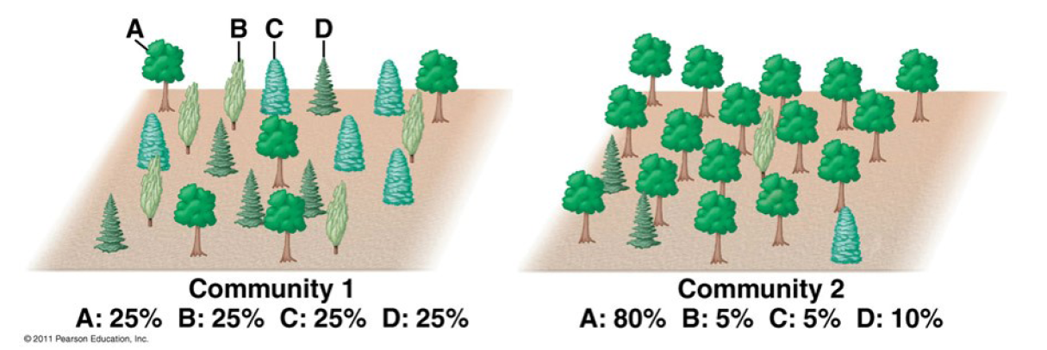
.
https://rpubs.com/dillmcfarlan/R_microbiotaSOP
Alpha diversity (microbial community evenness and richness)
Beta diversity similarity between individual microbial communities
How many different species (OTUs) are in each sample(richness)
How evenly they are distributed (evenness)
This image illustrates richness vs diversity. Both forests have the same richness (4 tree species) but Community 1 has much more even distribution of the 4 species while Community 2 is dominated by tree species A. This makes Community 1 more diverse than Community 2.

Slide 49
PHYLOSEQ

Slide 50
INSTALL AND LOAD PACKAGES
install.packages(c('readxl', 'tidyverse', 'vegan'))
if (!requireNamespace("BiocManager", quietly = TRUE)) install.packages("BiocManager")
BiocManager::install("phyloseq")
if (!requireNamespace("BiocManager", quietly = TRUE))
install.packages("BiocManager")
BiocManager::install("microbiome")
library(readxl)
library(tidyverse)
library(phyloseq)
library(microbiome)
library(vegan)
Notes:
if (!requireNamespace("BiocManager", quietly = TRUE))
install.packages("BiocManager")
BiocManager::install(c('phyloseq', 'microbiome'))

Slide 51
TASK 5
install.packages(c('readxl', 'tidyverse', 'vegan'))
if (!requireNamespace("BiocManager", quietly = TRUE)) install.packages("BiocManager")
BiocManager::install("phyloseq")
if (!requireNamespace("BiocManager", quietly = TRUE))
install.packages("BiocManager")
BiocManager::install("microbiome")
library(readxl)
library(tidyverse)
library(phyloseq)
library(microbiome)
library(vegan)
Notes:
if (!requireNamespace("BiocManager", quietly = TRUE))
install.packages("BiocManager")
BiocManager::install(c('phyloseq', 'microbiome’))

Slide 52
CREATE TAX TABLE
main=read.table('merged_estimated_number_read_NA.txt',header=TRUE,sep="\t")
t = separate(main,X.clade_name, into = c("Kingdom","Phylum", "Class", "Order", "Family", "Genus", "Species"), sep="\\|")
t=t[!is.na(t$Species), ]
t=t[!duplicated(t$Species),]
x=1:dim(t)[1]
OTUs= paste("OTU",x)
t=add_column(t, OTUs = OTUs, .before = "X116_R1_abundance.txt")
OTU =as.data.frame(t[,-which(names(t) %in% c("Kingdom","Phylum", "Class", "Order", "Family", "Genus","Type","clade_taxid"))])
row.names(OTU) = OTU$OTUs
OTU =as.data.frame(OTU[,-which(names(OTU) %in% c("OTUs","Species"))])
OTU[is.na(OTU)] = 0
names(OTU) = gsub(pattern = "_abundance.txt", replacement = "", x = names(OTU))
CountMatrix = OTU %>% as.matrix()
mode(CountMatrix) <- 'integer'
TAX =as.data.frame(t[,which(names(t) %in% c("Kingdom","Phylum", "Class", "Order", "Family", "Genus","Species","OTUs"))])
row.names(TAX) = TAX$OTUs
TAX =as.data.frame(TAX[,-which(names(TAX) %in% c("OTUs"))])
TaxaMatrix <- TAX %>% as.matrix()
Metadata <- read_xlsx("metadata_KINGS.xlsx", sheet=1) %>% as.data.frame()
rownames(Metadata) <- Metadata$SampleID

Slide 53
TASK 6
main=read.table('merged_estimated_number_read_NA.txt',header=TRUE,sep="\t")
t = separate(main,X.clade_name, into = c("Kingdom","Phylum", "Class", "Order", "Family", "Genus", "Species"), sep="\\|")
t=t[!is.na(t$Species), ]
t=t[!duplicated(t$Species),]
x=1:dim(t)[1]
OTUs= paste("OTU",x)
t=add_column(t, OTUs = OTUs, .before = "X116_R1_abundance.txt")
OTU =as.data.frame(t[,-which(names(t) %in% c("Kingdom","Phylum", "Class", "Order", "Family", "Genus","Type","clade_taxid"))])
row.names(OTU) = OTU$OTUs
OTU =as.data.frame(OTU[,-which(names(OTU) %in% c("OTUs","Species"))])
OTU[is.na(OTU)] = 0
names(OTU) = gsub(pattern = "_abundance.txt", replacement = "", x = names(OTU))
CountMatrix = OTU %>% as.matrix()
mode(CountMatrix) <- 'integer'
TAX =as.data.frame(t[,which(names(t) %in% c("Kingdom","Phylum", "Class", "Order", "Family", "Genus","Species","OTUs"))])
row.names(TAX) = TAX$OTUs
TAX =as.data.frame(TAX[,-which(names(TAX) %in% c("OTUs"))])
TaxaMatrix <- TAX %>% as.matrix()
Metadata <- read_xlsx("metadata_KINGS.xlsx", sheet=1) %>% as.data.frame()
rownames(Metadata) <- Metadata$SampleID

Slide 54
otuTABLE <- otu_table(CountMatrix, taxa_are_rows = TRUE)
taxTABLE <- tax_table(TaxaMatrix)
sampleDATA <- sample_data(Metadata)
phylo_obj <- phyloseq(otuTABLE, taxTABLE, sampleDATA)
### Extracting data from phyloseq object
OTUdata <- abundances(phylo_obj)
SampleData <- meta(phylo_obj)
TAXAData <- as.data.frame(tax_table(phylo_obj)@.Data)
phyobj_wrkshp=phylo_obj
CREATE PHYLOSEQ OBJECT

Slide 55
TASK 7
otuTABLE <- otu_table(CountMatrix, taxa_are_rows = TRUE)
taxTABLE <- tax_table(TaxaMatrix)
sampleDATA <- sample_data(Metadata)
phylo_obj <- phyloseq(otuTABLE, taxTABLE, sampleDATA)
### Extracting data from phyloseq object
OTUdata <- abundances(phylo_obj)
SampleData <- meta(phylo_obj)
TAXAData <- as.data.frame(tax_table(phylo_obj)@.Data)
phyobj_wrkshp=phylo_obj

Slide 56
VISUALIZATION
### Abundance bar plot
gp = subset_taxa(phylo_obj)
plot_bar(gp, fill="Class")
plot_bar(gp, fill="Phylum") +
geom_bar(aes(color = Phylum, fill = Phylum), stat="identity", position="stack") +
labs(x = "", y = "Estimated Counts") +
theme(panel.background = element_blank())
phyobj_wrkshp=phylo_obj

Slide 57
TASK 8
### Abundance bar plot
gp = subset_taxa(phylo_obj)
plot_bar(gp, fill="Class")
plot_bar(gp, fill="Phylum") +
geom_bar(aes(color = Phylum, fill = Phylum), stat="identity", position="stack") +
labs(x = "", y = "Estimated Counts") +
theme(panel.background = element_blank())
phyobj_wrkshp=phylo_obj

Slide 58
ALPHA DIVERSITY

Slide 59
# # Alpha-Diversity Visualisation (Shannon)
pr<-plot_richness(phyobj_wrkshp, x="Gender", color = "Gender", measures=c("Shannon"))
pr + geom_boxplot(data = pr$data,color="gray40",size=0.3,fill="gray90", alpha = 0.5,aes(x =Gender, y = value))+
theme_test()+ theme(strip.text = element_text(size=8),
axis.text.x = element_text(face="bold", size=10, angle = 45, hjust = 1),
axis.text.y = element_text(colour = "grey30", size = 10, face = "italic"),
axis.title.x = element_blank(),
axis.title.y = element_blank(), legend.position = "none")

Slide 60
# # Alpha-Diversity Statistics (Shannon)
wrkshp_Adiv <- estimate_richness(phyobj_wrkshp, measures=c("Observed", "Chao1", "Shannon", "InvSimpson"))
summary(wrkshp_Adiv)
head(wrkshp_Adiv)
wrkshp_MetaData <- meta(phyobj_wrkshp)
head(wrkshp_MetaData)
wrkshp_Adiv$SampleID <- rownames(wrkshp_Adiv)
wrkshp_Adiv_DF <- full_join(wrkshp_MetaData, wrkshp_Adiv)
#categorical
aovShannon_Gender= aov(Shannon ~Gender, data=wrkshp_Adiv_DF)
summary(aovShannon_Gender)
#Continuous
glmShannonCRPLevel =glm(Shannon ~Gender, data=wrkshp_Adiv_DF,family="quasipoisson")
summary(glmShannonCRPLevel)

Slide 61
BETA DIVERSITY

Slide 62
##Beta diversity
phyobj_wrkshp_shift <- microbiome::transform(phyobj_wrkshp, transform="shift", shift=1)
phylo_BrayDis <- phyloseq::distance(phyobj_wrkshp_shift, "bray")
wrkshp__MetaData <- meta(phyobj_wrkshp_shift)
adonis(phylo_BrayDis ~Gender, data=wrkshp__MetaData, permutations=999)
UCD_bray_PCoA <- ordinate(phyobj_wrkshp_shift, method="PCoA", distance="bray")
plot_ordination(phyobj_wrkshp_shift, UCD_bray_PCoA, color="Gender")

