Slide 1
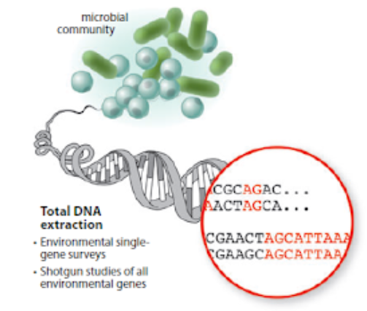

METAGENOMICS
http://hulab.ucf.edu/research/projects/metagenomics/introduction.html
OZLEM ALTAY, MD, PhD
Notes:
https://envgen.github.io/metagenomics.html
http://hulab.ucf.edu/research/projects/metagenomics/introduction.html

Slide 2
10:00-10:50*
10:50-11:05
11:05-11:55
11:55-12:10
12:10-13:00
13:00-14:00
14:00-14:50
14:50-15:05
15:05-15:55
15:55-16:10
16:10-17:00
Workshop 50 min
Short break 15 min
Workshop 50 min**
Short break 15 min
Workshop 50 min
Long break 60 min
Workshop 50 min
Short break 15 min
Workshop 50 min***
Short break 15 min
Workshop 50 min
* UK time
** 31 Oct Monday workshop starts here (11:00-17:00)
*** 07 Nov Monday additional starts here (15:00-17:00)
Notes:
R extended
Metaphlan
Diversity Analysis & statistics
Visulisation
Example papers & starting project report

Slide 3
Topic | Day | Facilitator
R extended | Monday | Xiya
Metaphlan | Tuesday | Ozlem
Diversity Analysis & statistics | Wednesday | Xiangyu
Visulisation | Thursday | Hong
Example papers & starting project report | Friday & Monday | Ozlem

Slide 4
Student |  | Supervisor
 |  | Online | On site
Sharaf | Ahammed | Ozlem | Ali
Ahmet | Ayman | Ozlem
Katy | Boucher | Xiangyu
Xihao | Cao | Xiangyu
Jingyan | Cui | Hong
Dylan | Keene | Hong | Abdulahad
Wing | Koon | Xiya
Longtao | Li | Xiya
Xinyi | Li | Han
Sinead | O'Farrell | Han
Christopher | Palmer | Lingqi | Bouchra
America | Pardo Gomez | Lingqi
Ignas | Stankaitis | Meng
Fiona | Taylor | Meng
Jeffrey | Tomiak | Meng
Xinyuan | Wang | Mengnan | Atakan
Yehan | Wang | Mengnan
Jinghe | Yan | Mengzhen
Yimiaho | Zhu | Mengzhen
Xiya is using Cheng’s account

Slide 5
Ozlem (havva.altay@scilifelab.se)
Xiangyu (xiangyu.li@scilifelab.se)
Hong (hong.yang@scilifelab.se)
Xiya (xiya.song@scilifelab.se )
Han (han.jin@scilifelab.se )
Lingqi(lingqi.meng@scilifelab.se )
Meng (meng.yuan@scilifelab.se )
Mengnan (mengnan.shi@scilifelab.se)
Mengzhen (mengzhen.li@scilifelab.se)

Slide 6
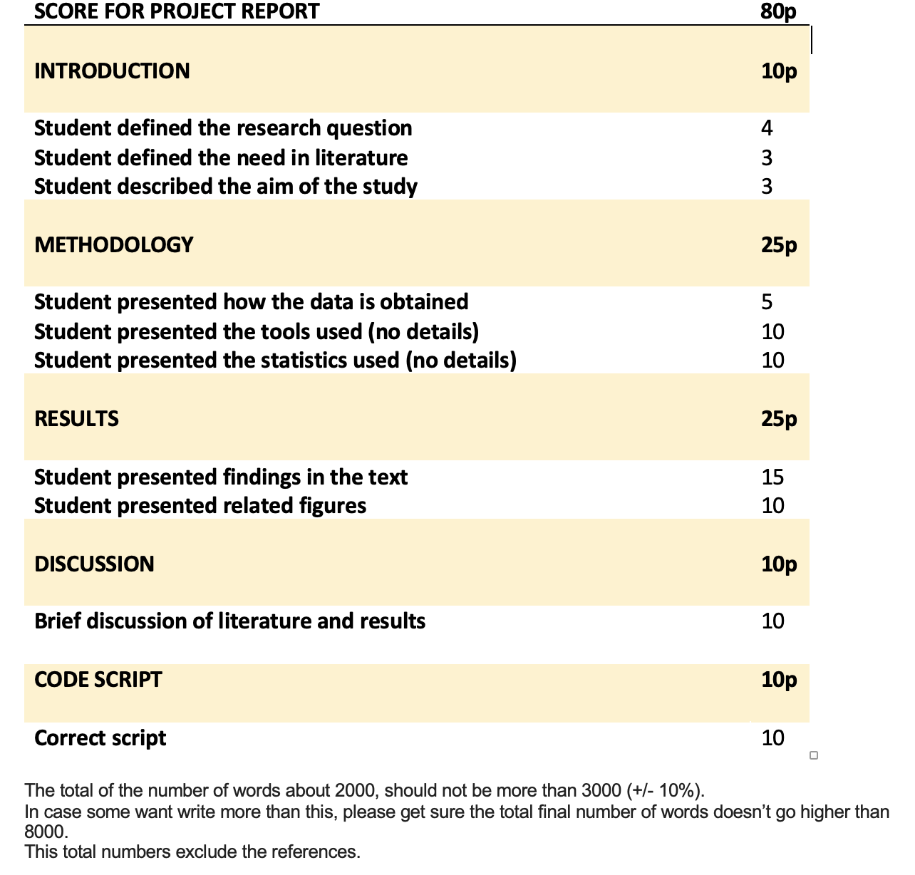
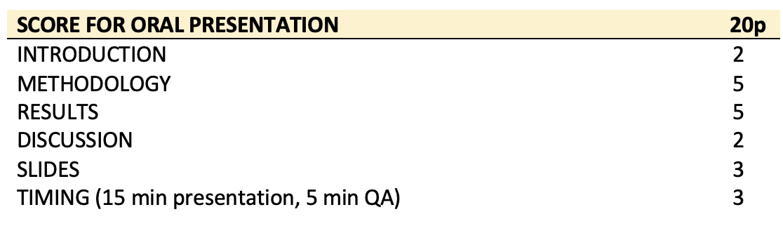

Slide 7


