Slide 1
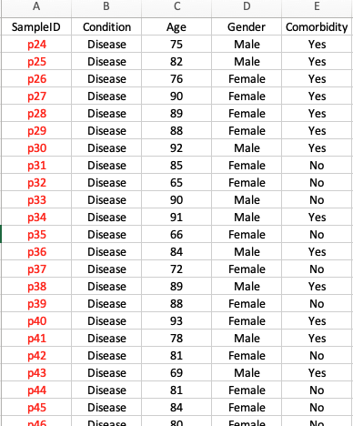
What can you do?
Merge the read for all samples and generate the read matrix. Same steps for relative abundance.
Create read and relative abundance phyloseq objects, respectively.
Calculate alpha diversity (read) and beta diversity (relative abundance)
Statistical analysis (alpha/beta diversity and species’ relative abundance)
Differential analysis
Disease vs control
Female vs male
With vs without comorbidity
Correlation analysis
Is there any diversity index correlated with age?
Is there any species’ relative abundance correlated with diversity index?
Is there any species’ relative abundance correlated with age?
Sample metadata

