Slide 1
Transcriptome MANUAL
By Abdulahad Bayraktar
Centre for Host-Microbiome Interactions Faculty of Dentistry, Oral & Craniofacial Sciences King’s College London
Notes:
Additional : https://github.com/sysmedicine/phd2020/tree/master/transcriptomics

Slide 2
Outline
loading modules
(0) Workspace
installing packages
checking sanity
getting sample data
Data Quality Control
(0) Indexing
getting reference data
indexing reference data
getting sample data
quality control
filtering, trimming, cleaning
Data Quantification
data quantification based on reference index
abundances ==> count and TPM/CPM
(0) Workspace
Creating R environment
Differential Gene Expression
determining batch effects
Model design
Gene Set
Enrichment
Gene Ontology
Pathways
Further
Installing & loading packages
Reading data appropriately
Creating/loading genome references
DGE analysis
Network analysis
Co-expression
Regulatory
Metabolic modeling

Slide 3
Workspace
!! Beware that you have enough space to work
# Working Space
mkdir transcriptome_module
cd transcriptome_module/
module load anaconda3
conda create -n transcriptome python=3.7
conda activate transcriptome
conda install kallisto
kallisto
conda install kb-python requests
kb info
conda install -c bioconda sra-tools
fastq-dump
conda install -c bioconda fastqc
module load fastqc
fastqc
conda install -c bioconda multiqc
multiqc
conda install -c bioconda cutadapt
cutadapt
Notes:
To check storage space on Slurm:
module load utilities/rosalind-fs-quota
ros-fs-quota
Move to a partition with enough space
Set download location configuration to working directory:
vdb-config --prefetch-to-cwd
To reset vdb-config configurations:
vdb-config –restore-defaults

Slide 4
Working environment check
module avail
module list
conda env list
conda list
conda list | grep kallisto
conda list | grep fastqc
conda list | grep multiqc
conda list | grep fastqc

Slide 5
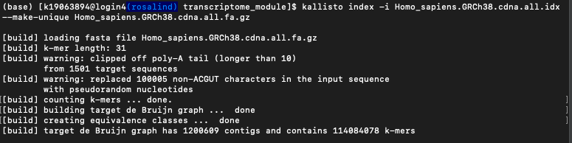
Reference and Indexing
# Ensembl FTP Download
# Download all cDNA FASTA file for kallisto
wget http://ftp.ensembl.org/pub/release-108/fasta/homo_sapiens/cdna/Homo_sapiens.GRCh38.cdna.all.fa.gz
# Removing very short sequences
cutadapt –m 100 --format fasta -o Homo_sapiens.GRCh38.cdna.all.edited.2.fa.gz Homo_sapiens.GRCh38.cdna.all.fa.gz
cutadapt –u 32 --format fasta -o Homo_sapiens.GRCh38.cdna.all.edited.fa.gz Homo_sapiens.GRCh38.cdna.all.fa.gz
# Indexing the Reference ( !! ✕ dash, ✕ space, ✓ hyphen !! : <hyphen>i, <double hyphen>make-unique)
kallisto index -i Homo_sapiens.GRCh38.cdna.all.edited.idx --make-unique Homo_sapiens.GRCh38.cdna.all.edited.fa.gz
Notes:
The Fasta file supplied can be either in plaintext or gzipped format. Prebuilt indices constructed from Ensembl reference transcriptomes can be download from the kallisto transcriptome indices site (https://www.ensembl.org/info/data/ftp/index.html).

Slide 6
Sample Selection
HIF1 mediates a switch in pyruvate kinase isoforms after myocardial infarction
PRJNA412001
Abstract: Alternative splicing of RNA is an underexplored area of transcriptional response. We expect that early changes in alternatively spliced genes may be important for responses to cardiac injury. Hypoxia inducible factor 1 (HIF1) is a key transcription factor that rapidly responds to loss of oxygen through alteration of metabolism and angiogenesis. The goal of this study was to investigate the transcriptional response after myocardial infarction (MI) and to identify novel, hypoxia-driven changes, including alternative splicing. After ligation of the left anterior descending artery in mice, we observed an abrupt loss of cardiac contractility and upregulation of hypoxic signaling. We then performed RNA sequencing on ischemic heart tissue 1 and 3 days after infarct to assess early transcriptional changes and identified 89 transcripts with altered splicing. Of particular interest was the switch in Pkm isoform expression (pyruvate kinase, muscle). The usually predominant Pkm1 isoform was less abundant in ischemic hearts, while Pkm2 and associated splicing factors (hnRNPA1, hnRNPA2B1, Ptbp1) rapidly increased. Despite increased Pkm2 expression, total pyruvate kinase activity remained reduced in ischemic myocardial tissue. We also demonstrated HIF1 binding to PKM by chromatin immunoprecipitation, indicating a direct role for HIF1 in mediating this isoform switch. Our study provides a new, detailed characterization of the early transcriptome after MI. From this analysis, we identified an HIF1-mediated alternative splicing event in the PKM gene. Pkm1 and Pkm2 play distinct roles in glycolytic metabolism and the upregulation of Pkm2 is likely to have important consequences for ATP synthesis in infarcted cardiac muscle.

Slide 7
Sample Quick Look
Purpose: The goal of this study was to investigate the transcriptional response after myocardial infarction (MI) and to identify novel, hypoxia-driven changes, including alternative splicing.
Methods:
To mimic MI, permanent left anterior descending artery (LAD) ligation
RNA sequencing on ischemic heart tissue 1 and 3 days after infarct
Findings: 719 upregulated and 183 downregulated genes 1 day after MI. By 3 days after MI, 1,457 genes were upregulated and 1,645 genes were downregulated
Accession | PRJNA412001; GEO: GSE104187
Data Type | Transcriptome or Gene expression
Scope | Multiisolate
Organism | Mus musculus[Taxonomy ID: 10090]
Accession | SRA | Sample
SAMN07692726 | SRR6068402 | sham_1dMI_1
SAMN07692725 | SRR6068403 | sham_1dMI_2
SAMN07692724 | SRR6068404 | MI_1dMI_1
SAMN07692723 | SRR6068405 | MI_1dMI_2
SAMN07692722 | SRR6068406 | sham_3dMI_1
SAMN07692721 | SRR6068407 | sham_3dMI_2
SAMN07692720 | SRR6068408 | MI_3dMI_1
SAMN07692719 | SRR6068409 | MI_3dMI_2
 | Control group | MI group
Time_1 | sham_1dMI_1 sham_1dMI_2 | MI_1dMI_1 MI_1dMI_2
Time_2 | sham_3dMI_1 sham_3dMI_2 | MI_3dMI_1 MI_3dMI_2
Notes:
To see SOFT file (and metadata): https://www.ncbi.nlm.nih.gov/geo/tools/geometa.cgi?acc=GSM5621175&scope=full&mode=soft

Slide 8
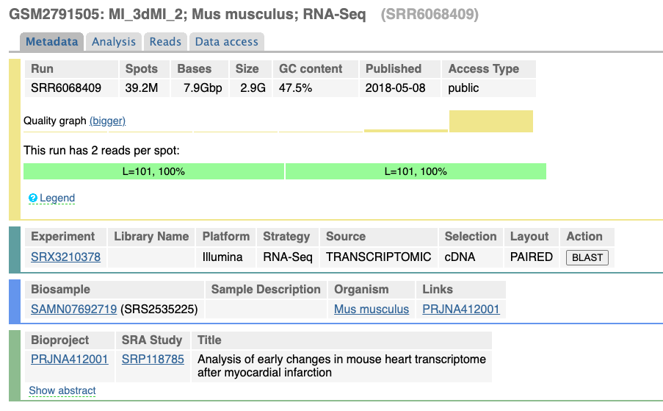
Sample Metadata

Slide 9
Sample Download
mkdir data
cd data
Best practice
Check ERA database for the samples
wget ftp://ftp.sra.ebi.ac.uk/vol1/fastq/SRR606/002/SRR6068402/SRR6068402_1.fastq.gz
wget ftp://ftp.sra.ebi.ac.uk/vol1/fastq/SRR606/002/SRR6068403/SRR6068403_1.fastq.gz
wget ftp://ftp.sra.ebi.ac.uk/vol1/fastq/SRR606/002/SRR6068403/SRR6068403_1.fastq.gz
pwd
To check where you are
Notes:
We are working one just one sample for this tutorial due to time restrictions
Samples: SRR16290086, SRR16290086, SRR16290085, SRR16290084, SRR16290083, SRR16290082, SRR16290081, SRR16290080, SRR16290079, SRR16290078, SRR16290077, SRR16290077, SRR16290076

Slide 10
Sample Download
mkdir data
cd data
SRA Way
prefetch SRR6068402 –p
cd SRR6068402
parallel-fastq-dump -s SRR6068402.sra --split-files --gzip &
Or edit (using nano) a SH file and write:
#/bin/bash
data_pos=$HOME/transcriptome_module/data/
cd $data_pos
prefetch SRR6068402 –p
wait
cd $data_pos/ SRR6068402
parallel-fastq-dump -s SRR6068402.sra --split-files --gzip
wait
…
pwd
To check where you are
Add “-f yes” to re-download
Notes:
We are working one just one sample for this tutorial due to time restrictions
Samples: SRR16290086, SRR16290086, SRR16290085, SRR16290084, SRR16290083, SRR16290082, SRR16290081, SRR16290080, SRR16290079, SRR16290078, SRR16290077, SRR16290077, SRR16290076

Slide 11
Quality Control
cd transcriptome_module/data
cd SRR6068402
fastqc SRR6068402_1.fastq.gz
fastqc SRR6068402 _1.fastq.gz
multiqc . -f
Notes:
You may use w3m package to visualize reports in HTML for the text-based, most basic information.
To install: conda install -c conda-forge w3m
To use: w3m—dump fastq_report.html

Slide 12
Quality Control
# To view them:
Open a new terminal tab on local
Command below to “pull” HTML files from server:
rsync [K ID]@login.rosalind.kcl.ac.uk:~/transcriptome_module/data/multiqc_report.html .
rsync [K ID]@login.rosalind.kcl.ac.uk:~/transcriptome_module/data/ SRR6068402/SRR6068402_1_fastqc.html .
rsync [K ID]@login.rosalind.kcl.ac.uk:~/transcriptome_module/data/ SRR6068402/SRR6068402_2_fastqc.html .

Slide 13
! If needed - Adapter Removal & Trimming
Illumina Universal Adapter length is 58 bp
cutadapt -j 4 -u -58 --nextseq-trim=10 -o SRR6068402/ SRR6068402 _1.noAdapter.fastq.gz SRR6068402/SRR6068402_1.fastq.gz
cutadapt -j 4 -u -58 --nextseq-trim=10 -o SRR6068402/SRR6068402_2.noAdapter.fastq.gz SRR6068402/SRR6068402_2.fastq.gz
-j : number of cores
-u : cut K bases from the beginning (i.e. -u K) or the end (i.e. -u -K)
--nextseq-trim=K : trim K bases from 3’ end (use for NextSeq and the NovaSeq) ! Beware double hyphen
-o : the output
Notes:
# For known/specific adapters, the command is:
cutadapt -a ADAPTER_FWD -A ADAPTER_REV -o out.1.fastq -p out.2.fastq reads.1.fastq reads.2.fastq

Slide 14
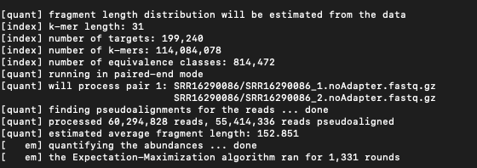
Quantification
# Quantification (~ 15 mins)
kallisto quant -i ../Homo_sapiens.GRCh38.cdna.all.idx -o SRR16290086 SRR16290086/SRR16290086_1.noAdapter.fastq.gz SRR16290086/SRR16290086_2.noAdapter.fastq.gz
Notes:
√ kallisto index -i Homo_sapiens.GRCh38.cdna.all.idx --make-unique Homo_sapiens.GRCh38.cdna.all.fa.gz

Slide 15
Import to R
# Move to working directory on local
mkdir SRR16290086 && mkdir SRR16290085
rsync [K ID]@login.rosalind.kcl.ac.uk:~/transcriptome_module/data/SRR16290086/abundance.h5 SRR16290086/abundance.h5 .
rsync [K ID]@login.rosalind.kcl.ac.uk:~/transcriptome_module/data/SRR16290085/abundance.h5 SRR16290085/abundance.h5 .
# then move to R

Slide 16
XX References - STAR
# Find reference files
1) Open NCBI, 2) select Assembly database £0 search human , 4) click on link to “FTP directory for RefSeq assembly”
or
https://ftp.ncbi.nlm.nih.gov/genomes/all/GCF/000/001/405/GCF_000001405.39_GRCh38.p13
# Download Human Genome as Reference - FASTA
wget https://ftp.ncbi.nlm.nih.gov/genomes/all/GCF/000/001/405/GCF_000001405.39_GRCh38.p13/GCF_000001405.39_GRCh38.p13_genomic.fna.gz
# Download Annotation file - GTF
wget https://ftp.ncbi.nlm.nih.gov/genomes/all/GCF/000/001/405/GCF_000001405.39_GRCh38.p13/GCF_000001405.39_GRCh38.p13_genomic.gtf.gz
# To check gzipped files
zcat homo_sapiens.tar.gz | head
Notes:
Ensembl cDNA: wget http://ftp.ensembl.org/pub/release-104/fasta/homo_sapiens/dna/Homo_sapiens.GRCh38.dna.primary_assembly.fa.gz
Ensembl Index: wget https://github.com/pachterlab/kallisto-transcriptome-indices/releases/download/ensembl-96/homo_sapiens.tar.gz

