Slide 1
Transcriptomics
MSc Microbiome in Health and Disease
7NNNMHD
Module 2
Abdulahad Bayraktar
Mardinoglu Lab
Centre for Host Microbiome Interactions
King’s College London

Slide 2
Outline
Technology
Objectives
Workflow
Terms
Tools
Analyses

Slide 3
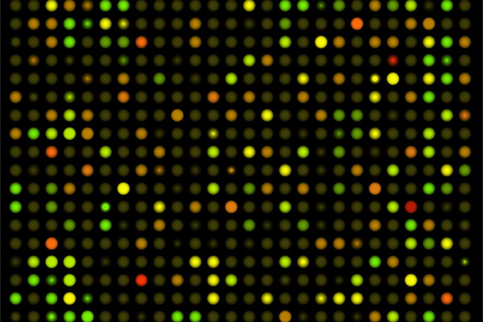
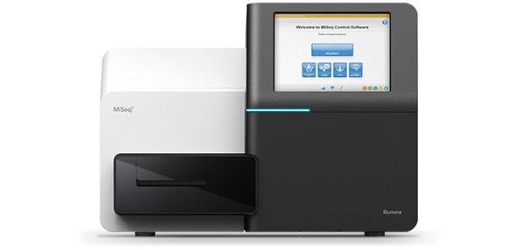
Introduction
Study of transcriptome:
RNA transcript
Under specific conditions
Methods:
qPCR ➔ Sanger
Microarrays
NGS
RNA-Seq (Illumina)
Nanopore
PacBio
Pyrosequencing
SOLID
Ion Torrent
cPAS-BGI/MGI
New actors are competing

Slide 4
Pros – Cons of RNA-Seq
Compared to other technologies:
Large scale + highest accuracy + comparably cheap = Dominating the market
No prior knowledge is required in the design
Expensive equipment
Either cheaper or faster (e.g. Oxford Nanopore, Pacific Biosciences)
Compared to proteomics
Less reflective of biological activity
Post-transcriptional regulations, RNA degradation etc.
Can be quantified better
DNA-RNA complementarity, replicability
Have more sources
Tools, databases/libraries, tutorials
Goal: quantifying expressions from >200K transcripts and >20K genes

Slide 5
Motivations
Understand the characteristic of tissues and cells
Identify the variations due to phenotypical differences, on gene or transcript level
Biomarker Genes
On downstream, these findings are used to:
Identify the perturbations of metabolites and their effects on functions
Functional patterns
Hallmark pathways

Slide 6
Workflow
Data Processing
Quality Control
Genome Mapping
Quantification
Experimental
Design
Wet-lab Experiments
RNA Extraction
Sample Exploration
Data Analysis
Library Preparation
Differential Expression
Sequencing
Functional Analysis
GEM
Network Analysis
KEGG
GO
FBA
Reporter
Metabolites
Co-exp
IN
TRN

Slide 7
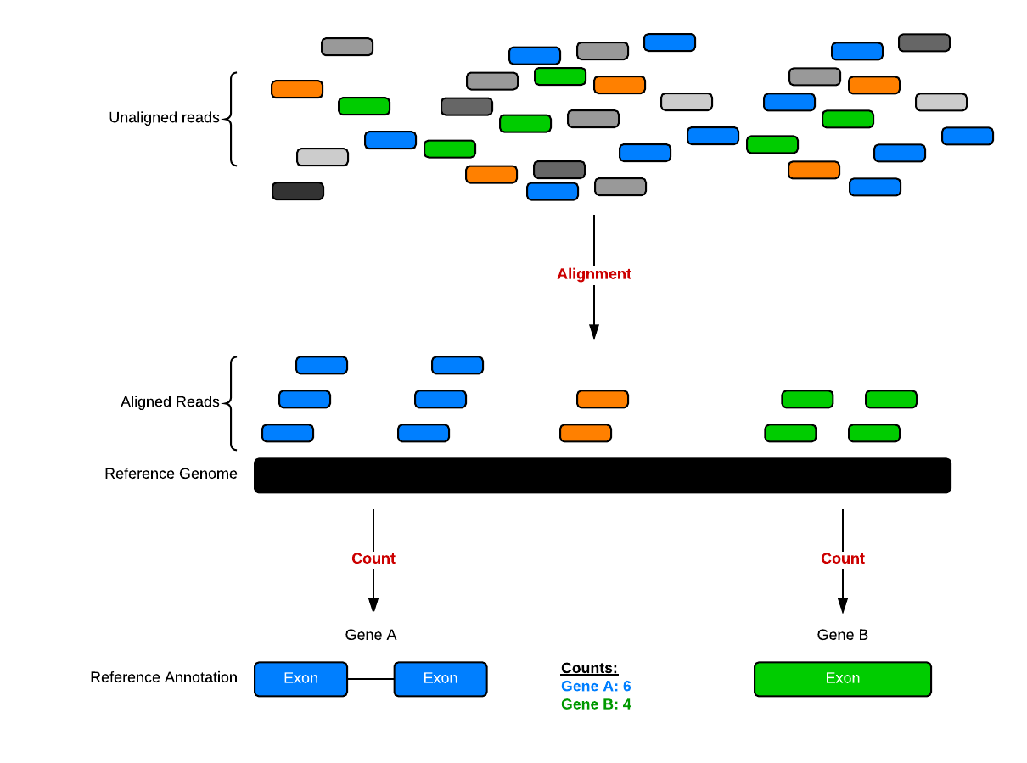
RNA-Seq
Illumina Sequencing by Synthesis
https://youtu.be/fCd6B5HRaZ8
Other Technologies
Introduction to Nanopore Sequencing
https://youtu.be/sv9fFeSd3kE
PacBio Sequencing - How it works
https://youtu.be/_lD8JyAbwEo
SOURCE: http://bioconnector.github.io/bims8382/r-rnaseq-airway.html

Slide 8
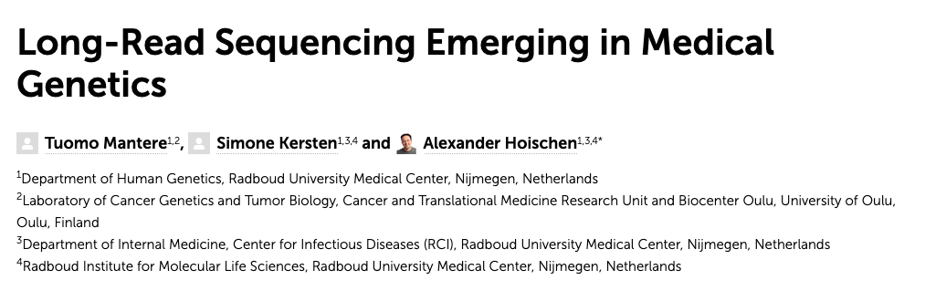
Experimental Design
Long- vs Short-Read:
Longer read provides:
Better assembly capabilities
Higher accuracy in complex regions
Structural variations
Tandem repeats
Phasing
Questionable
Practicality
Library preparation, equipment
Price
Cons?
High error rates
Less studied
Single- vs Paired-End:
Single: only one end of cDNA fragment generated.
Paired: cDNA fragment is generated from both ends
Notes:
Phasing refers to the means of assigning genetic variants to the homologous paternal and maternal chromosomes. In medical genetics, phasing is very important for understanding, e.g., inheritance patterns, parental origin of de novo mutations, mosaicism, allele-specific expression and disease risk-haplotypes

Slide 9
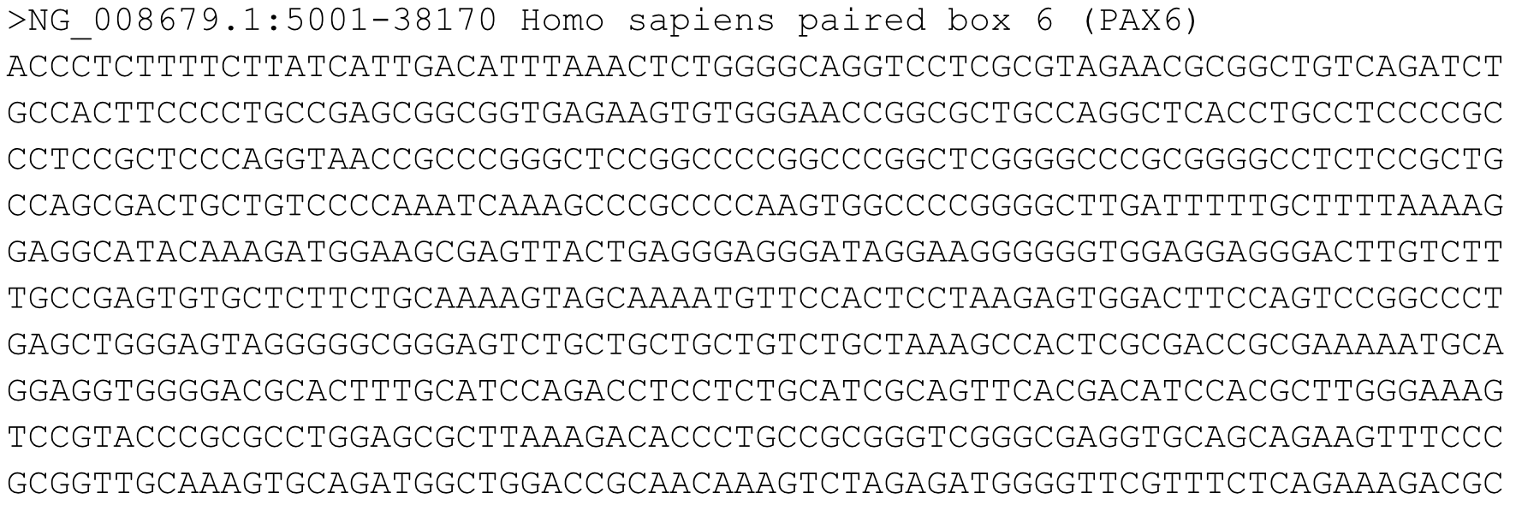
Data Formats
FASTA
Reference
FASTQ
Main output file for RNA-Seq
BAM
(Binary Alignment Mapping)
SAM
(Sequence Alignment Mapping)

Slide 10
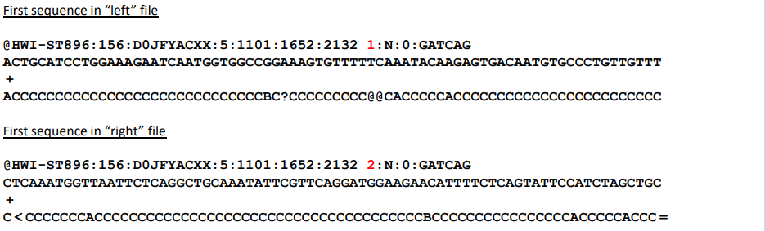
FASTQ
Raw data from sequencing machine
Standardized format
Text based:
Identifier/Name
Nucleotide sequences
Separator (+ sign)
Quality scores

Slide 11
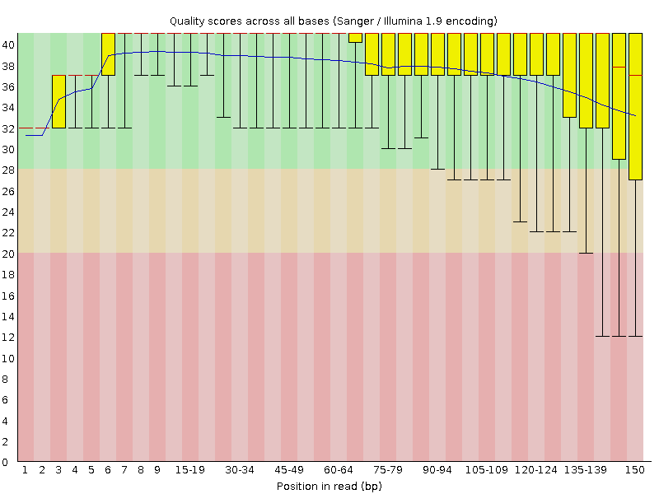
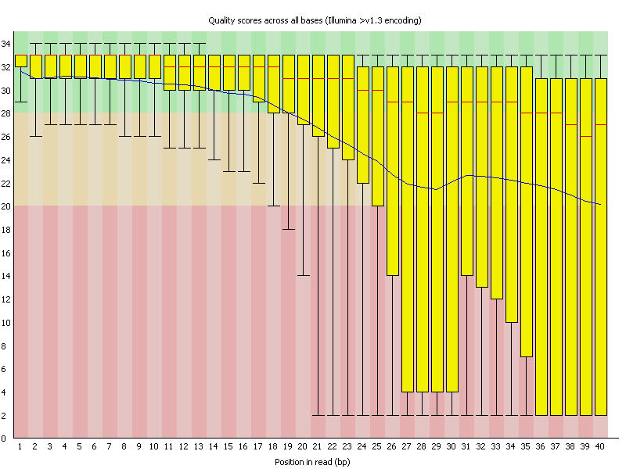
Quality Control
FastQC
During the QC, we can see:
GC content
Depth of the sequence (coverage)
Accuracy
Duplicates, Duplication %
Single/multiple alignment %
Solution?
Trimming
Quality Filtering
Notes:
For each position a BoxWhisker type plot is drawn. The elements of the plot are as follows: • The central red line is the median value • The yellow box represents the inter-quartile range (25-75%) • The upper and lower whiskers represent the 10% and 90% points • The blue line represents the mean quality

Slide 12
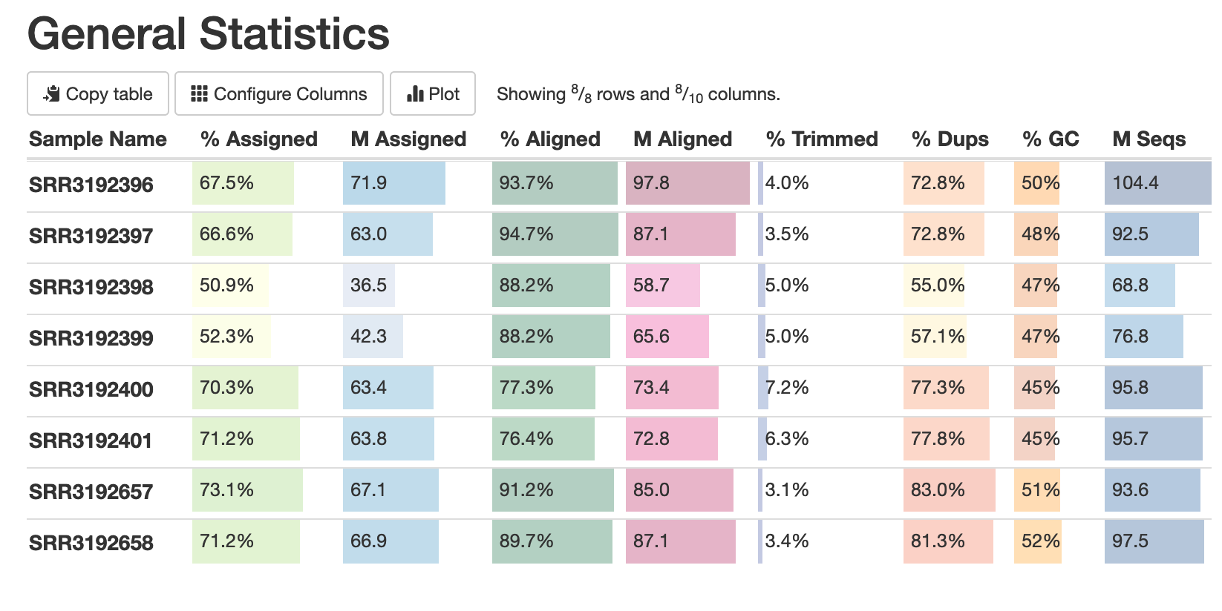
Quality Control
MultiQC

Slide 13
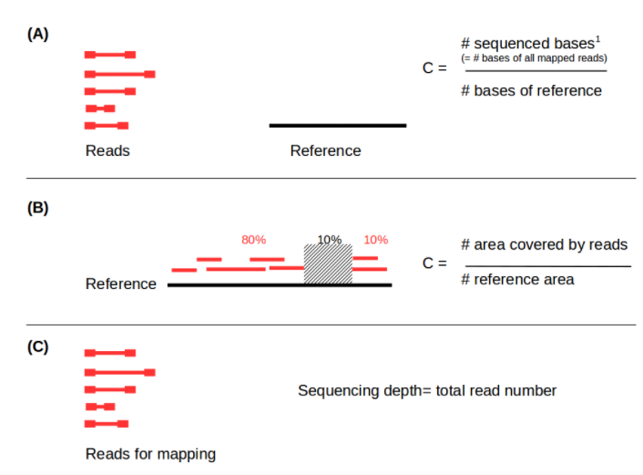
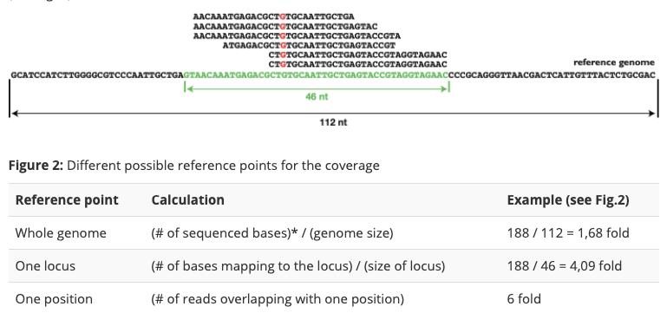
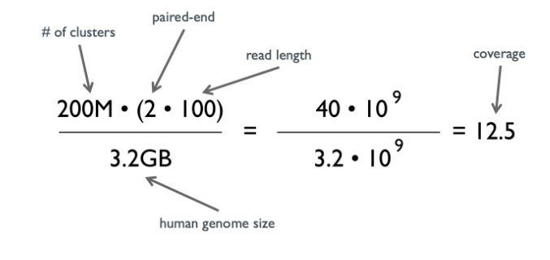
Reads per sample
Snapshot of highly expressed genes: 5-25 M
Coverage / Read depth
Redundancy
Percentage of average
Sequencing depth
Good: > 30 X

Slide 14
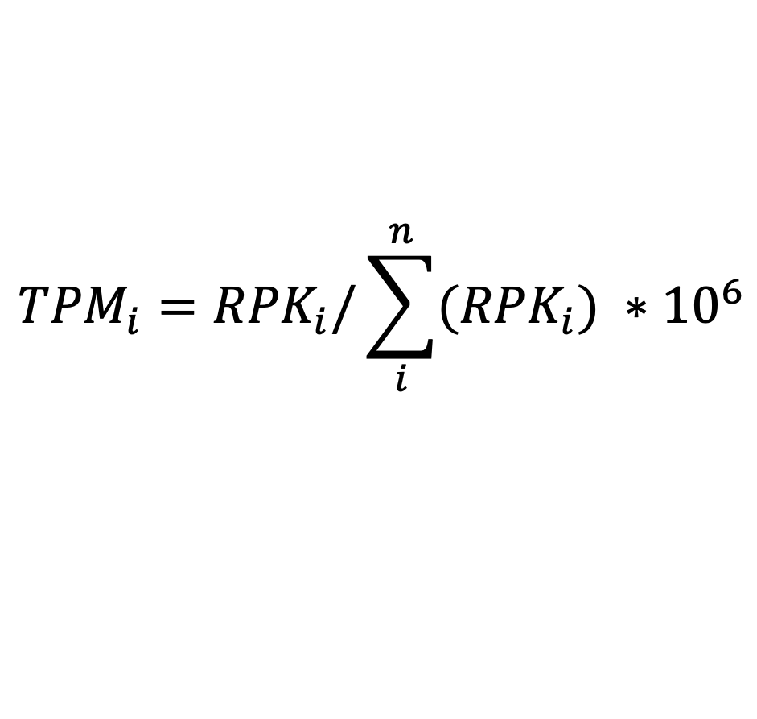

Count and Normalized Counts
$${RPKM}_{i}= \frac{X_{i}∗{10}^{3}}{N∗L_{i}} ∗{10}^{6}$$
Gene counts
Longer genes get more reads
NORMALIZATION !!!
CPM (Counts Per Million reads)
RPKM (Reads per Kilobase of exons per Million reads)
FPKM (Fragments per Kilobase of exons per Million reads)
TPM (Transcript Per Million)
$${TPM}_{i}={RPK}_{i}/\sum_{i}^{n}{({RPK}_{i})} ∗{10}^{6}$$

Slide 15
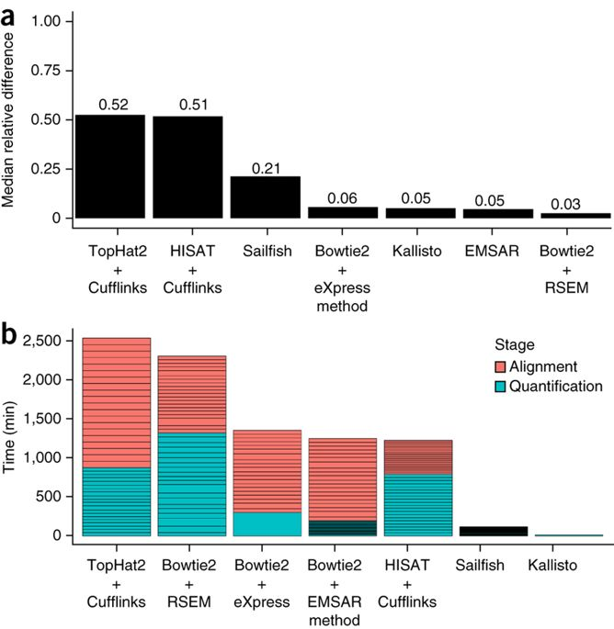
Alignment & Quantification Tools
Genome mapping:
Kallisto (pseudoalignment)
HISAT2
Bowtie2
Quantification
Kallisto
StringTie
Htseq
RSEM
Ballgown

Slide 16
Sample Exploration Goals
After we quantify and normalize the data, we must understand the data further for our study in respect to our research question/s/
Possible questions?

Slide 17
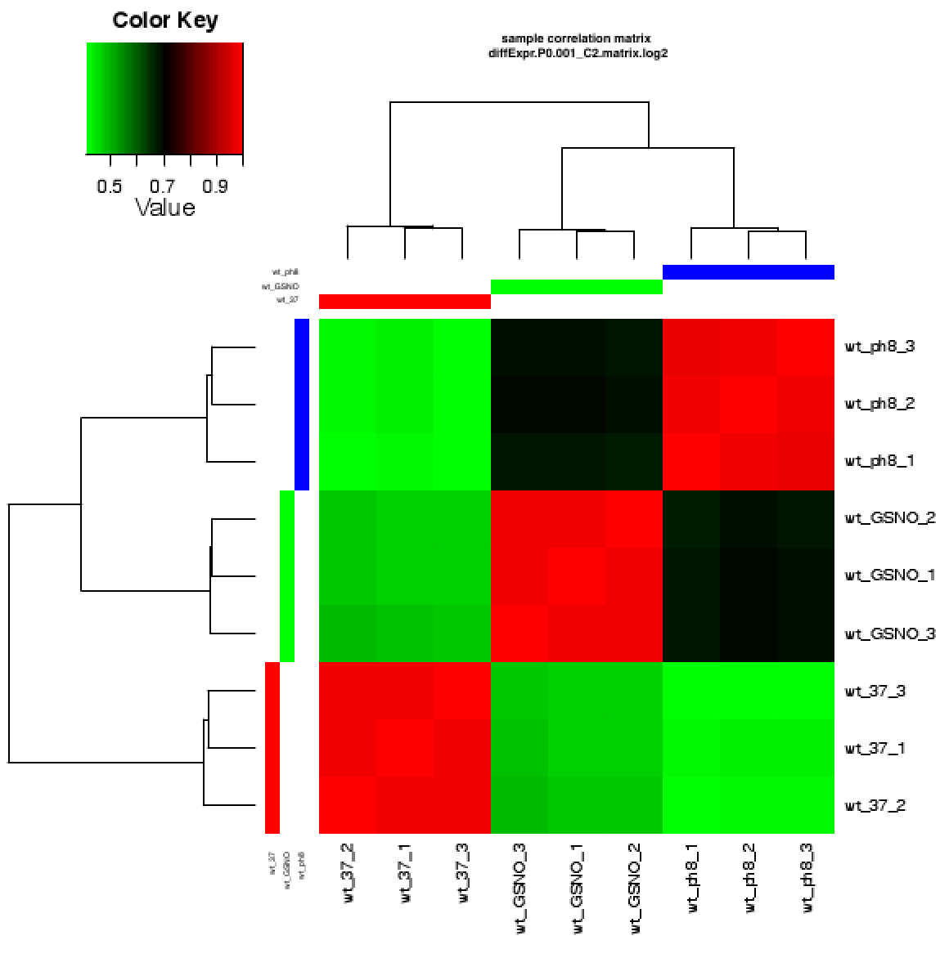
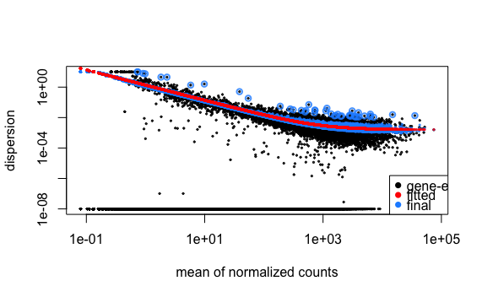
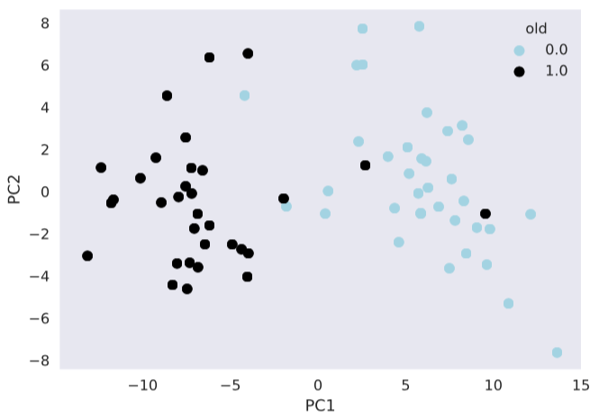
Sample Exploration Methods
Hierarchical Clustering
Sample correlation
Maximum Likelihood Estimation
Gene-wise dispersion estimation
Model fitting
Dimensionality Reduction
Group-wise/sample-wise distance

Slide 18
Differential Expression Analysis
To understand the transcriptional changes due to the difference in the phenotype
Observe:
How big is the change? → log-based fold changes
Over- or under-expressed?
Are they showing real difference? → p-value, q- value, False Discovery Rate (FDR)
Approaches:
DESeq2
EdgeR
Limma
Ballgown

Slide 19
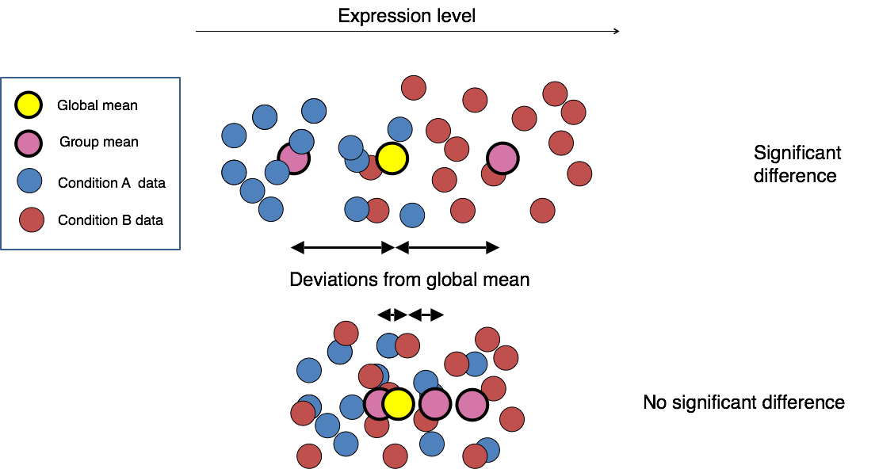
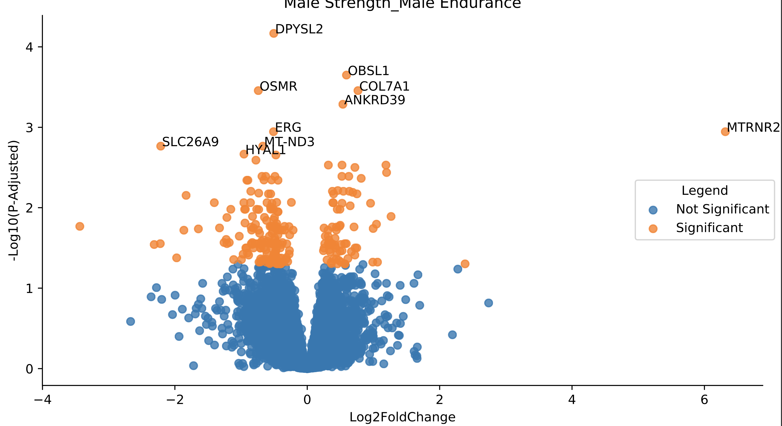

Slide 20
Functional Analysis
Differential Expression Analysis give us the gene-level statistics
To understand more on the effect of the changes, further analysis is needed
Gene-Set Enrichment Analysis
KEGG
Gene Ontology
WikiPathway
Reactome
David
Etc.
Cytoscape

Slide 21
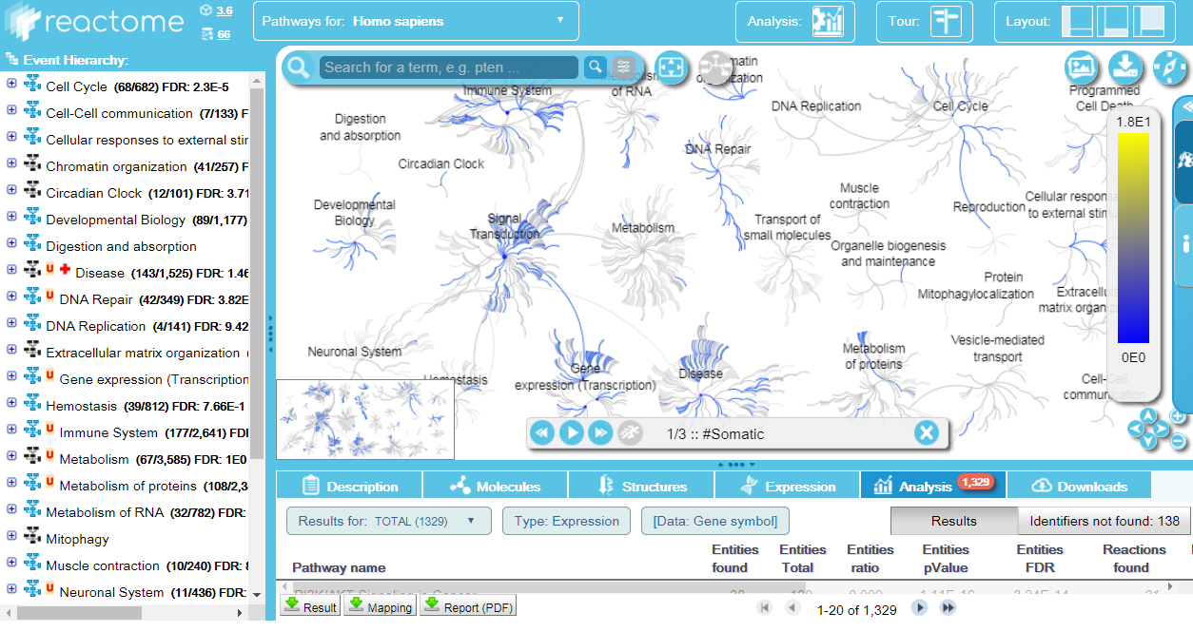
Reactome

Slide 22
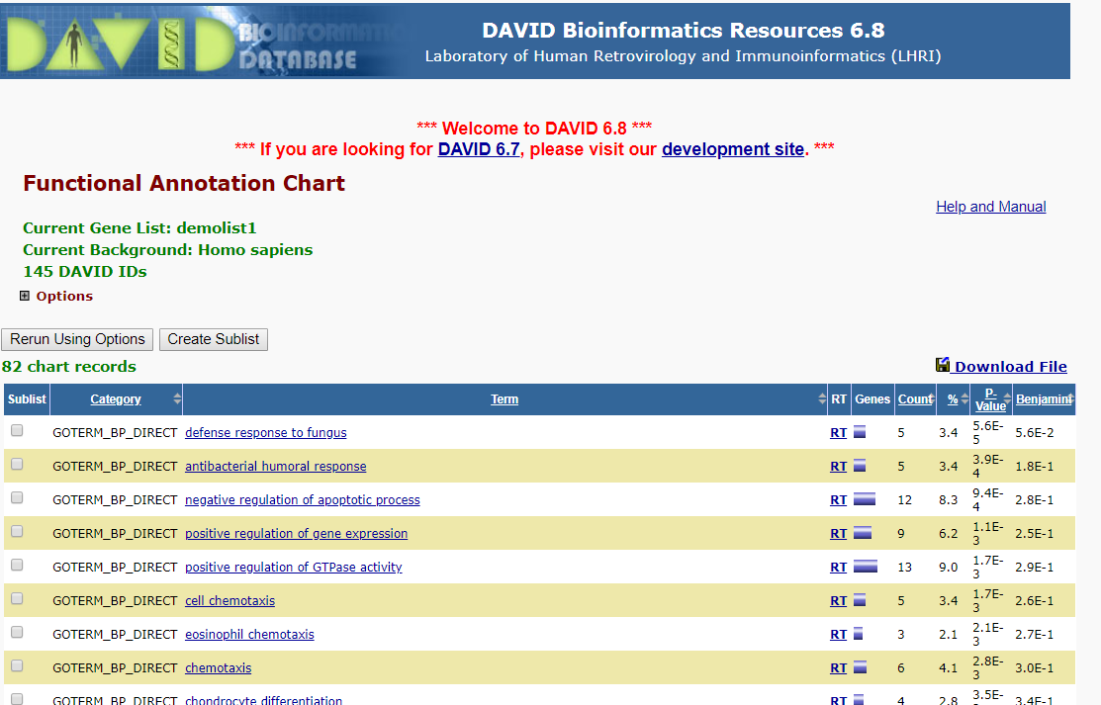
DAVID

Slide 23
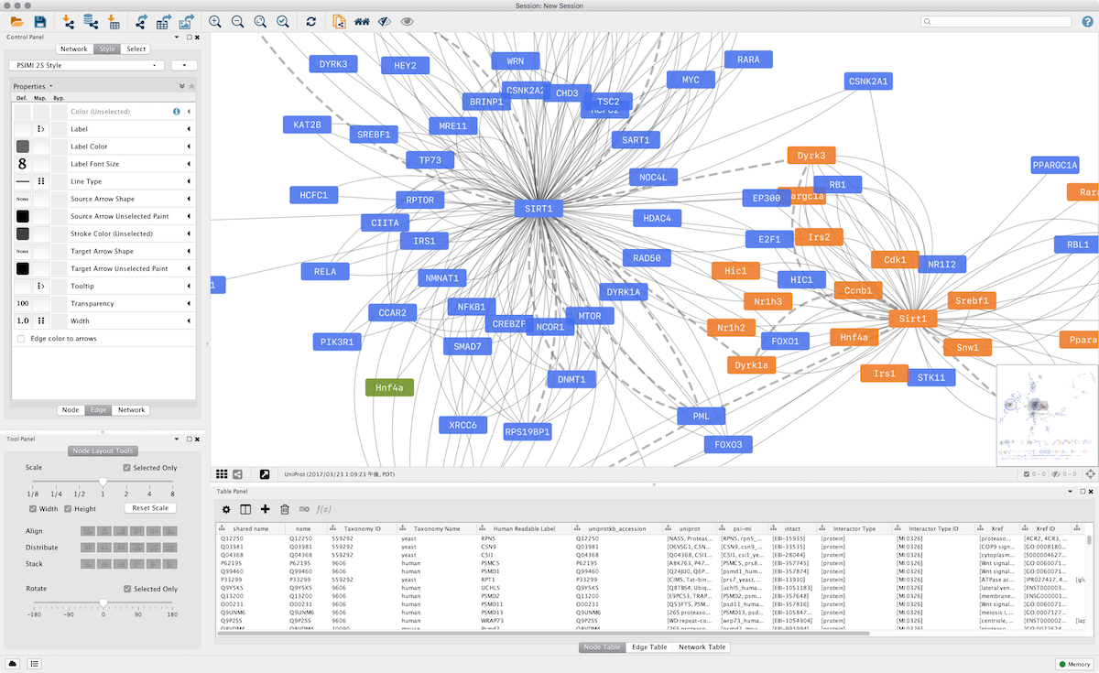
Cytoscape

Slide 24
Special thanks to for their contributions in the presentation:
Dr Cheng Zhang
Dr Muhammad Arif
Dr Ozlem Altay

