Slide 1
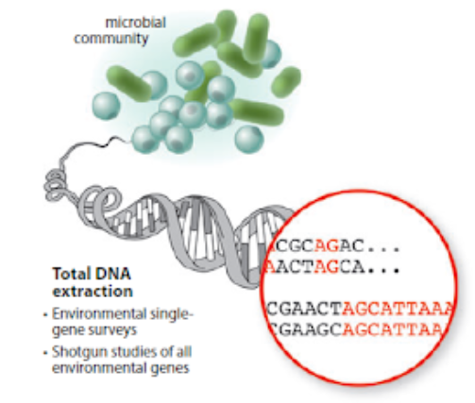

METAGENOMICS
http://hulab.ucf.edu/research/projects/metagenomics/introduction.html
OZLEM ALTAY, MD, PhD

Slide 2

.
.
Select a topic
Identify the research problem
Conduct a literature search
Construct a hypothesis
Determine the design of the research
Determine the research methods
Conduct the research and test the hypothesis
Analyze the data
Formulate conclusions

Slide 3
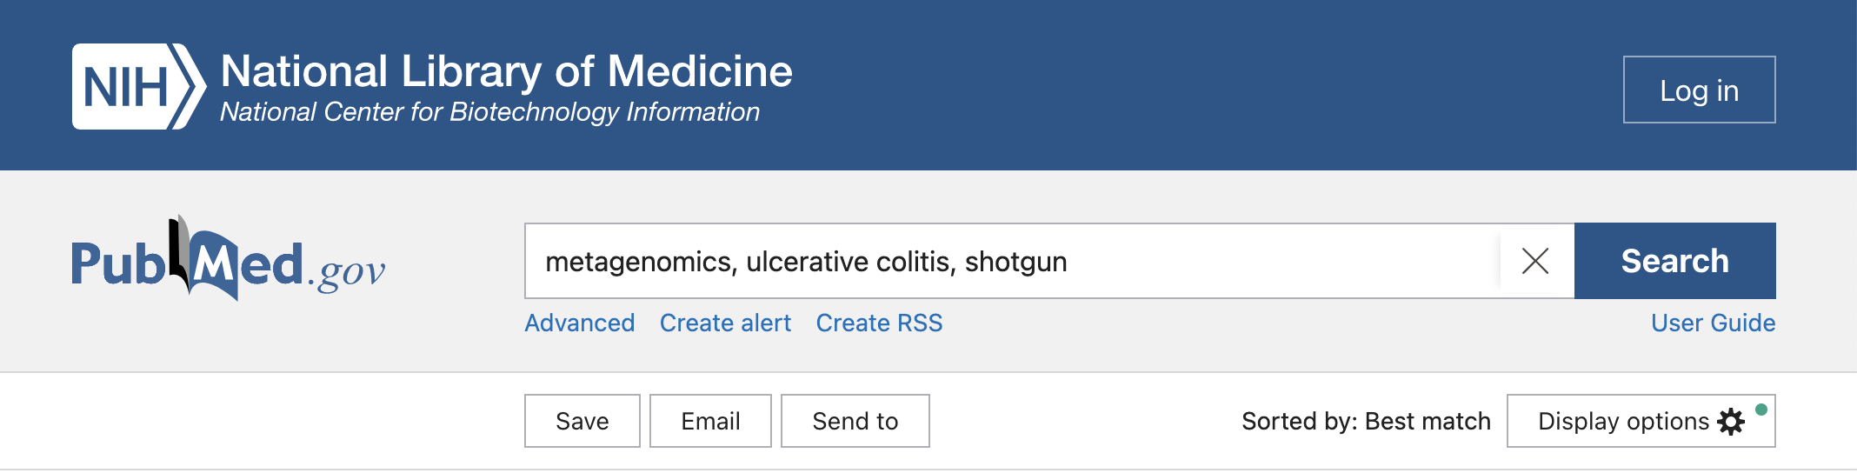
NCBI Pubmed
Keywords: metagenomics, ulcerative colitis, shotgun

Slide 4
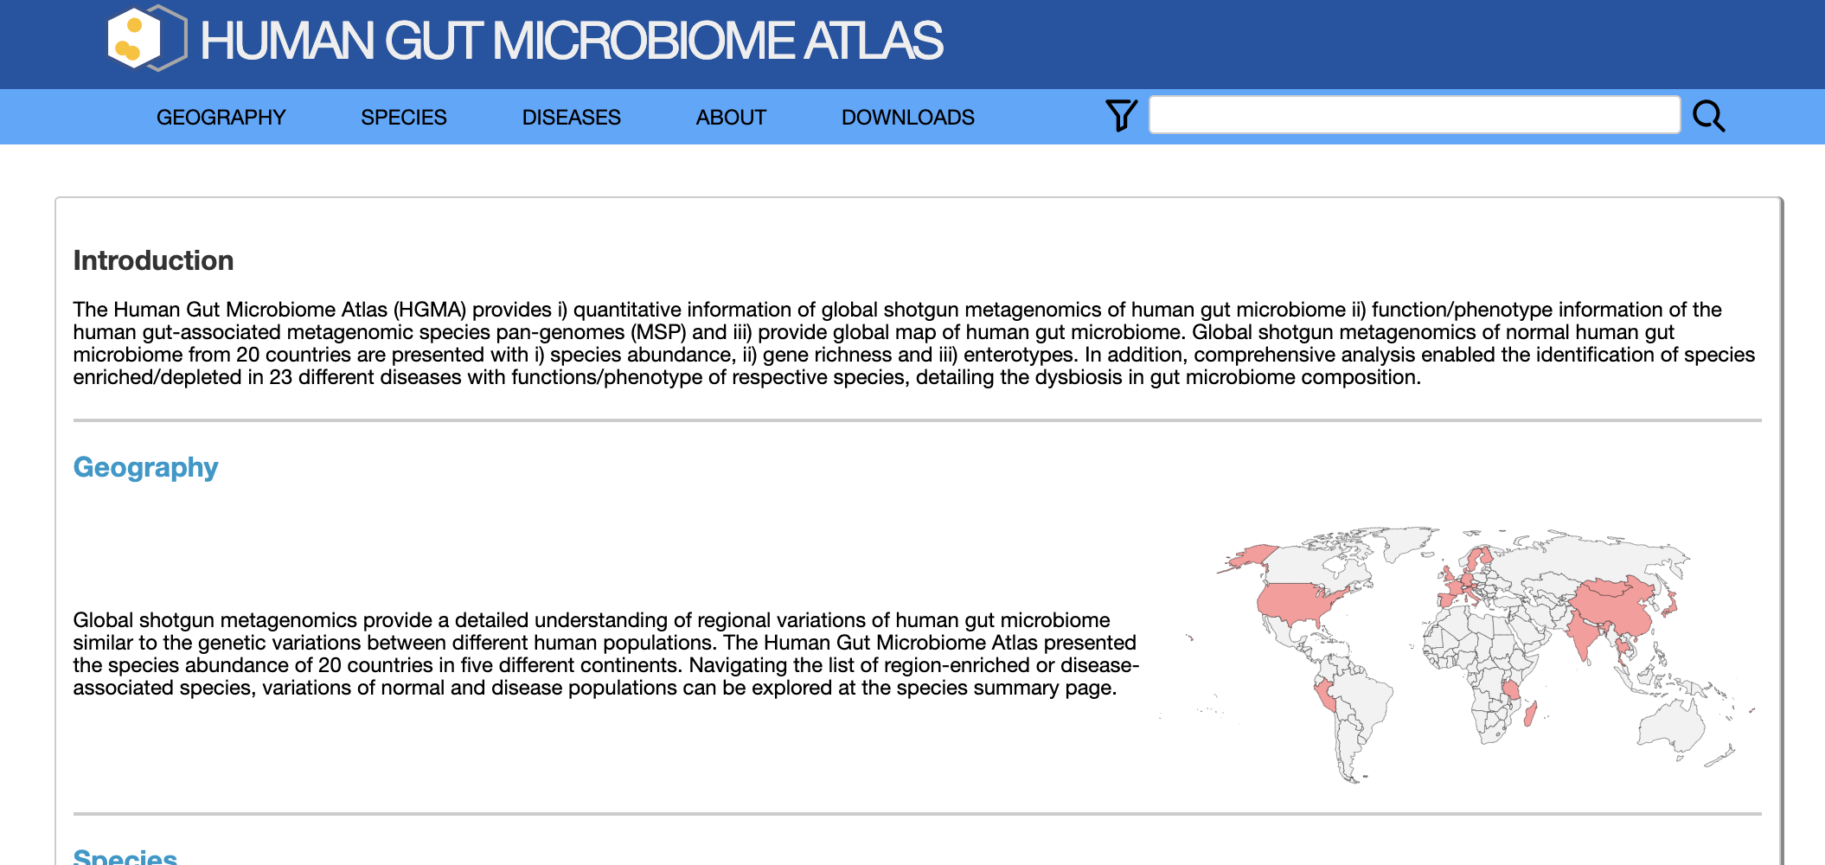

Slide 5

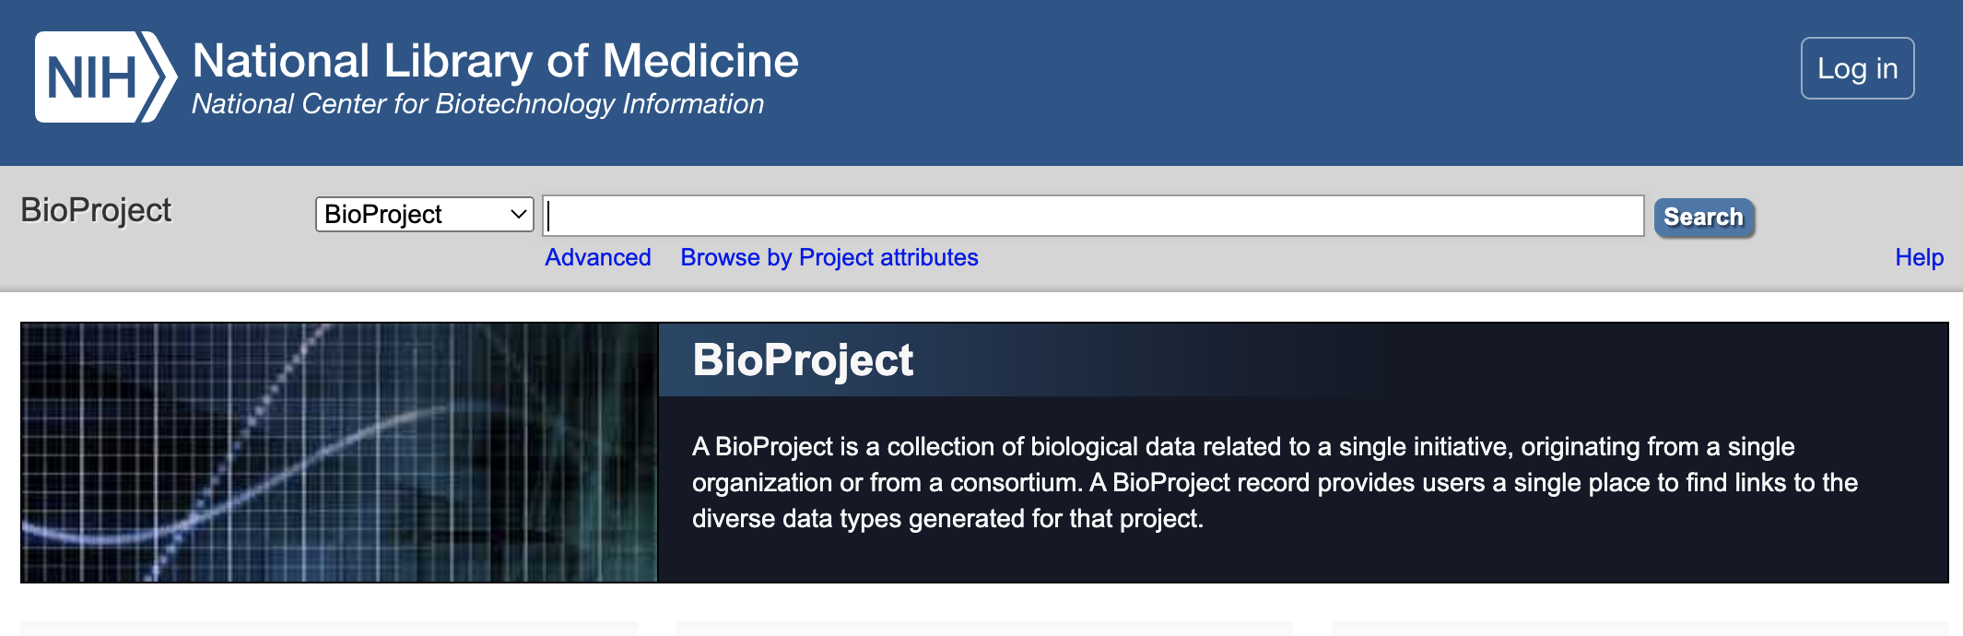

Slide 6
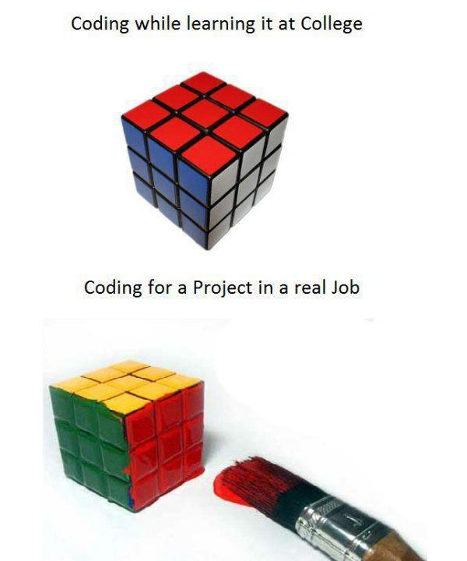

Slide 7
INSTALL SRA TOOLKIT

Slide 8
wget --output-document sratoolkit.tar.gz http://ftp-trace.ncbi.nlm.nih.gov/sra/sdk/current/sratoolkit.current-centos_linux64.tar.gz
tar -vxzf sratoolkit.tar.gz
export PATH=$PATH:$PWD/sratoolkit.3.0.0-centos_linux64/bin/
vdb-config --interactive
which fastq-dump
fastq-dump --stdout SRR390728 | head -n 8

Slide 9
SRA toolkit
Configured to connect to NCBI SRA and download via FTP.

Slide 10
wget --output-document sratoolkit.tar.gz http://ftp-trace.ncbi.nlm.nih.gov/sra/sdk/current/sratoolkit.current-centos_linux64.tar.gz

Slide 11
tar -vxzf sratoolkit.tar.gz
Decompress a file gzipped TAR files end with the extension .tar.gz
compressed by the standard GNU zip (gzip) compression algorithm
The GNU operating system is a complete free software system, upward-compatible with Unix.
GNU stands for “GNU's Not Unix”.

Slide 12
tar -vxzf sratoolkit.tar.gz
v = Verbose (optional). Displays the files as they are decompressed.
x = Extracts files from an archive.
z = Filters the archive through gzip.
f = Informs the tar command that the next parameter is the file name of the archive.

Slide 13
export PATH=$PATH:$PWD/sratoolkit.2.11.2-centos_linux64/bin/
Directory to run
Add a Directory to PATH
list of directories that tells the Unix shell where to look on the system when you request a particular program

Slide 14
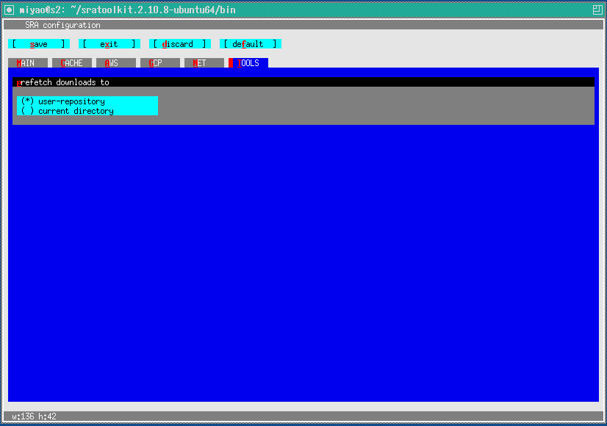
vdb-config --interactive
Inspect or change the configuration of the sra-toolkit
Necessary step but no action will be taken
Just type x
No capital

Slide 15
which fastq-dump
Download the SRA file (in sra format) and then convert them to fastq file
Check which version is installed

Slide 16
fastq-dump --stdout SRR390728 | head -n 8
Check if fastq-dump is working properly

Slide 17

wget --output-document sratoolkit.tar.gz http://ftp-trace.ncbi.nlm.nih.gov/sra/sdk/current/sratoolkit.current-centos_linux64.tar.gz
tar -vxzf sratoolkit.tar.gz
export PATH=$PATH:$PWD/sratoolkit.3.0.0-centos_linux64/bin/
vdb-config --interactive
which fastq-dump
fastq-dump --stdout SRR390728 | head -n 8

Slide 18
INSTALL SAMPLES BY SRA TOOLKIT

Slide 19
fastq-dump -I --split-files --gzip ERR011335
Sample name
file
extension
If your SRA file is paired, you will still end up with a single fastq file, since, fastq-dump, by default writes them as interleaved file. To change this, you can provide --split-files argument.

Slide 20

fastq-dump -I --split-files --gzip ERR011335
ERR011273
ERR011275
ERR011277
ERR011279
ERR011281
ERR011283
ERR011285
ERR011287
ERR011289
ERR011291
ERR011295
ERR011297
ERR011299
ERR011303
ERR011307
ERR011313
ERR011315
ERR011317
ERR011321
ERR011325
ERR011327
ERR011329
ERR011331
ERR011333
ERR011335
ERR011341
ERR011345
ERR011349

Slide 21

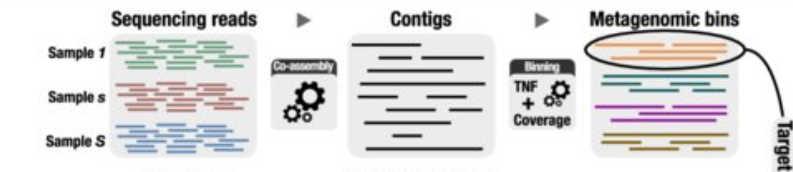
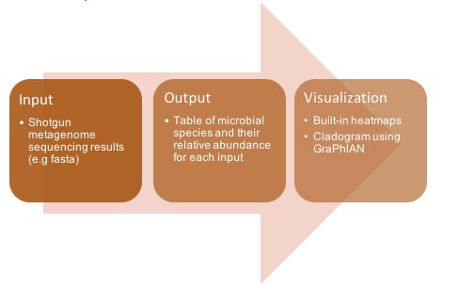
Compositional profiling
MetaPhlAn: Metagenomic Phylogenetic Analysis
Profiling the composition of microbial communities (Bacteria, Archaea and Eukaryotes) from metagenomic shotgun sequencing data (i.e. not 16S) with species-level.

Slide 22
Compositional profiling
MetaPhlAn: Metagenomic Phylogenetic Analysis
MetaPhlAn relies on ~5.1M unique clade-specific marker genes
identified from ~1M microbial genomes (~236,600 references and 771,500 metagenomic assembled genomes) spanning 26,970 species-level genome bins (SGB)

Slide 23
Compositional profiling
MetaPhlAn: Metagenomic Phylogenetic Analysis
unambiguous taxonomic assignments;
an accurate estimation of organismal relative abundance
SGB-level resolution for bacteria, archaea and eukaryotes
strain identification and tracking
orders of magnitude speedups compared to existing methods
metagenomic strain-level population genomics

Slide 24
INSTALLATION

Slide 25
wget https://repo.anaconda.com/miniconda/Miniconda3-latest-Linux-x86_64.sh -O ~/miniconda3/miniconda.sh
bash Miniconda3-latest-Linux-x86_64.sh
conda config --add channels defaults
conda config --add channels bioconda
conda config --add channels conda-forge
conda create --name mpa -c conda-forge -c bioconda python=3.7 Metaphlan

Slide 26
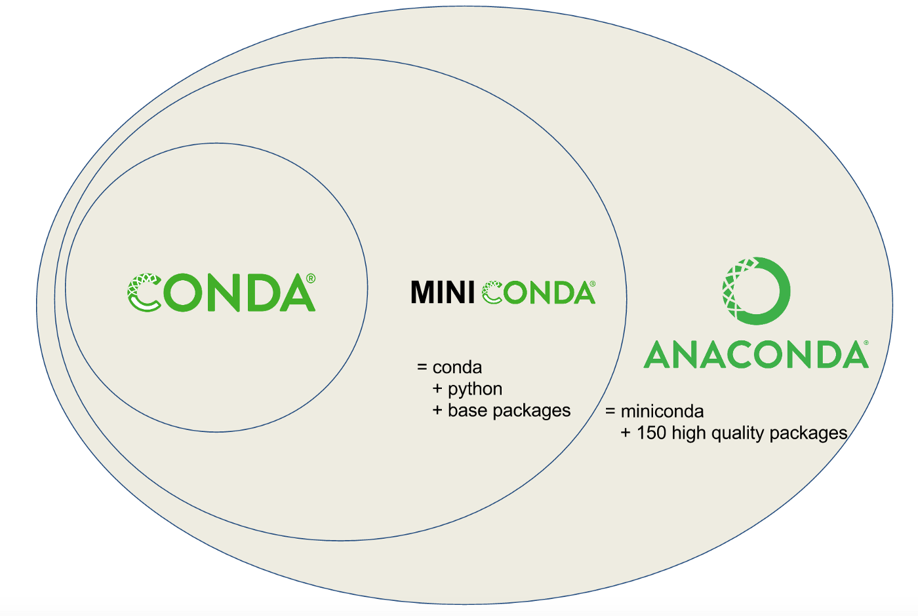
CONDA - MINICONDA - ANACONDA
A distribution of packages built for data science.
A bunch of data science packages → all set to start working with data
Reduce future issues dealing with the various libraries you’ll be using
conda
Create environments
Isolating projects that use different versions of Python and/or different version of packages
Install, uninstall, and update packages in our project environments.
https://towardsdatascience.com/managing-project-specific-environments-with-conda-b8b50aa8be0e
A package
Environment manager

Slide 27
Conda channels
Locations where packages are stored.
They serve as the base for hosting and managing packages.
Different channels can have the same package, so conda must handle these channel collisions
By default, conda prefers packages from a higher priority channel over any version from a lower priority channel
conda config --add channels new_channel
Adds the channel "new_channel" to the top of the channel list, making it the highest priority
https://conda.io/projects/conda/en/latest/user-guide/tasks/manage-channels.html

Slide 28
conda create
Environment
With conda, you can create, export, list, remove, and update environments that have different versions of Python and/or packages installed in them.
Switching or moving between environments is called activating the environment.
You can also share an environment file.
conda create --name mpa -c bioconda python=3.7 metaphlan
Create env
Env
name
Channel
Phyton version
PACKAGE

Slide 29
RUN METAPHLAN

Slide 30
conda activate mpa
metaphlan ERR011335_1.fastq.gz --input_type fastq > ERR011335_profile_count.txt -t rel_ab_w_read_stats

Slide 31
DOWNLOAD FILE TO LOCAL COMPUTER

Slide 32
In your terminal
scp -r oaltay@rackham.uppmax.uu.se:/home/oaltay/ERR011335_profile_count.txt .
Source file
File path
Secure copy
Destination file
Dot keeps the file name

Slide 33
MERGE OUTPUT

Slide 34

files<-list.files()
index<-grep("count.txt",files)
files<-as.matrix(files[index])
uni_info<-NULL
for (i in 1:length(files)){
data_each<-as.matrix(read.csv(files[i],header=T,skip=4,sep="\t")) #create a matrix by reading each files....keep the header, skip 4 rows, separate with tab
info_each<-data_each[,c("X.clade_name" ,"clade_taxid")]
uni_info<-rbind(uni_info,info_each)
}
uni_info<-as.matrix(unique(uni_info))
result<-NULL
for (j in 1:length(files)){
data_each<-as.matrix(read.csv(files[j],header=T,skip=4,sep="\t")) #all are character
loc<-match(uni_info[,"X.clade_name"],data_each[,"X.clade_name"])
value_each<-as.matrix(data_each[loc,"estimated_number_of_reads_from_the_clade"])
colnames(value_each)<-gsub("_profile_count.txt ","",files[j])
result<-cbind(result,value_each)
}
result<-cbind(uni_info,result)
write.table(result,file="merged_estimated_number_read.txt",sep="\t",row.names=F,col.names=T,quote=F)

Slide 35
install.packages(c('readxl', 'tidyverse', 'dplyr', 'vegan', 'ggpubr'))
if (!requireNamespace("BiocManager", quietly = TRUE))
install.packages("BiocManager")
BiocManager::install(c('phyloseq', ask = F, update = F))
if (!requireNamespace("BiocManager", quietly = TRUE))
install.packages("BiocManager")
BiocManager::install(c('microbiome'))
library(readxl)
library(tidyr)
library(dplyr)
library(tibble)
library(ggplot2)
library(phyloseq)
library(microbiome)
library(vegan)
main=read.table('merged_estimated_number_read_UC_KCL_bb.txt',header=TRUE,sep="\t")
t = separate(main,X.clade_name, into = c("Kingdom","Phylum", "Class", "Order", "Family", "Genus", "Species"), sep="\\|")
t=t[!is.na(t$Species), ]
t=t[!duplicated(t$Species),]
x=1:dim(t)[1]
OTUs= paste("OTU",x)
t=add_column(t, OTUs = OTUs, .before = "clade_taxid")
Notes:
install.packages(c('readxl', 'tidyverse', 'dplyr', 'vegan', 'ggpubr'))
if (!requireNamespace("BiocManager", quietly = TRUE))
install.packages("BiocManager")
BiocManager::install(c('phyloseq', ask = F, update = F))
if (!requireNamespace("BiocManager", quietly = TRUE))
install.packages("BiocManager")
BiocManager::install(c('microbiome'))
library(readxl)
library(tidyr)
library(dplyr)
library(tibble)
library(ggplot2)
library(phyloseq)
library(microbiome)
library(vegan)
main=read.table('merged_estimated_number_read_UC_KCL_bb.txt',header=TRUE,sep="\t")
t = separate(main,X.clade_name, into = c("Kingdom","Phylum", "Class", "Order", "Family", "Genus", "Species"), sep="\\|")
t=t[!is.na(t$Species), ]
t=t[!duplicated(t$Species),]
x=1:dim(t)[1]
OTUs= paste("OTU",x)
t=add_column(t, OTUs = OTUs, .before = "clade_taxid")
OTU =as.data.frame(t[,-which(names(t) %in% c("Kingdom","Phylum", "Class", "Order", "Family", "Genus","Type","clade_taxid"))])
row.names(OTU) = OTU$OTUs
OTU =as.data.frame(OTU[,-which(names(OTU) %in% c("OTUs","Species"))])
OTU[is.na(OTU)] = 0
names(OTU) = gsub(pattern = "_profile_count.txt", replacement = "", x = names(OTU))
CountMatrix = OTU %>% as.matrix()
mode(CountMatrix) <- 'integer'
TAX =as.data.frame(t[,which(names(t) %in% c("Kingdom","Phylum", "Class", "Order", "Family", "Genus","Species","OTUs"))])
row.names(TAX) = TAX$OTUs
TAX =as.data.frame(TAX[,-which(names(TAX) %in% c("OTUs"))])
TaxaMatrix <- TAX %>% as.matrix()
Metadata <- read_xlsx("metadata_UC_KCLbb.xlsx", sheet=1) %>% as.data.frame()
rownames(Metadata) <- Metadata$SampleID
otuTABLE <- otu_table(CountMatrix, taxa_are_rows = TRUE)
taxTABLE <- tax_table(TaxaMatrix)
sampleDATA <- sample_data(Metadata)
phylo_obj <- phyloseq(otuTABLE, taxTABLE, sampleDATA)
###

Slide 36
OTU =as.data.frame(t[,-which(names(t) %in% c("Kingdom","Phylum", "Class", "Order", "Family", "Genus","Type","clade_taxid"))])
row.names(OTU) = OTU$OTUs
OTU =as.data.frame(OTU[,-which(names(OTU) %in% c("OTUs","Species"))])
OTU[is.na(OTU)] = 0
names(OTU) = gsub(pattern = "_profile_count.txt", replacement = "", x = names(OTU))
CountMatrix = OTU %>% as.matrix()
mode(CountMatrix) <- 'integer'
TAX =as.data.frame(t[,which(names(t) %in% c("Kingdom","Phylum", "Class", "Order", "Family", "Genus","Species","OTUs"))])
row.names(TAX) = TAX$OTUs
TAX =as.data.frame(TAX[,-which(names(TAX) %in% c("OTUs"))])
TaxaMatrix <- TAX %>% as.matrix()
Metadata <- read_xlsx("metadata_UC_KCLbb.xlsx", sheet=1) %>% as.data.frame()
rownames(Metadata) <- Metadata$SampleID
otuTABLE <- otu_table(CountMatrix, taxa_are_rows = TRUE)
taxTABLE <- tax_table(TaxaMatrix)
sampleDATA <- sample_data(Metadata)
phylo_obj <- phyloseq(otuTABLE, taxTABLE, sampleDATA) save(file = "phyloseq_object_read_2022.Rdata",phylo_obj,OTUdata,SampleData,TAXAData)
Notes:
install.packages(c('readxl', 'tidyverse', 'dplyr', 'vegan', 'ggpubr'))
if (!requireNamespace("BiocManager", quietly = TRUE))
install.packages("BiocManager")
BiocManager::install(c('phyloseq', ask = F, update = F))
if (!requireNamespace("BiocManager", quietly = TRUE))
install.packages("BiocManager")
BiocManager::install(c('microbiome'))
library(readxl)
library(tidyr)
library(dplyr)
library(tibble)
library(ggplot2)
library(phyloseq)
library(microbiome)
library(vegan)
main=read.table('merged_estimated_number_read_UC_KCL_bb.txt',header=TRUE,sep="\t")
t = separate(main,X.clade_name, into = c("Kingdom","Phylum", "Class", "Order", "Family", "Genus", "Species"), sep="\\|")
t=t[!is.na(t$Species), ]
t=t[!duplicated(t$Species),]
x=1:dim(t)[1]
OTUs= paste("OTU",x)
t=add_column(t, OTUs = OTUs, .before = "clade_taxid")
OTU =as.data.frame(t[,-which(names(t) %in% c("Kingdom","Phylum", "Class", "Order", "Family", "Genus","Type","clade_taxid"))])
row.names(OTU) = OTU$OTUs
OTU =as.data.frame(OTU[,-which(names(OTU) %in% c("OTUs","Species"))])
OTU[is.na(OTU)] = 0
names(OTU) = gsub(pattern = "_profile_count.txt", replacement = "", x = names(OTU))
CountMatrix = OTU %>% as.matrix()
mode(CountMatrix) <- 'integer'
TAX =as.data.frame(t[,which(names(t) %in% c("Kingdom","Phylum", "Class", "Order", "Family", "Genus","Species","OTUs"))])
row.names(TAX) = TAX$OTUs
TAX =as.data.frame(TAX[,-which(names(TAX) %in% c("OTUs"))])
TaxaMatrix <- TAX %>% as.matrix()
Metadata <- read_xlsx("metadata_UC_KCLbb.xlsx", sheet=1) %>% as.data.frame()
rownames(Metadata) <- Metadata$SampleID
otuTABLE <- otu_table(CountMatrix, taxa_are_rows = TRUE)
taxTABLE <- tax_table(TaxaMatrix)
sampleDATA <- sample_data(Metadata)
phylo_obj <- phyloseq(otuTABLE, taxTABLE, sampleDATA)
###

Slide 37

HAVVA OZLEM ALTAY
havva.altay@scilifelab.se

